Slide 1
RSPS Symposium Kiawah Island March 2012
Technology for RSPS REALTORS®

Slide 2
Technology
To enhance our business
To reach out to clients and customers
Notes:
Discussion of two of the most important ways we use technology: so we can know more about our business, network with other professionals to get more business and then to reach out and market via technology.

Slide 3
Apps
I Phone and I Pad app—downloaded over 10 million times (and counting)
Android downloaded 1.5 million times (and counting)
Win Mobile App 48,000 downloads
Notes:
Ask who has the app—who is recommending it to clients. Note that in the last survey, Gen X was the largest group of 2nd home buyers

Slide 4
Look!
446 million photos viewed on apps last month
167 per second
Notes:
That’s a Kiawah Island listing—photos are king on the Internet

Slide 5
Look!
68 million listing detail pages viewed on mobile aps last month
25 per second
Notes:
Photos make the buyer look at the listing detail pages

Slide 6
Global
1.2 million unique international visitors searched on realtor.com last month
Normal range is 600,000 to 800,000
Notes:
This is heating up

Slide 7
International
Since January, realtor.com translates listings into 11 foreign languages
Automatically converts square feet to square meters
Notes:
This is one of the reasons—more accessibilty

Slide 8
Set your sites
http://www.realtor.org/global
http://www.realtor.org/resorts
Notes:
Go to these sites—explore, discuss, ask who is using them. Point out that those with the RSPS designation can take any webinar for the class for free—more information available constantly

Slide 9
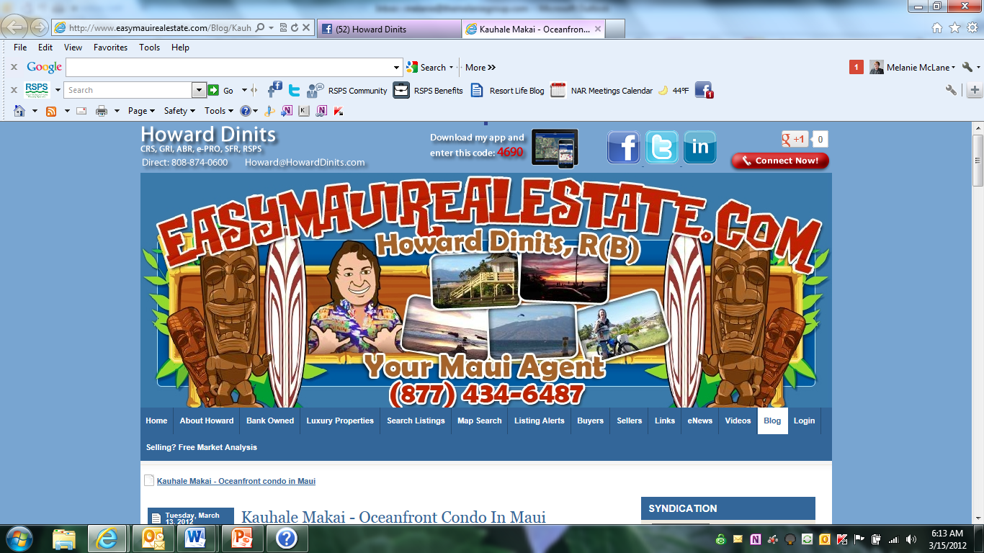

Slide 10
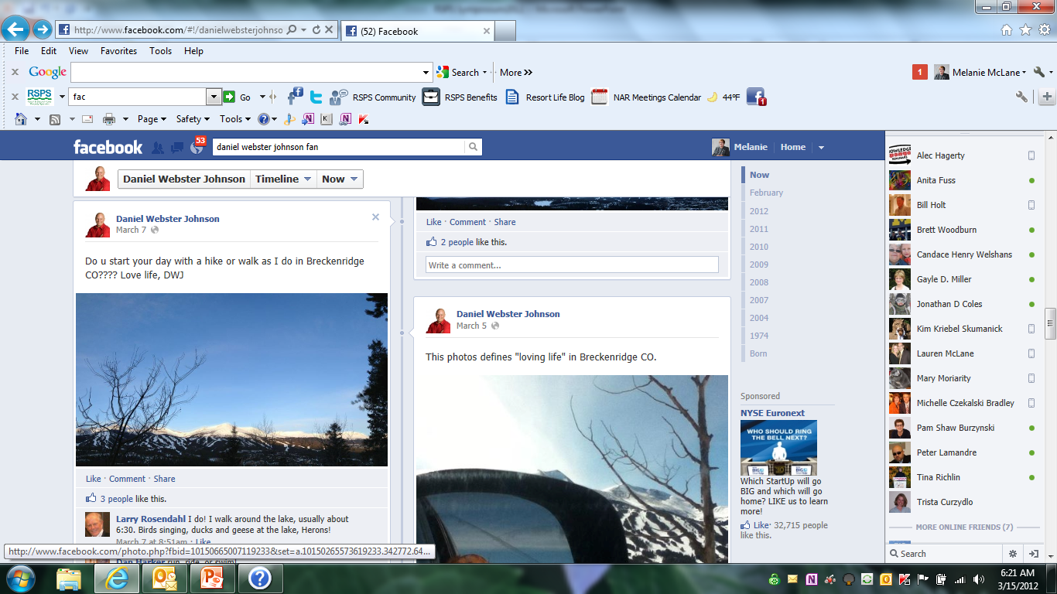

Slide 11
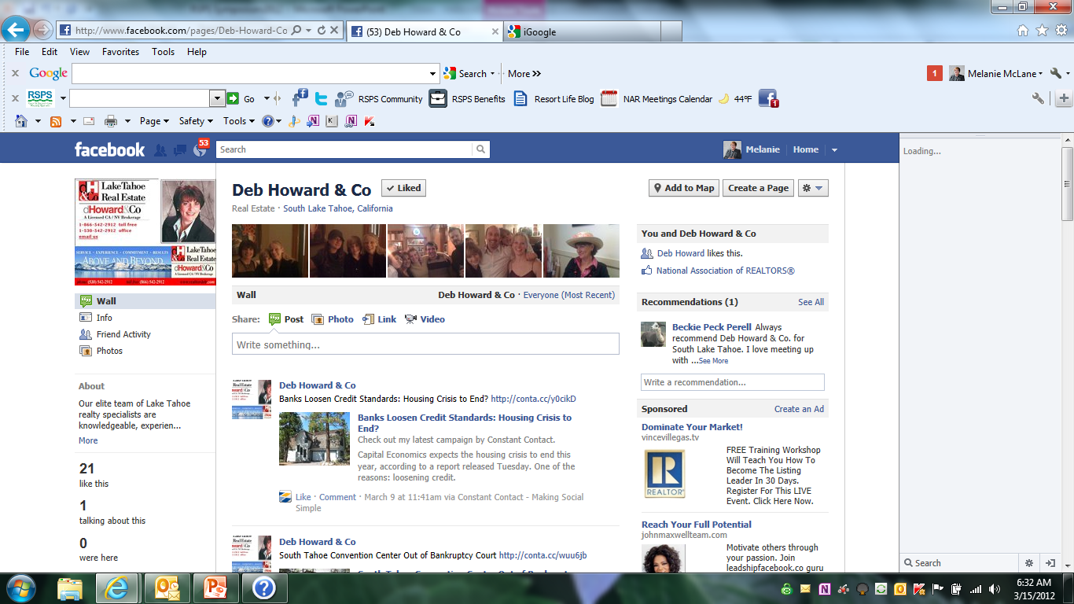

Slide 12
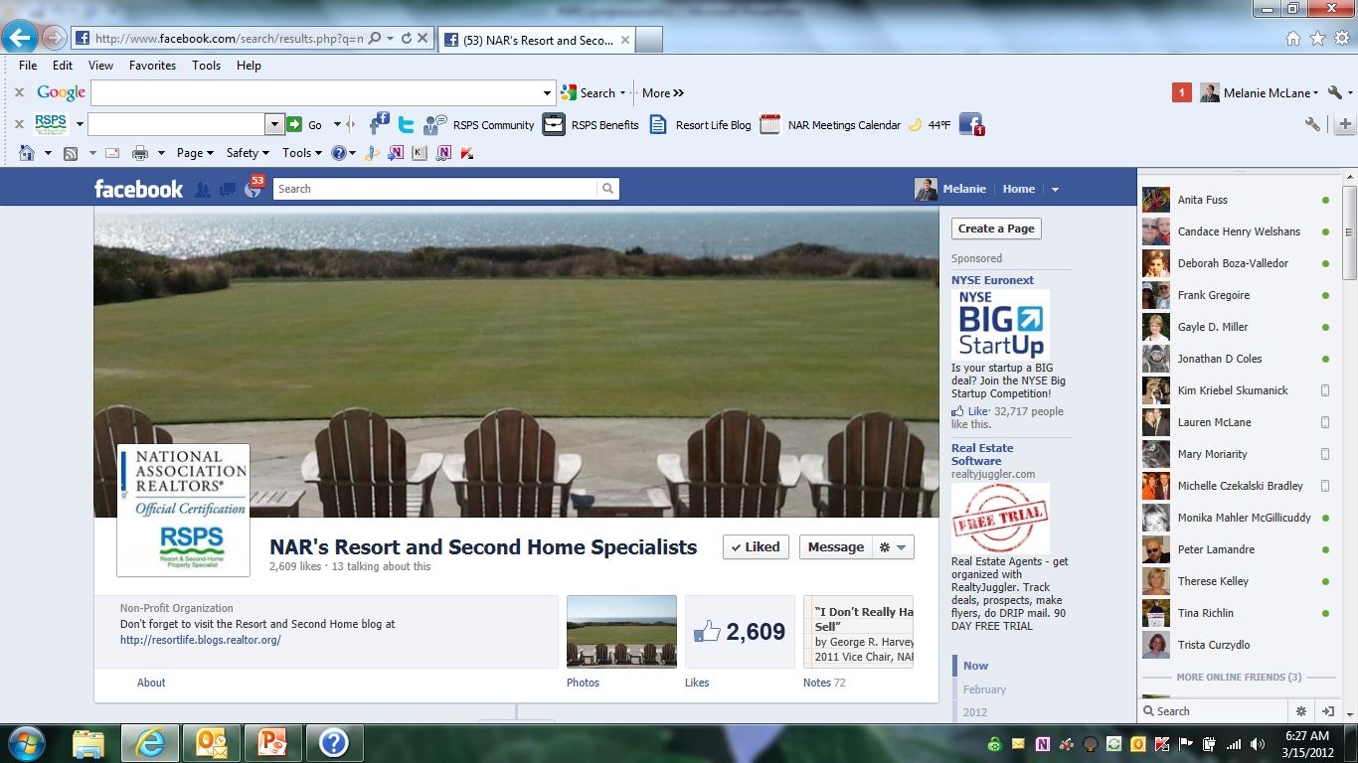

Slide 13
