Slide 1
New Jersey Realtors® and Boys & Girls Club

Slide 2
2016 Partnership:
Fundraiser, Drives, and Community
New statewide YPN: first event was a Boys & Girls Club fundraiser held at the Meadowlands Racetrack
NJ Realtors®’ board of directors and members donated hundreds of items – sunscreen, bathing suits, flip flops, towels and more – to support swim programs at Clifton, Paterson, Lodi, and Trenton Boys & Girls Clubs
Relationship with Mercer County Boys & Girls Club, our new neighbor in Trenton – working to help fund a community garden

Slide 3
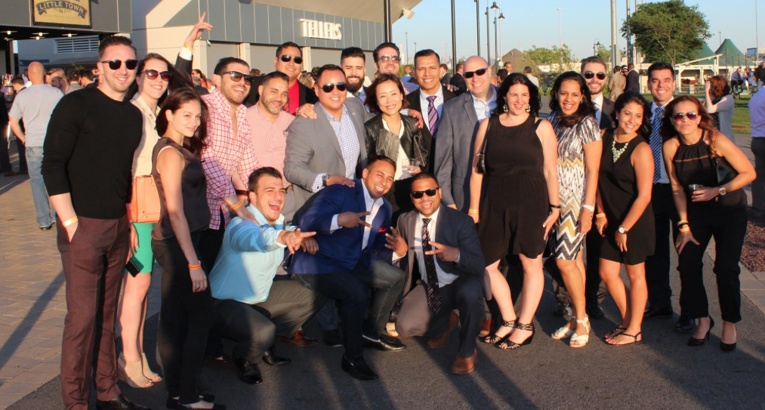
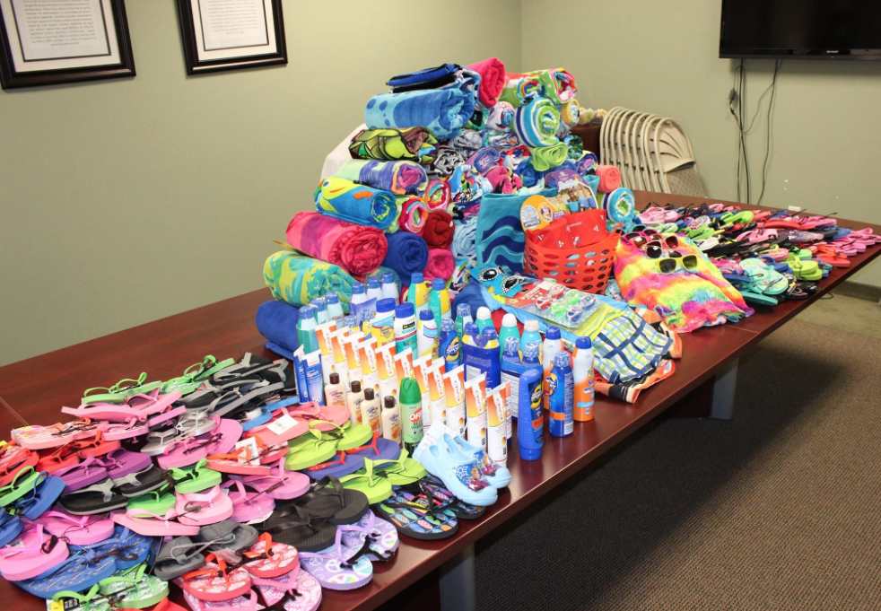
2016 Partnership:
Fundraiser, Drives, and Community

