Slide 1

New Name and Logo
REBRANDING

Slide 2

Soft Rollout
REBRANDING

Slide 3
Soft Rollout
REBRANDING

Slide 4
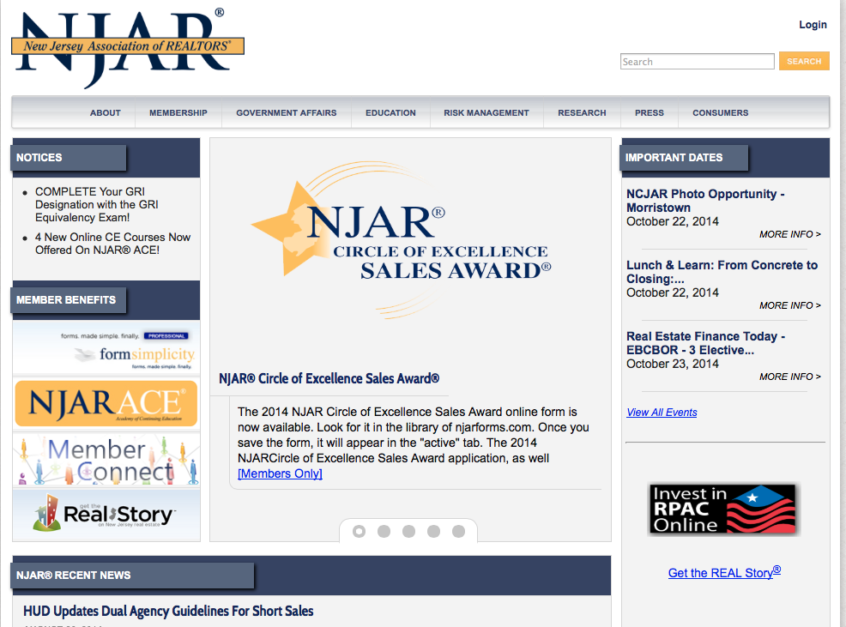
Old Website
REBRANDING

Slide 5

New Site to be Launched
December 2014
REBRANDING

Slide 6
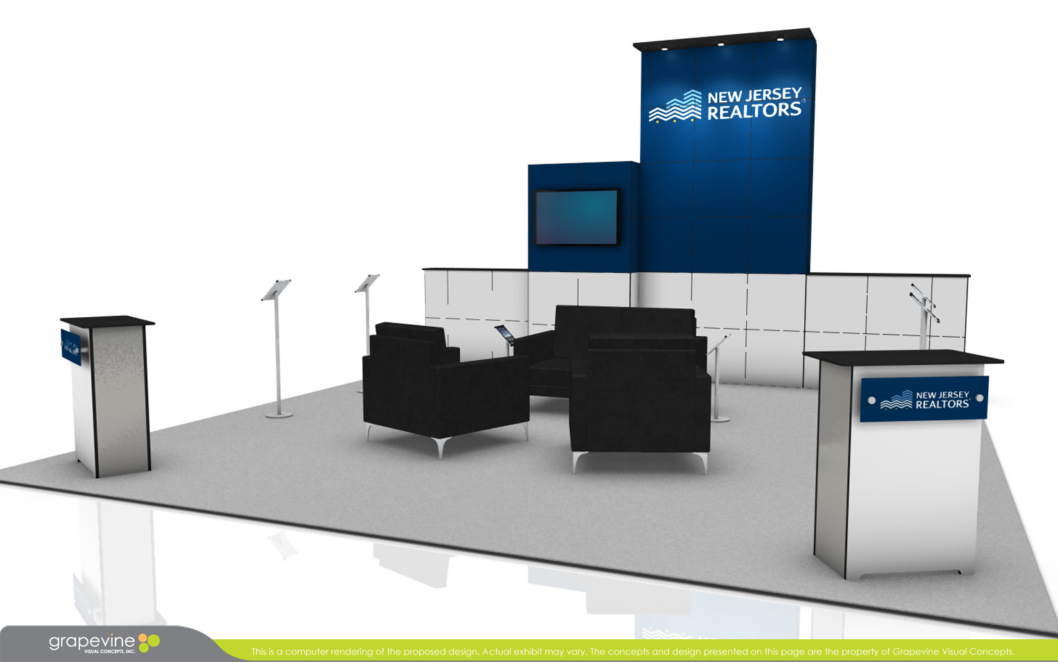
Trade Show Booth
REBRANDING

Slide 7
Value Proposition
REBRANDING

Slide 8

End-of-Year Campaign: Oct. 7
RPAC

Slide 9
End-of-Year Campaign: Oct. 7
Subject: LAST CHANCE: Only 2 Days Left!
Sent to members who had not yet invested their fair share
Results:
  23,729 emails sent
  26.08 percent open rate
  50 click throughs
RPAC

Slide 10
End-of-Year Campaign: Oct. 9
RPAC

Slide 11
End-of-Year Campaign: Oct. 9
Subject: Tax on Commissions
Sent to members who had not yet invested their fair share
Results:
  23,702 emails sent
  36.13 percent open rate
  142 click throughs
RPAC

Slide 12
End-of-Year Campaign: Oct. 9
RPAC

Slide 13
End-of-Year Campaign: Oct. 9
Subject: You’re So Close…
Sent to members who clicked on the link in the Oct. 7 email, but did not invest
Results:
  41emails sent
  56.41 percent open rate
  3 click throughs
RPAC

Slide 14
End-of-Year Campaign
Between Oct. 3 and 6, there were only 4 contributors
Between the campaign from Oct. 7 to 9, we had 100 additional contributors, totaling $11,310
Member participation prior to the campaign was at 30.41 percent, just shy of participation goal
The campaign push worked and we met the participation goal
For comparison’s sake, in 2013, we had just 26 percent participation
RPAC

