Slide 1
Using the NAR Association Models Tool
Facilitator Guide
NATIONAL ASSOCIATION OF REALTORS®

Slide 2
To facilitate or not?
Notes:
This PowerPoint Guide is designed to help facilitators lead associations through the Models process, but it can also be used to help association leaders – staff or volunteer – decide whether to use the process or not.
Some AEs and/or their volunteer leaders prefer to have an “outside” facilitator move them through most of these processes to avoid any perceived or real bias on the part of an ‘inside” facilitator. Reviewing these materials will help you to decide which direction your association may want to take.
(Note: an exception to using a facilitator would be the AE’s personal development, which would realistically be done just by the AE.)

Slide 3


The Facilitator Guide will help guide the process in all five areas:
Strategic Planning
Structural Audit
Staff / Volunteer Alignment
Job search, hiring & transition assistance
Personal Career Planning
Notes:
The Facilitator Guide will provide suggestions for applying the tool to each of these five areas and give you step-by-step directions for how you can set up each session, plus tips about analyzing the results.

Slide 4
You Will Learn
How to use the tool simply and effectively
The tool’s various applications
Who should use the tool
How to evaluate, interpret and use the results
How to explain each component to others

Slide 5
Section 1: Review of Facilitator Guide Materials
Notes:
List of items included:
Step-by-step directions to finding and using the tool
Association Models document (specific descriptions of each model)
Models Questionnaire
Sample Results page
Sample AE Job Description
Sample President Job Description
Sample Operational Philosophy document
Link to NAR ALD Volunteer Resource Guide info
Case studies describing reasons for using the tool

Slide 6
Section 2: About the tool
Notes:
This section will enable you to explain the purpose of the tool and the three basic models, of which each association is a blend.
The REALTOR® Association Models Planning Tool simplifies the tasks of association self-evaluation and planning for enhanced member service though the use of three models of association management: Administrative, Management, and Leadership.

Slide 7

What is the tool anyway?
Notes:
The ultimate role of the REALTOR® organization is to help shape and influence a favorable business environment for its members.
Each REALTOR® association has the responsibility to efficiently and effectively provide value to its members. While the operating framework in which an association chooses to serve its members may vary depending on its organizational structure, demographics, size, available resources, and diversity of needs, there are many creative ways to deliver and optimize value, even with limited resources.
This tool is a way to help you achieve these goals. How? First you’ll enter thoughtful answers to the self-evaluation questionnaire. Then, the results report automatically generated from the questionnaire will provide you with a set of tools to grow your association.

Slide 8

  It is a resource to understand and grow your association
Notes:
Where will your association be in five years? What are your goals? How will you achieve them?
These are tough questions that many association executives rarely have time to focus on. The daily routine of attracting members, managing volunteers, and balancing the books often takes precedence over the big picture.
A description of all three models can be found at:
http://www.realtor.org/ae/manage-your-association/association-models-planning-tool/understanding-the-three-association-management-models

Slide 9
3 Association Models
Administrative
Management
Leadership
a
m
l
Notes:
The REALTOR® Association Models Planning Tool simplifies the tasks of association self-evaluation and planning for enhanced member service though the use of three models of association management: Administrative, Management, and Leadership.

Slide 10
The Administrative Model
Member focused
Tends to have a fairly small staff structure
  1 part-time AE to 3 or 4 full time staff
Relies on significant member involvement for planning, decisions, and logistics
a
Notes:
What's an Administrative Association?
A purely administrative association is member-focused. It typically has a fairly small staff, ranging from one part-time association executive to three full-time professional staff.
The AE maintains a general familiarity in legal, regulatory, and business issues impacting the association and has a basic competency in the office management skills, including word processing and spreadsheets, bookkeeping, and basic technology skills, such as e-mail and the Internet.
The AE knows where to find information that is important to members in conducting their daily business activities.
AE compensation is locally competitive and comparable to other high-level administrative positions.
Elected leadership is very involved in the administration of the association, and the authority for nearly all decision-making is vested in the officers and the board of directors. The association focuses on networking activities and opportunities for members to learn from one another.

Slide 11
The Administrative Model
The AE has:
Basic competency in office management skills
Knows where to find info important to members
Basic familiarity in legal, regulatory and industry issues
a

Slide 12
The Administrative Model
The AE must:
Possess general knowledge of business and financial operations
Establish good working relationships with service providers
Efficiently administer association business
Be skilled at engaging member involvement
a

Slide 13
The Management Model
Source of info for members on best business practices and trends
Usually a larger staff
  Often from 3 - 12
  Most are non-exempt
AE is responsible for all aspects of administration
  Has some focus on community and R.E. industry issues
m
Notes:
What Is a Management Association?
A purely management association is a source of information for its members on best business practices and trends. Staff size typically ranges from three to 12, with defined positions responsible for specific programs.
The staff possesses expertise in managing and communicating legal, regulatory, and business issues impacting the association and effectively manages association business. Most of the staff are non-exempt.
The AE is responsible for all administration and management of the association, with added focus on community and real estate industry issues. The AE creates staff job descriptions, hires and manages staff, sets staff salaries within the budget, and determines staff structure. AE compensation is regionally competitive and may be based on data from statewide salary surveys.
Volunteer leadership determines the association's strategic vision and sets parameters for staff empowerment. Decision-making authority is vested in the board of directors with authority for most operational decisions delegated to staff. Overall, management is a hands-on model with healthy volunteer involvement and some restrictions on the AE's authority.

Slide 14
The Management Model
Volunteer leadership
  determines strategic vision and sets parameters for staff involvement
  Decision-making authority with directors and operational decisions delegated to staff
  Hands-on model with active volunteer involvement and some restrictions on AE’s authority
m

Slide 15
The Management Model
The AE has :
Strong competency skills in office management
Broad-based understanding of legal, regulatory and industry issues.
m

Slide 16
The Management Model
The AE must:
Possess strong knowledge of business and financial operations
Develop and manage staff around an organizational plan with clear responsibilities
Ensure that strategic and business planning processes are in place
m

Slide 17

The Leadership Model
High level of sophistication and proactivity
  Initiates and implements innovative and creative programs, products and services that provide enhanced value for members
Usually includes senior mgt. team of department heads who report to AE
l
Notes:
What Is a Leadership Association?
A purely leadership association implements innovative and creative programs, products, and services that provide enhanced value for members beyond their day-to-day businesses.
Typically, staff includes a senior management team of department heads who report to the AE and are responsible for all association administration and management.
The AE and the senior management team position the organization based on envisioned real estate industry trends. Staff possesses expertise and provides leadership in political, legal, regulatory, and business issues impacting the association.
AE compensation is nationally competitive in the upper range and may vary depending on member needs and market conditions.
Elected leadership determines strategic vision, but staff develops goals and plans to implement the vision. Decision-making authority for all operational procedures is vested in the AE. Further, policies are in place to authorize the AE to take action quickly when an emergency arises, without having to seek approval from elected leaders.

Slide 18
The Leadership Model
AE and senior mgt. position the organization based on envisioned R.E. trends
  possess expertise and provide leadership in political, legal, regulatory, and business issues
  Initiates policy formation and advocacy
l

Slide 19
The Leadership Model
Volunteer leadership
  Determines strategic vision, but staff develops goals and plans to implement it.
Decision making authority for operation is with AE
  Policies are in place to authorize AE to take quick action without prior approval
l

Slide 20
The Leadership Model
The AE must:
Seek out new and innovative programs, products, and services
Develop creative management solutions
Cultivate a highly evolved and trained staff team
Be a respected and motivating influence for staff and leaders
l

Slide 21
Which Model Fits?
Most associations are a BLEND of the 3 models
Administrative
Management
Leadership
Notes:
The three models define services associations provide.
These models should be viewed as just three points on a continuum, and not just in their pure sense. Associations should not expect to fit neatly into any one model, rather it is likely that many associations are operating in all models, depending upon the function or service. For example, an association may fall predominantly into the Administrative Model, but its governance may be more closely aligned to the Management Model.
Volunteer and staff leaders may use these models as a guideline to assess their current operations and determine where they aspire to be in delivering value. This document will also help them determine how they can partner with other associations to expand the menu of services they can offer their members.

Slide 22
No model is better than the other!
It’s all about resource allocations, volunteer involvement, and priorities!
Notes:
No model is "better" than another. They merely reflect an association’s resources, volunteer involvement, and priorities.

Slide 23

Who Should Use It
AEs and other staff
Board of Directors
Leadership Team
Strategic Planning Committee
AE Search Committee
Use it over and over again … things change!
Notes:
Associations will benefit and prosper from this planning tool if their volunteer and staff leaders work together as partners to identify their model of choice based on their association’s business philosophy and member needs and preferences.
Possible uses:
AEs and other staff may use it to determine their internal alignment in how the association’s goals should be carried out.
The Board of Directors may use it to determine their overall operating philosophy and direction for the future.
The Leadership Team may use it to help develop with the AE the AE’s position description and evaluation processes.
The Strategic Planning Committee may use it to determine the steps necessary to move from “Current” to “Future.”
An AE search committee may use it to identify the competencies necessary and desired in AE candidates.

Slide 24

Why you Should Use it
Identify where your association is today
Identify where your association would like to be in the future
Align staff and leadership expectations
Career planning and professional development
Notes:
We frequently hear about AEs and volunteer leaders butting heads because they see things very differently in terms of their roles and responsibilities. They see their associations differently – both how they are today or where they want them to be in the future.
Or sometimes they’re not disagreeing about these things, they collectively just aren’t sure what they should be doing to help their associations progress.
Using this planning resource will help you help your association focus on what’s important to them and help you plan for the future by painting a clearer picture of what that picture might look like.

Slide 25
When You Should Use It
Strategic Planning
Structural Audit
Staff / Volunteer Alignment
Job search, hiring & transition assistance
Personal Career Planning
Notes:
In fact, the Models Planning Tool can be used over and over again several ways:
To assess the association's current operating philosophy
To identify where the association would like to be
To align leadership and staff expectations
To identify your professional career planning and development goals
To serve as an annual strategic planning tool
To help assess specific programs or operations within you association
To serve as a structural audit tool for association reorganization
To help develop or modify an AE job description
To provide a needs assessment for AE search committees in hiring AEs.

Slide 26
Section 2: Taking the Online Questionnaire
Notes:
This section will explain how to take the questionnaire found on www.realtor.org.
You’ll evaluate your association in each category by selecting one response from the available choices. Read through all of the questions before you begin to get a better understanding of the nature of the questions and the time you’ll need. You must select an answer for each question within each section of the questionnaire.
The questionnaire allows you to respond for both current (where your association is now in delivering services) and future (where you would like to be in terms of delivering services) operations simultaneously.

Slide 27

The Questionnaire
www.realtor.org/models
  On Realtor.org (search under “Models Planning Tool”)
    31 Questions
    5 key areas to evaluate
    Simplifies task of self-evaluation
  Today and the future on one questionnaire!!!!
  Helps plan for member services
Notes:
As noted in the slide, the questionnaire can be accessed at:
http://www.realtor.org/models under left-hand navigation link –”Planning Questionnaire”. You can also view/print a “Sample Assessment Questionnaire.”

Slide 28

What is Evaluated?
Physical & Financial Resources
Member Services
Internal & External Resources
Governance & Structure
Staff Competencies
Notes:
You’ll receive a snapshot of your association -- either as it is today or as you’d like it to be in the future -- based on your responses in the questionnaire about five essential categories:
Governance of Association Structures and Organizational Operations
Physical and Financial Resources
Staff Competencies
Member Services
Internal and External Relations
The tool can be used one time as an assessment of your current association management processes, then taken a second time to map a growth strategy.
You can fill out a questionnaire every year as part of your strategic planning, and you can also have several members or your leadership and staff fill out a questionnaire, then compare your answers.

Slide 29

Can do each section separately or all at once
Notes:
The next few slides will examine each section more thoroughly.

Slide 30

Governance & Structure
Volunteer Involvement
Leadership Focus
Decision-making
Authority
Committee Structure

Slide 31

Physical & Financial Resources
Office Location & equipment
Finances
Budgeting process
Reserves & Investment policies

Slide 32

Staff Competencies
Staff Structure
Staff Compensation
Staff Professional Development
Executive’s Role & Focus

Slide 33

Member Services
Member recruitment, retention & orientation
Professional Standards
Education
RE business tools
Networking
Communication tools

Slide 34

Internal & External Relations
Volunteer Leadership recruitment
Other relationships
Political awareness
Government advocacy

Slide 35
Section 3: Accessing the Models Tool
Notes:
This section will show screen shots of the Models section on the NAR website.

Slide 36

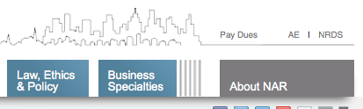

How Do You Access the Tool?
Just three clicks! From REALTOR.org…
1
2

Slide 37
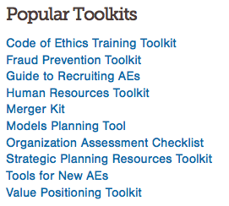
Sign on to www.realtor.org with
User Name and Password.
3
Notes:
IMPORTANT NOTE: The Tool’s assessment questionnaire is password-protected at www.realtor.org and the user must log into www.realtor.org with their User Name and Password first. If they have forgotten either or they have none, there are instructions on the page to help them further.

Slide 38

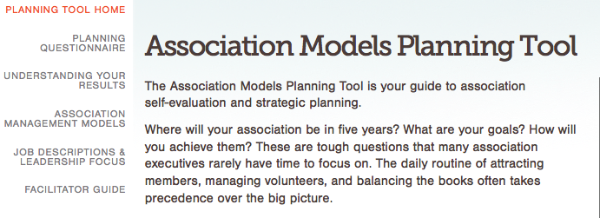
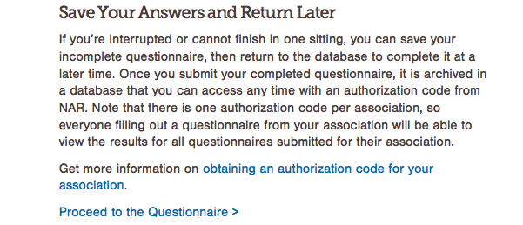
Once at the Models homepage, click on
“Planning Questionnaire”
The link to “Proceed to Questionnaire” is at the bottom of the page

Slide 39
Next: Begin new questionnaire, including your Association NRDS #
Notes:
Next, you are asked to input the association’s NRDS ID, which can be obtained from either NAR Association Leadership Development department staff or the association’s AE.
Then, it’s necessary to indicate the areas of assessment questionnaire to evaluate. Please check ALL FIVE of them for a complete assessment, then click Begin Assessment.

Slide 40

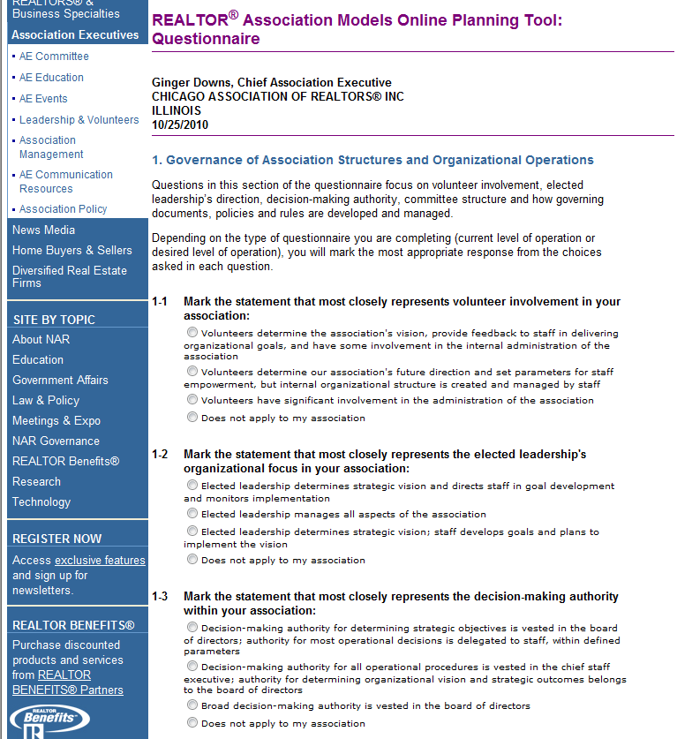
The old
Notes:
This slide illustrates the questionnaire as it was before the 2011 revision. You may choose to hide this slide if you are not explaining the differences between the old and the new to your audience.

Slide 41
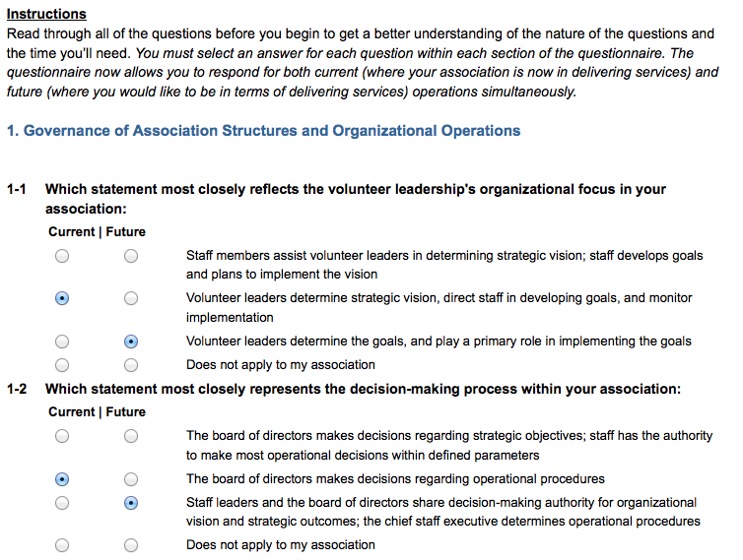
Notes:
How to Complete the Questionnaire
You’ll evaluate your association in each category by selecting one response from the available choices. Read through all of the questions before you begin to get a better understanding of the nature of the questions and the time you’ll need.
You must select an answer for each question within each section of the assessment questionnaire. The questionnaire allows you to respond for both current (where your association is now in delivering services) and future (where you would like to be in terms of delivering services) operations simultaneously.
Follow the directions on the questionnaire page, and answer each question for your current assessment and your desired future results. ALL OF THE QUESTIONS SHOULD BE ANSWERED as it will skew results if not.

Slide 42
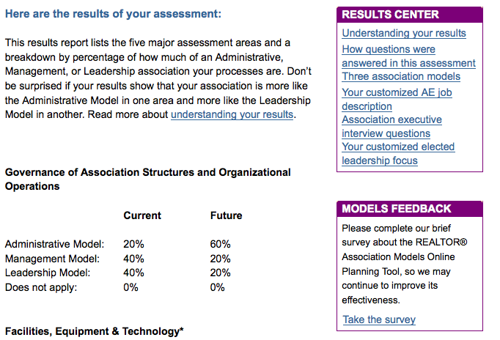
Individual results
REALTOR® Association Models General Assessment Results
Notes:
Individual Results.
This results report lists the five major assessment areas and a breakdown by percentage of how much of an Administrative, Management, or Leadership association you believe your processes are.
Don’t be surprised if your results show that your association is more like the Administrative Model in one area and more like the Leadership Model in another.

Slide 43
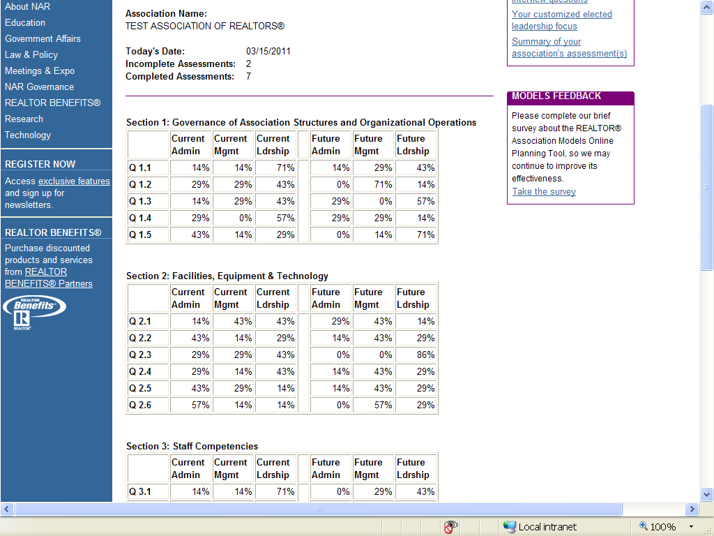
aggregate results
Notes:
Aggregate Results
This view provides an aggregate of the results compiled from all participants within an association that completed the Models questionnaire. The results provide a percentage of how each question was answered by all who completed the questionnaire. For example, the results may indicate that 25% of the respondents selected the administration response option for a particular question in the Governance section; 70% selected the management option; and 5% selected the Leadership option. From these results, you may conclude that most of your association’s “stakeholders” believe that the association operates in a management mode for that area of Governance.
NOTE: The association’s aggregate results may only be viewed by the Association’s AE. It provides not only aggregate results but how each individual completed the questionnaire. The AE can provide the results to any facilitator working with the association on their self-evaluation. The AE will need to contact NAR Association Leadership Development staff at 1(800)874-6500 to obtain their association’s code to get access.

Slide 44
Questionnaire General Tips
Plan to spend about 5 to 10 minutes to complete each section, or about 30 to 45 minutes total
Read through all the questions before you begin, to get a better understanding of the nature
Although you may think not all of the questions apply to your association, answer every question as best you can, because skipped questions will skew the percentages in your results
Notes:
Time Commitment
Plan to spend about five to 10 minutes responding to each of the five sections, about 30 to 45 minutes to complete the questionnaire. Read through all the questions before you begin to get a better understanding of the nature of the questions and the time you’ll need.
Avoid Skewed Results
Although you may think not all of the questions apply to your association, answer every question as best you can, because skipped questions will skew the percentages in your results.

Slide 45


Save & Return Later
Interruptions? No problem!
Save your incomplete questionnaire and return to it at a later time.
Notes:
Save Your Answers and Return Later
If you’re interrupted or cannot finish in one sitting, you can save your incomplete questionnaire, then return to the database to complete it at a later time. Once you submit your completed questionnaire, it is archived in a database that you can access any time with an authorization code from NAR.
IMPORTANT NOTE:
Those completing the questionnaire who need to return later will be prompted to enter their association’s NRDS ID, and an authorization code prior to getting access to their questionnaire and will need to get that code from NAR or their AE.

Slide 46

Overcoming objections
It’s part of their commitment to the association!
Notes:
Objections you may hear:
Takes too much time
I don’t how to answer
Be prepared to address each objective. The principal reason to complete this questionnaire and the process that follows it is the individual’s commitment to the healthy growth of their association.

Slide 47
Section 4: The tool’s applications
Notes:
This section will examine each of the tool’s applications in detail.

Slide 48
How You Should Use It
Strategic Planning
Structural Audit
Staff / Volunteer Alignment
Job search, hiring & transition assistance
Personal Career Planning
Notes:
Here are the five primary uses of the tool.

Slide 49
How You Should Use It
Strategic Planning
Structural Audit
Notes:
It’s likely that the most common uses of the Tool will be for strategic planning or structural audit purposes. Utilization of the tool for those two functions are addressed in the next several slides.

Slide 50

Strategic Planning
Assess current competencies
Envision association’s future
To identify gaps between where the association is now and where it wants to go

Slide 51

Structural Audits
Helps leadership identify critical areas of an association
Identify resources needed to achieve association’s goals

Slide 52
The Setup for Strategic Planning & Audits
Explain how the tool can help result in a better plan
Identify the players
Schedule the planning session or audit
Introduce the tool
Explain the “today” and “future” aspects
Determine outcomes (planning or audit)
Choose one of two options for taking the test:
  As a group
  individually

Slide 53
Session Preparation for the Facilitator
Compile Results
Determine approach
  Operational philosophy or
  Strategy/objective development
Draft Operational Philosophy based on the 5 assessment areas
Create comparison data (today v. future) and identify changes desired
Send document 1 or 2 to planning group

Slide 54
2 Processes to Consider
Where we are today
Where we want to go

Slide 55
Results:
Today’s Assessment
Clear assessment of how planners see the association in the present
Identify major differences in responses and discuss
List the gaps in the analysis to address in the plan
Where we are today

Slide 56
Results:
Planning for the Future
Assess how planners see the association in the future
Identify major differences in responses and discuss
List the gaps in the analysis of desired future direction
Where we want to go

Slide 57
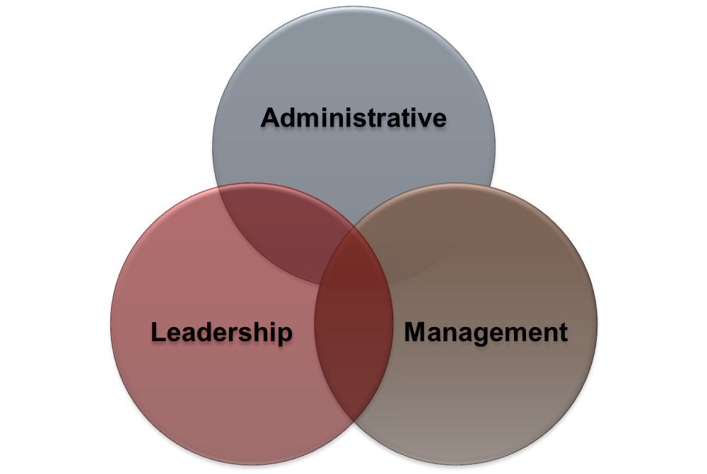
The Planning Session: Models
Explain general results
  Most associations are a blend of the 3 models
Review the association’s specific results
  combined answers

Slide 58

Analyzing Today v. the Future
Identify major differences in present and future analyses
Compare current resources and goals in order to determine strategies/objectives

Slide 59
Are there differences between “current” and “future?
Notes:
A form to insert the aggregated answers for each question for both “current” and “future” easily pinpoints those assessment areas that need to be addressed in the evaluation process.

Slide 60
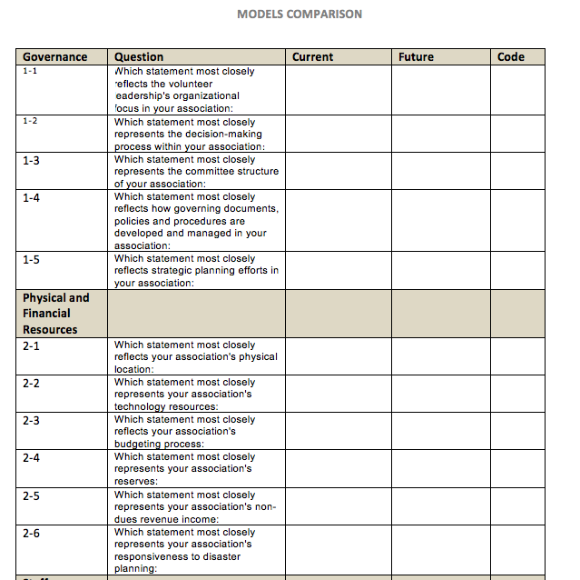
Sample Comparison Chart
Notes:
Here is a sample of a form that can be used by a facilitator to compare aggregate responses from current to future. In the last column is a place for a “code” to indicate whether there was a D (difference) or N/D (no difference) in the current and future opinions. This will help a facilitator work through the differences. The facilitator may also choose to highlight the Code cell to more quickly see those that are different.
The form can be found at: (http://www.realtor.org/sites/default/files/applications-and-forms/2014/models-comparison-template.pdf)

Slide 61


Integrating the assessment into the plan: an operating philosophy
Notes:
After identifying the gaps between today and the future, identify the major goals and develop objectives to reach each goal.

Slide 62
An Example: developing an operating philosophy
ABC Association of REALTORS®
WHY?
Stale/old/un-implemented strategic plan
Wanted some direction for planning the next couple of years
Notes:
The next two slides walk us through an example of an association who completed the Models exercise, why they did it and what their results showed.

Slide 63
How did they do it?
The CEO, senior staff, and Board completed questionnaire and compiled results
Provided their model percentages
Developed an intro about their use of this tool and descriptions of each model
Cut and pasted their completed organizational statements from their aggregate results
Included it as in introduction to their Strategic Plan

Slide 64
The Results!
% administrative
% management
% leadership
Updated CEO position description
New volunteer leadership description
An operating philosophy
Direction for determining planning objectives for the next 2-3 years
Notes:
Their results allowed them to update the CEO and volunteer leadership position descriptions, an operating philosophy to guide them and their strategic plan, and specific direction the plan’s objectives for the next 2-3 years.
A sample of this operating philosophy for the ABC Association can be found at: (http://www.realtor.org/ae/manage-your-association/association-models-planning-tool/facilitator-guide/sample-operational-philosophy)

Slide 65

What if there is disagreement about the results?
Notes:
Encourage an honest discussion about their association’s resource capability and allocation.
Review their operating philosophy (the blend of the three models).
Keep working toward consensus.

Slide 66
The Other Applications

Slide 67
How You Should Use It
Staff / Volunteer Alignment
Job search, hiring & transition assistance
Personal Career Planning
Notes:
Other applications of this tool are explained on the next few slides.

Slide 68

Staff/Volunteer Alignment
Align expectations
Identify and align staff and volunteer roles
Align goals with resources
Encourage open communication
Identify the “disconnects”
Help staff understand resource allocations
Notes:
Once the questionnaire is completed, you will automatically generate a customized job description for both the AE and the President (Note: This is customized, as most associations will not fit solely into one model.)
Encourage the AE and President to review together and have an open discussion on their different, yet complementary roles and responsibilities.
For additional information visit NAR’s Volunteer Leadership Resources on R.org: (http://www.realtor.org/governance/volunteer-leadership-resources)

Slide 69

Job Search Assistance
Identify competencies, character, and skill set for a candidate
Create a job description customized to association needs
Match association’s current resources with resources that they want
Help chief staff determine staffing needs
Notes:
The job description lists job duties, responsibilities, and skills needed, and can be modified based on the changing needs of the association. Since most associations will not fall solely into one model, the job description will be based on skills and functions that can be tied to more than one association model.
This is a great document to have when negotiating employment contracts, planning for AE education classes for yourself, and defining which responsibilities are typically that of the AE and which are those of the elected leadership.
Once an AE job description has been developed from the assessment, the association can access sample interview questions that can be selected from each REALTOR® association model.

Slide 70

Career Planning Assistance
Understand the AE’s job description
Personal SWOT
Identify gaps in AE’s professional development. What tools are needed?
Ensure that the job description is in alignment with the desired model for the association.
Notes:
It is recommended that the AE job description be run twice -- at the current model level and then at the desired future level.
By comparing the two descriptions, the AE will be able to identify gaps in skill sets, so that they can work towards their professional development goals.

Slide 71
Case Studies
Notes:
Case studies that will help identify reasons for using the Models Tool and more can be found at:
http://www.realtor.org/AECModel.nsf/files/Case+studies.pdf/$FILE/Case+studies.pdf
These illustrate why an association might use this process plus give some examples of how each process works.

