Slide 2
Benefits for REALTORS®
Enhance REALTOR® Image – Illustrates our relevance and reach as most influential PAC in Texas.
Enhance REALTOR® Influence – Expands our influence at public policy table by growing our reach and leadership position.

Slide 3
Educate & Empower REALTORS®
Educate & Establish Consumer Culture
Increase TREPAC Investments & Encourage Activism
TREPAC Goals

Slide 4
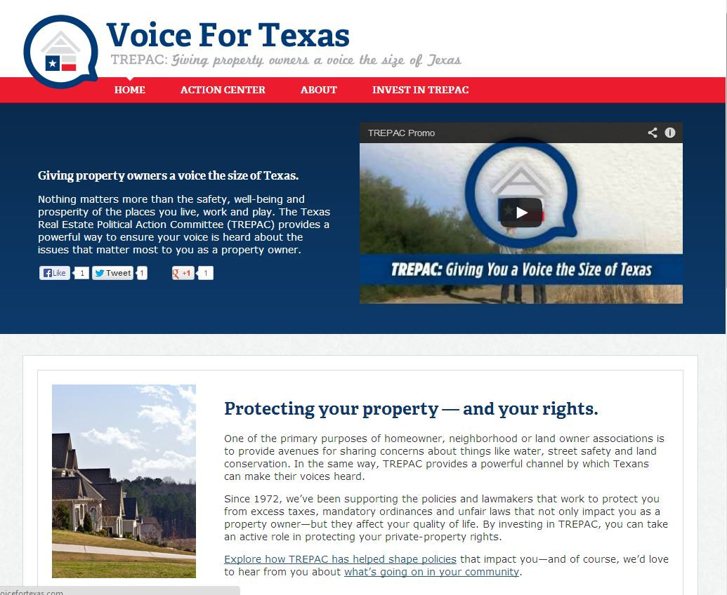
www.VoiceForTexas.com

Slide 5
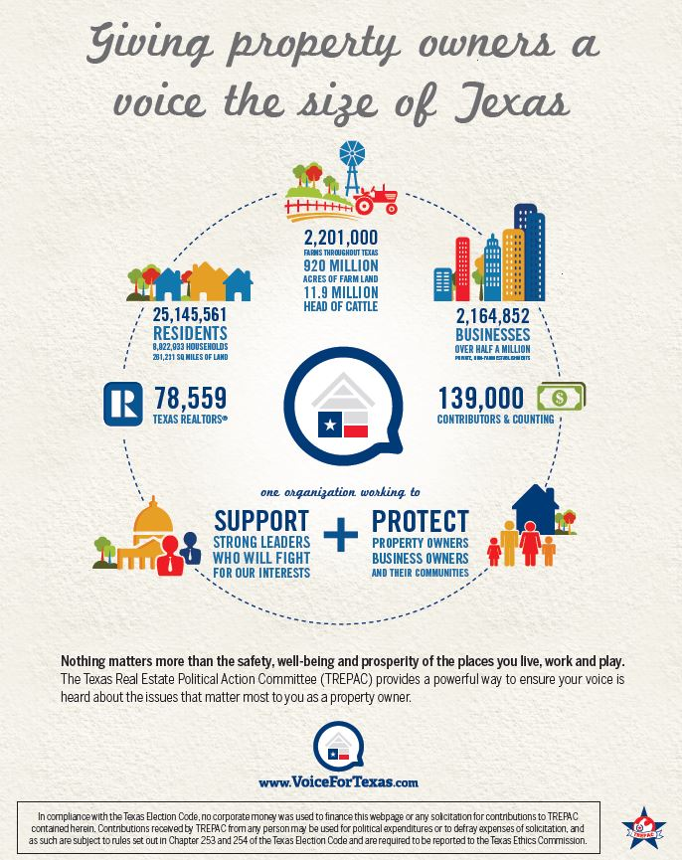

Slide 6
Major Investor Program
Major investor launch at BOLC in October.
Program benefits Major Investors and the PAC by helping you leverage your networks
Each Major Investor gets 50 client contact opportunities 4 times a year – 200 client touches
Accomplished via auto-generated postcards

Slide 7
