Slide 1
Putting REALTOR® Safety First: Safety Strategies for the Modern REALTOR®

Slide 2
Learning Goals
Understand exposure to risks
Follow safety best practices
Assess a potentially dangerous situation and take appropriate action
Safeguard your own and your clients’ personal data
Encourage all to follow safety best practices and company safety policies

Slide 3
NAR’s Safety Program
Reduce the number of safety incidents that occur in the industry
Every REALTOR® comes home safely to their family every night
www.nar.realtor/safety

Slide 5
Module 1: Your Personal Safety

Slide 6
Safety Spheres
Your personal safety
Your office and colleagues
Buyers
Sellers
Online
Your home and family
What happens in one safety sphere can impact others

Slide 7
Five Key Actions
Strategy
Best practices
Learn from webinars and videos
Learn and use personal protection resources
Improve safety culture

Slide 8
A High-Risk Business?
87 real estate professionals met with fatal injuries in 2019 per U.S. Bureau of Labor Statistics
One-third caused by “violence and other injuries”
Many incidents are never reported
When one real estate professional is harmed, all suffer

Slide 9
Why Is Real Estate Risky?
Image of success
Meeting unknown prospects at properties
Working at unfamiliar properties at odd hours
Sitting open houses alone
Entering vacant properties
Driving with strangers while multitasking
Public visibility
Many ways for prospects to make contact
Handling client’s personal information
Who would harm me?

Slide 10
What Do Others Say?
Have been the victim of a crime while on the job
Felt threatened on the job










Slide 11
What Do Others Say?
Feared for personal safety or safety of personal information
When and Where
35% After a threatening email, text message, phone call, or voicemail
17% During an open house
7% Meeting a new client for the first time at a secluded location/property
7% Driving a client
7% During a showing
3% Meeting a new client for the first time in a public place

Slide 12
What Do Others Say?
Meets unknown prospects at the real estate office or a neutral location first
More women than men have feared for their safety

Slide 13
What Do Others Say?
58% Use a smartphone app to track whereabouts
49% Carry a self-defense weapon
38% Have taken a self-defense course
29% Participated in a REALTOR® safety course
The most common types of self-defense weapons
 | Women |  | Men
Pepper spray |  | 26% | 5%
Firearm |  | 11% | 21%
Pocket knife |  | 5% | 11%
Taser |  | 6% | 1%
Baton/club |  | 4% | 6%
Battery operated noisemaker |  | 2% | 3%

Slide 14
What Do Others Say?
Real estate brokerage has standard procedures for agent safety
Real estate office has standard procedures for safeguarding and proper disposal of client data

Slide 15
The Crime Equation
Motive
+ Opportunity
= Crime
Remove part of the equation, lessen likelihood of a crime

Slide 16
Understanding the Criminal Mind and Motivation
 | Predator | Thief
Motive | Power, control | Profit
Crime | Assault, rape, murder | Burglary, robbery
Emotional | Yes | No
Goal | Isolate the victim | Be isolated
Decision-making | Fulfill emotional needs | Potential profit versus risk

Slide 17
Sharpen Your Safety Sense
All of us have a built-in safety sense, our survival instinct
What does instinct feel like?
Nagging feeling Wonder—What if? Anxiety Hunches Gut feeling Curiosity | Doubt Hesitation Suspicion Apprehension Fear Dark humor

Slide 18
10-Second Safety Scan
Take 2 seconds when you
Arrive at your destination
Step out of your car
Walk toward the property
Arrive at the door
Enter the property
Remember POWDER
Parking your car
Out of your car
Walking to the property
Door
Entering the property
Reverse the scan steps when leaving

Slide 19
How We Respond to Threats
Denial and delay: This can’t be happening!
Deliberation: What should I do?
Decision: Okay. Here goes!
Recycle through denial, delay, deliberation.
Physical responses:
Stress hormones
Heart rate increases
Dissociation
Shutting down: negative panic
What can we do?
Confidence
Preparation

Slide 20
The Strongest Defense
“The strongest defense is a plan of what you will do to avoid high-risk situations and what you will do if you find yourself in danger.”
Amanda Ripley, The Unthinkable, Who Survives When Disaster Strikes—and Why.

Slide 21
Fight or Flight?
Depends on a combination of factors:
Physical capability
Proximity of the attacker
Presence of a weapon
Knowledge of self-defense

Slide 22
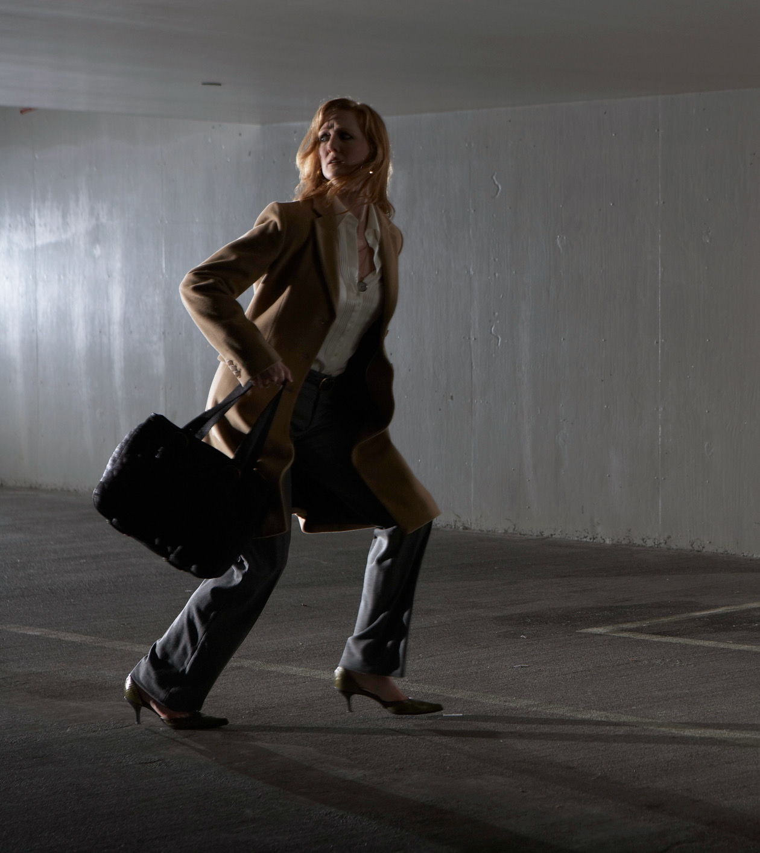
Escape the Situation
If threatened––act decisively and escape unharmed
Don’t apologize or announce intention
Running away is as courageous as fighting back
Can you make an escape?

Slide 23
Can You Escape?
Fitness level and stamina
Clothing
Terrain and obstacles
Safe location to run to

Slide 24
Should You Try to Defend Yourself?
Fighting back: A conscious decision when escaping is not an option

Slide 25
Can You Diffuse the Situation?
Buy time to assess the situation, decide what to do
Create a distraction and escape
On the other hand,
May trigger the predator’s emotions
May justify an attack (in the predator’s mind)

Slide 26
Should You Take a Self-Defense Class?
Benefits
Rehearse simulated confrontations
Learn to recognize and evaluate threats
Improve fitness
Gain confidence to:
Handle threats
Choose right response
Defend yourself
Calm fear responses

Slide 27
Choosing a Self-Defense Class
Ask family, friends, and colleagues
Observe a class
Ask about the training goals
Match your fitness level
Choose group instruction
Check for safety precautions
No-pressure environment

Slide 28
Should Your Arm Yourself?
Personal choice
Comply with all state and local laws
Follow best practices for firearm safety
Learn to use the weapon for self-defense
Consider other options for self-defense weapons: sprays, baton, Taser

Slide 29
Learn to Use Weapons for Self-Defense
A weapon is a liability if an attacker can take it away and use it against you
Learn how to use it properly for self-defense
Know and comply with your state’s weapons laws

Slide 30
Your Smartphone—Your Personal Safety Tool
GPS tracking
Texting
Alerts and alarms
Photo sharing
Surveillance
Call blockers

Slide 31
Do You Know the Caller?
You can be tricked into a conversation with someone you don’t know
Scammers feed off your reactions
Listen to your instincts
If you don’t remember the caller, you’ve probably never met

Slide 32
Calls to 911––You Should Know
Where do 911 calls go?
Response time?
Can the emergency system locate you?
Is the system GPS enabled?
Can the emergency operator call back?
Can police provide extra patrols during open-house events or around vacant properties?
How/when should you report non-emergencies?

Slide 33
8 Criteria for Choosing Safety Products
Supports behavioral and cultural change
Designed for prevention
Rooted in behavioral science
Alerts emergency contacts based on proximity
Two types of alerts: uncomfortable vs. emergency
Unobtrusive––will not make legitimate prospects uncomfortable
Helps identify “red flags”
Integrated with 911

Slide 34
Auto Safety
Drive separately or be the driver
Keep your car in top operating condition
Store breakdown essentials in trunk
Know where you are going
Avoid aggressive drivers or road rage situations
No texting or multitasking while driving
The average time your eyes are off the road while texting is 5 seconds (enough time to cover the length of a football field–– blindfolded)

Slide 35
Parking Lot Safety
Keep keys out and ready to open the car door
Unlock only the driver-side door
Check the back seat
Lock all doors immediately upon entering and get moving
Keep car keys on a separate key ring from house and office keys

Slide 36
More Safety Tips
Know who is calling
Keep your cell phone ready to use
Personal location devices––GPS wearables
Know where you are going
Roadside service
Cold weather essentials
Stalking is a predatory crime

Slide 37
Module 2: Your Office Safety Team

Slide 38
Safety: An Essential Business System
Think about safety as an essential business system
Safety systems remind us to apply precautions consistently

Slide 39
Safety Systems = Professionalism
Safety systems demonstrate your professionalism.
Prospective clients will appreciate and respect you for taking steps to ensure everyone’s safety.

Slide 40
Assessing Our Safety Best Practices
Strengthen your office safety culture
Best practices must be adopted and followed by everyone
Inconsistency could be seen as discriminatory
Everyone or no one?
On your own
A Special Message For Men
Men may underestimate the possibility of becoming crime victims
Ignoring safety precautions puts others at risk

Slide 41
Planning Our Safety Strategies
Find out what agents and employees do day-to-day
Use the checklists in this manual to take stock
Smartphone Safety Checklist
Agent’s Property-Showing Safety Checklist
Open-House and Model-Home Safety Checklist
Listing Appointment Safety Checklist
Tap into the online REALTOR® Safety program resources at www.nar.realtor/safety

Slide 42
Every Day Is Safety Awareness Day
Talk about safety
Share what you have learned
Help your colleagues stay safe

Slide 43
Safety as Teamwork
Use the Buddy System When
The property is vacant
There is poor cell phone service at the property
You have an uncomfortable feeling prior to the appointment
You haven’t closed a deal in a while
A medical emergency may occur

Slide 44
Office Policy on Weapons
Work with an attorney to develop an office policy
Weapons policies should cover:
State laws regarding concealed carry
Licensing and registration requirements
Storage in or near office premises
Transportation in vehicles
Employers cannot require employees to carry a weapon

Slide 45
REALTOR® Safety Network
REALTOR® Safety Alerts via social media when a physical or cyberthreat to REALTORS® warrants national attention
Widespread threat affecting REALTORS®
REALTOR® or an immediate family member is missing, and the family seeks assistance
Fraudulent use of association name or the names of its programs
Alerts issued via Facebook.com/nardotrealtor and other social media, communications directors, and AEs
Report an incident at www.nar.realtor/safety/realtor-safety-alert-submission-form

Slide 46
Active Shooter Situation
Three choices for action:
Run to a place of safety
Hide and deny access
Fight––the last resort
Choose the best option and commit to taking action
Role of Law Enforcement
First task is to end the incident
May have to pass up injured
Follow law enforcement instructions
Keep your hands visible and empty with fingers spread
Don’t yell, scream, or point

Slide 47
More Safety Tips
Office distress code (e.g., “I’m going to the bank”)
Keep your ID handy
Working alone––keep doors locked
Sign out and in

Slide 48
Module 3: Safety With Buyers

Slide 49
First Meetings
CITO––Come Into The Office
Standard office policy
Prospect Identification Form
Photocopy the ID and attach it to the form
Snap a photo of the prospect’s ID and send it to the office
Be wary of email contacts who refuse to provide a full name

Slide 50
Equal Professional Services
Procedures or forms used to collect information from prospects must be applied consistently
Inconsistent application could be viewed as discriminatory
REALTORS® shall not deny equal professional services to any person for reasons of race, color, religion, sex, handicap, familial status, national origin, sexual orientation, or gender identity.
National Association of REALTORS®, Code of Ethics, Article 10

Slide 51
Background Checks? Yes or No?
No national database with complete and accurate criminal records
Inconsistent classification and delayed reporting
Percentage of crimes reported
46% robberies
37% simple assaults
52% aggravated assaults
33% rape and sexual assaults

Slide 52
Who Knows Your Location?
Office should know your property showing itinerary
Take a showing buddy
Calls and alerts
Call or text the office to confirm your arrival
Ask for a call back
Set an alarm
Ask the prospect to step outside while you secure the property
Notify office when showing is finished and state where you are going next

Slide 53
Distress Codes
Secret word or phrase to signal danger (e.g., “Could you email me the easement file?”)
What code words do you use?

Slide 54
Arriving at the Property––Prepare the Home
Turn on all the lights
Open drapes and blinds
Unlock exterior doors
Open interior doors
Open garage door
Clear obstructions
Put away dangerous objects
Position surveillance cameras

Slide 55
Set the Tome
How and where you greet the arriving prospect
Set an authoritative and in-control tone
Maintain a social distance of about 5–7 feet from a prospect

Slide 56
Risky Locations
Bedrooms and bathrooms
Closets and pantries
Out buildings
Garages
Basements
Stairs
Prospect goes up or down the stairs first
Maintain a four-stair difference
Prospect moves away from the top or bottom of the stairs before you complete the ascent or descent
Keep a grip on the handrail

Slide 57
Showing Vacant Properties
Learn the house before you show it
Squatter inside? Leave immediately and call the police.
Angry former homeowner? Apologize for the disturbance and leave.
Call lender, asset management company, or listing agent
Meet the neighbors
No after-dark showings

Slide 58
Commercial Properties
Schedule showings of vacant commercial sites during daylight hours
Thick walls and remote locations may interfere with cell phone reception

Slide 59
Showing a Property After Dark
Ineffective way to show a property
Turn on all lights as you go through
Open all shades, curtains, or blinds
Advise your supervisor of the appointment time
Take a showing buddy

Slide 60
Red Flags
Is an attack imminent?
Predator “testing the waters”
Attempt to isolate the victim
Escalation from professional to personal
Invasion of body space
Uninvited touching
Personal questions

Slide 61
Body Language
Looking out the window
Lack of eye contact
Hands in the pockets
Cool weather clothing in warm weather
Dilated pupils
Changes in breathing or facial expression
Visible veins
Wiping hands
Fidgeting

Slide 62
Verbal Signals
More interest in you than in the house
Issuing orders
Asking you to move closer
Sharing excessive personal information
Suggestive language that is too familiar or intimate
Inappropriate compliments
Speaking louder, faster, or in a sharper tone

Slide 63
More Safety Tips
Quick exit
Carry essentials only
Take a photo
Check your surroundings
Lock up
Use your car key fob
Don’t say vacant
Wear flat-heeled shoes
Evaluate the risk

Slide 64
Module 4: Safety with Sellers

Slide 65
Listing Appointment Safety
Could be a lure
Who referred the caller?
Check out the property, prospect, and neighborhood
Use the Evaluate, Assess, React Worksheet
Watch for “red flags”
If it doesn’t feel right, leave immediately

Slide 66
Showing Safety for Sellers
Include seller safety awareness in listing presentation
Provide tips and suggestions for safeguarding valuables and information
Caution that other agents may not take the same precautions

Slide 67
Staging for Safety
Remove obstacles
Secure or temporarily remove pets
Safeguard valuables, personal information––credit cards, bills, checkbooks, mail, bank statements, family photos, and schedules
Lock up firearms, ammunition, weapons, and knives, including the kitchen knife block
Increase security while on the market

Slide 68
Open House and Model Home Safety
No opportunity to screen prospects
Model homes in isolated locations
Use the buddy system
Familiarize yourself with the property––inside and outside
Keep office, family, or a friend informed of your whereabouts and schedule

Slide 69
Before the Open House
Carry only essentials
Familiarize yourself with the house and note confined areas to avoid
Plan two escape routes
Unlock the deadbolt locks for quick access to the outside
Check around the outside of the house
Keep basement and garage exits locked from inside
Check mobile phone strength and signal
Complete safety routine before admitting any visitors

Slide 70
Visitor Sign-in
Require sign-in
Ask for identification
State in publicity that identification is required
Maintain separate sign-in and registration lists at model homes

Slide 71
Closing Up
Most vulnerable time––never assume the home is vacant
Ask for help from a colleague, friend, or family at closing time
Inform a contact when you begin closing
Lock front door first
Check all window locks
Go from the top floor to the bottom and the back to the front, locking the doors behind you
Check the backyard and garage

Slide 72
Photograph and Virtual Tours
Virtual tours can be used to case a home
Items that will be removed for showing should be kept out of sight when shooting a video tour
Geotagging
Embeds GPS metadata with digital photos
Location data posted with photo
Disable metadata on phones, cameras, but not GPS location tracking

Slide 73
More Safety Tips
Warn owners (and children) not to show their home by themselves
Know the agent
Lock up personal information
Lock up prescription medicines
Take a tour from a “stranger’s viewpoint”
Protect children’s identity
Identification required
Inform neighbors
Control open house traffic
Watch out for the “white glove” test
Perform post-showing check
Place a “not for rent” sign in the window
Increase surveillance

Slide 74
Module 5: Internet Safety

Slide 75
Email Security
Not a secure communication channel
How many emails do you receive every day?
Every email passes through 3rd-party servers
No control after it’s sent
Most serious security threats originate from human behavior

Slide 76
Just One Click!
One click on a “phishy” website or email can:
Result in a data breach that exposes confidential client, customer, and employee information
Unleash malware, viruses, worms, Trojan horses, spyware, and/or ransomware
Most viruses and malware infect computers when users click on links or fall for scams
Interconnections between people and devices increase the risks exponentially

Slide 77
Phishing
Spear phishing: Involves targeting a specific victim (e.g., accountant or personnel employee)
Whale phishing: Targets “big-fish” victims in upper levels of a company
Angler phishing: Targets social media users
Typo squatters: Rely on mistyped URLs or titles of websites

Slide 78
Wire Fraud
Combines phishing with wire transfer fraud
Urgent email impersonates the real estate professional or others (loan officer, accountant, attorney, contractor, etc.)
Asks for quick wire transfer to the scammer’s account to secure the transaction
Wired funds withdrawn and account closed before fraud is discovered

Slide 79
Use Your Tech Smarts
Don’t click on links or open attachments from unknown senders
Be suspicious of anonymous e-cards
Verify the requestor’s identity and query independently before sharing confidential information
Watch for tipoffs in phishing emails
Look for https: in the URL
Secure passwords and password manager
Avoid unsecured networks
Adjust privacy settings

Slide 80
Smart Passwords
Purpose: slow down and discourage hackers
Social media profiles can make guessing easy
Secure passwords:
Random combinations
Acronyms
Picture, Action, Object (PAO)
www.howsecureismypassword.net
Use a password management app

Slide 81
Five Best Practices
Take stock
Scale down
Lock it
Pitch it
Plan ahead
Free Data Security Toolkit at www.nar.realtor/data-privacy-security/nars-data-security-and-privacy-toolkit

Slide 82
More Safety Tips
Practice safe online shopping
Shield your computer from viruses
Rules of thumb for scaling down client data
Download a free data security toolkit

Slide 83
Module 6: Safety for Your Home and Family

Slide 84
Are You Oversharing?
Target for identity theft, phishing, and even stalking
Details about relationships, family matters, or personal dramas
Rants and emotional venting
Embarrassing photos of yourself or others
Photos of restaurant meals or spa and salon appointments
Photos of your children and information about their activities
Vacation photos while away from home
The Internet is forever

Slide 85
Social Media Safety
Keep business and personal separate
Watch what you say
Use privacy controls
Control friend requests
Don’t reveal too much information in profiles
Tweets are forever

Slide 86
Identity Theft
First line of defense: Vigilance and caution
Use secure https: connections
Look for the padlock icon in URL field
Check bills and statements

Slide 87
Cleaning Up Identity Theft
Place a fraud alert at one of the three credit bureaus:
Equifax
Experian
TransUnion
Order credit reports from all three bureaus
Create an Identity Theft Report

Slide 88
Trash or Treasure
Shred any documents with personal information:
Unwanted credit card applications
“Convenience checks"
Credit card receipts and statements
Outdated financial records
Remove address labels from shipping boxes before discarding

Slide 89
Child Identity Theft
Fast-growing area of identity crime
May not be discovered for many years
Tip-offs:
Unpaid balances from collection agencies
Credit card and loan offers addressed to child
Warning pop-up when e-filing your taxes and listing child as a dependent
IRS notification stating that your child owes taxes
Create a credit report for the child and place a freeze on it
Interactive toys and baby monitors can be accessed by hackers

Slide 90
Safety at Home
Install security cameras, motion sensor outdoor lights, smart doorbell, and smart locks
Get to know your neighbors
Check in with family and friends
Keep the garage closed and secured
Keep trees and bushes trimmed

Slide 91
More Safety Tips
Keep your profile photo professional
Keep personal profiles private
Check security of doors and locks (and change locks if necessary)
Keep track of keys
Monitor your financial accounts

Slide 92
Thank you for participating in this course!

