Slide 1
Putting REALTOR® Safety First: Safety Strategies for the Modern REALTOR®

Slide 2
NAR’s Safety Program
Reduce the number of safety incidents that occur in the industry
Every REALTOR® comes home safely to their family every night
www.nar.realtor/safety

Slide 4
Your Personal Safety

Slide 5
Safety Spheres
Your personal safety
Your office and colleagues
Buyers
Sellers
Online
Your home and family
What happens in one safety sphere can impact others

Slide 6
Five Key Actions
Strategy
Best practices
Learn from webinars and videos
Learn and use personal protection resources
Improve safety culture

Slide 7
A High-Risk Business?
87 real estate professionals met with fatal injuries in 2019 per U.S. Bureau of Labor Statistics
One-third caused by “violence and other injuries”
Many incidents are never reported
When one real estate professional is harmed, all suffer

Slide 8
Why Is Real Estate Risky?
Image of success
Meeting unknown prospects at properties
Working at unfamiliar properties at odd hours
Sitting open houses alone
Entering vacant properties
Driving with strangers while multitasking
Public visibility
Many ways for prospects to make contact
Handling client’s personal information
Who would harm me?

Slide 9
What Do Others Say?
Have been the victim of a crime while on the job
Felt threatened on the job










Slide 10
What Do Others Say?
Feared for personal safety or safety of personal information
When and Where
35% After a threatening email, text message, phone call, or voicemail
17% During an open house
7% Meeting a new client for the first time at a secluded location/property
7% Driving a client
7% During a showing
3% Meeting a new client for the first time in a public place

Slide 11
What Do Others Say?
Meets unknown prospects at the real estate office or a neutral location first
More women than men have feared for their safety

Slide 12
What Do Others Say?
58% Use a smartphone app to track whereabouts
49% Carry a self-defense weapon
38% Have taken a self-defense course
29% Participated in a REALTOR® safety course
The most common types of self-defense weapons
 | Women |  | Men
Pepper spray |  | 26% | 5%
Firearm |  | 11% | 21%
Pocket knife |  | 5% | 11%
Taser |  | 6% | 1%
Baton/club |  | 4% | 6%
Battery operated noisemaker |  | 2% | 3%

Slide 13
What Do Others Say?
Real estate brokerage has standard procedures for agent safety
Real estate office has standard procedures for safeguarding and proper disposal of client data

Slide 14
The Crime Equation
Motive
+ Opportunity
= Crime
Remove part of the equation, lessen likelihood of a crime

Slide 15
Understanding the Criminal Mind and Motivation
 | Predator | Thief
Motive | Power, control | Profit
Crime | Assault, rape, murder | Burglary, robbery
Emotional | Yes | No
Goal | Isolate the victim | Be isolated
Decision-making | Fulfill emotional needs | Potential profit versus risk

Slide 16
Sharpen Your Safety Sense
All of us have a built-in safety sense, our survival instinct
What does instinct feel like?
Nagging feeling Wonder—What if? Anxiety Hunches Gut feeling Curiosity | Doubt Hesitation Suspicion Apprehension Fear Dark humor

Slide 17
10-Second Safety Scan
Take 2 seconds when you
Arrive at your destination
Step out of your car
Walk toward the property
Arrive at the door
Enter the property
Remember POWDER
Parking your car
Out of your car
Walking to the property
Door
Entering the property
Reverse the scan steps when leaving

Slide 18
How We Respond to Threats
Denial and delay: This can’t be happening!
Deliberation: What should I do?
Decision: Okay. Here goes!
Recycle through denial, delay, deliberation.
Physical responses:
Stress hormones
Heart rate increases
Dissociation
Shutting down: negative panic
What can we do?
Confidence
Preparation

Slide 19
The Strongest Defense
“The strongest defense is a plan of what you will do to avoid high-risk situations and what you will do if you find yourself in danger.”
Amanda Ripley, The Unthinkable, Who Survives When Disaster Strikes—and Why.

Slide 20
Fight or Flight?
Depends on a combination of factors:
Physical capability
Proximity of the attacker
Presence of a weapon
Knowledge of self-defense

Slide 21
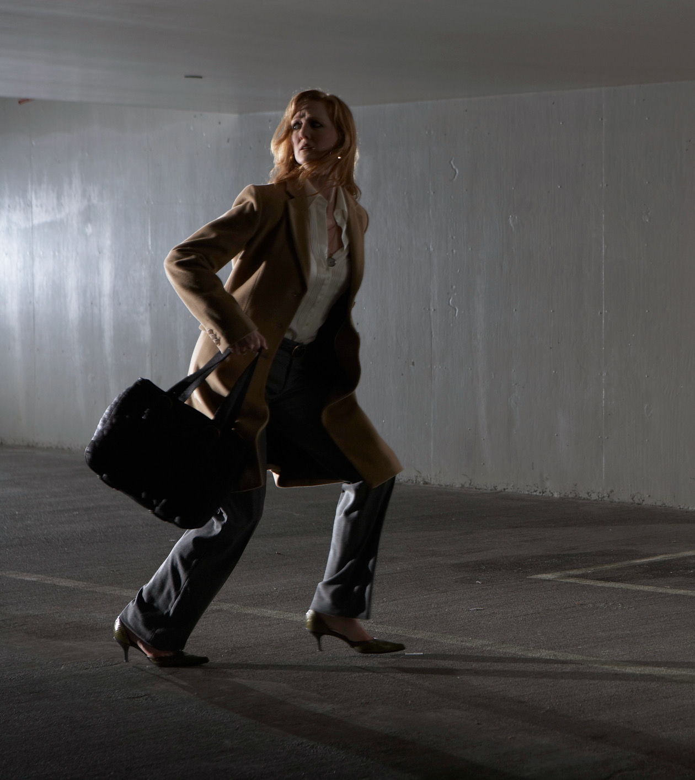
Escape the Situation
If threatened––act decisively and escape unharmed
Don’t apologize or announce intention
Running away is as courageous as fighting back
Can you make an escape?

Slide 22
Can You Escape?
Fitness level and stamina
Clothing
Terrain and obstacles
Safe location to run to

Slide 23
Should You Try to Defend Yourself?
Fighting back: A conscious decision when escaping is not an option

Slide 24
Can You Diffuse the Situation?
Buy time to assess the situation, decide what to do
Create a distraction and escape
On the other hand,
May trigger the attacker’s emotions
May justify an attack (in the predator’s mind)

Slide 25
Should You Take a Self-Defense Class?
Benefits
Rehearse simulated confrontations
Learn to recognize and evaluate threats
Improve fitness
Gain confidence to:
Handle threats
Choose right response
Defend yourself
Calm fear responses

Slide 26
Choosing a Self-Defense Class
Ask family, friends, and colleagues
Observe a class
Ask about the training goals
Match your fitness level
Choose group instruction
Check for safety precautions
No-pressure environment

Slide 27
Should Your Arm Yourself?
Personal choice
Comply with all state and local laws
Follow best practices for firearm safety
Learn to use the weapon for self-defense
Consider other options for self-defense weapons: sprays, baton, Taser

Slide 28
Learn to Use Weapons for Self-Defense
A weapon is a liability if an attacker can take it away and use it against you
Learn how to use it properly for self-defense
Know and comply with your state’s weapons laws

Slide 29
Your Smartphone—Your Personal Safety Tool
GPS tracking
Texting
Alerts and alarms
Photo sharing
Surveillance
Call blockers

Slide 30
Do You Know the Caller?
You can be tricked into a conversation with someone you don’t know
Scammers feed off your reactions
Listen to your instincts
If you don’t remember the caller, you’ve probably never met

Slide 31
Calls to 911––You Should Know
Where do 911 calls go?
Response time?
Can the emergency system locate you?
Is the system GPS enabled?
Can the emergency operator call back?
Can police provide extra patrols during open-house events or around vacant properties?
How/when should you report non-emergencies?

Slide 32
8 Criteria for Choosing Safety Products
Supports behavioral and cultural change
Designed for prevention
Rooted in behavioral science
Alerts emergency contacts based on proximity
Two types of alerts: uncomfortable vs. emergency
Unobtrusive––will not make legitimate prospects uncomfortable
Helps identify “red flags”
Integrated with 911

Slide 33
Auto Safety
Drive separately or be the driver
Keep your car in top operating condition
Store breakdown essentials in trunk
Know where you are going
Avoid aggressive drivers or road rage situations
No texting or multitasking while driving
The average time your eyes are off the road while texting is 5 seconds (enough time to cover the length of a football field–– blindfolded)

Slide 34
Parking Lot Safety
Keep keys out and ready to open the car door
Unlock only the driver-side door
Check the back seat
Lock all doors immediately upon entering and get moving
Keep car keys on a separate key ring from house and office keys

Slide 35
Thank you for participating in this course!

