Slide 1
The REALTOR® Code of Ethics
New Member Orientation Program

Slide 2
HISTORY AND BACKGROUND

Slide 3
History and Background
of the Code of Ethics
The NATIONAL ASSOCIATION OF REALTORS® formed in 1908.

Slide 4
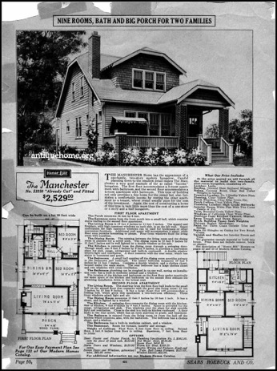
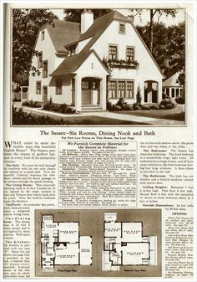
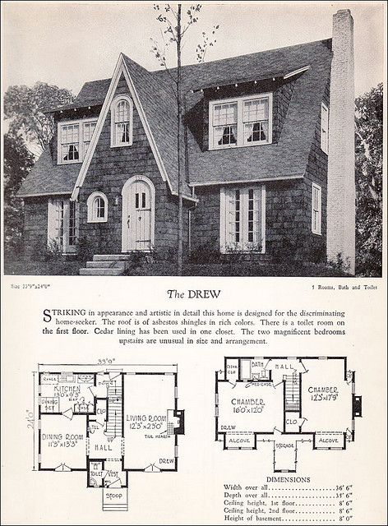
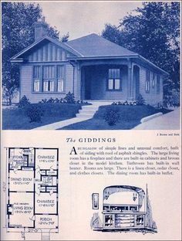
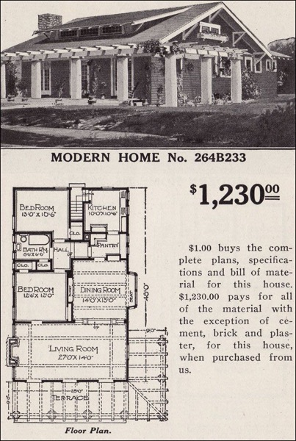
History and Background
of the Code of Ethics
At that time…
No license laws.
Real estate industry had a history of speculation, exploitation, and disorder.

Slide 5
History and Background
of the Code of Ethics
Code was adopted in 1913 to establish a professional standard of conduct.
Code of Ethics formed the basis for many license laws.

Slide 6
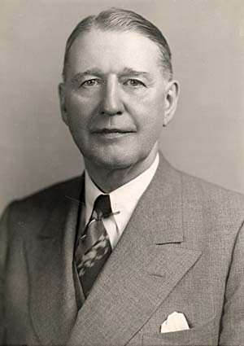
History and Background
of the Code of Ethics
From its inception, the Code of Ethics required arbitration of monetary disputes between REALTORS®.
NAR Executive Vice President
Herbert U. Nelson in 1935

Slide 7
THE PREAMBLE
Under all is the land…

Slide 8
The Preamble
The Golden Rule
Widely allocated ownership” and “widest distribution of land ownership”
Maintain and improve the standards of their calling.

Slide 9
The Preamble
Share with fellow REALTORS® a common responsibility for the integrity and honor of the real estate profession.
Strive to become and remain informed on issues affecting
real estate.
Willingly share the fruit of your experience and study with others

Slide 10
The Preamble
Identify and take steps to eliminate practices which may damage the public or which might discredit or bring dishonor to the real estate profession.
Urge exclusive representation of clients.
Do not attempt to gain any unfair advantage over competitors.
Refrain from making unsolicited comments about other practitioners.

Slide 11
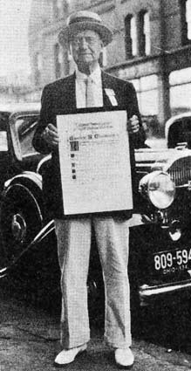
The Preamble
If an opinion is sought about a competitor (or the REALTOR® believes comment is necessary), the opinion should be offered in an objective, professional manner.
The term REALTOR® stands for competency, fairness, high integrity, moral conduct in business relations.
No inducement of profit and no instruction from clients can justify departure from these ideals.
Charles N. Chadbourn of Minneapolis, who coined the term REALTOR® in 1916.

Slide 12
The Preamble
The Preamble can not be the basis for disciplining a REALTOR®.

Slide 13
BUSINESS ETHICS

Slide 14
Business Ethics
Industry codes
Company policies
Individual moral values
Business ethics and legal standards
Business ethics and the REALTOR® Code of Ethics

Slide 15
Business Ethics
All REALTORS® regardless of their specialty in the real estate business (appraisal, property management, etc.) are bound by the duties in the REALTORS®’ Code of Ethics.

Slide 16
STRUCTURE OF THE CODE

Slide 17
The Three Major Sections
Duties to Clients and Customers
Duties to the Public
Duties to REALTORS®

Slide 18
The Structure of the Code of Ethics
Three Sections
- Broad statements of ethical principles
Standards of Practice
- Support, interpret, and amplify the Articles under which they are stated

Slide 19
The Structure of the Code of Ethics
Case Interpretations
- Specific fact situations to which the Articles and/or Standards of Practice
are applied
Standards of Practice
- Only Articles of the Code can be violated, though Standards of Practice
can be cited in support of an alleged violation

Slide 20
ETHICS/ARBITRATION

Slide 21
Pathways of Professionalism
Three major sections:
Respect for public
Respect for property
Respect for peers

Slide 22
Ethics or Arbitration
Ethics: Basic Issue
- Is there a possible violation of the Code of Ethics?
Arbitration: Basic Issue
- Is there an arbitrable issue, that is, a money dispute?
- Typically a dispute over which REALTOR ® is entitled to the cooperative commission in a transaction.

Slide 23
The Ethics Enforcement Process
Who can file a complaint?

Slide 24
The Grievance Committee
A screening committee comprised of members of the Association appointed to the committee.
Key question for the Grievance Committee:
If the allegations in the complaint were taken as true on their face, is it possible that a violation of the Code of Ethics occurred?

Slide 25
Professional Standards
Hearing Panel
Function is to conduct a full “due process” hearing with
sworn testimony, witnesses and evidence.
Hearing Panel is comprised of members of the Professional Standards Committee.

Slide 26
Professional Standards
Hearing Panel
After conducting a hearing, the Hearing Panel decides whether there was a violation of the Code of Ethics, proven by clear, strong and convincing proof.
If the Hearing Panel finds a violation of the Code of Ethics, the Panel then determines the discipline to be imposed on the violator (respondent).

Slide 27
Authorized Discipline (and administrative processing fees)
Letter of Warning
Letter of Reprimand
Education
Fine not to exceed $15,000
Probation for one year or less
Suspension for not less than 30 days nor more than one year
Expulsion from membership for period of one to three years
Suspension or termination of MLS privileges
Administrative processing fee (if found in violation) not to exceed $500 (“Court Costs”)

Slide 28
Authorized Discipline (and administrative processing fees)
An administrative processing fee is not considered discipline.
It is charged as part of the association’s adopted policy for enforcing the Code of Ethics.
It is not to be used on a case-by-case basis, but rather as an overall policy of the association.

Slide 29
Authorized Process
Request filed
Arbitration is conducted under Article 17 of the Code of Ethics and the state arbitration statute (if any).
Arbitrate, Don’t Litigate!

Slide 30
Authorized Process
Article 17 provides that arbitration occurs under the following circumstances:
- Contractual disputes or specific non-contractual disputes
(see Standard of Practice 17-4);
- Between REALTORS® (principals) associated with different firms;
- Arising out of their relationship as REALTORS®

Slide 31
Grievance Committee
Committee performs a screening function similar to review of
ethics complaints.
Key question for the Grievance Committee:
If the allegations in the request for arbitration were taken as true on their face, is the matter at issue related to a real estate transaction and is it properly arbitrable, i.e. is there some basis on which an award could be based?

Slide 32
MEDIATION

Slide 33
Mediation
A voluntary process in which disputing parties meet with a mediator appointed by the Association to create a mutually acceptable resolution of the dispute, rather than having a decision imposed by an arbitration hearing panel.

Slide 34
Mediation
Mediation can occur before or after the Grievance Committee reviews requests for arbitration, depending on local Association policy.
If a dispute is resolved in mediation, the parties sign an agreement spelling out the terms of the settlement, and no arbitration hearing is held.

Slide 35
Mediation
Mediation is the preferred dispute resolution system of the
NATIONAL ASSOCIATION OF REALTORS®.

Slide 36
Mediation
Mediation | Arbitration
Low-cost | Moderate cost
Little delay | Moderate delay
Maximum range – solutions | Win/lose/split
Parties control outcome | Arbitrators control outcome
Uncertain closure | Definite closure
Maintain/improve relationship | May harm relationship

Slide 37
Professional Standards
Hearing Panel
Function is to conduct a full “due process” hearing with
sworn testimony, witnesses and evidence.
Hearing Panel is comprised of members of the Professional Standards Committee.

Slide 38
Professional Standards
Hearing Panel
After the hearing, the Hearing Panel decides which REALTOR® is entitled to the award (typically a disputed commission in a transaction), proven by a preponderance of the evidence.

Slide 39
Payment of the Award
Generally, the award of the Panel in an arbitration case can be judicially enforced if not paid by the non-prevailing party.
Some associations have procedures requiring that awards by deposited with the association pending review of the hearing process or during legal challenge.

Slide 40
NAR’s Arbitration Guidelines
Found in the Code of Ethics and Arbitration Manual.
Guidance to Hearing Panels as to how to determine procuring cause in arbitration hearings.
Also referred to as “Suggested Factors for Consideration by a Hearing
Panel in Arbitration.”
Guidelines focus on “procuring cause” as the basis for resolving most commission disputes between brokers.

Slide 41
Key Factors in a Procuring
Cause Dispute
No predetermined rule of entitlement may be established by an association.
Hearing Panels should consider the entire course of events.
Matters such as the first showing of the property, the writing of the successful offer or the existence of an agency relationship with the buyer are not, in themselves, exclusive determiners of procuring cause/entitlement.

Slide 42
Key Factors in a Procuring
Cause Dispute
The key concepts of procuring cause are referenced in this definition from Black’s Law Dictionary, Fifth Edition:
“The proximate cause; the cause originating a series of events which, without break in their continuity, result in the accomplishment of the prime object.”

Slide 43
ARTICLES FROM THE
CODE OF ETHICS

Slide 44
Article One
Protect and promote the interests of
the client.
This obligation to the client is primary;
But must treat all parties honestly, regardless of agency or non-agency relationship.
Standard of Practice 1-2 defines terms such as “client,” “customer,” “agent,”
and “broker.”

Slide 45
Article Two
DISCLOSE
DISCLOSE
DISCLOSE

Slide 46
Article Two
Avoid exaggeration, misrepresentation, and concealment of pertinent facts about the property or the transaction;
But there is no obligation to discover latent defects, matters outside scope of license, or matters confidential under agency or non-agency relationships.

Slide 47
Article Nine
Agreements shall be in writing whenever possible;
In clear and understandable language;
Expressing the specific terms,
conditions, obligations and commitments
of the parties.
A copy of each agreement shall be furnished to each party upon their signing or initialing.

Slide 48
Article Nine
Standard of Practice 9-1 requires that reasonable care be used to keep documents current by use of written extensions and amendments.

Slide 49
Article Twelve
Truth and Honesty in real estate communications.

Slide 50
Article Twelve
Be honest and truthful in your real
estate communications.
Present a “true picture” in your advertising, marketing, and
other representations.
REALTORS® must ensure that their
status as real estate professionals in
readily apparent.
Recipients of all real estate communications must be notified that those communications are from a real estate professional.

Slide 51
Article Sixteen
Do not engage in any practice or take any action inconsistent with the agency or other exclusive relationship that other REALTORS® have with clients.

Slide 52
Article Sixteen
Examples of issues covered by Article 16 and its Standards of Practice:
Innovative or aggressive business practices
Advertising/solicitations which may be received by other REALTORS® clients
Solicitation of listings and agency relationships of clients of other brokers
Dealing with other brokers’ clients
Obligations when entering into
exclusive relationships
Agency and/or brokerage relationship disclosure

Slide 53
IN CONCLUSION…

Slide 54
The REALTOR® Code of Ethics…
Protects the buying and selling public.
Promotes a competitive real estate marketplace.
Enhances the integrity of the industry.
Is your promise of performance.
Is your promise of professionalism.

