Slide 1



Slide 2

Upcoming Webinar

Slide 3
CENTER FOR REALTOR® FINANCIAL WELLNESS WEBINAR AND SEMINAR DISCLAIMER
For Education and Information Purposes Only
Please note that the information and materials provided in Center for REALTOR® Financial Wellness webinars and seminars are not intended or provided to be used as a substitute for the advice of your tax, investment, legal and/or financial advisors or to be the basis of specific financial planning activities. The opinions and views expressed or shared in this presentation represent only those of the developers, speakers, presenters or instructors and have not been endorsed or approved by the National Association of REALTORS®. While substantial care is taken to try to provide accurate and current data and information, the National Association of REALTORS® does not warrant the accuracy, completeness or timeliness of any data and information provided in the webinars and seminars. Further, any principles and conclusions presented are subject to court decisions and to local, state and federal laws and regulations and any revisions of such laws and regulations. If you seek or need tax, investment, legal or financial advice, you must obtain such advice and services from the appropriate professionals.
Any links to third-party websites, tools, materials or resources are provided as a convenience and for your information. Any products, services or opinions of third-party entities or associated individuals are neither endorsed nor have they been vetted by the National Association of REALTORS®, and their inclusion in the webinar or seminar and any related materials do not constitute a recommendation by the National Association of REALTORS® and should not be inferred as suggesting a preference over other products, services or information available in the market. The National Association of REALTORS® bears no responsibility for the accuracy, completeness, legality or the content provided in the webinar or seminar and any related materials.

Slide 4

Nicole Cole, MBA
Wealth Advisor
Colonial River Wealth Management
NICOLE.COLE@COLONIALRIVER.COM
540-318-0007
Securities offered through LPL Financial, member FINRA/SIPC. Investment advice offered through Colonial River Investments, LLC. a registered investment advisor. Colonial River Investments & Colonial River Wealth Management are separate entities from LPL Financial.

Slide 5
Taxes & Retirement
For NATIONAL ASSOCIATION OF REALTORS® MEMBERS
-- After the Tax Cuts and Jobs Act of 2017
Securities offered through LPL Financial, member FINRA/SIPC. Investment advice offered through Colonial River Investments, LLC. a registered investment advisor. Colonial River Investments & Colonial River Wealth Management are separate entities from LPL Financial.
Notes:
Welcome…

Slide 6
The Financial Advisor presenting this material is in no way employed by, affiliated with, or endorsed by the IRS, the Social Security Administration or any other government agency. The financial professional is not permitted to offer, and no statement contained herein shall constitute tax or legal advice.
This presentation is designed to provide general information on the subjects covered. Pursuant to IRS Circular 230, it is not intended to provide specific legal or tax advice and cannot be used to avoid tax penalties or to promote, market or recommend any tax plan or arrangement. You are encouraged to consult your personal tax advisor or attorney before making any decisions about your personal situation. Much of the information contained in this presentation is based on current tax rules and policies as stated on IRS.GOV, and is subject to change in the future.
This presentation is provided for informational purposes only. It is not intended to be used as the sole basis for financial decisions, nor should it be construed as advice designed to meet the particular needs of an individual’s situation. All Examples are hypothetical and for illustrative purposes only. Actual results will vary. No part of this presentation is intended to make an offer of sale or purchase of any specific security or insurance product.
Notes:
Here are the mandatory disclosures. Keep in mind, I am a Financial Advisor, not a CPA, Enrolled Agent or Attorney, so the contents of this presentation are based on things I see day to day in my practice and are not specific advice for your situation.

Slide 7
Our Goals:
Understand relevant changes to personal income tax under the Tax Cuts and Jobs Act of 2017
Understand the impact of the Tax Cuts and Jobs Act on retirement income streams
Identify retirement savings resources by tax type for REALTORS®
Identify tools and strategies available to REALTORS® preparing for or in retirement
Avoid the political and stick to the actionable
Notes:
That said, there is a very practical aspect to taxes. Many of the decisions you make will have tax implications. Whether or not you use a professional to look forward at those implications is another story. My goal is for you to leave here with a better understanding of how taxes are different in retirement and avoid some very common tax pitfalls. We’ll discuss the new tax law and how the changes impact many of these decisions. Of course, I want to limit the topic today to what is, not anyone's beliefs on what should be, so we’ll stay away from the political and stick to the actionable. Sound good to everyone?
One note before we get started – we’ll focus on Married Filing Jointly stats because that’s our most common attendees to these seminars, but for other filing statuses such as single or head of household, all the principles remain the same.

Slide 8

Notes:
If you don’t know what to think of Tax Reform – don’t worry, you’re not alone.

Slide 9
Married Filing Jointly Brackets - 2019
Taxable Income | Ordinary Income Brackets
0 - $19,400 | 10% of taxable income
$19,400 - $78,950 | $1905 + 12% over $19,400
$78,951 - $168,400 | $8,907 + 22% over $78,950
$168,401 - $321,450 | $28,179 + 24% over $168,400
$321,451 - $408,200 | $64,179 + 32% over $321,450
$408,201 - $612,350 | $91,379 + 35% over $408,200
$612,351 + | $161,379 + 37% over $612,350
https://www.nerdwallet.com/blog/taxes/federal-income-tax-brackets/ accessed 10.1.19
Notes:
How many of you have filled out a paper tax form?
If so, you’ve probably seen a more complete version of the bracket system, which looks more like this – with a base amount, then the rate for the amount above. When people filled out paper forms, this representation makes it much easier to realize that only thin income that falls into a given bracket is taxed at that rate.

Slide 10
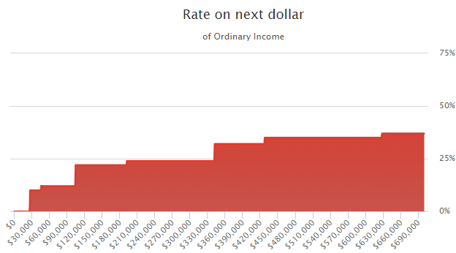
MFJ – Ordinary Income Tax Map - 2019
35%
37%
32%
22%
24%
12%
10%
Information in chart is based off Ordinary Income Brackets for 2018 and takes into consideration the Standard Deduction of $24,000
https://taxfoundation.org/2018-tax-brackets/ accessed 10.1.19
Notes:
This might be an easier way to visualize tax brackets. We call it a tax map because it illustrates the rate at which each additional dollar of ordinary income would be taxed. In retirement, two of the most common sources of ordinary income are pension income and withdrawals from IRA accounts.
Notice from 0 to about $27,000 there is no tax. That’s due to the new larger standard deduction, plus an additional $2600 for both of these clients being over age 65, which we’ll discuss in a few slides. From about 27,000 to just over $45,000, income falls into the 10% - only the income that falls in that range gets taxed at 10%. 2019 standard deductions were increased by $400 to $24,400.
For the income that falls between about $45,000 and $103,900, that is taxed at 12%. If those ranges look odd to you, its because we’ve included the new Standard deduction for married couples, which we’ll discuss later in the presentation.
There are two spots on this map worth really paying attention to, because they are big jumps – do you see them? The jump from 0-10 and again from 12-22, and the jump from 24 to 32 are where the biggest opportunities for planning lie.

Slide 11
Marginal Tax Rates
The Tax Bracket your last dollar fell into…
Notes:
We’ve just hit on a very important concept. That is the concept of marginal tax rates. Your Marginal Tax rate is the rate you paid on the last dollar of income

Slide 12
Capital Gains and Qualified Dividends Get Different Treatment
Public Policy goal of different Capital Gains and Qualified Dividends brackets is to encourage investment
Similar Marginal Tax Concept to Ordinary Income: Only the amount above the threshold is taxed at the higher rate
Prior to the act, these brackets were linked directly to Ordinary Income brackets, now they stand alone
https://www.fool.com/taxes/2017/12/22/your-guide-to-capital-gains-taxes-in-2018.aspx accessed 1.5.18
Notes:
Capital Gains and Qualified dividends get their own brackets that are separate from ordinary income. These brackets are lower primarily to meet the public policy goal of encouraging investment in the economy.
There is still a marginal tax concept for capital gains and dividends, but the brackets are considerably different.
So here is a question – at what rate are Capital Gains Taxed?

Slide 13
Long Term Capital Gains Brackets (MFJ) - 2019
Taxable Income | Capital Gains Brackets
$0 - $78,750 | 0%
$78,751 - $488,850 | 15%
$488,851+ | 20%
https://www.nerdwallet.com/blog/taxes/capital-gains-tax-rates/ accessed 10.1.19
Notes:
Capital Gains also have a marginal structure. notice the 15% capital gains bracket roughly aligns with the ordinary income brackets, so long term capital gains and qualified dividends that would fall into the 10 or 12% ordinary income brackets actually come through at a 0% rate. The reason is that the old capital gain system was effectively “left behind” in the new tax bill.
We only get up to the 15% capital gains rate for gains that would fall into the 22% bracket in the new system.
The 20% capital gains rate applies where the old 39.6% ordinary income bracket would have began, so the tax bill didn’t dramatically change capital gain opportunities for high income earners.

Slide 14
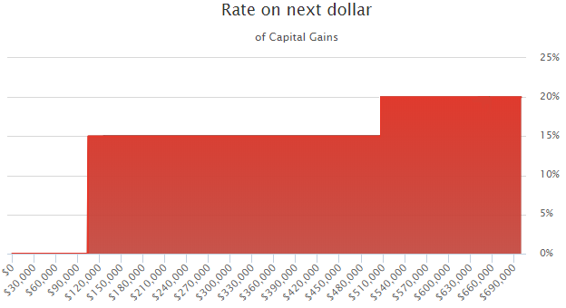
MFJ – Long Term Gain and Dividend - 2019
20%
15%
0%
Information on this chart is based on the standard deduction if a married couple filing jointly who are both over 65 had 103,800 of capital gain, they would still pay 0%
Source: Tax Clarity Software Output for Capital Gains.
Notes:
You guessed it – although 15% is a rule of thumb, it does not hold true all the time.
So again, here is a tax map. If you had only dividends and capital gains on your tax return, you would pay 0% until you have enough to fill the 12% ordinary income tax bracket (less $200 for 2018). For tax payers in the highest ordinary income bracket, the capital gains rate is 20%.
This is a really important concept because it shows how Capital Gain taxation is actually linked to ordinary income. Once the combination of capital gains plus ordinary income pushes you above the threshold, your capital gains become taxable at 15%. This structure really didn’t change under the new tax bill, but because of a new larger standard deduction, the range at which it impacts you changes.

Slide 15
Deductions Exemptions
Credits
Notes:
Which brings us to the changes in deductions, exemptions and credits. These reduce your net federal tax bill, effectively making the first several thousands of dollars into your household tax free.

Slide 16

Deductions
An amount deducted from taxable income
Standard Deduction – $24,400 for Married or $12,200 for Single in 2019
Alternative: Itemized Deductions (Schedule A)
  Mortgage interest on debt up to $750,000 of debt acquired after 12/14/2017 (not including HELOC*)
  Charitable gifts of cash or check up to 60% of adjusted gross income
  State and Local Tax up to $10,000
Additional Deduction for 65+ and/or Blind remains
https://www.nerdwallet.com/blog/taxes/federal-income-tax-brackets/ accessed 10.1.19
https://www.cnbc.com/2017/11/03/the-good-the-bad-and-the-money-what-the-gop-tax-plan-means-for-you.html accessed 1.5.18
http://time.com/5080756/irs-prepay-property-tax-deduction-2017-2018-limit/ accessed 1.5.18
Notes:
You can think of deductions as reductions to income for certain things you spend money on. You can either track those things, such as mortgage interest, investment interest, tax prep fees, and complete a schedule A, or you can take the standard deduction, which was increased pretty dramatically, from $13,000 for a couple to $24,400 for a couple under the new tax law. It is commonly estimated that only about 15% of the population will itemize after the new tax bill goes into effect. For many retired taxpayers, even before the increase there simply are not enough deductions to warrant itemizing on schedule A.
IRS data indicate that only about 10% of filers will itemize under the new tax law. This has a huge impact on the incentives for buying and owning a home, which is very important to NAR members in discussing incentives for home purchase with clients or for themselves.
NOTE: HELOC interest IS deductible if proceeds of loan were used to acquire, construct, or substantially improve residence
Once you reach age 65, or if you are blind, you get an additional deduction of $1,300 each if you are married, or $1,600 if you are single. This provision was retained in the new tax law.

Slide 17

Exemptions
For Being Alive
$4,050 per person in your household in 2017
GONE!
https://www.usatoday.com/story/money/taxes/2017/12/26/these-9-tax-deductions-are-going-away-in-2018/108910040/ accessed 1.5.18
Notes:
What changed? The personal exemption is gone. For 2018, the personal exemption would have been $4150 per person in the household for 2018.
Here is a list of other exemptions that are going away:
Personal exemptions
Home equity loan interest
Moving Expenses
Casualty and theft losses except in disaster areas
Job expenses
Subsidized parking and transit reimbursement
Tax preparation fees
Other miscellaneous deductions
Donations to colleges in exchange for athletic event seats

Slide 18

Credits
Incentivize behavior:
Healthcare Tax Credit
Earned Income Tax Credit
Education Credits
Savers Credit
Child Credit
Notes:
Deductions and exemptions reduce your taxable income, indirectly reducing your tax. Credits on the other hand directly reduce your tax bill. Deductions and tax credits are specifically designed to incentivize behavior, credits more directly. Two of the most common tax credits are the healthcare tax credit and the earned income tax credit. A less common one, but one that may be accessed by some people who take a part time job in retirement is the saver’s credit, which basically incentivizes lower income people to save into retirement accounts.
Remember, even if you’ve been a high earner all your life, your tax return may be set up to present you as a low earner between the point of a formal retirement and the time you are forced to begin taking required minimum distributions from IRA accounts.

Slide 19
Deductions, Exemptions, Credits
Gross Income (MFJ) | $38,000
Minus Deductions and Exemptions | $24,000 Standard Deduction $1,300 (x2) Deduction for 65+ $26,600 Total
$2,000 IRA Contribution | $2,000 Deduction
Income Subject to Tax | $9,400
Times 10% Tax Rate | $940
Saver’s Tax Credit for IRA Contribution | $1,000
Total Tax Due | $0
Deductions and exemptions are based off the 2018 tax year.
*Example used as illustration only and is not indicative of any particular situation. Actual results will vary.
Notes:
Here’s a hypothetical example of a couple that with $38,000 of Gross income that is all ordinary income. At least $2,000 of the income must be in the form of wages. First, we reduce the income by the standard deduction for a Married Couple Filing Jointly plus the additional deduction for 65+, then we take off $2,000 for a contribution to a traditional IRA to come up with our Taxable Income of $9,400. Notice how the deductions reduced the Taxable Income?
Please note, IRA deductions are actually taken from gross income prior to the standard deduction on the tax return
Then we multiply that times 10%, since all of that income falls in the 10% bracket. For a Tax bill of $940.
Remember, credits are different than deductions and exemptions in that they directly reduce the tax bill. In this case, the savers credit results in a $1,000 tax credit, taking the total Federal tax bill for these clients down to 0. Why only 0? This credit is non-refundable.

Slide 20
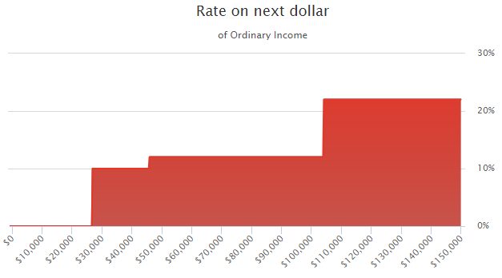
Middle Income MFJ Brackets
Deductions
Notes:
Remember how our tax map showed no tax up to $27,000? That was the impact of the new standard deduction.
$27,000 is the standard deduction plus the age 65 additional deductions for married filing jointly. 2019

Slide 21
The “Real” Tax System
Required Minimum Distributions
Capital Gains
Social Security Benefits
Medicare Premiums
Potential Roth Conversions or large withdrawals from IRAs
3.8% Net Investment Income Tax
PEP (Personal Exemption Phaseout)
Pease (Itemized Deduction Phaseout)
AMT (Alternative Minimum Tax)
Notes:
Realistically, if that were all there was to our tax system, it would be relatively intuitive, but unfortunately, in retirement we see several complicating factors. Each of the factors you see on the screen creates an environment where what you expect to pay may not be what you end up actually paying. We’ll dig into each in this section.
As previously discussed the Personal Exemption Phaseout has been removed for 2018
Additionally, The Pease limitation phased out 3% of a taxpayer’s itemized deductions once income crossed a certain threshold (in 2017, those with more than $261,500 of AGI as individuals, or $313,800 as married couples).
Notably, while the Pease limitation was literally a phaseout of itemized deductions, because the magnitude of the phaseout was based on an individual’s income (not their deductions, as it was based on the amount of income over the threshold), the Pease limitation was effectively a 1% to 1.2% surtax for upper income individuals. Accordingly, the removal of the Pease limitation effectively provides a further reduction in marginal tax rates for upper-income individuals. https://www.kitces.com/blog/final-gop-tax-plan-summary-tcja-2017-individual-tax-brackets-pass-through-strategies/ accessed 1.5.18
The AMT exemption amounts will increase to $70,300 for single filers and $109,400 for joint filers and will phase out for those taxpayers at $500,000 and $1 million, respectively, according to the nonpartisan Tax Policy Center’s analysis of the bill. These changes will end after 2025. https://www.factcheck.org/2017/12/guide-tax-changes/ accessed 1.5.18

Slide 22
Capital Gains
Mutual funds pass through (Phantom Gains)
Rebalancing Triggers
Long term gains can create ordinary income tax!
For real estate investors: 1031 Exchange
Notes:
When you think of Capital Gains if you are like many people, you think 15% tax, only when I sell something that appreciated. Not really something to be that concerned about. What many don’t realize is that you can recognize capital gains even without selling anything, particularly if you own mutual funds. This is called a “phantom gain.”
The best way to illustrate is with a Hypothetical Example. Say Mutual fund A bought Apple stock in 1985. You bought the mutual fund in 2014 and held it all the way through 2015. In the middle of 2015, the fund manager decides that Apple isn’t a good investment value anymore and sells the entire position. Any gain that was recognized on the sale must be passed through the mutual fund to the current shareholders, even if they didn’t participate in any of the gain of the underlying stock.
The important thing to remember about Capital Gains is that if you have invested Non-Qualified money, even if you are generally a buy and hold type investor, it is likely you will recognize at least some capital gains in some years. More importantly, when you experience a Capital Gain on your return, it can have a greater impact than just the tax on the gain because it increases your adjusted gross income and may cause other deductions, or exclusions to be phased out.
For investors in real estate, proceeds from the sale of a property are considered capital gains – by exchanging the value received from the sale of one property into the purchase of another property (using a qualified intermediary), you can defer the capital gains tax to later when the new property is sold. It’s important to keep in mind, though, that a 1031 exchange may require a comparatively high minimum investment and holding time. This makes these transactions more ideal for individuals with a higher net worth. And, due to their complexity, 1031 exchange transactions should be handled by professionals. [Estate planning could allow you to “take” the tax-deferral to the grave if the properties don’t need to be sold to fund retirement income.]

Slide 23
The Sequence of Returns
Notes:
Let’s take a look at the Sequence of Returns

Slide 24
Why the Sequence of Returns Matters
The sequence of returns may have less of an impact on the portfolio of a long-term investor who is no longer putting money in, nor taking money out.
However, the relationship between an investor’s rate of withdrawal and the sequence of returns can have a dramatic impact on a portfolio’s ability to last during the withdrawal period (usually during retirement).
Notes:
Let's discuss a serious risk to any retirement income strategy. I'm sure it would surprise most people in this room that if two people retired at the same age, with the same amount of money, averaged the same 8% rate of return on that money, and withdrew the same exact amount per year, that one could reach his 90's with more than he started, while the other retiree become bankrupt in his mid 80's.

Slide 25
Factors Affecting Portfolio
Results Before Retirement
The Accumulation Phase
• Average Annualized Returns
• Asset Allocation
• Staying Invested
In this example:
Annual Income Withdrawals: None
Starting Values (one time lump sum):
  Portfolio A = $100,000 Portfolio B = $100,000
Average Annual Return:
  Portfolio A = 8% Portfolio B = 8%
Value at Age 65:
  Portfolio A = $684,848 Portfolio B = $684,848
No Difference
Notes:
On this slide, the ONLY difference is the Sequence of the annual returns in their portfolio. Both Portfolios have starting values of $100,000 (one time lump sum), and both average the same 8% overall annual return, the series is just inverted.
Notice how NO annual income withdrawals are made by either portfolio in this example, and the result is an identical total of $684,848 at the age of 65 (even though the annual returns were inverted)

Slide 26
Factors Affecting Portfolio
Results After Retirement
The Distribution Phase
• Sequence of Returns
• Product Allocation
• Portfolio Protection
In this example:
Annual Income Withdrawals:
5% of first year value (adjusted thereafter for inflation)
Starting Values (age 65):
  Portfolio A = $684,848 Portfolio B = $684,848
Average Annual Return:
  Portfolio A = 8% Portfolio B = 8%
Value at Age 90:
  Portfolio A = $0 Portfolio B = $2,622,984
Big Difference
Notes:
The key is averaging an 8% doesn't mean steadily receiving 8% per year of interest and earnings every year. They had some good years and some bad years of investment returns. They both take annual withdrawals of 5% of the first year value.
Again, the ONLY difference is the Sequence of the annual returns in their portfolio. Again, the annual returns are exactly the same for the two retirees, the sequence is just inverted. One had the bad years in the beginning , while the other had the bad years at the end of retirement.
Since nobody can accurately and consistently predict when their stock market investments will have good years or bad years, steady and predictable income from Social Security, or Pensions or similar income sources are what may separate the successful retiree vs the one who runs out of money too early.

Slide 27
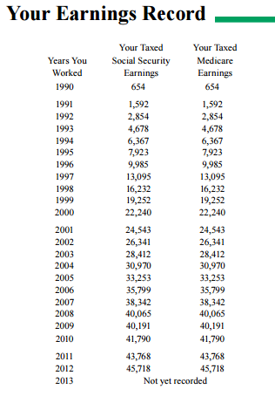
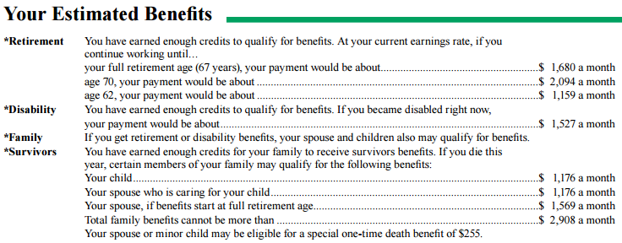
Individual Benefits
Best 35 Years
P.I.A.
Benefit at age 70
…$1,680 a month
…$2,094 a month
…$1,159 a month
Benefit at age 62
Online Statements are available at
www.ssa.gov
Example used as illustration only, actual results will vary.
Source: Social Security Administration (www.ssa.gov).
Notes:
Does this look familiar? Your earnings record used to be sent out every year, but were stopped because of budget cuts. The Earnings Records just resumed last year and are being sent out to workers ages 25, 30, 35, 40, 45, 50, 55, 60.
Social Security takes into consideration your best 35 working years. It is important to double check all numbers, there have been mistakes and it could affect your benefit if not corrected within 3 years. You can also access your Earnings Record online at www.ssa.gov and create an account.
Lets look at the numbers that have been magnified for us. This top number is your Primary Insurance Amount (PIA) and is your benefit if you were to collect at your Full Retirement Age (FRA). The middle number is if you were to wait until age 70 to collect, and the bottom number is if you were to collect at age 62.
Source: https://www.ssa.gov/myaccount/SSA-7005-OL.pdf

Slide 28
Social Security is Taxed based on your other income
Provisional Income
50% of Social Security Benefit
Ordinary Income
Dividends and Capital Gains
Non-Taxable Interest
https://www.irs.gov/pub/irs-pdf/p915.pdf
Accessed 8/23/16
Notes:
One of the best examples of the counterintuitive nature of how Minimum Distributions interact with capital gains to create ordinary income is through the taxation of Social Security. If all you had on your tax return was Social Security, you would pay no Federal Income tax at all, but when you have other types of income, it can cause your Social Security to become taxable.
It’s common among advisors to say 85 percent of benefits are going to be taxable. For high income people, 85 percent is often taxable and 15 percent is tax free. For middle and upper middle income folks, that is often not true, because it is based on a formula called the provisional income formula, which can have some strange impacts. Let’s walk through how that happens.
Your “provisional income” includes 1/2 of your Social Security benefits, plus all other taxable income, including dividends and realized capital gains, interest, plus non-taxable interest earnings, such as from municipal bonds.

Slide 29
On The Return
 | 40k IRA 20k Social Security | 20k IRA 40k Social Security
Taxable Social Security
Taxable Other income
Total Taxable Income
Minus Standard Deduction and Personal Exemptions
Net Taxable Income
Total Federal Income Tax
$11,100
$4,000
$40,000
$20,000
$51,100
$24,000
$26,600
$26,600
$24,500
$0
$2,559
$0
Table assumes Married Filing Jointly, 2018 tax brackets, Standard Deduction, plus additional deductions for over 65.
The characters in this example are fictional only. Your actual experience will vary. This hypothetical example is shown for illustrative purposes only and not guaranteed
Notes:
When we bring those numbers onto the tax return, we see it a bit more clearly. The 40k IRA/20k Social Security blend results in $2,571 of Federal Income Tax. The opposite Blend creates no federal income tax at all!
Total Federal Income Tax Calculation:
Total Taxable Income = $51,100
Standard Deductions = $26,600 ($24,000 + $2,600) - $24,000 for married filing jointly, plus an additional $2,600 ($1,300/each) for being over 65.
$51,100 - $26,600 = $24,500 Net Taxable Income
Based on where they fall on the MFJ Brackets….
Total Federal Income Tax will equal = $1,905 + 12% over $19,050
$24,500 - $19,050 = $5,450
$5,450 x .12 = $654
$654 + $1,905 = $2,559 Total Federal Income Tax

Slide 30

The Four Tax Buckets
TAX-DEFERRED
INCOME & ESTATE
TAX-FREE
TAXABLE
TAX-FREE
Provided for informational purposes only, not intended to provide tax or legal advice or serve as the basis for financial decisions. Your needs, objectives and experience will vary. Consult a qualified tax professional regarding your individual situation.
Notes:
A simple way to visualize the impact of taxes on your money is to divide your assets into four buckets.
The Taxable Bucket represents accounts for which you receive a 1099 form each year:
CDs
Mutual funds held in non-qualified accounts
Stock Dividends
Bond Interest
Reinvested dividends
The Tax-Deferred Bucket represents:
Traditional IRA
401(k), 403 (b), 457 (b)
Non-qualified annuities
Savings bonds
The Income Tax Free / Estate Taxable Bucket includes:
Roth IRA
Municipal bonds
Life insurance
The Income Tax Free / Estate Tax Free Bucket includes items found in Bucket 3 used to fund:
Irrevocable Life Insurance Trust
To help minimize taxes in the future, you should consider taking action today. In fact, the more money you have, the more advantageous it can be to move assets to the right on the tax bucket continuum. But because the goal is to reduce the total amount of taxes you pay in retirement, you may have to take on a greater tax bill today. You can do this by strategically repositioning assets from Buckets 1 and 2 to Buckets 3 and 4 to reduce retirement income taxes as much as possible.
(As always, you should consult with a qualified tax professional regarding your individual situation and what may make the most sense for you.)

Slide 31

The Tax Bucket Assets
TAX-DEFERRED
INCOME & ESTATE
TAX-FREE
TAXABLE
TAX-FREE
Income
  Salary
  Commission, Rent, etc.
Non-qualified $
  CDs
  Mutual funds held in non-qualified accounts
  Stock Dividends
  Bond Interest
  Reinvested dividends
  Capital Gain from sale of real estate investment
Qualified $
  IRA, 401k, 403b, TSP, Individual K, etc
Non-qualified $
  Annuities
  Savings bonds
  1031 Exchange
Qualified $
Roth 401k/IRA
Non-qualified $
Permanent Life Insurance (non-MEC)
Muni-bond
Irrevocable Life Insurance
Provided for informational purposes only, not intended to provide tax or legal advice or serve as the basis for financial decisions. Your needs, objectives and experience will vary. Consult a qualified tax professional regarding your individual situation.
Notes:
A simple way to visualize the impact of taxes on your money is to divide your assets into four buckets.
The Taxable Bucket represents accounts for which you receive a 1099 form each year:
CDs
Mutual funds held in non-qualified accounts
Stock Dividends
Bond Interest
Reinvested dividends
The Tax-Deferred Bucket represents:
Traditional IRA
401(k), 403 (b), 457 (b)
Non-qualified annuities
Savings bonds
The Income Tax Free / Estate Taxable Bucket includes:
Roth IRA
Municipal bonds
Life insurance
The Income Tax Free / Estate Tax Free Bucket includes items found in Bucket 3 used to fund:
Irrevocable Life Insurance Trust
To help minimize taxes in the future, you should consider taking action today. In fact, the more money you have, the more advantageous it can be to move assets to the right on the tax bucket continuum. But because the goal is to reduce the total amount of taxes you pay in retirement, you may have to take on a greater tax bill today. You can do this by strategically repositioning assets from Buckets 1 and 2 to Buckets 3 and 4 to reduce retirement income taxes as much as possible.
(As always, you should consult with a qualified tax professional regarding your individual situation and what may make the most sense for you.)

Slide 32
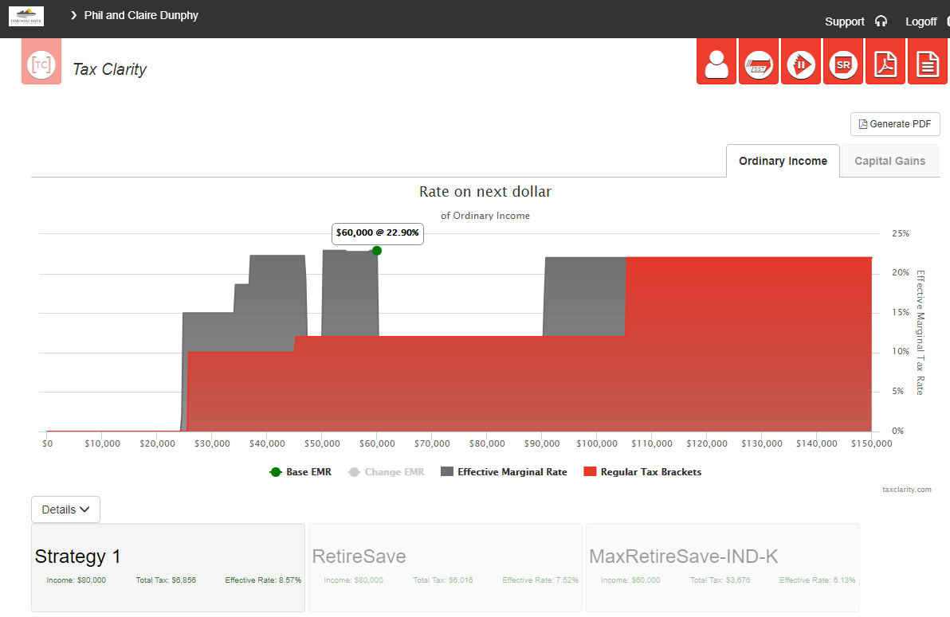
TAX CLARITY CASE EXAMPLE

Slide 33
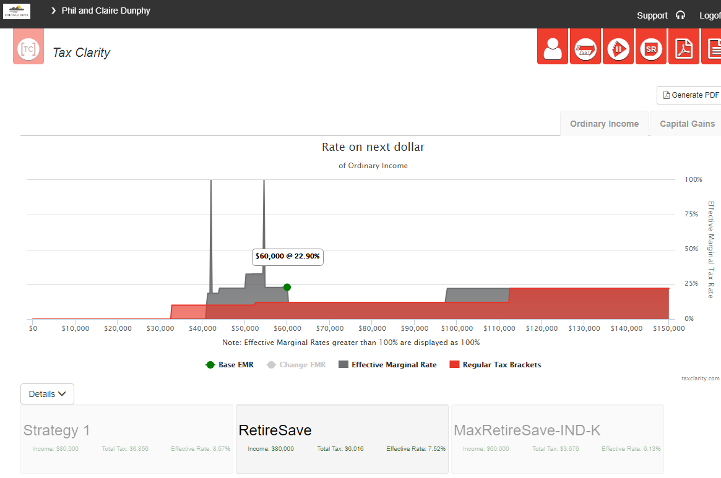
TAX CLARITY CASE EXAMPLE

Slide 34
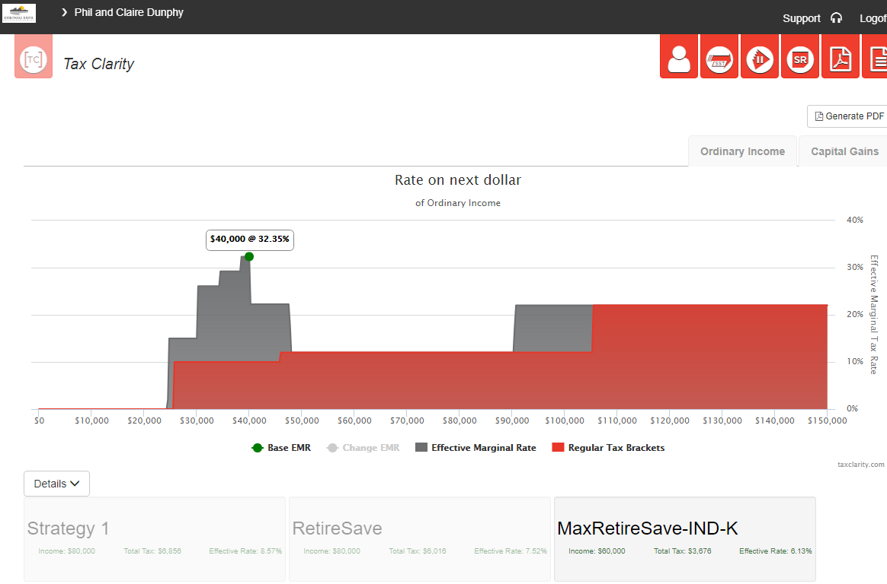
TAX CLARITY CASE EXAMPLE

Slide 35
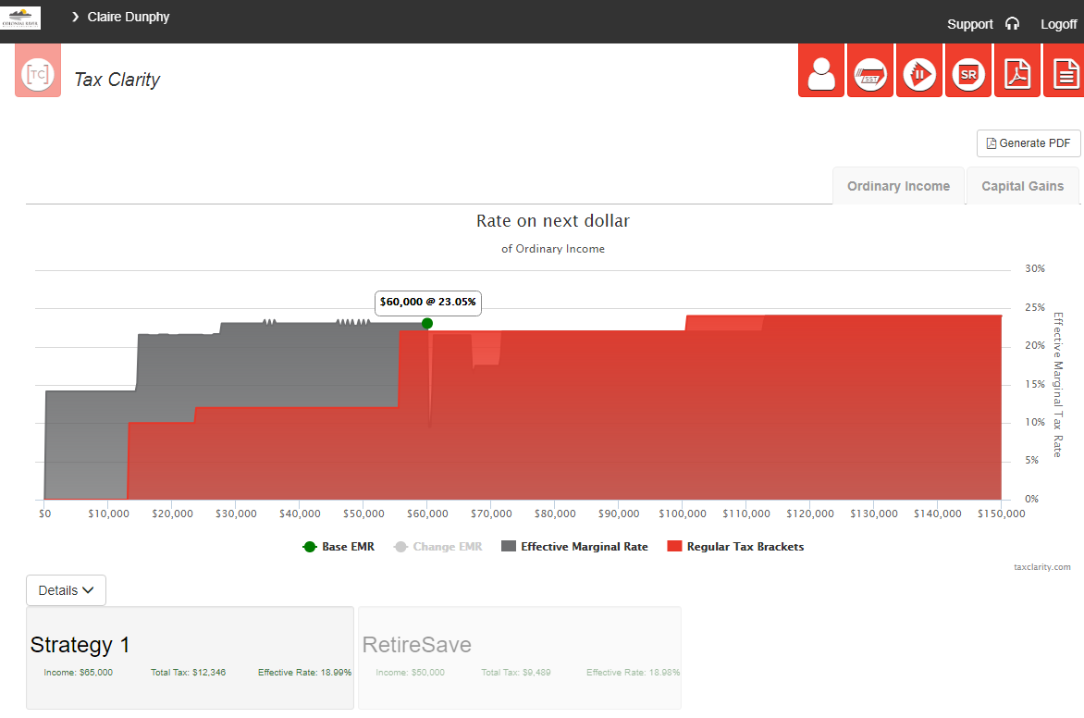
TAX CLARITY CASE EXAMPLE

Slide 36
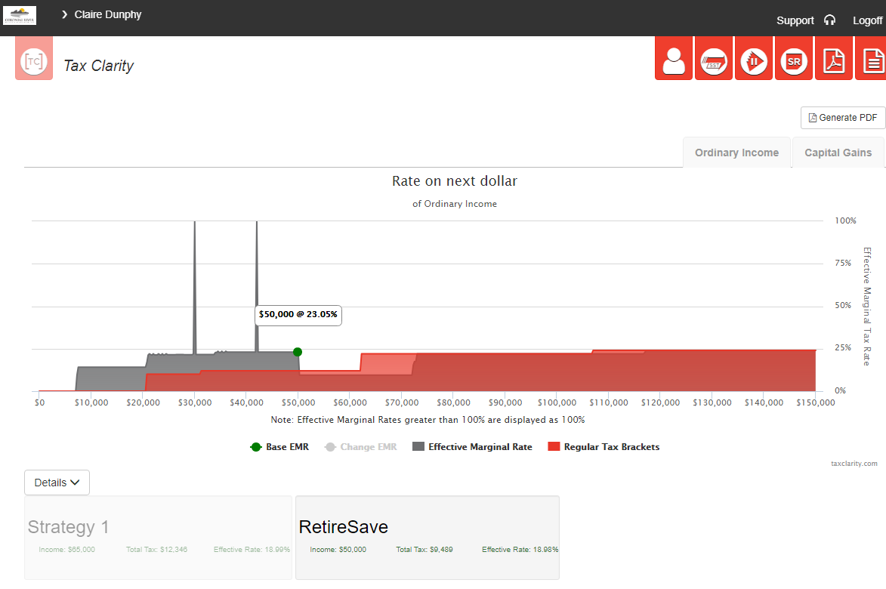
TAX CLARITY CASE EXAMPLE

Slide 37
REALTOR® Specific: Retirement Concerns & Strategies
CONCERN | STRATEGY
Single Pension Income (SS) & Retirement Income Uncertainty | Create own pension (e.g., annuity asset)
No Employer Plan | Create Individual Plan or Non-Qualified Annuity
Inconsistent Income | Save in Non-Qualified Tax Favored Assets
Market Risk | Save in Protected Retirement Assets
Taxes / Withdrawal Risk | Diversify Asset Tax Types Before Retirement
Longevity Risk | Save In Protected Retirement Income Assets
Business Risk | Protection Plan using Life Insurance
Health Risk (Long-Term Care, Disability, Terminal Illness) | Leverage Insurance Strategies
Notes:
Ultimately, REALTORS® need to “Business Plan” for your retirement income as early as possible and then work your business to fund your current lifestyle and your retirement “business” plan.
Where you have gaps, you can use your REALTOR® skills to fill – working part-time, establishing real estate residual income (rental income) but protecting it with another asset, setting real estate sales goals or options for after your main retirement (eg., retire at 67 and plan to sell x houses a year to generate enough income to cover lifestyle income need beyond social security so you don’t have to use your own retirement savings until age 71; incorporate spousal retirement income assets and create joint retirement income streams where possible for when a spouse passes)

Slide 38
4 Great Questions Your Retirement Plan should address…
What specific plans have you made to increase your income during retirement?
What would happen to your financial situation if the stock market dropped 40% like it did from 2000 and 2008?
If you died this year, how would your family’s lifestyle have to change after paying the taxes to the IRS?
What plans have you and your children made for dealing with rising healthcare costs and Alzheimers?

Slide 39
Any one may so arrange his affairs that his taxes shall be as low as possible; he is not bound to choose that pattern which will best pay the Treasury; there is not even a patriotic duty to increase one's taxes.
  Judge Learned Hand - Helvering v. Gregory, 69 F.2d 809, 810-11 (2d Cir. 1934).
Notes:
One of my favorite tax related quotes of all times – and the greatest name for a Judge ever!

Slide 40
Q&A
You may submit a question/comment in the chat or send an email to financialwellness@nar.realtor.

Slide 41
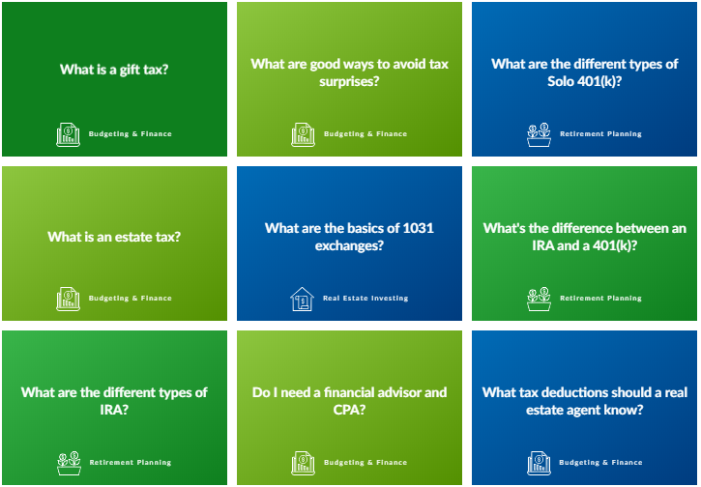
Resources for Realtors
Visit: financialwellness.realtor to discover:
    Good ways to avoid tax surprises.
    The basics of 1031 exchanges.

Slide 42
Additional Services
Your Personal Tax Map Varies greatly based on your personal circumstances.
Schedule a no-obligation appointment with my firm for a FREE Tax Map report.
At that appointment we can provide you with information on how insurance and/or investments may help create a tax-efficient retirement income strategy.
We are not tax professionals and encourage you to seek independent advice from a qualified tax professional regarding in-depth specifics of your personal situation.
Notes:
You didn’t come for the food
Subconsciously, you came because you’re looking for something
You came because you know on a deeper level that something is missing and you might need help making the most critical decisions in your life
You’re looking for someone to trust, to rely on
You’re looking for a guide and a true partner who cares more about you than anyone else
It’s possible that I am that person

Slide 43
Thank You For Your Time
FOR MORE INFORMATION OR A COMPLIMENTARY CONSULT & TAX MAP:
Nicole Cole, MBA
Wealth Advisor
540-318-0007
NICOLE.COLE@COLONIALRIVER.COM
Securities offered through LPL Financial, member FINRA/SIPC. Investment advice offered through Colonial River Investments, LLC. a registered investment advisor. Colonial River Investments & Colonial River Wealth Management are separate entities from LPL Financial.
Notes:
Welcome…

