Slide 1


REALTORS® and the
Tax Cuts & Jobs Act
Recording Available: March 25th

Slide 2

Webinar site:
Nar.realtor/cffw/webinar

Slide 3
CENTER FOR REALTOR® FINANCIAL WELLNESS WEBINAR AND SEMINAR DISCLAIMER
For Education and Information Purposes Only
Please note that the information and materials provided in Center for REALTOR® Financial Wellness webinars and seminars are not intended or provided to be used as a substitute for the advice of your tax, investment, legal and/or financial advisors or to be the basis of specific financial planning activities. The opinions and views expressed or shared in this presentation represent only those of the developers, speakers, presenters or instructors and have not been endorsed or approved by the National Association of REALTORS®. While substantial care is taken to try to provide accurate and current data and information, the National Association of REALTORS® does not warrant the accuracy, completeness or timeliness of any data and information provided in the webinars and seminars. Further, any principles and conclusions presented are subject to court decisions and to local, state and federal laws and regulations and any revisions of such laws and regulations. If you seek or need tax, investment, legal or financial advice, you must obtain such advice and services from the appropriate professionals.
Any links to third-party websites, tools, materials or resources are provided as a convenience and for your information. Any products, services or opinions of third-party entities or associated individuals are neither endorsed nor have they been vetted by the National Association of REALTORS®, and their inclusion in the webinar or seminar and any related materials do not constitute a recommendation by the National Association of REALTORS® and should not be inferred as suggesting a preference over other products, services or information available in the market. The National Association of REALTORS® bears no responsibility for the accuracy, completeness, legality or the content provided in the webinar or seminar and any related materials.

Slide 4


Presenter: Ryan L. Losi
CPA, Executive Vice President

Slide 6

Ryan L. Losi, CPA
PIASCIK Shareholder & Executive Vice President
Specialize in Real Estate and International Taxation
24 years of Real Estate & International Tax (including Tax Controversy Experience)
Built PIASCIK’s Real Estate & International Tax Practices to one of the largest in the Mid-Atlantic Region
Former PwC International Tax Manager, with National ITS consulting team, managed 15 professionals based out of NYC
Member, AICPA and Virginia Society of CPAs (Chairman of Tax Committee 2016-2018)
Syndicated Tax CPE Instructor across 48 State CPA Societies and Institutes thru ACPEN
Served as board member on a number of trade associations, business councils and privately held companies

Slide 7
REALTORS AND THE Tax cuts and jobs act
How REALTORS® can run a tax efficient sales commission business utilizing the new Tax Cuts & Jobs Act

Slide 8
TODAY’S WORKING WORLD
In today’s working world most people fall into one of the following categories:
Employee;
Independent contractor/self-employed (e.g., sole proprietorship)
Business owner (e.g., have employees)
Investor; or
a combination these.
Notes:
As a real estate salesperson you are a sole proprietor for tax purposes.

Slide 9
DEFINITION OF A BUSINESS
The occupation, work, or trade in which an entity is engaged in for purposes of generating a profit.

Slide 10
CHARACTERISTICS OF A BUSINESS
Profit motive
Name
Business location
Separate bank account in which it transacts
Books and records and other essential documents (i.e., financials statements and supporting documentation)
A tax return
A business license (if applicable)
Can set up a pension for its workers (More on this)
Many more items.

Slide 11
CHARACTERISTICS OF A BUSINESS
Let’s take a closer look at this and put some live numbers to this example. Remember, in this example, the realtor is transacting their business through a sole proprietorship.

Slide 12
SIMPLE SOLE PROPRIETORSHIP
Commission Income
Real Estate Broker
Seller
Notes:
Seller/Buyer pays the broker
Broker pays the real estate salesperson licensed within the brokerage
The commission income is like sales revenue for the realtor who operates their sole proprietorship business

Slide 13
SIMPLE SOLE PROPRIETORSHIP
Commission Income
Real Estate Broker
Seller
Commission Income
Realtor
Notes:
Seller/Buyer pays the broker
Broker pays the real estate salesperson licensed within the brokerage
The commission income is like sales revenue for the realtor who operates their sole proprietorship business

Slide 14
SIMPLE SOLE PROPRIETORSHIP
Commission Income
Real Estate Broker
Seller
Commission Income
Operating Business as a Sole Proprietor
Realtor
Deposit Commission Income in Bank
Bank
Account
Notes:
Seller/Buyer pays the broker
Broker pays the real estate salesperson licensed within the brokerage
The commission income is like sales revenue for the realtor who operates their sole proprietorship business

Slide 15
SIMPLE SOLE PROPRIETORSHIP
Notes:
$189K assumes sold 30 homes average price of $300K, 3% listing commission and 70/30 broker split
Example excludes Other income/losses as well as Standard Deduction and/or Itemized deductions to simply and isolate the impact of the planning for our presentation

Slide 16
SIMPLE SOLE PROPRIETORSHIP
Platform materials –
financialwellness.realtor
Notes:
$189K assumes sold 30 homes average price of $300K, 3% listing commission and 70/30 broker split
Example excludes Other income/losses as well as Standard Deduction and/or Itemized deductions to simply and isolate the impact of the planning for our presentation

Slide 17
SIMPLE SOLE PROPRIETORSHIP
Notes:
$189K assumes sold 30 homes average price of $300K, 3% listing commission and 70/30 broker split
Example excludes Other income/losses as well as Standard Deduction and/or Itemized deductions to simply and isolate the impact of the planning for our presentation

Slide 18
SIMPLE SOLE PROPRIETORSHIP
Notes:
$189K assumes sold 30 homes average price of $300K, 3% listing commission and 70/30 broker split
Example excludes Other income/losses as well as Standard Deduction and/or Itemized deductions to simply and isolate the impact of the planning for our presentation

Slide 19
SIMPLE SOLE PROPRIETORSHIP
Notes:
$189K assumes sold 30 homes average price of $300K, 3% listing commission and 70/30 broker split
Example excludes Other income/losses as well as Standard Deduction and/or Itemized deductions to simply and isolate the impact of the planning for our presentation

Slide 20
SIMPLE SOLE PROPRIETORSHIP
Notes:
$189K assumes sold 30 homes average price of $300K, 3% listing commission and 70/30 broker split
Example excludes Other income/losses as well as Standard Deduction and/or Itemized deductions to simply and isolate the impact of the planning for our presentation

Slide 21
The Tax Cuts and Jobs Act (“TCJA”)
Signed into law on December 22, 2017
Affected all U.S. taxpayers, both individuals and businesses, starting in 2018
Affected some taxpayers in 2017
Substantial changes – largest overhaul to the U.S. tax system in over 30 years
Overall, not a “simplification”
Notes:
Was the most business friendly (small and large) tax bill passed in a generation
A gift to realtors and real estate investors

Slide 22
TCJA – Who Wins, Who Loses?
Notes:
The final results are in from IRS from first year of TCJA
95% of taxpayers had either a reduction or no change their income taxes
80% had a reduction
Only 5% had an increase in their tax (Mostly high W-2 employees living in high taxed states)
Tax cuts weighted heavily toward the top 5% ($200K+ income) since they pay over 60% of total countries income taxes

Slide 23
TCJA – Who Wins, Who Loses?
Notes:
The final results are in from IRS from first year of TCJA
95% of taxpayers had either a reduction or no change their income taxes
80% had a reduction
Only 5% had an increase in their tax (Mostly high W-2 employees living in high taxed states)
Tax cuts weighted heavily toward the top 5% ($200K+ income) since they pay over 60% of total countries income taxes

Slide 24
Qualified Business Income
QBI is net income from a qualified domestic trade or business
Qualified trades or businesses include sole proprietorships, partnerships (GPs, LPs, LLLPs), S Corporations, LLCs, and certain trusts

Slide 25
Qualified Business Income
QBI does not include:
  Capital gains/losses, dividends, interest, other income that is not business related
  Reasonable compensation paid by an S Corp to its shareholders
  Amount paid by partnership to a partner as a guaranteed payment

Slide 26
Qualified Business Income
Qualified trades and businesses do not include specified service businesses
  Trades or businesses involving performance of services in certain fields such as law, health, accounting, actuarial science, performing arts, consulting, athletics, financial services, brokerage services, including investing and investment management, trading, or dealing in securities, partnership interests, or commodities or
  Any trade or business where principal asset is the skill or reputation of one or more of its employees or owners
Exempt from the specified service business definition – engineering & architecture
Notes:
Shortly after the law passed but before Treasury issued regulations tax practitioners were concerned Treasury would take a wide view of “brokerage” and include insurance salespersons, realtors, freight forwarders, travel agents and anyone who brokers buyers and sellers of a marketplace.
Fortunately, Treasury took a very narrow view and included only financial brokers like stockbrokers. Realtors dodged a bullet!!

Slide 27
Qualified Business Income
Brokerage Services
Shortly after the TCJA passed but before Treasury issued regulations tax practitioners were concerned Treasury would take a wide view of “brokerage” and include any “brokered” activity like insurance, real estate, shipping, freight, travel and anyone who brokers buyers and sellers of a marketplace. Fortunately, Treasury took a very narrow view and included only financial securities brokers like stockbrokers. Realtors dodged a big bullet!!
Notes:
Shortly after the law passed but before Treasury issued regulations tax practitioners were concerned Treasury would take a wide view of “brokerage” and include insurance salespersons, realtors, freight forwarders, travel agents and anyone who brokers buyers and sellers of a marketplace.
Fortunately, Treasury took a very narrow view and included only financial brokers like stockbrokers. Realtors dodged a bullet!!

Slide 28
Qualified Business Income –
Income Thresholds
2020 - $163,300 (single) or $326,600 (joint)
If taxable income is above –
  Deduction is limited to the lesser of: 20% of QBI or 20% of taxable income (less net capital gains)
  Further limited to: The greater of 50% of qualified W-2 wages OR 25% of qualified W-2 wages plus 2.5% of unadjusted basis of qualified property
Notes:
If your taxable income is over $400K and you have significant QBI from your business, then converting/switching to a S corporation likely makes sense. We’ll discuss this further later in the presentation.

Slide 29
Qualified Business Income –
Income Thresholds
2020 - $163,300 (single) or $326,600 (joint)
If taxable income is below –
  Deduction is limited to the lesser of: 20% of QBI or 20% of taxable income (less net capital gains)
  No wage limitations
  Specified service businesses can take deduction
  Limitations phased in as income exceeds the thresholds
Notes:
Basically no limitations even for SSTB’s if taxable income is under the limits

Slide 30
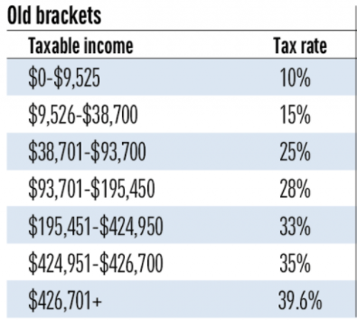
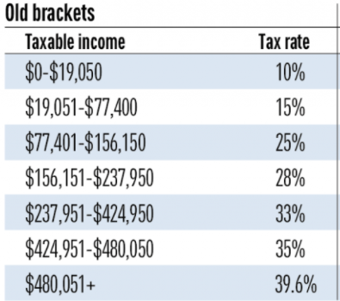
Individual Provisions
Pre TCJA 2017 Tax Brackets
Single
MFJ
Notes:
Notice the income tax brackets and income tax rates
Notice the highest tax rate
Notice when the marriage penalty kicks in

Slide 31
Individual Provisions
Pre TCJA 2017 Tax Brackets
Single
MFJ
Marriage Penalty
Notes:
Notice the income tax brackets and income tax rates
Notice the highest tax rate
Notice when the marriage penalty kicks in

Slide 32
Individual Provisions
2019 Tax Brackets
Tax rate | Single | Married, filing jointly | Married, filing separately | Head of household
10% | $0 to $9,700 | $0 to $19,400 | $0 to $9,700 | $0 to $13,850
12% | $9,701 to $39,475 | $19,401 to $78,950 | $9,701 to $39,475 | $13,851 to $52,850
22% | $39,476 to $84,200 | $78,951 to $168,400 | $39,476 to $84,200 | $52,851 to $84,200
24% | $84,201 to $160,725 | $168,401 to $321,450 | $84,201 to $160,725 | $84,201 to $160,700
32% | $160,726 to $204,100 | $321,451 to $408,200 | $160,726 to $204,100 | $160,701 to $204,100
35% | $204,101 to $510,300 | $408,201 to $612,350 | $204,101 to $306,175 | $204,101 to $510,300
37% | $510,301 or more | $612,351 or more | $306,176 or more | $510,301 or more
Notes:
Notice the expanded income tax brackets and lowered income tax rates
Notice the highest tax rate was reduced
Notice when the marriage penalty kicks in. It’s at a much higher threshold of income

Slide 33
Individual Provisions
2019 Tax Brackets
Tax rate | Single | Married, filing jointly | Married, filing separately | Head of household
10% | $0 to $9,700 | $0 to $19,400 | $0 to $9,700 | $0 to $13,850
12% | $9,701 to $39,475 | $19,401 to $78,950 | $9,701 to $39,475 | $13,851 to $52,850
22% | $39,476 to $84,200 | $78,951 to $168,400 | $39,476 to $84,200 | $52,851 to $84,200
24% | $84,201 to $160,725 | $168,401 to $321,450 | $84,201 to $160,725 | $84,201 to $160,700
32% | $160,726 to $204,100 | $321,451 to $408,200 | $160,726 to $204,100 | $160,701 to $204,100
35% | $204,101 to $510,300 | $408,201 to $612,350 | $204,101 to $306,175 | $204,101 to $510,300
37% | $510,301 or more | $612,351 or more | $306,176 or more | $510,301 or more
Marriage Penalty
Notes:
Notice the expanded income tax brackets and lowered income tax rates
Notice the highest tax rate was reduced
Notice when the marriage penalty kicks in. It’s at a much higher threshold of income

Slide 34
Individual Provisions
2020 Tax Brackets
Tax rate | Single | Married, filing jointly | Married, filing separately | Head of household
10% | $0 to $9,875 | $0 to $19,750 | $0 to $9,875 | $0 to $14,100
12% | $9,876 to $40,125 | $19,751 to $80,250 | $9,876 to $40,125 | $14,101 to $53,700
22% | $40,126 to $85,525 | $80,251 to $171,050 | $40,126 to $85,525 | $53,701 to $85,500
24% | $85,526 to $163,300 | $171,051 to $326,600 | $85,526 to $163,300 | $85,501 to $163,300
32% | $163,301 to $207,350 | $326,601 to $414,700 | $163,301 to $207,350 | $163,301 to $207,350
35% | $207,351 to $518,400 | $414,701 to $622,050 | $207,351 to $311,025 | $207,351 to $518,400
37% | $518,401 or more | $622,051 or more | $311,026 or more | $518,401 or more
Notes:
Notice the expanded income tax brackets and lowered income tax rates
Notice the highest tax rate was reduced
Notice when the marriage penalty kicks in. It’s at a much higher threshold of income

Slide 35
Individual Provisions
2020 Tax Brackets
Tax rate | Single | Married, filing jointly | Married, filing separately | Head of household
10% | $0 to $9,875 | $0 to $19,750 | $0 to $9,875 | $0 to $14,100
12% | $9,876 to $40,125 | $19,751 to $80,250 | $9,876 to $40,125 | $14,101 to $53,700
22% | $40,126 to $85,525 | $80,251 to $171,050 | $40,126 to $85,525 | $53,701 to $85,500
24% | $85,526 to $163,300 | $171,051 to $326,600 | $85,526 to $163,300 | $85,501 to $163,300
32% | $163,301 to $207,350 | $326,601 to $414,700 | $163,301 to $207,350 | $163,301 to $207,350
35% | $207,351 to $518,400 | $414,701 to $622,050 | $207,351 to $311,025 | $207,351 to $518,400
37% | $518,401 or more | $622,051 or more | $311,026 or more | $518,401 or more
Marriage Penalty
Notes:
Notice the expanded income tax brackets and lowered income tax rates
Notice the highest tax rate was reduced
Notice when the marriage penalty kicks in. It’s at a much higher threshold of income

Slide 36
Individual Provisions
2020 Standard deduction increased
  $12,400 single filers (only $6,350 in 2017)
  $24,800 MFJ (only $12,700 in 2017)
No personal or dependent exemption deduction (2018-2025)
Notes:
Doubled the standard deduction. Makes it simpler to file a 1040 and most no longer need to itemize.

Slide 37
Individual Provisions
Miscellaneous itemized deductions are suspended (nondeductible thru 2018 - 2025)
  Tax prep fees, legal fees, investment management fees, NFL agent fees, union dues, unreimbursed employee expenses, etc.
Moving Expenses
  No longer deductible by individuals
  Reimbursements from employer are included in gross income (previously excluded from individual’s income)
Notes:
The repeal of miscellaneous itemized deduction hurt a really small group of taxpayers
Moving expenses no longer deductible/excludable. Simplier for relocation now.

Slide 38
Individual Provisions
State and local tax deduction
  Capped at $10,000 (This greatly impacted residents in CA, NY, NJ, CT, and DC)
Alternative Minimum Tax
  TCJA increased exemption amount for individuals in calculating AMT ($72,900 single filers or $113,400 MFJ filers)
  Exemption is now indexed for inflation
  Phaseout increased to $518,400 for single filers and $1,036,800 MFJ filers)
Estate Tax lifetime exclusion increased to $11.58M ($23.16M for married couple)
Gift Tax annual exclusion $15,000 (no change)
  However, with the continuation of the Unification of the Gift and Estate Tax Credit, one can now gift up to $11.58M ($23.16M for married couple) tax free during their lifetime.
Notes:
SALT limited thru 2025.
No one is in AMT hardly
Estate planning less tax motivated now. Save on legal fees

Slide 39
SIMPLE SOLE PROPRIETORSHIP
Commission Income
Real Estate Broker
Seller
Commission Income
Operating Business as a Sole Proprietor
Realtor
Deposit Commission Income in Bank
Bank
Account
Notes:
Remember this? Let’s apply some of things we have learned.

Slide 40
SIMPLE SOLE PROPRIETORSHIP
Notes:
$189K assumes sold 30 homes average price of $300K, 3% listing commission and 70/30 broker split
Example excludes Other income/losses as well as Standard Deduction and/or Itemized deductions to simply and isolate the impact of the planning for our presentation

Slide 41
SIMPLE SOLE PROPRIETORSHIP
Notes:
We want to set up our own SEP IRA and max out the contribution
We want to ensure that we maximize the new QBI deduction
Both of these create HUGE tax deductions and dramatically reduce taxable income

Slide 42
SIMPLE SOLE PROPRIETORSHIP
Notes:
We want to set up our own SEP IRA and max out the contribution
We want to ensure that we maximize the new QBI deduction
Both of these create HUGE tax deductions and dramatically reduce taxable income

Slide 43
SIMPLE SOLE PROPRIETORSHIP
Notes:
We want to set up our own SEP IRA and max out the contribution
We want to ensure that we maximize the new QBI deduction
Both of these create HUGE tax deductions and dramatically reduce taxable income

Slide 44
SIMPLE SOLE PROPRIETORSHIP
Notes:
Before any planning, taxable income was $127K and we paid $57K in taxes and we had cash flow of only $79K
After planning taxable income was reduced to $81K and we paid $43K in taxes and we had cash flow of $93K PLUS $25K in Retirement/SEP IRA

Slide 45
SIMPLE SOLE PROPRIETORSHIP
Notes:
Before any planning, taxable income was $127K and we paid $57K in taxes and we had cash flow of only $79K
After planning taxable income was reduced to $81K and we paid $43K in taxes and we had cash flow of $93K PLUS $25K in Retirement/SEP IRA

Slide 46
SIMPLE SOLE PROPRIETORSHIP
Notes:
Before any planning, taxable income was $127K and we paid $57K in taxes and we had cash flow of only $79K
After planning taxable income was reduced to $81K and we paid $43K in taxes and we had cash flow of $93K PLUS $25K in Retirement/SEP IRA

Slide 47
SIMPLE SOLE PROPRIETORSHIP
Notes:
Before any planning, taxable income was $127K and we paid $57K in taxes and we had cash flow of only $79K
After planning taxable income was reduced to $81K and we paid $43K in taxes and we had cash flow of $93K PLUS $25K in Retirement/SEP IRA

Slide 48
SIMPLE SOLE PROPRIETORSHIP
Notes:
Before any planning, taxable income was $127K and we paid $57K in taxes and we had cash flow of only $79K
After planning taxable income was reduced to $81K and we paid $43K in taxes and we had cash flow of $93K PLUS $25K in Retirement/SEP IRA

Slide 49
RECAP
SEP IRAs are powerful tools for sole proprietorships
SEP IRA assets are fully protected from creditors
Simple tax and financial planning techniques can save a lot
There are also other planning technics to employ should income increase
  Solo 401(k)
  S Corporation
  Real estate professional that Materially Participates in rental real estate
  Tax credit purchases
Notes:
If taxable income increases, it might make since to switch to a Solo 401(k) since large contributions can be made.
If taxable income begins to reach $400K and it is expected to consistently be equal or higher in the foreseeable future; then a sole proprietorship is not the best entity and an S corporation is in order to max out both the QBI deduction and pension contributions
If you are a realtor, you may qualify for a very special tax exception for your rental real estate property. The Material Participant Real Estate Professional. Special test to qualify Allows you to use your losses from rentals against all of your other income.

Slide 50
TCJA Small Business – Takeaways
Claim the QBI deduction
100% expensing for business fixed assets thru 2021
Lower Marginal Tax Brackets and Tax Rates through 2025 (maybe)
Fewer individuals subject to AMT (and no corporations subject to AMT)
Platform materials financialwellness.realtor
Notes:
Keep in mind that there are 100% expensing elections available for you for your business assets (office furniture, computers, smart phones, equipment, etc.) thru 2021.
We are in the lowest rate tax environment in a generation. Keep that in mind.

Slide 51
2020 COVID-19 Tax Relief
Tax Due Date moved from April 15th to July 15th
Tax Payments for 2019 and 1st qtr 2020 moved from April 15th to July 15th without penalty or interest
States are starting to follow suit
Economic Impact Payment to taxpayers starting in April and then in May ($1,200 and $2,400)
Mortgage relief up to 12 months
Families First Coronavirus Response Act (March 18th signed by President Trump) to provide expansive payroll tax relief for employers, tax credits for employers and self employed, and paid leave benefits to employees and many more areas of relief.
SBA Business Interruption Loans

Slide 52
If you have further questions, you can reach me at:
PIASCIK
(866) 527-1815
4470 Cox Road
Suite 250
Glen Allen, VA 23060 www.piascik.com
Notes:
ANY QUESTIONS?

Slide 54
Questions?
Ask in the chat
Or send an email to:
Financialwellness@nar.realtor

Slide 55
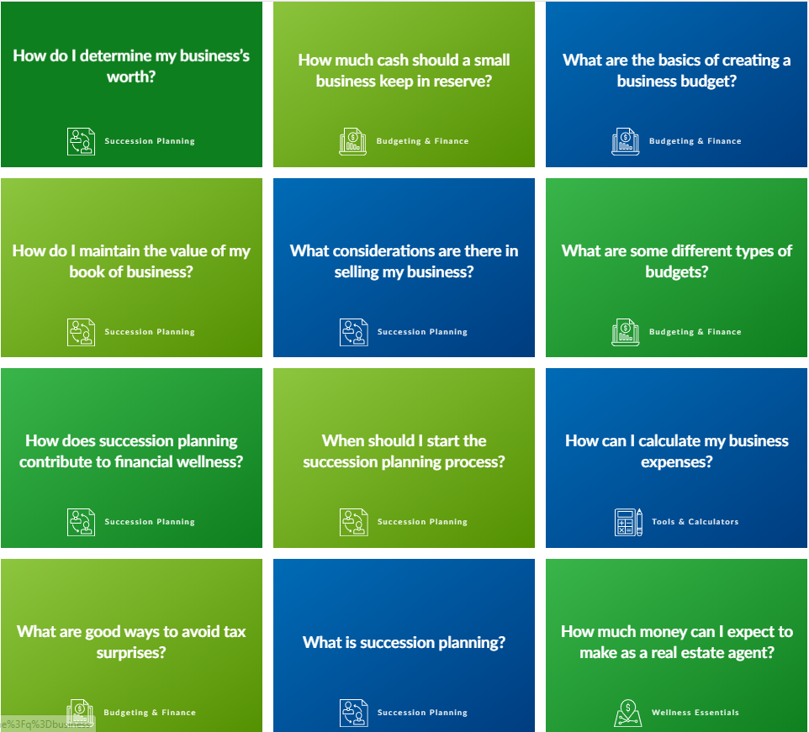
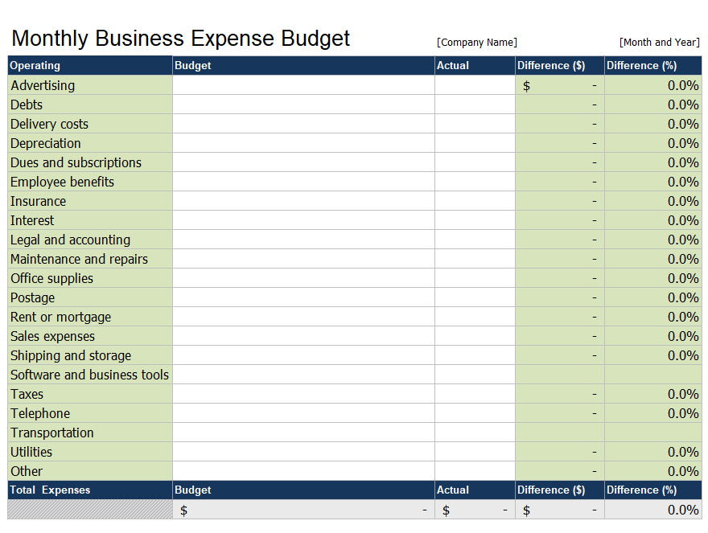
Additional Resources visit: FinancialWellness.realtor

Slide 56
Thank You For Your Time
Webinar Recording Available:
Wednesday, March 25
Visit – nar.realtor/cffw/webinars
FOR MORE INFORMATION or QUESTIONS EMAIL:
financialwellness@nar.realtor
Notes:
Welcome…

Slide 57
1. Visit FinancialWellness.realtor
2. Leave us your feedback.
3. Register for the next webinar.
Thanks!

