Slide 1
New Jersey Realtors® Meeting Center

Slide 2
Meetings
Meetings were scheduled via email, with documents attached
RSVP’s were handled by staff liaison
Meetings needed to be held in person
Contentious votes were often difficult to count for our Board of Directors 150 members
Issues of quorum, who could vote, and procedure, often staff did not know rules
Multiple inconsistencies in scheduling and holding committee meetings in accordance with association bylaws

Slide 3
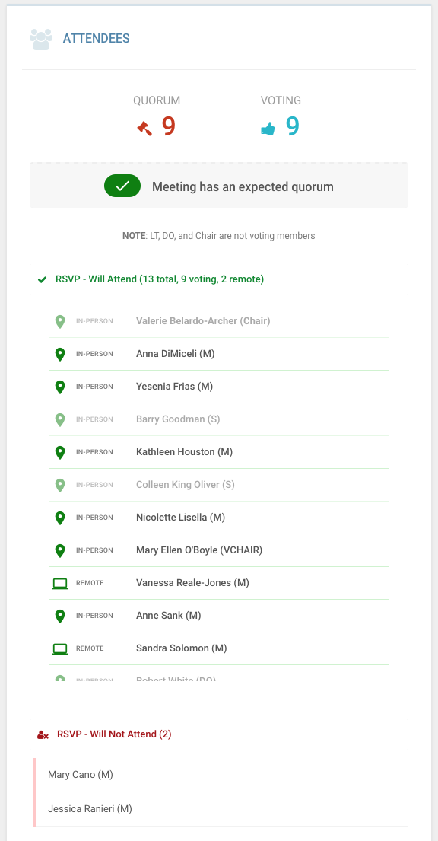
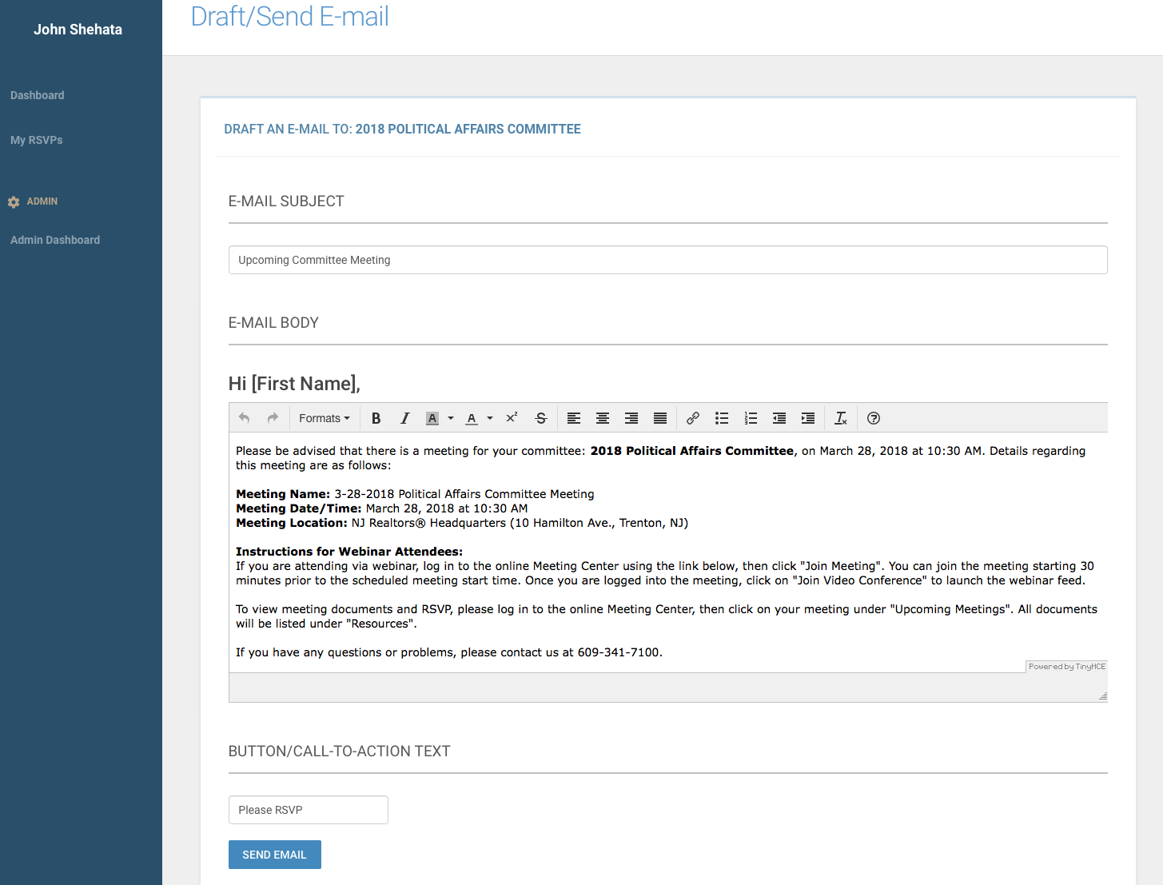
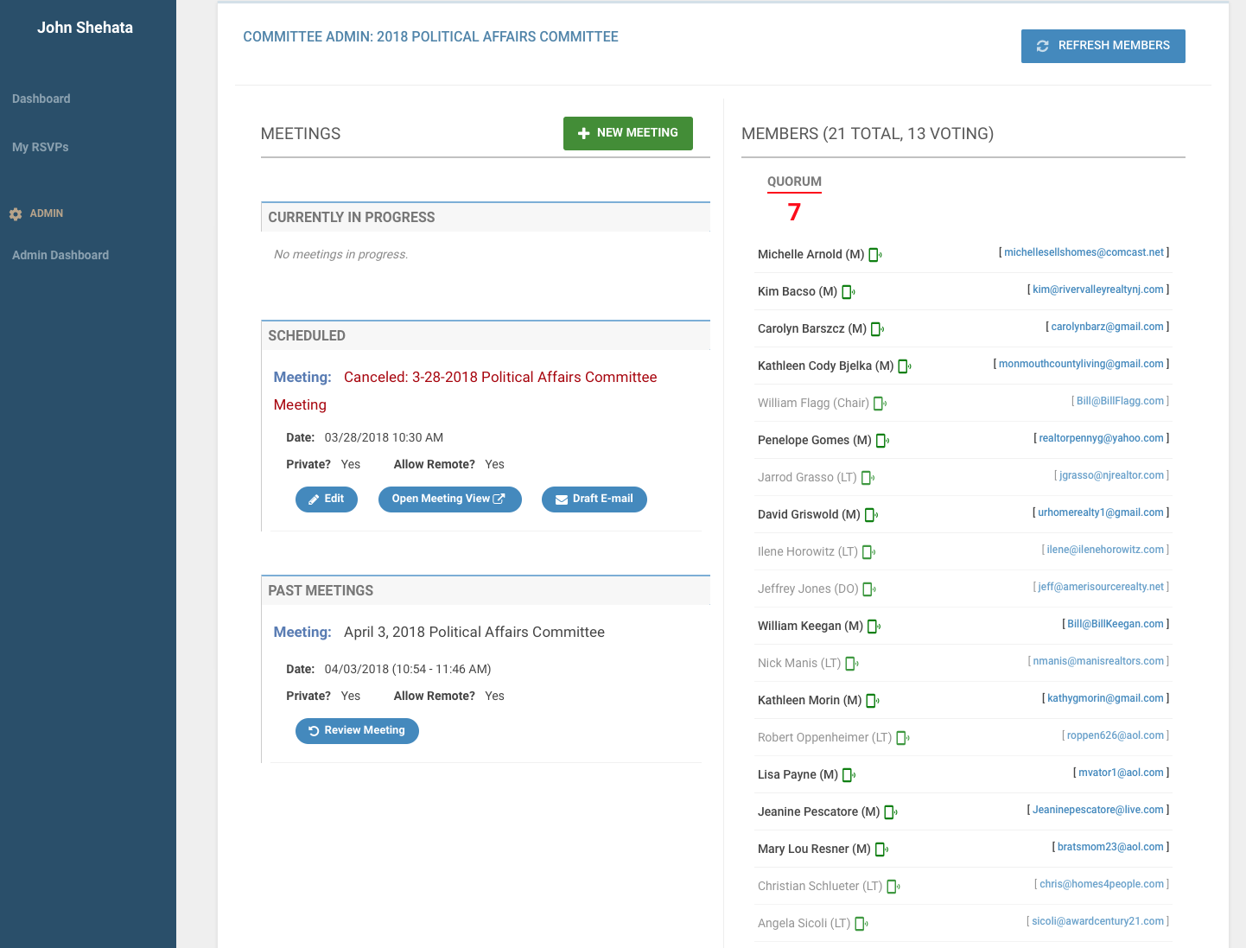
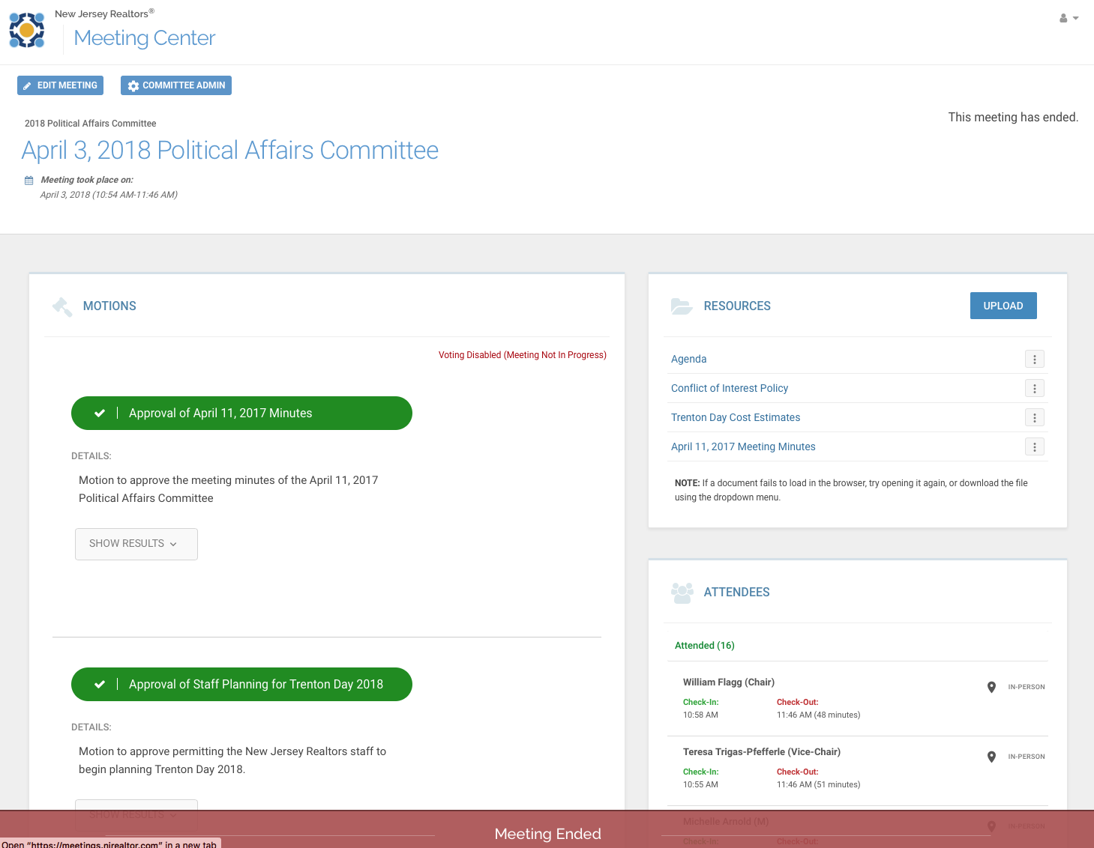
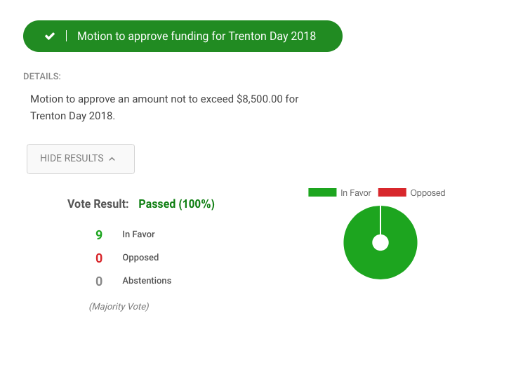
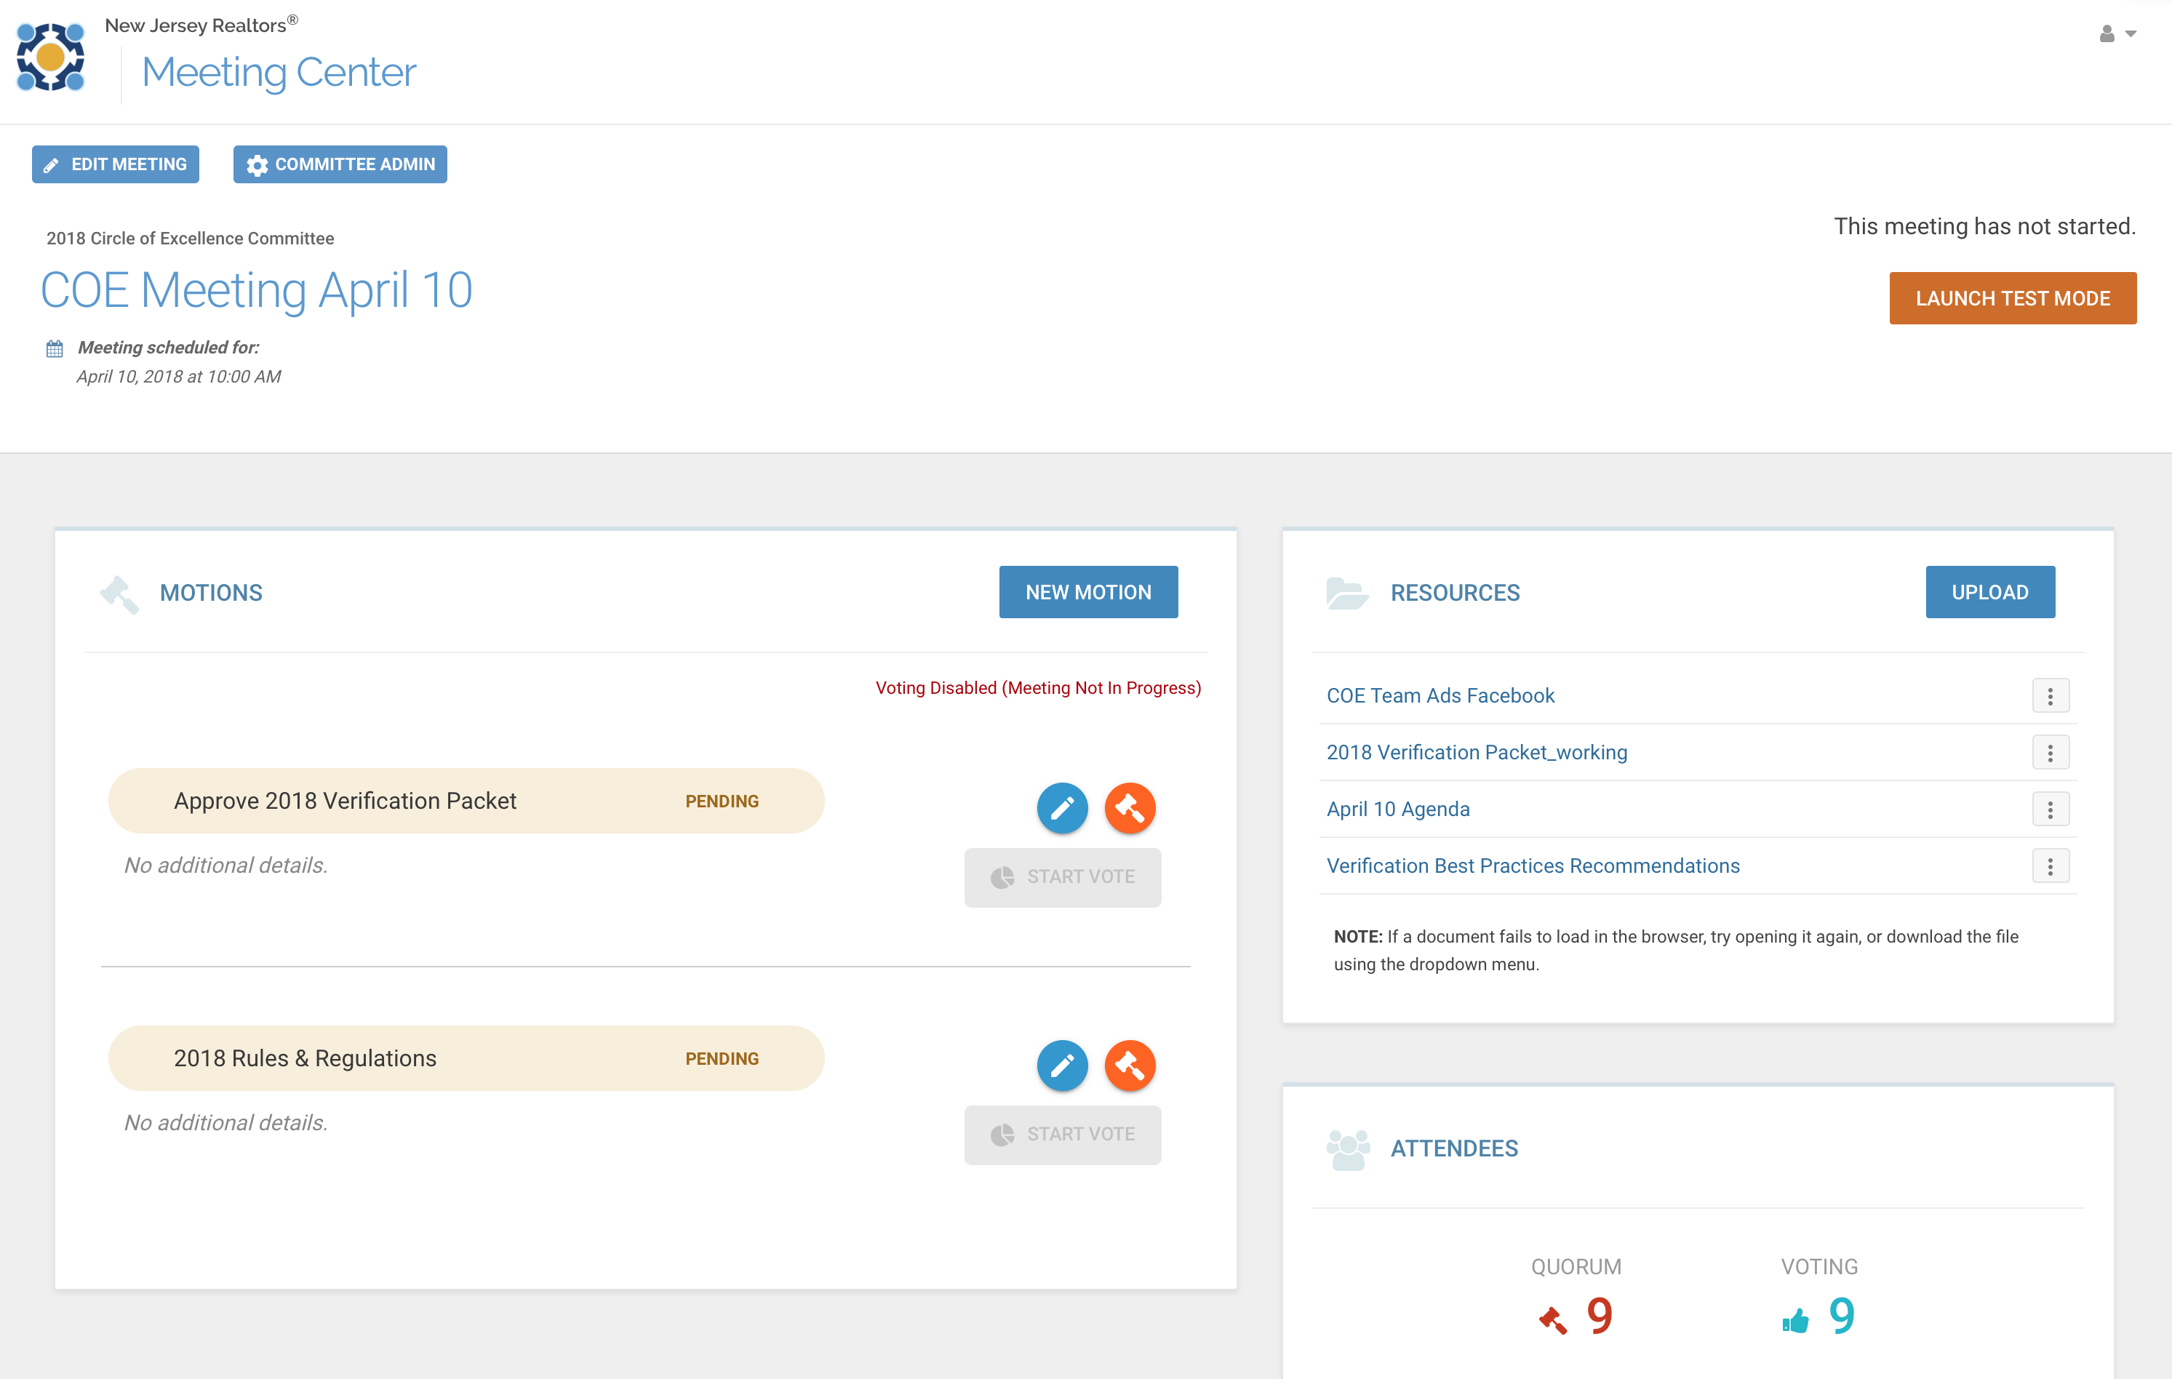
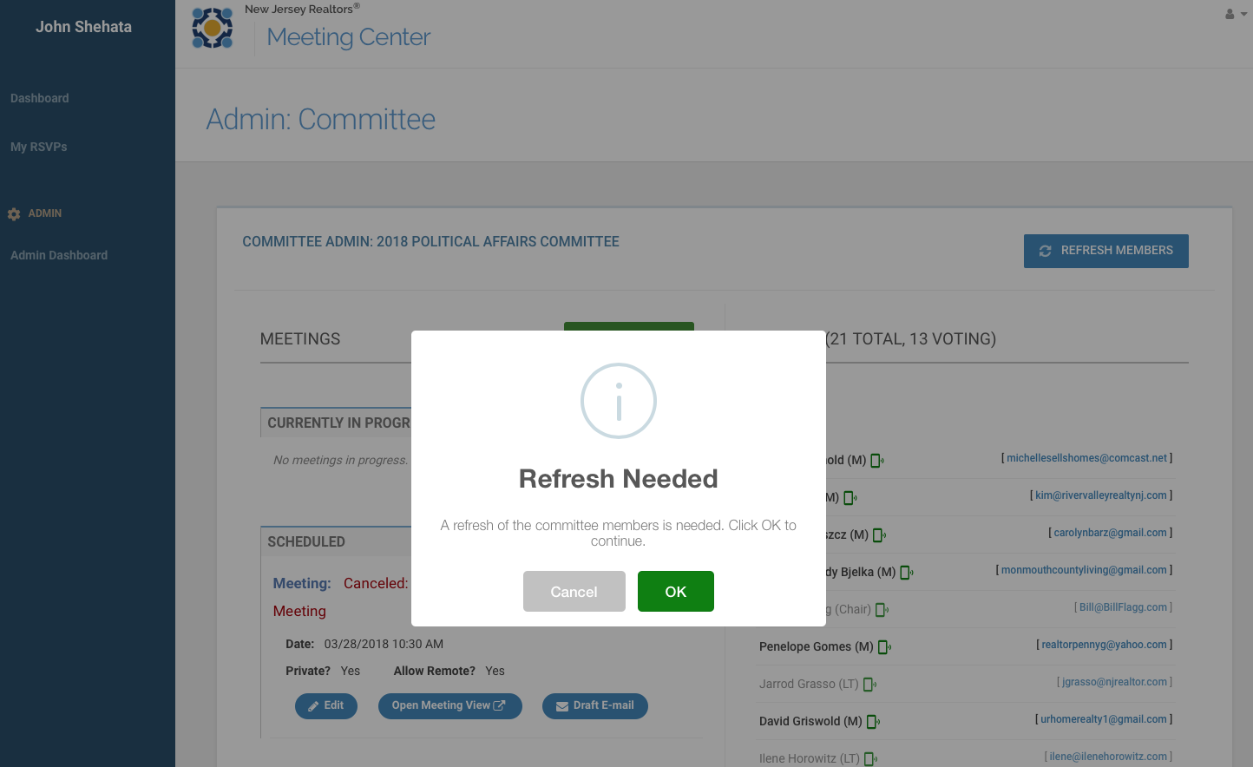
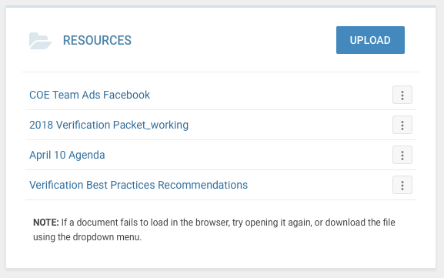
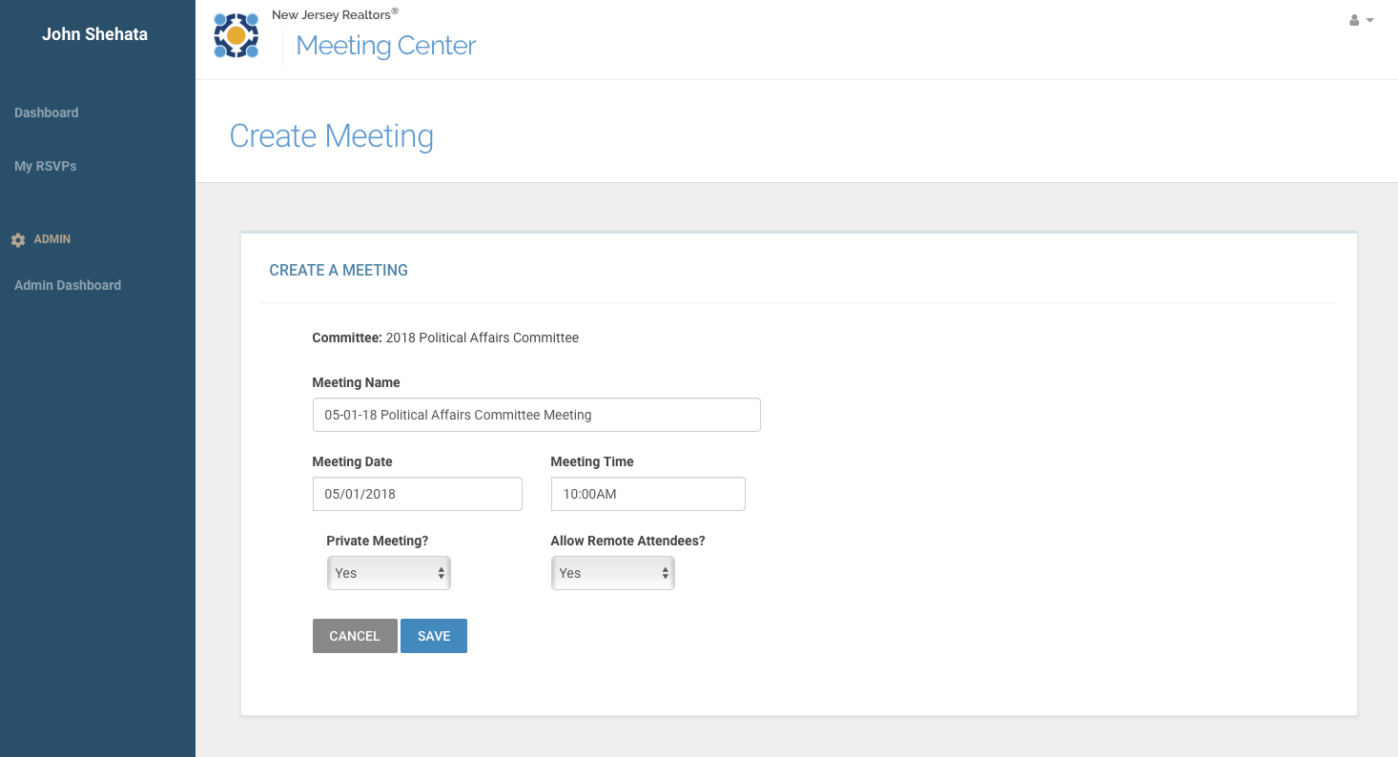
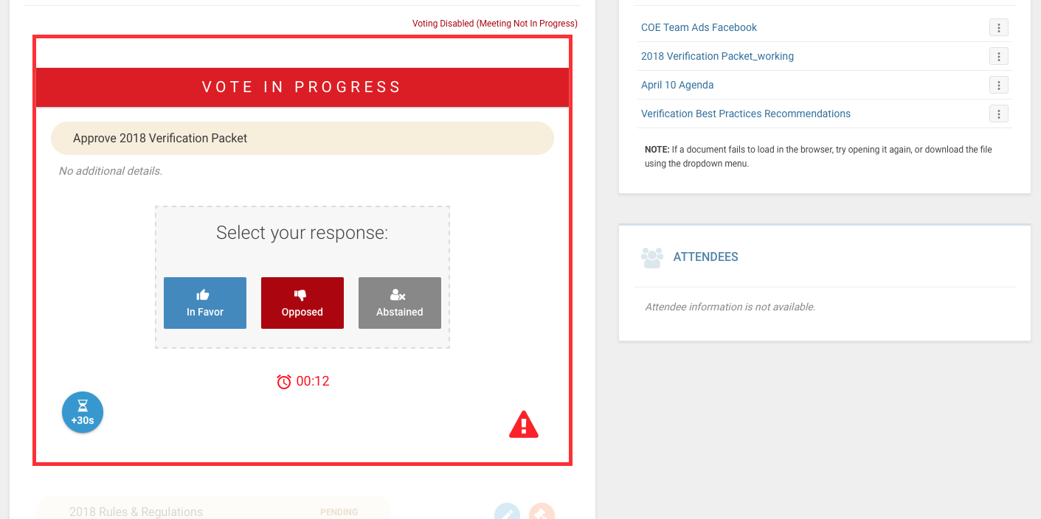
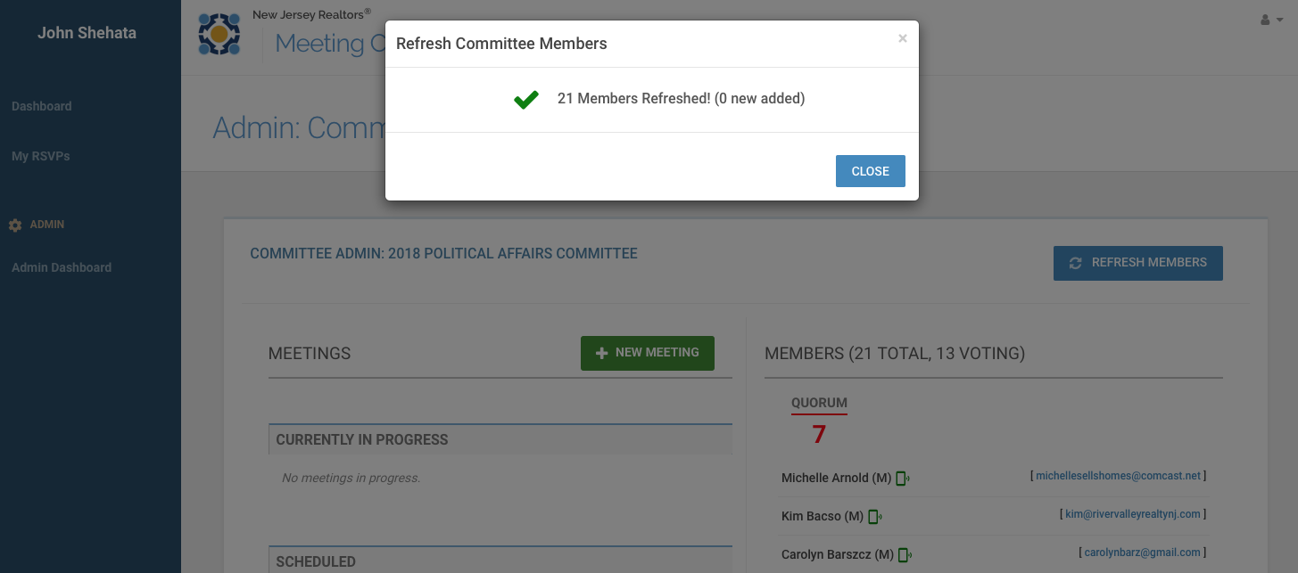
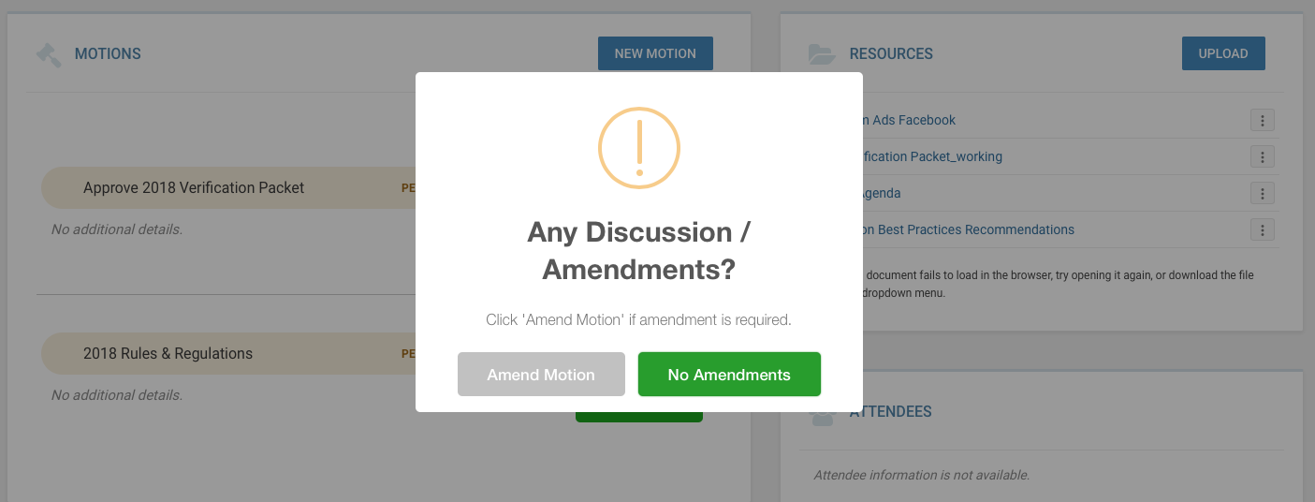
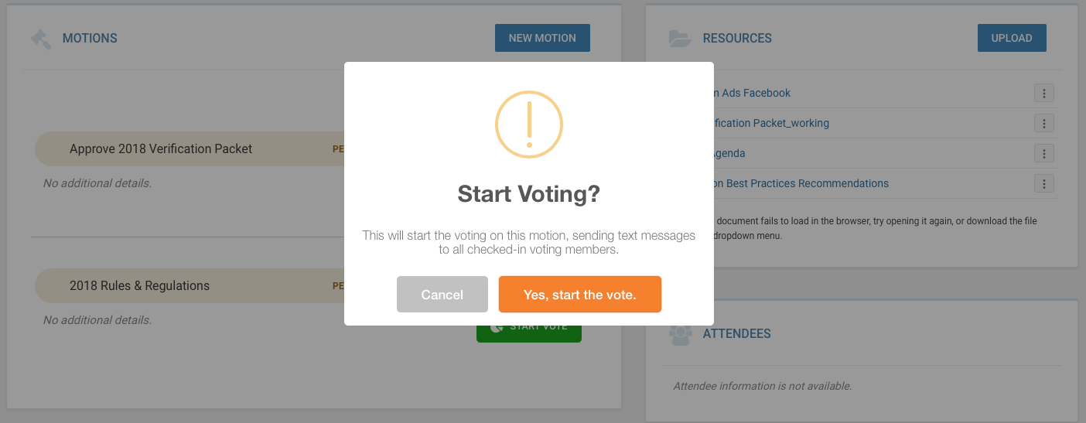
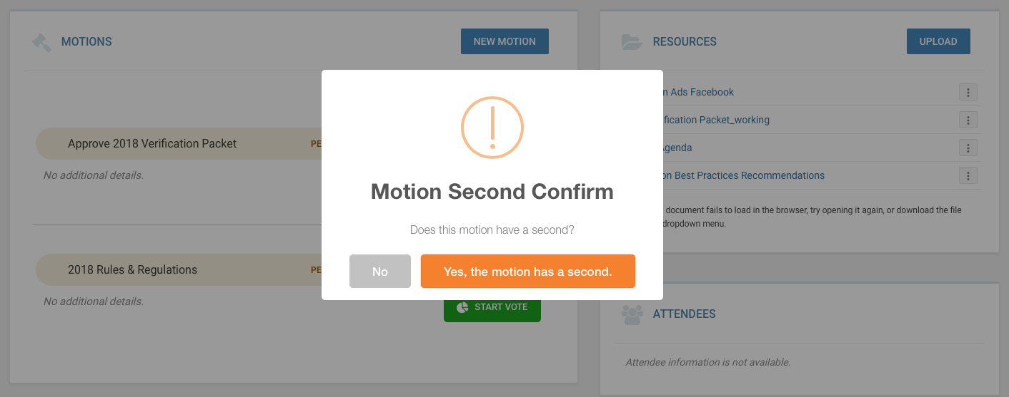
Meetings - Solution
Meeting management moved online
Meetings created within system
Emails and RSVPs managed online
Documents stored on system
Quorum automatically calculated, removing District Officers, Leadership Team, etc.
Voting handled via system
Zoom room is automatically created via API
No verbal votes, votes are via text or web interface
Members can be manually checked in
Attendance is written back to RAMCO

