Slide 2


EARLY SUCCESS
Launched
November 2, 2018
58,700+ members participating*
9,700+ earned Endorsement*
Learning 100 Award**
*As of August 15 2020
**Announced August 8, 2019

Slide 3

QUICK FACTS
Mobile-Friendly
Participants Report
10 hours, over 2 weeks
No additional cost

Slide 4
EVALUATE, EHANCE, SHOWCASE
The C2EX Competencies
Real Estate Law
Code of Ethics
Article 10 Code of Ethics
Advocacy
Trust & Integrity
Technology
Safeguard Privacy
Areas of Practice
Client Service
Professional Reputation
Broker

Slide 5
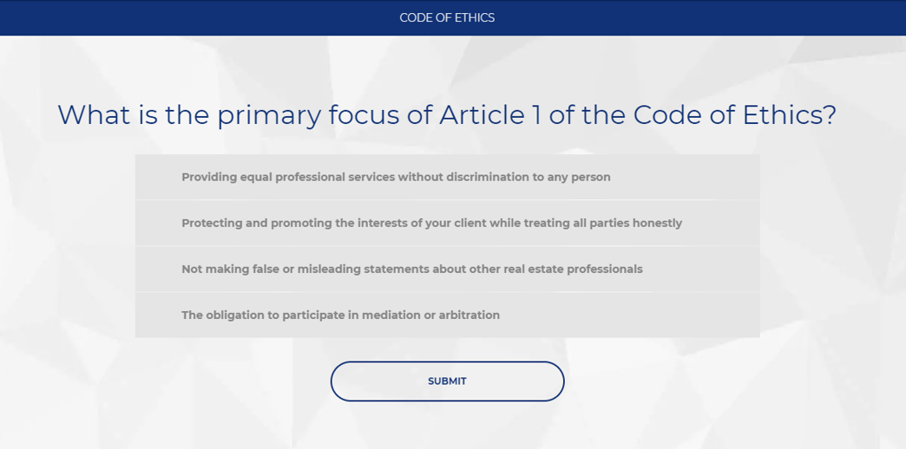
EVALUATE
Assessment example:

Slide 6
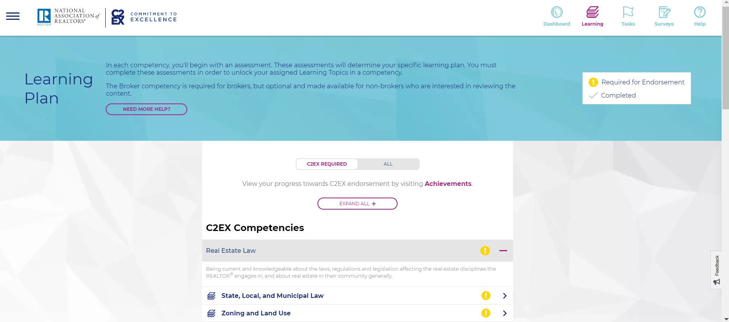
ENHANCE
Personalized Learning paths based on the C2EX Assessment results

Slide 7
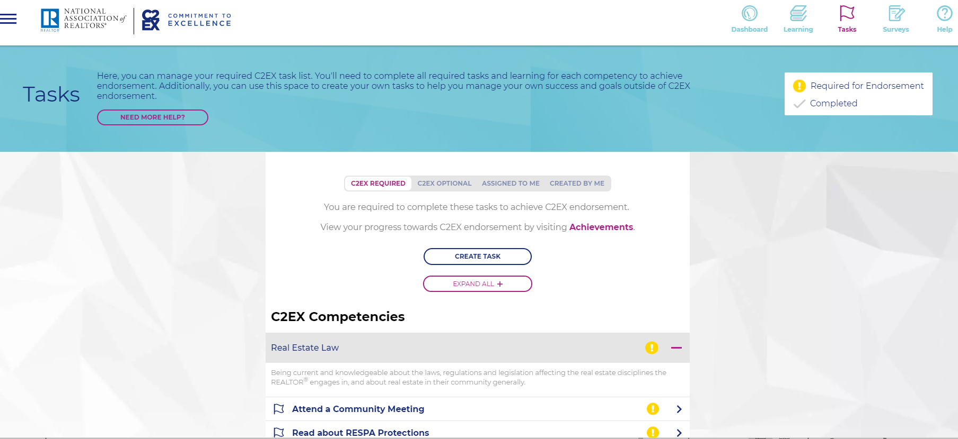
ENHANCE
Complete required Tasks then earn the C2EX Endorsement, & create your own

Slide 8

ADDITIONAL FEATURES
Send Surveys – open house, showing, closing, general performance, & create your own
Library – view NAR resources and materials
Videos and other guides in the Help Section

Slide 9



ENDORSEMENT MATERIALS
Print and Frame Certificate
Endorsement Certificate – Shareable on Social Media

Slide 10



ENDORSEMENT MATERIALS
Table Tent
11 x 14 Pledge Mini Poster

Slide 11
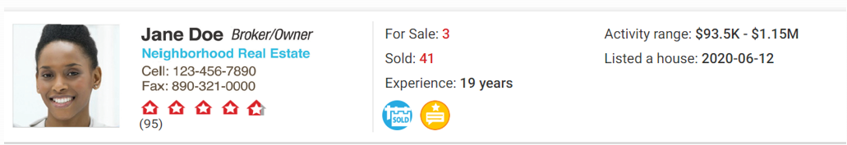

REALTOR.COM
Your Endorsement appears on Realtor.com!

Slide 12
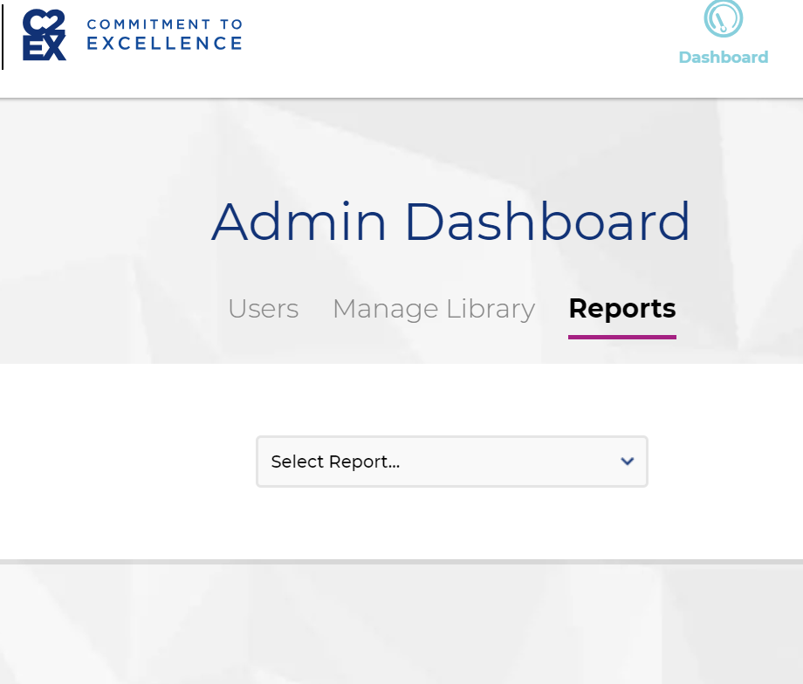
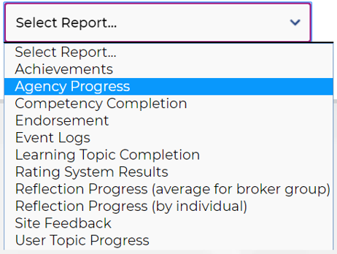
BROKER BENEFITS
Training Tool
Suggest content, assign tasks
Admin Access
Track agent progress and run various reports
Brokerage Branding
Upload Brokerage’s logo

Slide 13

CODE OF ETHICS
Earning and maintaining your C2EX Endorsement fulfills your Code of Ethics Requirement for 2021!

Slide 14
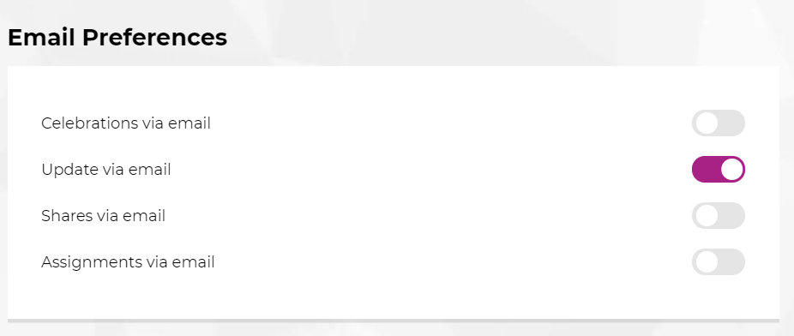

STAY INFORMED
Stay informed about C2EX platform updates and events:
1. Click the compress icon menu (looks like 3 horizontal lines) in the upper-left corner of the platform.
2. Select “Profile”.
3. Toggle “Update via email” and slide the dot over to the right side until purple.

Slide 15

2020 C2EX CHALLENGE
Increase marketability and boost business!
Earn your Endorsement between June 1 – Oct. 1
& help your state become a 2020 Challenge Champion!
Get started at C2EX.realtor

Slide 16
Get Started!
C2EX.Realtor
Questions?
C2EX@NAR.realtor
888-299-9669
Download Free Marketing Materials!
NAR.realtor/C2EX

