Slide 1
Brokers Respond
to COVID-19
SBA Loans, Unemployment Insurance, and Other Business Adjustment Advice from Brokers Around the Country

Slide 2
Opening Remarks
Bob Goldberg
CEO, National Association of REALTORS®
Vince Malta
2020 President, National Association of REALTORS®
Tracy Kasper
2020 Broker Engagement Committee Chair
Donna Smith
2020 Broker Engagement Committee Vice Chair

Slide 3
Advocacy
Intro by Nate Johnson
Public & Federal Issues Liaison
Moderated by Sarah Young
Director of Real Estate Services and Policy Oversight

Slide 4
SBA Loans
Erin Stackley
Senior Representative, Commercial Legislative Policy
Independent Contractor Unemployment Insurance
Nia Duggins
Policy Representative for Business Issues
Tax and Mortgage Forbearance
Evan Liddiard
Senior Policy Representative, Federal Taxation
Ken Fears
Senior Policy Representative, Banking, Lending, and Housing Finance

Slide 5
Financial Wellness
Kasey Stewart
Director, Member Development

Slide 6
Webinars
NAR.realtor/CFFW/Webinars
Website
FinancialWellness.realtor

Slide 7
Residential Transaction Resources
Deanne Rymarowicz
Associate Counsel

Slide 8
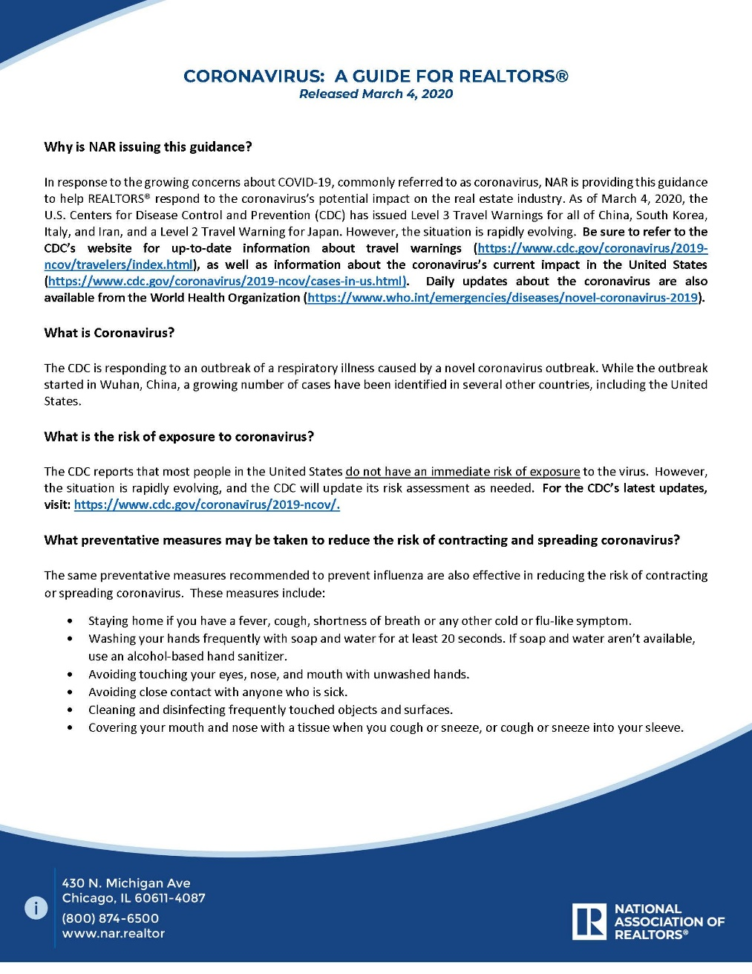
EVOLVING GUIDANCE
March 4
“May I ask a potential buyer about their recent travel plans?”

Slide 9
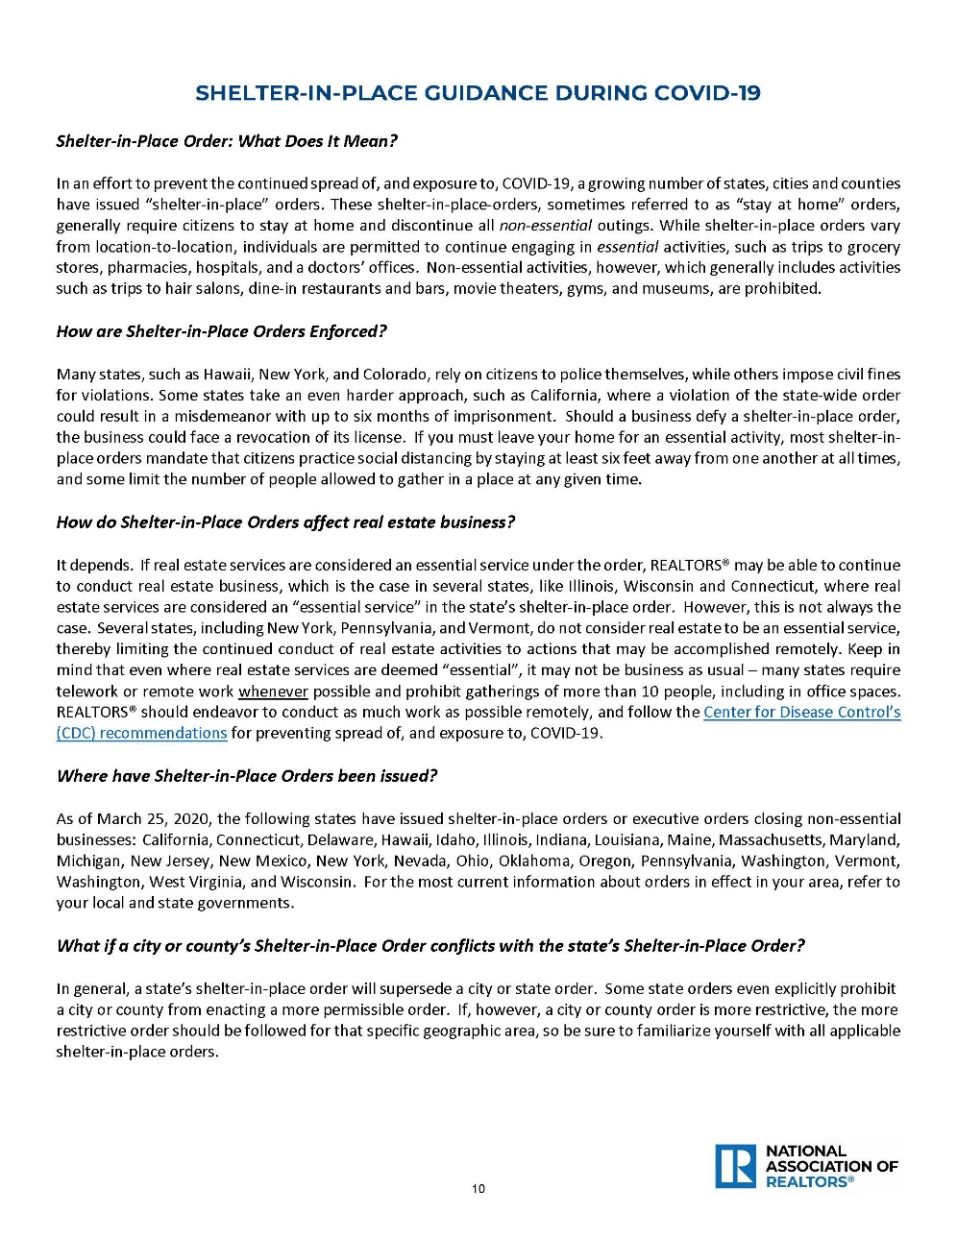
EVOLVING GUIDANCE
March 26
“How can I conduct my business under a shelter in place order?”

Slide 10
NAVIGATING UNCHARTERED WATERS
OVERVIEW
Decision Making Standard
Back to Basics

Slide 11
DECISION MAKING STANDARD
How can I provide first-class client service and move the transaction forward, while demonstrating care for the wellbeing of others, reducing the risk of exposure to and spread of COVID-19, and complying with local, state and federal public health policies?
?

Slide 12
BACK TO BASICS
COMPLY
COMMUNICATE
Adhere to state and local restrictions.
What’s known and what’s not known, too.
CONTRACTS
BEST PRACTICES
Use an appropriate addendum to address extensions.
Virtual meetings and showings, e-signatures, RON, electronic recordings.

Slide 13
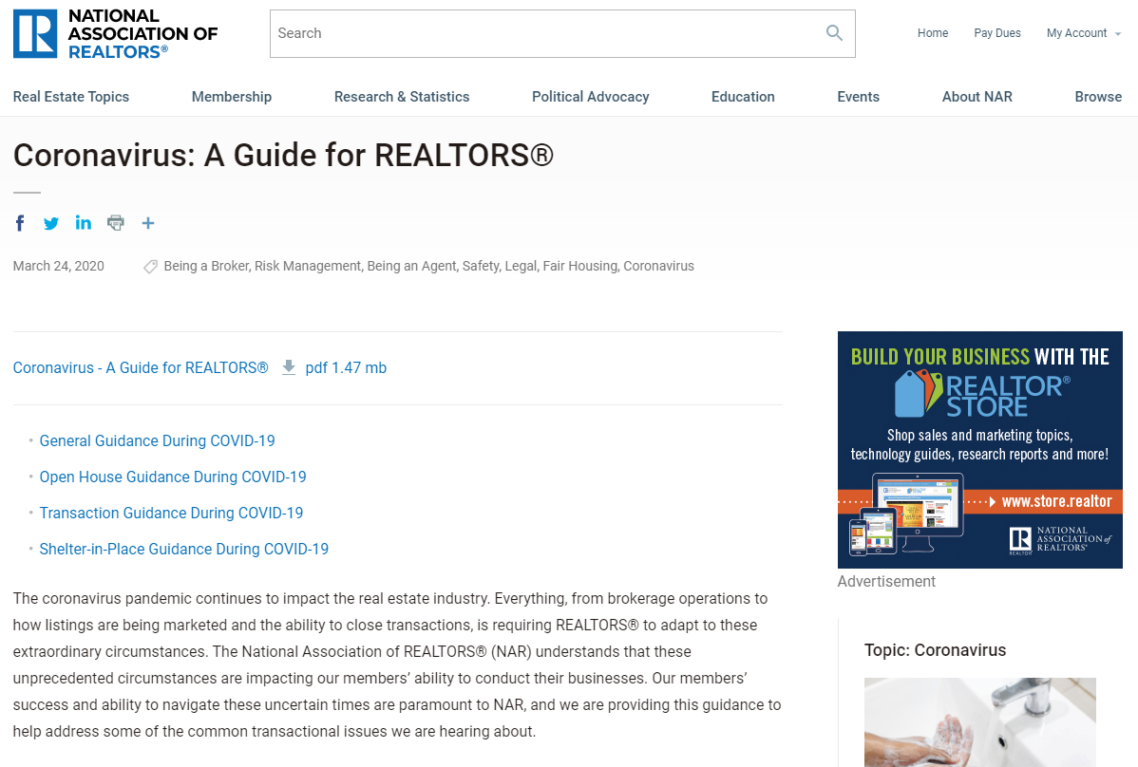
NAR GUIDANCE
General
Transaction
Active Listings
Properties in Escrow
Leased Properties
Shelter in Place
Broker Checklist!

Slide 14
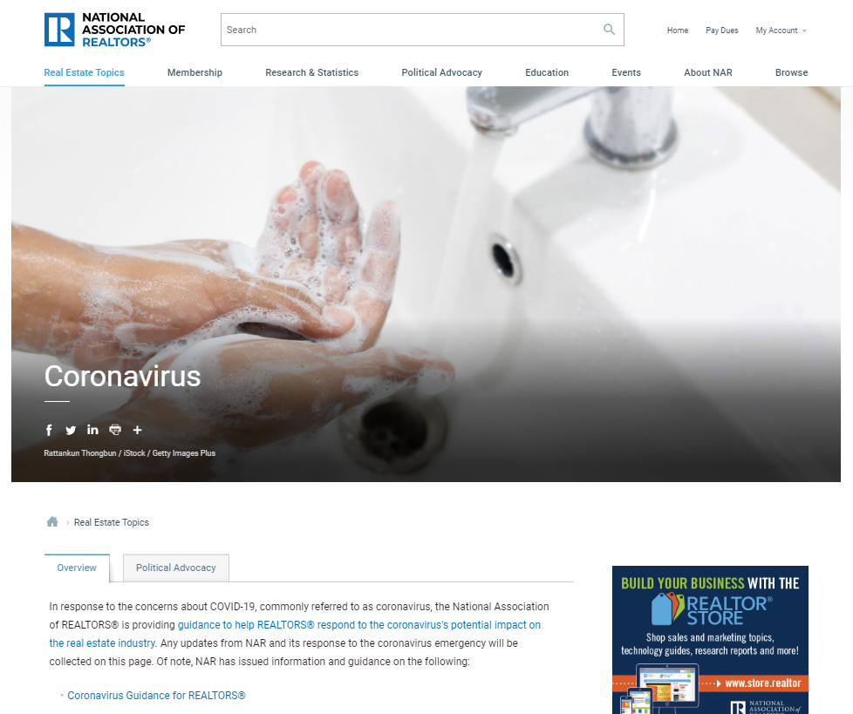
NAR GUIDANCE
nar.realtor/coronavirus

Slide 15
Broker-to-Broker Panel
Moderated by Robert Bailey
Owner and Broker, Bailey Properties

Slide 16
Panelists
Steven Domber
Berkshire Hathaway HomeServices Hudson Valley Properties
Nikki Coppola
Century 21 Award Rancho San Diego
Christina Pappas
The Keyes Company
Tiffany Meyer
Howard Hanna J.C. Meyer Realtors

Slide 17
Closing Remarks
Tracy Kasper
2020 Broker Engagement Committee Chair
Donna Smith
2020 Broker Engagement Committee Vice Chair

Slide 18
Today’s webinar has been recorded and
will be available at nar.realtor/brokers.

