Slide 1
We’ll get started
soon!

Slide 2
2020 Joint AE Institute – Moving Forward
…. a Virtual Reality

Slide 3
Webinar Tips
Close out of extra browsers or websites on your current browser
Using Q&A –
    Click “question” or “chat” icon at the bottom or lower right corner of your screen.
    On the Q & A panel, type your question in the text box.
    We will be fielding your questions throughout the program.

Slide 4
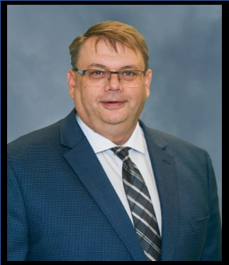
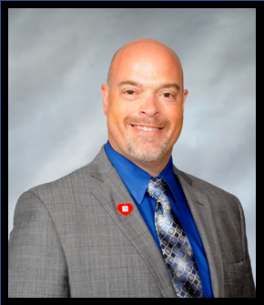
Bill Stirling, CEO
Newfoundland Labrador
Association of REALTORS®, CAN
Jim Haisler, CEO
Heartland REALTOR® Organization
Illinois, USA

Slide 5
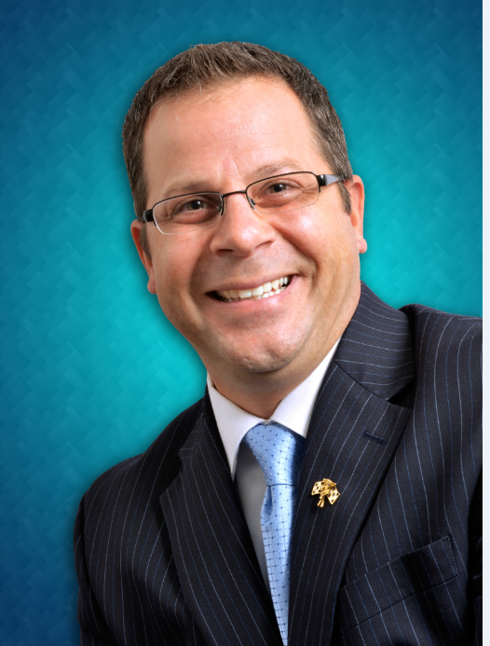
Recipe for Success
Lead…Motivate…Inspire
Brian Blasko

Slide 6
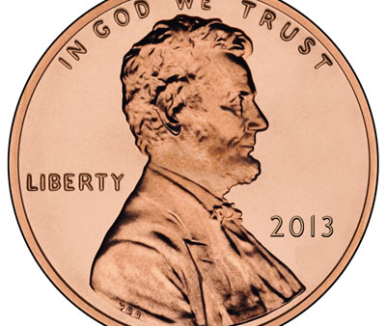
Ingredient #1
A penny for your thoughts…
- Positive thinking vs.
negative reactions
- Brian’s Broccoli Theory

Slide 7
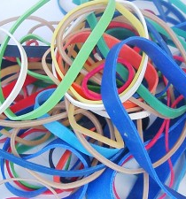
Ingredient #2
A rubber band to stay flexible
- View change as opportunity
- Benefits of Interdependency

Slide 8
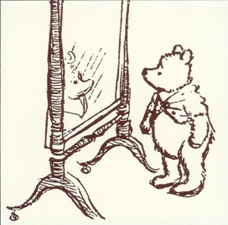
Ingredient #3
A mirror to reflect self-pride
- Develop self-leadership
Find the good in
yourself and others

Slide 9
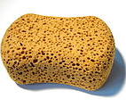
Ingredient #4
A sponge to absorb life
- Quality vs. Quantity
Great leaders vs.“okay”
leaders

Slide 10
Brian Blasko
www.brianblasko.com

Slide 11
Bill Stirling, CEO
Newfoundland Labrador
Association of REALTORS®, CAN
Jim Haisler, CEO
Heartland REALTOR® Organization
Illinois, USA

Slide 12
AE’s Lead Series
Join us on Thursday, March 26
2:00 PM EDT
To register visit:
NAR.realtor
Search: AE’s Lead
Click the dropdown for “March”
And Register for "Best Practices for Strengthening Staff & Volunteer Relationships"

