Slide 1
NAR FAMILY CERTIFICATIONS
AND DESIGNATIONS
Updated 11.4.22 | NAR

Slide 2
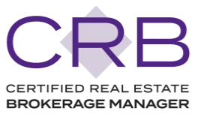
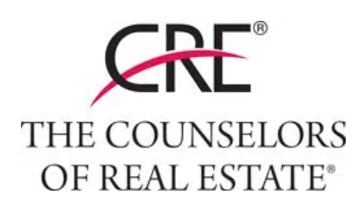
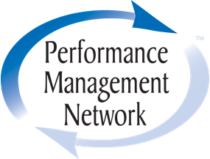
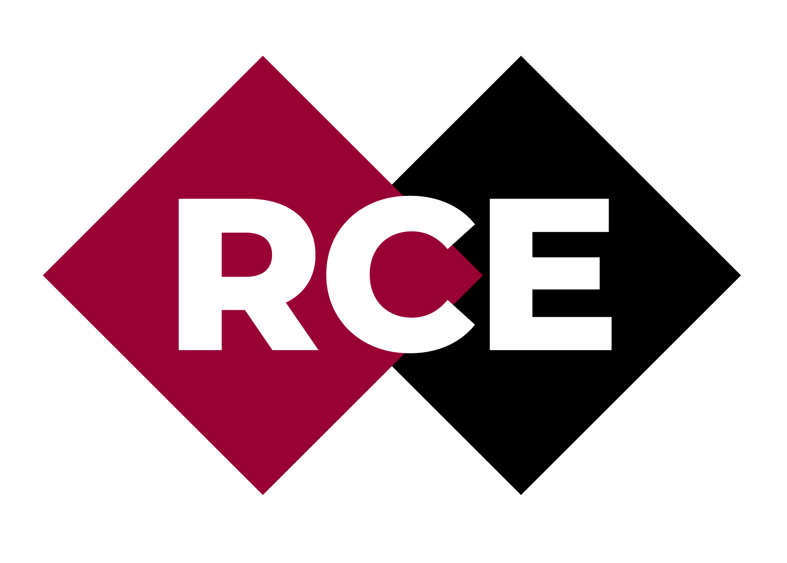
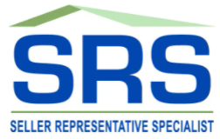
NAR Designations
Designations are specialized credentials for REALTORS®. Designations offer extensive benefits that are continually improved upon and expanded. For this reason, maintaining a designation requires annual dues and continued membership in NAR.

Slide 3
Accredited Buyer’s Representative – ABR®
ABR® designees advocate for homebuyers, and are recognized as
distinguished agents in the industry. The designation program establishes a
foundation of training, skills, and resources to help real estate professionals
succeed as a buyer’s representative.
Valuable real estate education that elevates your skills and knowledge in the eyes of homebuyers.
Ongoing specialized information, programs, and updates that keep you knowledgeable on the issues and trends facing homebuyers.
Access to members-only publications, marketing tools and resources.
Networking and referral opportunities.
Presented by REBAC (Real Estate Buyer's Agent Council) and the Center for REALTOR® Development. Contact REBAC at rebac@nar.realtor or 800-648-6224.

Slide 4
Accredited Land Consultant - ALC
Accredited Land Consultants (ALCs) are land professionals who are the most accomplished, most experienced, highest-performing land experts. Becoming an ALC requires successful completion of a rigorous education program, a proven track record of transaction performance, and a commitment to professional growth.
Designees gain:
Access to the network of ALC designees, who work together to build and share knowledge, develop trusted relationships, and expand business opportunities
Presented by the REALTORS® Land Institute (RLI) Contact RLI at 800.441.5263 or rli@nar.realtor

Slide 5
Certified Commercial Investment Member - CCIM
A CCIM (Certified Commercial Investment Member) is a recognized expert in the commercial and investment real estate industry. The designation process ensures that CCIMs are proficient not only in theory, but also in practice. This elite corps of CCIMs includes brokers, leasing professionals, investment counselors, asset managers, appraisers, corporate real estate executives, property managers, developers, institutional investors, commercial lenders, attorneys, bankers, and other allied professionals.
Designees gain:
Recognition of your expertise in the commercial and investment real estate industry
Access to a network of 13,000 members across the U.S. and around the globe
Exclusive discounts on CCIM education and benefits
Presented by the REALTORS® Land Institute (RLI) Contact RLI at 800.441.5263 or rli@nar.realtor
Presented by the REALTORS® Land Institute (RLI) Contact RLI at 800.441.5263 or rli@nar.realtor

Slide 6
Certified International Property Specialist - CIPS
Instantly align yourself with the best in international real estate by earning the CIPS designation. The designation requires completion of five full-day courses focusing on the critical aspects of international real estate transactions. CIPS designees are connected to an influential network of over 3,500 professionals who turn to each other first when looking for referral partners.
Globalization of economies and international capital flow
Marketing and business planning strategies
Roles, expectations, and cultural business practices of global transactions
Courses for U.S. residents, non-residents, AEs
Presented by the National Association of REALTORS® and the Center for REALTOR® Development Contact Member Support at 800.441.5263 at CIPS@nar.realtor

Slide 7
Certified Property Manager® - CPM®
CPM® designees are recognized as experts in real estate management. Holding this designation demonstrates expertise and integrity to employers, owners, and investors.
Go farther in your career. Over half of CPMs hold senior-level management positions
Expand your network. Generate business referrals. Meet future employees or employers. And consult with our experts.
Your annual IREM membership and all the benefits that come with it are included when you enroll
Showcase your credibility with a digital badge to add to your email, social media profiles, website and more
Presented by the Institute of Real Estate Management (IREM) Contact IREM® at 800.837-0706, ext. 4650
Presented by the REALTORS® Land Institute (RLI) Contact RLI at 800.441.5263 or rli@nar.realtor

Slide 8
Certified Real Estate Broker Manager - CRB
The Certified Real Estate Brokerage Manager (CRB) is one of the most respected and relevant designations offered in real estate business management and is awarded to REALTORS® who have completed advanced educational and professional requirements. CRB Designees are better positioned to streamline operations, integrate new technology and apply new trends and business strategies.
Designees gain:
Access to the network of ALC designees, who work together to build and share knowledge, develop trusted relationships, and expand business opportunities
Visit REBInstitute.com or contact the Real Estate Business Institute (REBI) at info@REBIInstitute.com or 800.621.8738
Presented by the REALTORS® Land Institute (RLI) Contact RLI at 800.441.5263 or rli@nar.realtor

Slide 9
Certified Residential Specialist - CRS
The CRS designation is the highest credential awarded to residential sales agents, managers, and brokers. On average, CRS designees earn nearly three times more in income, transactions, and gross sales than non-designee REALTORS®.
Designees gain:
Access to the network of ALC designees, who work together to build and share knowledge, develop trusted relationships, and expand business opportunities
Presented by Residential Real Estate Council Contact RRC at www.crs.com/about-us/contact-us or 800.462-8841
Presented by the REALTORS® Land Institute (RLI) Contact RLI at 800.441.5263 or rli@nar.realtor

Slide 10
Counselor of Real Estate® - CRE®
The Counselors of Real Estate® is an organization of commercial property experts worldwide who provide seasoned, objective advice on real property and land-related matters. Only 1,100 professionals from all disciplines of real estate, academia and government hold the CRE credential. Membership is selective and extended by invitation, although commercial real estate practitioners with 10 years of proven experience may apply.
To be invited, prospective members must be recognized, by their peers, clients and employers, for their outstanding professional achievement, impeccable judgment, and commitment to integrity in the field of real estate counseling. The organization includes brokers, appraisers, land planners, accountants, attorneys, property developers and managers, bankers, real estate account executives, and members from other disciplines.
Presented by The Counselors of Real Estate® Contact CRE® at 312.329.8427 or info@cre.org
Presented by the REALTORS® Land Institute (RLI) Contact RLI at 800.441.5263 or rli@nar.realtor

Slide 11
General Accredited Appraiser - GAA
For general appraisers, this designation is awarded to those whose education and experience exceed state appraisal certification requirements and is supported by the National Association of REALTORS®.
You must have a minimum of 1000 hours of appraisal work experience beyond state certification requirements to apply
You will complete 60 hours of tested course work in addition to the Appraiser Qualification Board’s education requirement at the time of certification
Presented by National Association of REALTORS® Contact GAA program staff at 800.874.6500, ext. 8268 or email appraisal@nar.realtor

Slide 12
NAR’s Green Designation
NAR’s Green Designation provides the foundation you need to build a better
business focused on green real estate. Consumer demand for high-performance
homes is growing, which is why it’s important for you to be well-versed in green features. Discover the benefits of resource-efficient homes and incorporate sustainable practices into your business with NAR's Green Designation.
Access to customizable members-only marketing tools to help you build your business A comprehensive understanding of how homes with green features are available in every market and should be promoted differently than traditional homes.
Improved visibility as a trusted advisor, and source of information on the topic.
Presented by the Green REsource Council and the Center for REALTOR® Development.
Contact the Green REsource Council at green@nar.realtor or 800.

Slide 13
Graduate, REALTOR® Institute - GRI
REALTORS® with the GRI designation have in-depth training in legal and regulatory issues, technology, professional standards, and the sales process. Earning the designation is a way to stand out to prospective buyers and sellers as a professional with expertise in these areas.
Be better able to serve and protect your increasingly sophisticated clients through an understanding of new technology, laws, and procedures
Marketing materials – customizable flyer, banner ad, and postcard
GRI referral form
Network with other GRI designees
Presented National Association of REALTORS® Contact your State Association for information.

Slide 14
Performance Management Network - PMN
This designation is unique to the REALTOR® family designations, emphasizing that in order to enhance your business, you must enhance yourself. It focuses on negotiating strategies and tactics, networking and referrals, business planning and systems, personal performance management and leadership development.
Show your clients that you’re an industry leader committed to continuing education
Join a strong network of real estate professionals
Discounts on online education
Download banner ads to use on your site
Exclusive access to PMN-only events during national meetings
Presented by Women’s Council of REALTORS® Contact the Women’s Council of REALTORS® at 800.3245.8512 or visit the Women’s Council of REALTORS® website

Slide 15
REALTOR® Association Certified Executive - RCE
RCE is the only professional designation designed specifically for REALTOR® association executives. RCE designees exemplify goal-oriented AEs with drive, experience and commitment to professional growth.
Formal recognition at the annual Association Executives Institute (AEI)
An RCE plaque to display and an RCE pin to wear
Enhanced skills in every aspect of REALTOR® association management
Networking with other association executive leaders
Presented by National Association of REALTORS® Contact Renee Holland at 312.329.8545 or rholland@nar.realtor (link sends email)

Slide 16
Residential Accredited Appraiser - RAA
For residential appraisers, this designation is awarded to those whose education and experience exceed state appraisal certification requirements and is supported by the National Association of REALTORS®.
Earning the designation lets your clients know that you are committed to excellence in your field. Already a member of an appraisal group? You may be qualified for the Fast Track Option to earning this designation.
Presented by National Association of REALTORS® Contact RAA program staff at 312.329.8268 or email appraisal@nar.realtor

Slide 17
Seller Representative Specialist - SRS
The Seller Representative Specialist (SRS) designation is the premier credential in seller representation. It is designed to elevate professional standards and enhance personal performance. The designation is awarded to real estate professionals who demonstrate the knowledge and skills essential for seller advocacy. SRS designees represent a global community of REALTORS® who use their advanced training and expertise to go above and beyond their client’s expectations.
The SRS Course will redefine your "normal" and reinvent the way you represent sellers. It provides a comprehensive foundation of skill development, training and resources to help real estate professionals represent the interests of sellers in today’s marketplace.
Visit www.REBInstitute.com or contact the Real Estate Business Institute (REBI) at info@rebinstitute or 800.621-8738

Slide 18
Society of Industrial and Office REALTORS® - SIOR
The SIOR designation is held by only the most knowledgeable, experienced, and successful commercial real estate brokerage specialists. To earn it, designees must meet standards of experience, production, education, ethics, and provide recommendations.
The designation is granted in one of six specialist categories:
Industrial (transaction specialist)
Office (transaction specialist)
Industrial & Office (dual transaction specialist)
Sales Management (manages at least 10 sales or leasing agents)
Executive Management (manages 100+ agents in three or more offices)
Advisory Services (consultant or advisory practitioner)
Presented by Society of Industrial and Office REALTORS® Contact SIOR at 202.449.8200

Slide 19
Seniors Real Estate Specialist® - SRES®
The SRES® Designation program educates REALTORS® on how to profitably and ethically serve the real estate needs of the fastest growing market in real estate, clients ages 50+. By earning the SRES® designation, you gain access to valuable member benefits, useful resources, and networking opportunities across the U.S. and Canada to help you in your business.
Identify the power of generational demographics.
Develop and maintain relationship marketing skills.
Counsel rather than sell to seniors.
Understand the implications of tax laws, probate and estate planning.
Presented by SRES® Council and the Center for REALTOR® Development. Contact SRES® Council at sres@nar.realtor or 800.500.4564

Slide 20
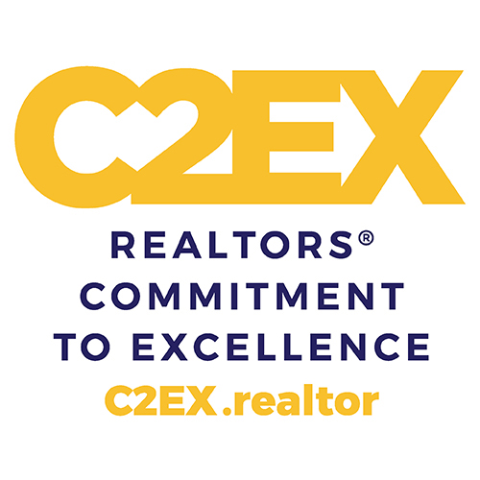
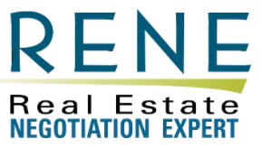
NAR Certifications
Like designations, certifications are also specialized credentials for REALTORS®. Maintaining a certification requires only an application fee and continued membership in NAR, but no annual dues.

Slide 21
At Home With Diversity® - AHWD
REALTORS® know the importance of adapting and remaining relevant in
today’s marketplace. By developing a business practice rooted in inclusion
and equality, REALTORS® can help buyers of all cultural backgrounds achieve
the dream of homeownership. The At Home With Diversity® (AHWD) certification
course covers how to work effectively with diverse populations so you can build
business success in today’s multicultural real estate market.
Knowledge of the subtleties of U.S. fair housing laws
Business etiquette for specific cultures
An edge in expanding your business to include international clientele
Credit towards the ABR® and CIPS designations, and as a task in C2EX
Presented by the National Association of REALTORS® and the Center for REALTOR® Development. For more information, please contact ahwd@nar.realtor or 800.874.6500, ext. 83

Slide 22
REALTORS® Commitment to Excellence - C2EX
The REALTORS® Commitment to Excellence (C2EX) program is a multiple award-winning, web-based program that focuses on 10 areas of industry professionalism including client service, real estate law, and data privacy. It’s not a certification, designation, or course. It’s an Endorsement from the NATIONAL ASSOCIATION OF REALTORS®.
C2EX Endorsed REALTORS®
Earn promotional materials announcing their achievement and an icon on REALTOR.com alerting potential clients to their endorsement
Satisfy their NAR Code of Ethics training requirement for the current cycle
Access a network of C2EX Endorsed REALTORS® across the U.S. and around the globe
For more information please contact C2EX@nar.realtor or 1.888.299.9669

Slide 23
Certified Real Estate Team Specialist - CRETS
The Certified Real Estate Team Specialist (C-RETS) certification is designed to improve team development, individual leadership skills, and financial performance. C-RETS courses provide the tools, strategies, and knowledge that are required of today’s real estate professionals who are either considering or currently operating in a team environment. It is for team leaders, team members, those looking to start a team, and those who simply want to sharpen their management skills.
Visit www.REBInstitute.com or contact the Real Estate Business Institute (REBI) at info@REBInstitute.com or 800.621.8738

Slide 24
Digital Marketing: Social Media
The RRC Digital Marketing: Social Media certification is for real estate professionals who want to develop expertise with social media resources and the sites that are an essential part of today's digital marketing mix, whether you are promoting your business or the properties you represent.
Distinguish yourself as an expert with your clients and team members
Practical plans for implementing and managing your business's social media strategy
Guides for interpreting analytics and engagement to help reassess and revise strategies routinely
Risk management recommendations to incorporate into your social media strategy
Presented by Residential Real Estate Council Contact RRC at www.crs.com/about-us/contact-us or 800.462.8841

Slide 25
e-PRO®
NAR's e-PRO® certification program helps REALTORS® master the advanced digital marketing techniques of today. With the e-PRO® certification, REALTORS® increase their ability to reach customers, expand their capabilities, and build trust by safeguarding client information.
Create and manage a powerful online presence through your website, social media,
video, and more.
Streamline real estate transaction processes using customer relationship management (CRM) systems, and transaction management platforms.
Create search engine marketing (SEM) and search engine optimization (SEO) strategies.
Protect your business from a data breach and safeguard client information.
Presented by the National Association of REALTORS® and the Center for REALTOR® Development. Contact e-PRO® at epro@nar.realtor or 877.397.3132

Slide 26
Inside Sales Agent - ISA
The Inside Sales Agent certification program teaches REALTORS® the art of cultivating leads and adding qualified customers to the office’s sales funnel. The certification provides opportunities to learn and practice the skills and techniques top agents use to turn leads to clients and existing customers into repeat business while helping you build your lucrative career.
Scripts and dialogues that help you get valuable information from potential clients to build your team’s pipeline
Customer service strategies and techniques to help generate more referrals and leads
Guides on how to build professional relationships and tools to strength interpersonal communications
Tools to help close higher number of sales
Presented by the Residential Real Estate Council Contact RRC at crs.com/about/-us/contact-us or 877.397.3132

Slide 27
Luxury Homes Certification - LHC
Luxury Homes Certification is for agents looking to hone their skills in the ever-growing luxury home market. The courses included will give REALTORS® the knowledge they need to approach the luxury niche, including pricing strategies, negotiation tactics, and how to stand out from the crowd.
Distinguish yourself as an expert in the luxury market with your clients and team members
Steps on how to break into the luxury real estate business
Outline of the seven steps to fairly valuing luxury home pricing
An understanding of the critical components of luxury home presentations to those of other home market segments
Advanced negotiation tactics essential to serving the luxury market
Presented by the Residential Real Estate Council Contact RRC at CRSHelp@crs.com

Slide 28
Military Relocation Program - MRP
When U.S. servicemembers, veterans, and their families relocate, having
the expertise of a real estate professional who understands their specific
needs makes the transfer easier, faster, and less stressful. NAR’s Military
Relocation Professional (MRP) certification educates REALTORS® about
working with these families to find the housing solutions that best suit
their needs and to take full advantage of available benefits and support.
Presented by the National Association of REALTORS® and the Center for REALTOR® Development. Contact us at MRP@nar.realtor or 888.648.8321

Slide 29
Pricing Strategy Advisor - PSA
Determining property values depends more than ever on professional expertise and competence, the best use of technology, and approaching the pricing assignment from various perspectives. Enhance your skills in pricing properties, creating CMAs, working with appraisers, and guiding clients through the anxieties and misperceptions they often have about home values with the Pricing Strategy Advisor (PSA) certification.
Presented by the National Association of REALTORS® and the Center for REALTOR® Development. Contact us at psa@nar.realtor.

Slide 30
Real Estate Investing - REI
The Real Estate Investing (REI) certification program is for REALTORS® who want to master the ins and outs of working with investors and those who are establishing themselves as real estate investors.
Distinguish yourself as an expert to your clients and team members
Guides identifying types of residential investors and ways to meet their unique needs
Understanding of the pros and cons of different investment opportunities
Tools to help you calculate the return on investment and perform income analysis
Practical insight into professional property management, cash flow, operating income, and more
Presented by the Residential Real Estate Council Contact RRC at crs.com/about-us/contact-us

Slide 31
Real Estate Negotiation Expert - RENE
The Real Estate Negotiation Expert (RENE) certification is for real estate professionals who want to sharpen their negotiation and client advocacy skills.
Improve your negotiating skills
Learn about behind-the-scenes issues and how to deal with them
Learn how to handle a wide range of personalities and situations
Learn to sort out the competing objectives of the parties involved in a transaction
Presented by the Real Estate Business Institute (REBI) Contact REBI at 800.621.8738 or info@rebinstitute.com

Slide 32
Resort and Second-Home Property Specialist - RSPS
In addition to classic vacation homes, the resort and second-home niche also includes college housing and properties for investment purposes. No matter where you live, second-home properties exist in your area. The Resort and Second-Home Property Specialist (RSPS) certification gives you the specialized skills and knowledge to maximize the business opportunities this market presents. By earning your certification, you are instantly viewed as a qualified, competent professional in this arena.
Presented by the National Association of REALTORS® and the Center for REALTOR® Development. Contact us at resort@nar.realtor or 800.874.6500, ext. 8320

Slide 33
Short Sales and Foreclosure Resource – SFR®
Designed for real estate professionals at all experience levels, NAR’s SFR® certification course provides a framework for: directing distressed sellers to financial and legal professionals, qualifying sellers for short sales, developing a short sale package, and more! Confidently navigate these transactions and become a trusted resource for short sales and foreclosures with SFR®.
Presented by the National Association of REALTORS® and the Center for REALTOR® Development. Contact us sfr@nar.realtor or 877.510.7855

Slide 34
Smart Home
The Smart Home certification is for real estate professionals who want to develop expertise in the technology, privacy issues, and best transition tactics involved in selling smart homes.
Distinguish yourself as an expert in a growing real estate niche.
Plug into the Smart Home technology community.
Use pre-made toolkits available to you once you’re certified.
Presented by Residential Real Estate Council Contact RRC at www.crs.com/about-us/contact-us

Slide 35
THANK YOU
For more information on each of the NAR Family Designations and Certifications, visit nar.realtor/Designations

