Slide 1
Association Legal Issues Amidst COVID-19
NAR Legal Affairs | March 31, 2020
NATIONAL ASSOCIATION OF REALTORS®

Slide 2
OVERVIEW
Association management and employment issues
Federal advocacy efforts
Real estate as an "essential service" efforts
Residential transaction issues
Commercial transaction issues
State extensions of CE/license renewal deadlines
MLS issues

Slide 3
Association Management
Employment Issues
AND
Lesley M. Muchow
Deputy General Counsel and Vice President of Legal Affairs

Slide 4
ASSOCIATION MANAGEMENT AND EMPLOYMENT ISSUES
Clear and regular communications with employees
Remote Work and Employee Travel
Handling Staff Reports of COVID-19
Association Events – Postpone, Cancel or Virtual
Families First Coronavirus Response Act

Slide 5
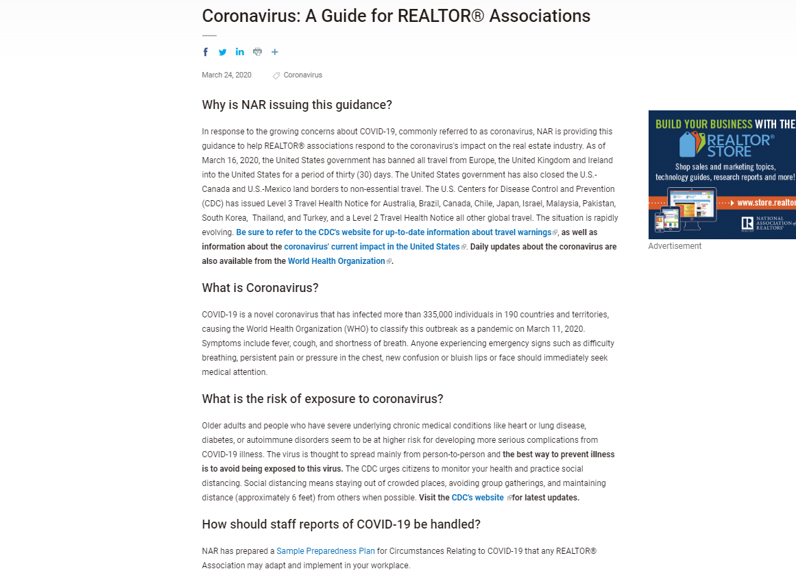
Coronavirus: A Guide for REALTOR® Associations

Slide 6


Slide 7
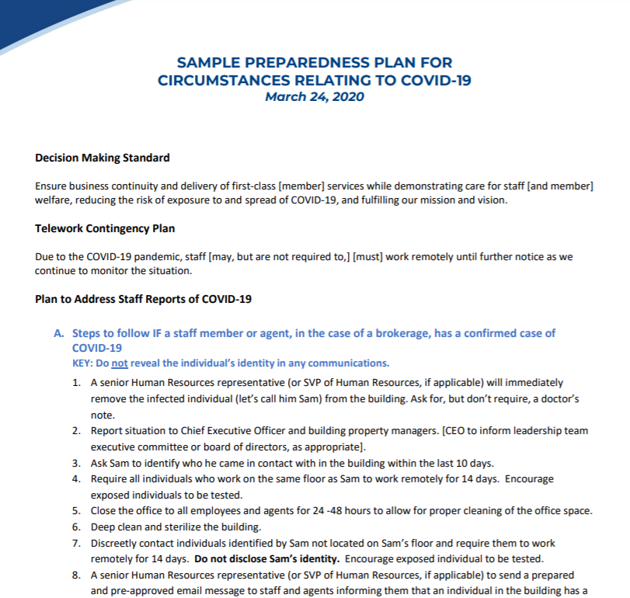
Sample Preparedness Plan

Slide 8
FAMILIES FIRST CORONAVIRUS RESPONSE ACT
Effective April 1 - December 31, 2020
Private employers with
< 500 employees
In addition to any other available leave
Not Retroactive
Cost Neutral via payroll tax credits
Two types of paid leave

Slide 9
Emergency Paid Sick Leave Act
Extended FMLA
10 days of paid sick leave.
No service requirement.
Unable to work for 1 of 6 reasons:
  Subject to federal/state/local quarantine or isolation order.
  Advised by health care provider to self-quarantine.
  Experiencing COVID-19 symptoms and seeking medical diagnosis.
  Caring for individual subject to order or self-quarantine;
  Caring for a child whose school or care provider is closed or unavailable;
  Experiencing any other substantially –similar condition specified by Sec HHS.
Reasons 1-3: 100% of pay up to $511/day and $5,110 total
Reasons 4-6: 2/3 regular pay up to $200/day and $2,000 total
12 weeks of paid FMLA.
  2 weeks paid under EPSL
Requires employee have worked for at least 30 calendar days.
May be taken for ONE reason:
  Employee unable to work or telework because needs to care for a child under the age of 18 AND
  Child’s school or care provider is closed or unavailable because of COVID-19 related public health emergency declared under federal, state or local law.
2/3 regular pay up to $200/day; $10,000 in the aggregate.

Slide 10
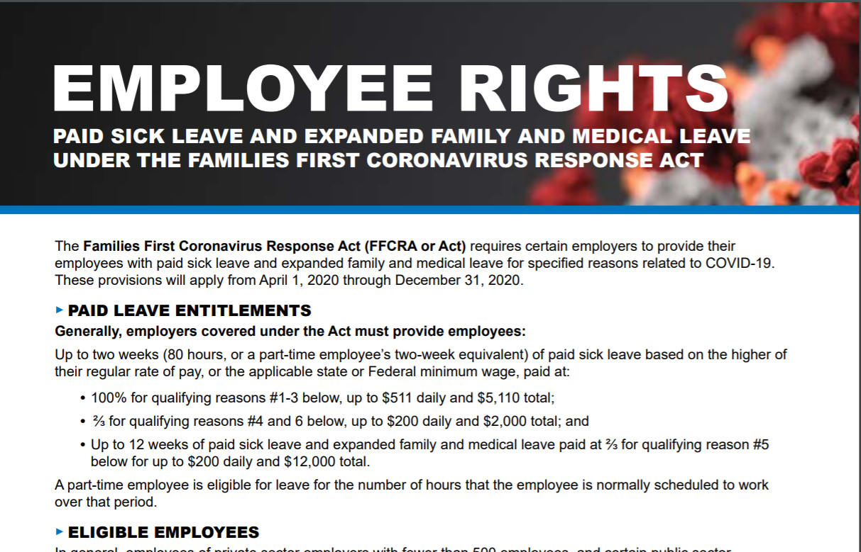
https://www.dol.gov/sites/dolgov/files/WHD/posters/FFCRA_Poster_WH1422_Non-Federal.pdf

Slide 11
Federal Advocacy Efforts
Katie Johnson
General Counsel and Chief Member Experience Officer

Slide 12
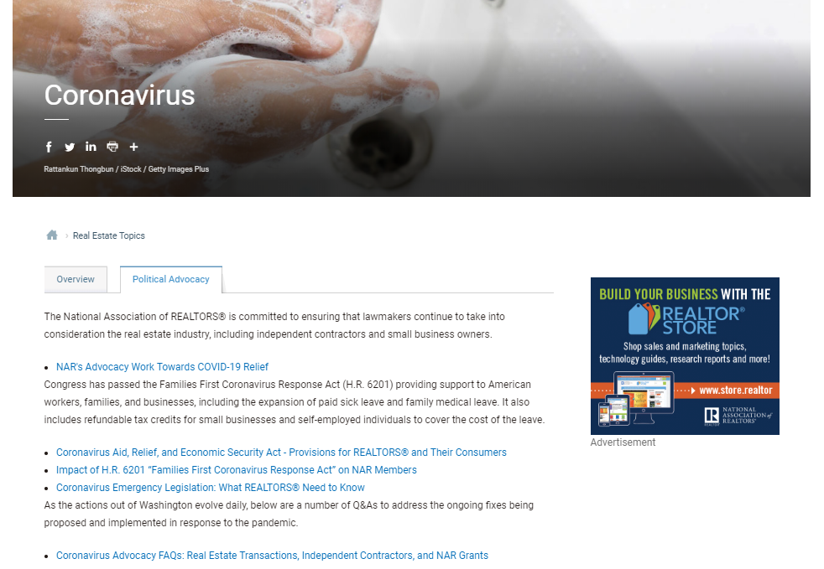

Slide 13
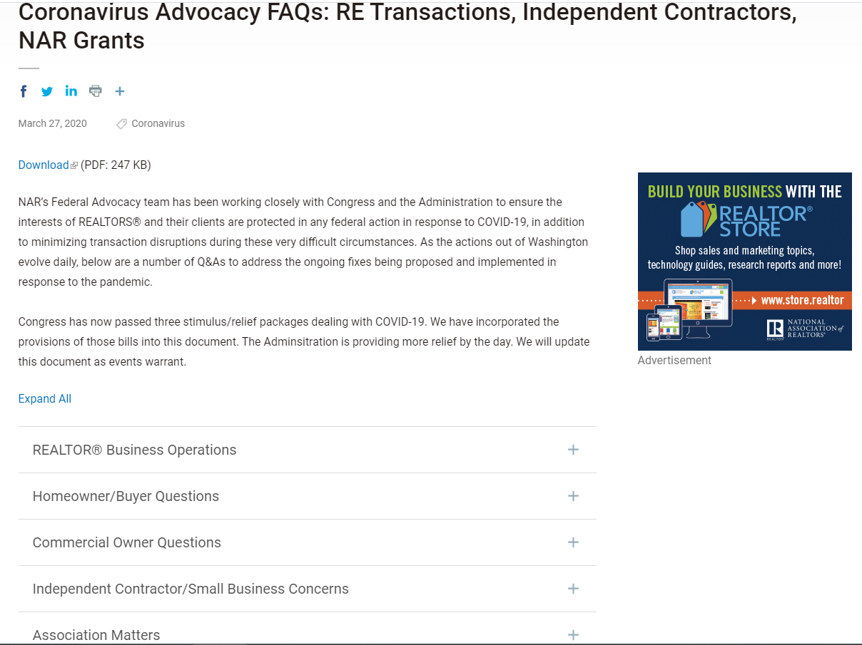

Slide 14
Real Estate as an
“Essential Service” Efforts
Katie Garrity
Associate Counsel

Slide 15
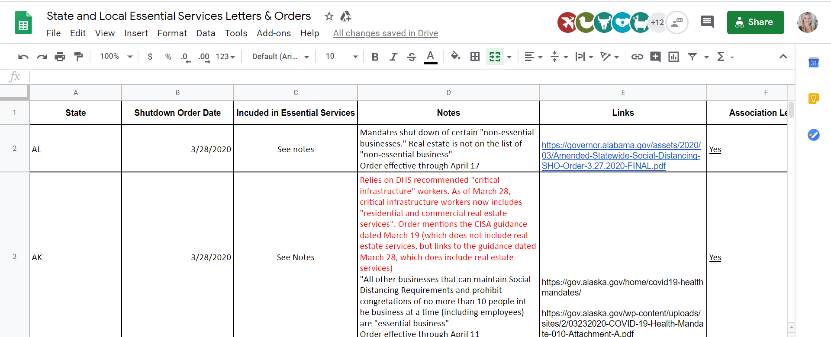
Executive Orders Spreadsheet
OVERVIEW

Slide 16
CISA “Essential Critical Infrastructure Workforce”
OTHER COMMUNITY- OR GOVERNMENT-BASED OPERATIONS AND ESSENTIAL FUNCTIONS
Residential and commercial real estate services, including settlement services.

Slide 17
Residential Transaction Issues
Deanne Rymarowicz
Associate Counsel

Slide 18
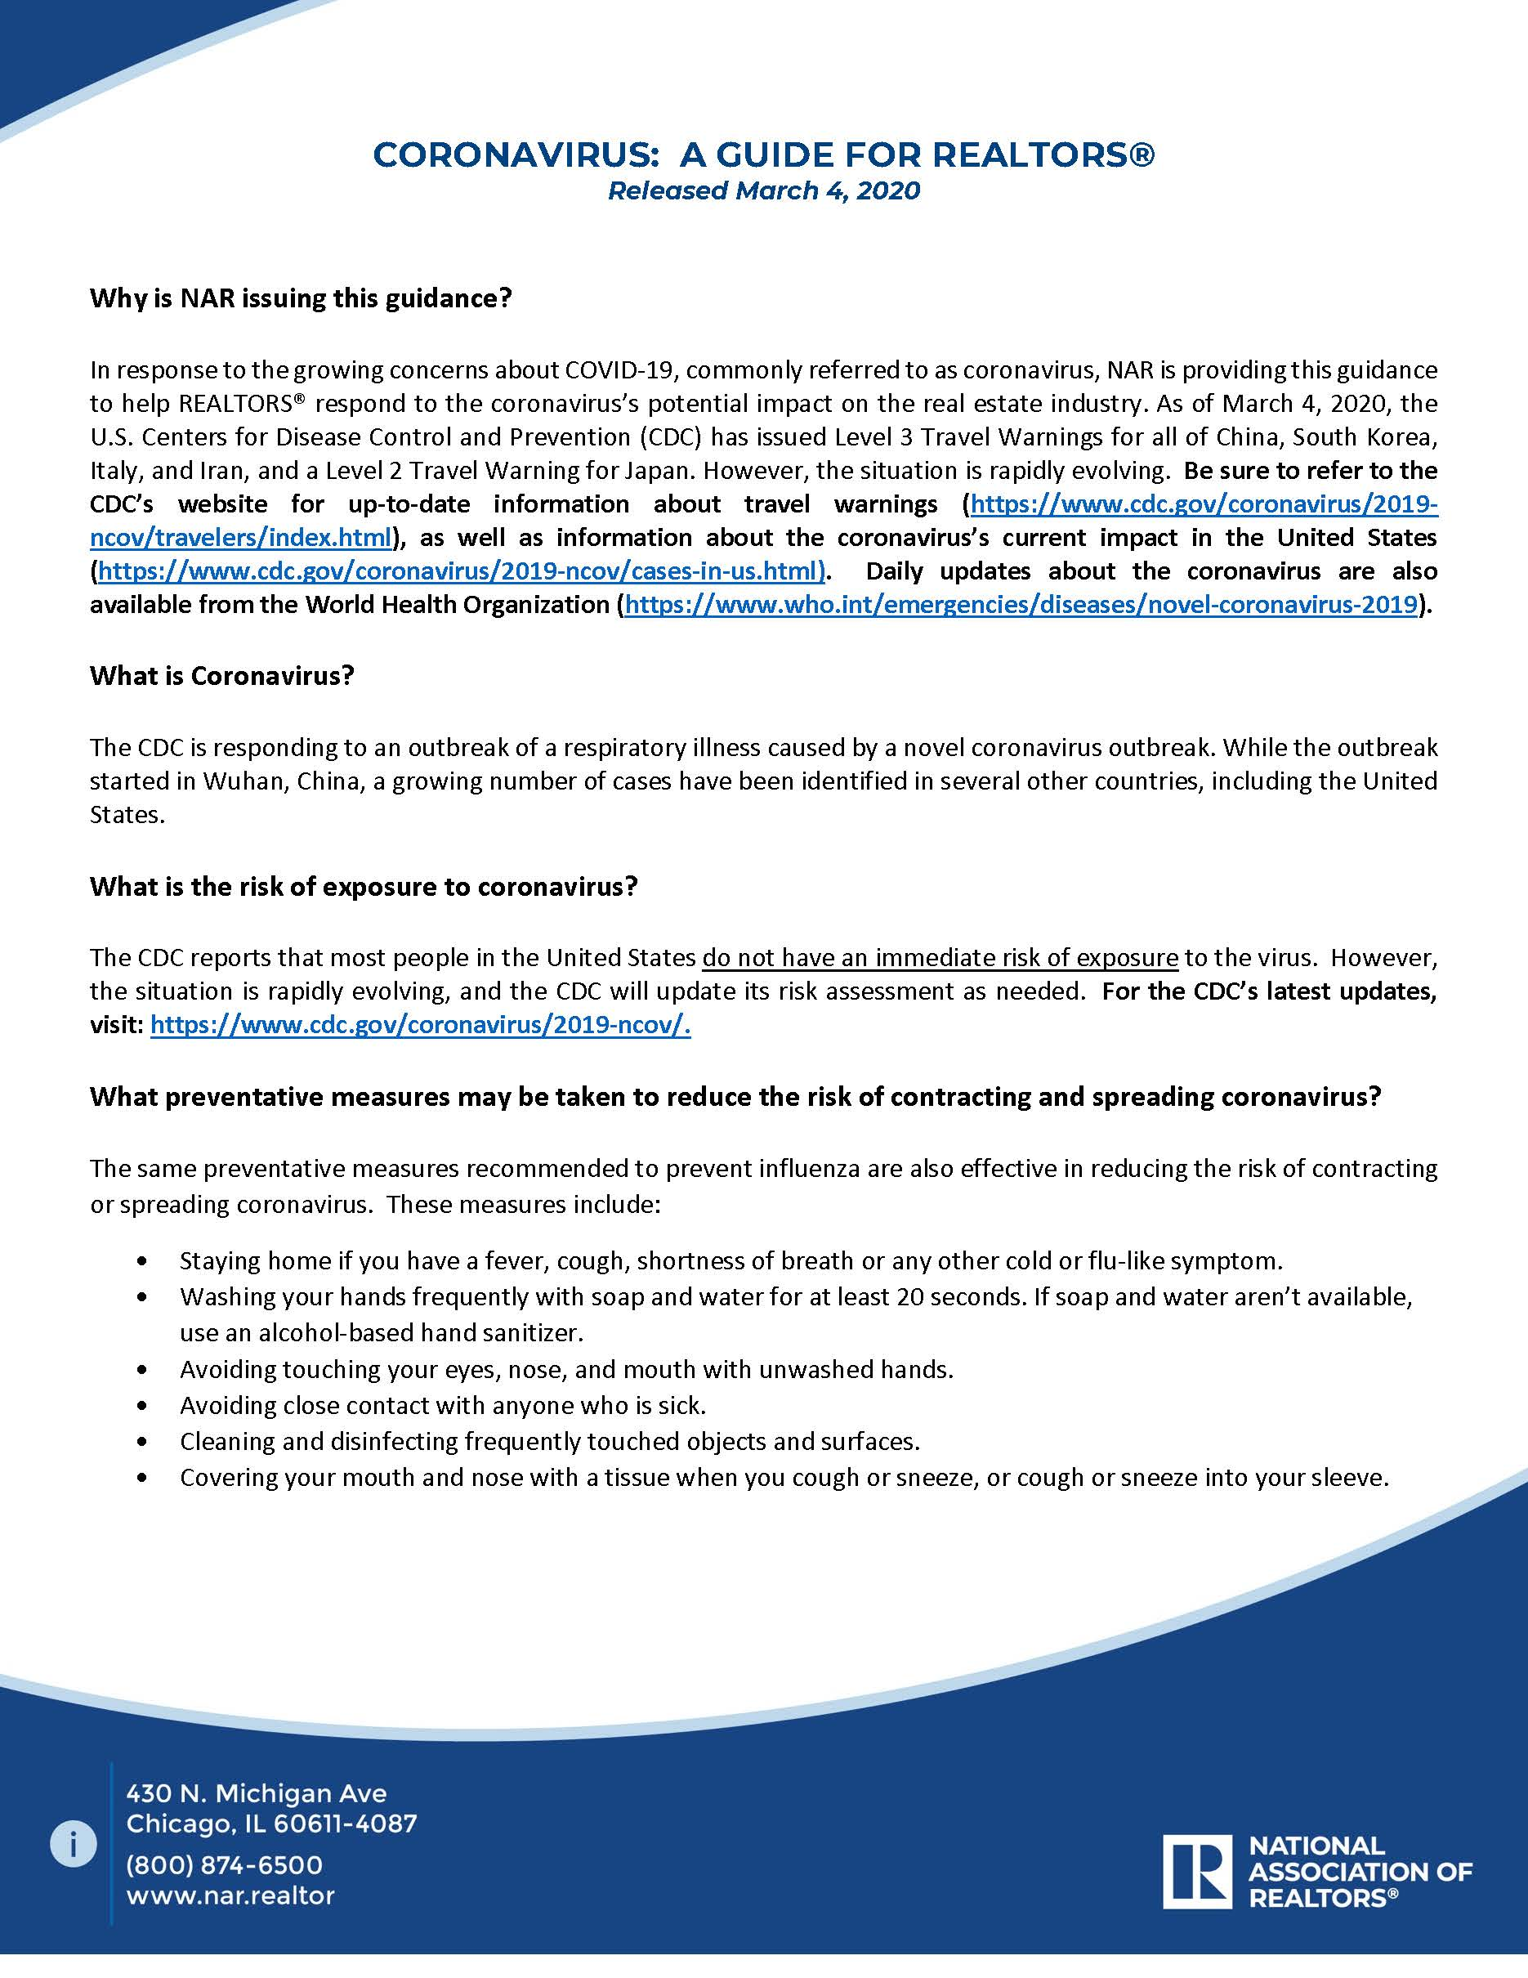
EVOLVING GUIDANCE
March 4
“May I ask a potential buyer about their recent travel plans?”

Slide 19
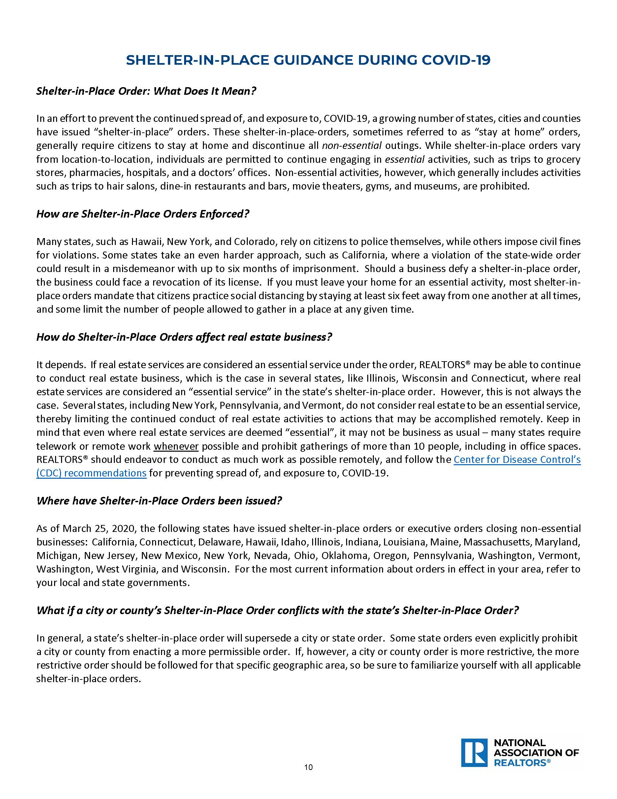
EVOLVING GUIDANCE
March 26
“How can I conduct my business under a shelter in place order?”

Slide 20

NAVIGATING UNCHARTERED WATERS
OVERVIEW
Decision Making Standard
Back to Basics

Slide 21
DECISION MAKING STANDARD
How can I provide first-class client service and move the transaction forward, while demonstrating care for the wellbeing of others, reducing the risk of exposure to and spread of COVID-19, and complying with local, state and federal public health policies?
?

Slide 22
BACK TO BASICS
COMPLY
COMMUNICATE
Adhere to state and local restrictions.
What’s known and what’s not known, too.
CONTRACTS
BEST PRACTICES
Use an appropriate addendum to address extensions.
Virtual meetings and showings, e-signatures, RON, electronic recordings.

Slide 23
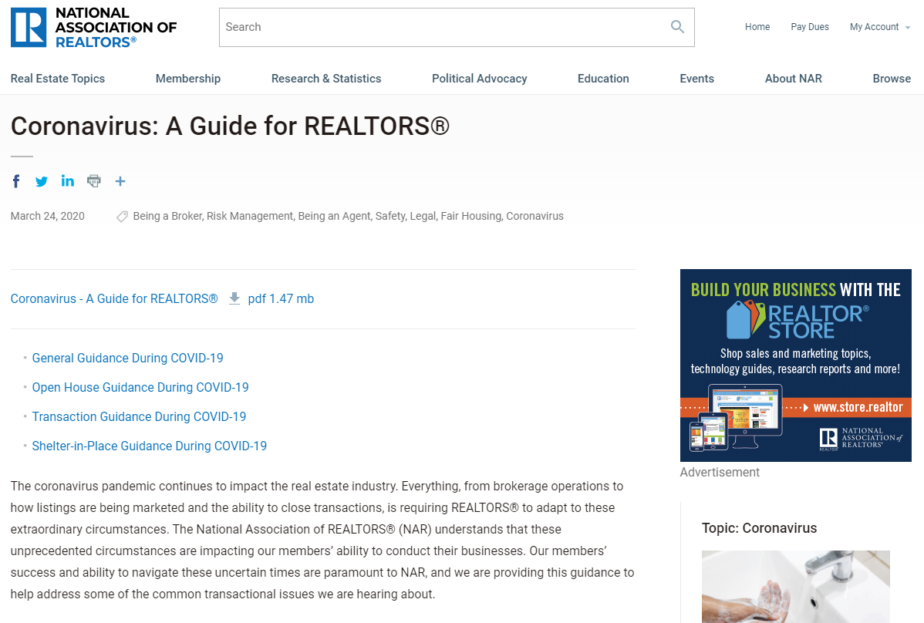
NAR GUIDANCE
General
Open House
Transaction
  Active Listings
  Properties in Escrow
  Leased Properties
Shelter in Place

Slide 24


MORE NAR RESOURCES

Slide 25
Commercial Transaction Issues
State Deadline Extensions
AND
Charlie Y. Lee
Associate Counsel

Slide 26

COVID-19 Mitigation Efforts
Managing entries and screening policies are appropriate but it must be implemented fairly and equally to avoid discrimination issues
Have a plan prepared to deal with any suspected or confirmed case of COVID-19
  Send an alert
  Work with local health and government

Slide 27

Key Lease Provisions
Force Majeure
Casualty
Condemnation or Eminent Domain
Interruption of Essential Services
Delay, Excuse or Termination of Performance

Slide 28
Rent Relief
Limit it to 30 to 60 days
Rent deferral instead of rent waiver
Rent Assessment Application
Commercial Eviction Moratoriums

Slide 29

Best Practice
Find out how other local landlords are resolving relief requests
Inform tenants about government relief programs
Work together with tenant to find a solution during an unprecedented time and avoid potential vacancies

Slide 30



State Deadline Extensions
Contacted State Real Estate Commissions
  Collaboration with ARELLO
  State Education Directors
COVID-19 Specific Extensions
  Specific date or period of time after end of state of emergency
  Official actions by 10 states
  Unofficial actions by 5 states
General extensions

Slide 31
MLS Issues
Rene Galicia
Director, MLS Engagement

Slide 32
MLS Considerations
Days on market
Open House Fields
Virtual Tours/Showings
Data Quality (accuracy + reliability)
Market Research Resources
Nar.realtor/clearcooperation

Slide 33
NAR RESOURCES RECAP
Association Management and Employment:
  Coronavirus: A Guide for REALTOER® Associations: https://www.nar.realtor/ae/coronavirus-a-guide-for-realtor-associations
  Coronavirus Guidance and Resources for Employers: https://www.nar.realtor/coronavirus-resources-and-guidance-for-employers
  Sample Preparedness Plan: https://www.nar.realtor/sample-preparedness-plan-for-circumstances-relating-to-covid-19
  Best Practices for Remote Work: https://www.nar.realtor/best-practices-for-working-from-home
  Families First Coronavirus Response Act:
    https://www.nar.realtor/political-advocacy/coronavirus-advocacy-faqs-re-transactions-independent-contractors-nar-grants
    https://www.nar.realtor/political-advocacy/impact-of-h-r-6201-families-first-coronavirus-response-act-on-nar-members
    https://www.dol.gov/agencies/whd/pandemic/ffcra-questions
    https://www.dol.gov/sites/dolgov/files/WHD/posters/FFCRA_Poster_WH1422_Non-Federal.pdf

Slide 34
NAR RESOURCES RECAP
Federal Advocacy Efforts
  Political Advocacy Resource Tab: https://www.nar.realtor/coronavirus#section-181292
Residential Transaction Issues for Members
  Coronavirus: A Guide for REALTORS®: https://www.nar.realtor/coronavirus-a-guide-for-realtors
https://www.nar.realtor/open-house-guidance-during-covid-19
https://www.nar.realtor/transaction-guidance-during-covid-19
https://www.nar.realtor/shelter-in-place-guidance-during-covid-19
  Virtual Showings and Virtual Tours: https://www.nar.realtor/virtual-showings-and-virtual-tours
  Transaction Guidance After Natural Disaster: https://www.nar.realtor/transaction-guidance-after-natural-disaster
Commercial Transaction Issues
  Coronavirus Guidance: Commercial Real Estate: https://www.nar.realtor/coronavirus-guidance-commercial-real-estate

