Slide 1
REALTORS® Political Action Committee
Liz Demorest
RPAC Fundraising Manager
NATIONAL ASSOCIATION OF REALTORS®

Slide 2
RPAC Supports Pro-REALTOR® Candidates – Regardless of Party
Notes:
RPAC is not focused on the right, left or even the middle of the aisle; we ARE focused on the issues that matter to the real estate industry and to consumers.
We support the candidates who stand up for property ownership and investment—issues that transcend politics.
In the last election cycle, RPAC remained one of the top trade association PACs in the nation in terms of direct contributions to candidates with disbursements of over $5.2 million dollars to federal candidates and national political committees.
And once again in the 2018 cycle, we were the most bipartisan of the top ten PACs in the country.
In the current political climate, PACs play an important role in moderating the political discussion and urging results over ideology.

Slide 3
Fundraising Resources
Notes:
For staff in the room – these all count toward your Advocacy Core Standards

Slide 4
RPAC Brochures
Notes:
The standard brochure has Federal Issues, but Associations can customize the brochure by adding their own issues, logos, and photos
1 free brochure per association member each year, order on realtorparty.realtor

Slide 5
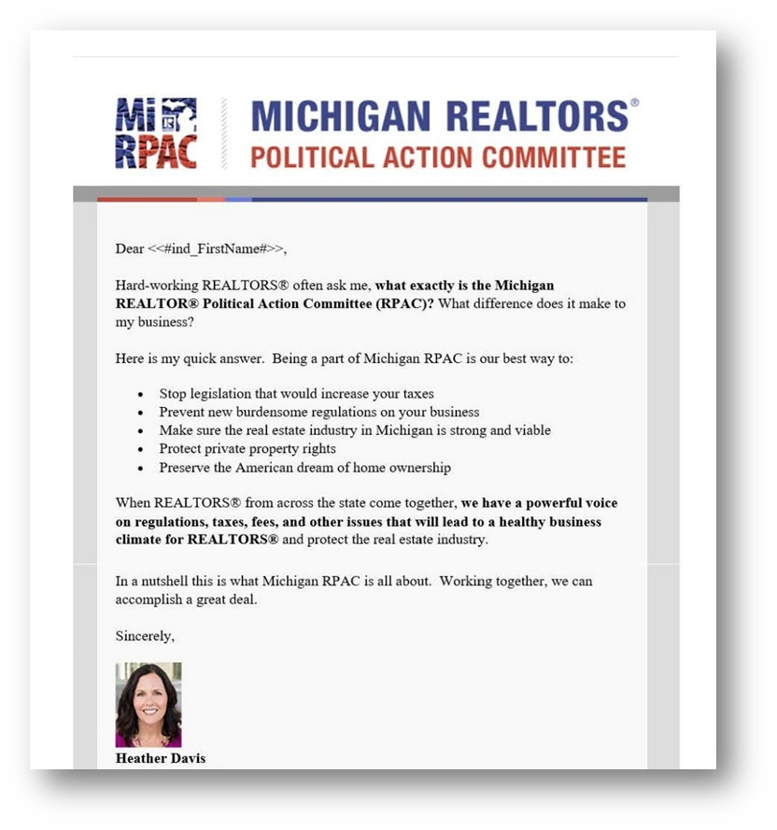
Online Fundraising Campaigns
Target messages to specific audience
Custom Branding
Notes:
Another easy way to promote the value of RPAC.
We do a variety of campaigns – Major investor payment plans, move-up campaigns, targeting past investors, new members, members in a specific area. The PAC Management System has a wealth of data points that can be used to specialize the message and reach a specific audience in your association.
All webforms and emails can be set up with custom branding or templates to ‘wrap’ your messages or forms. This means that the information is consistent with your website and other materials you put out to members.
The online messages are a part of your overall fundraising effort. –coordinate with local events or things like a Legislative Day at the Capital.
We work with your staff to determine a timeline and strategy for your campaigns.

Slide 6
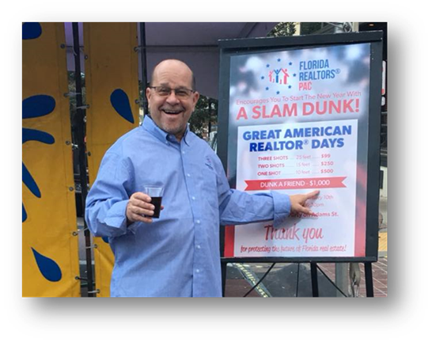
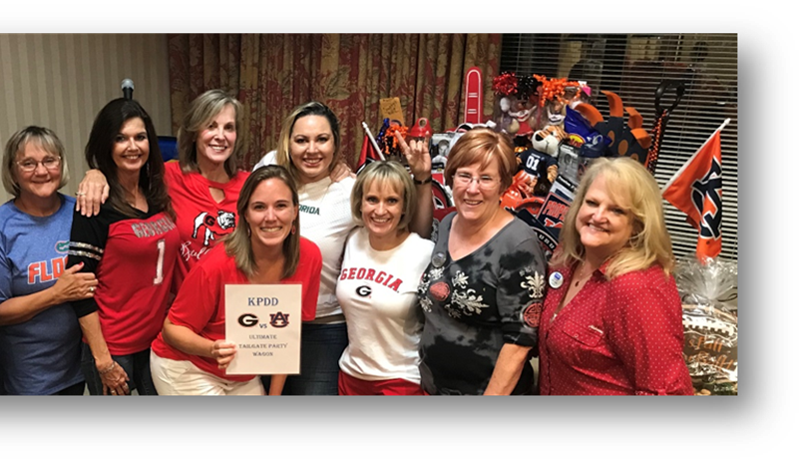
RPAC Fundraising Grants
Focus: Increase RPAC participation & receipts
Fundraising purposes only – not for recognition events
Notes:
The RPAC Fundraising Partnership Grants help state and local associations increase their RPAC fundraising receipts and RPAC participation.
This program is also focused on FUNDRAISING- so it cannot be used for recognition events
Ideas from groups at CLDD:
Free headshots for PAC investment
Trivia Night
Phone Bank
Golf Outing
Non-CLDD Ideas:
Block of tickets to sporting event with networking time before/after
Brewery Night

Slide 7
RPAC Fundraising Grant Amounts
Type | # of members | Max Grant Amount | Required Raised
Small Local | Fewer than 500 | $5,000 | $15,000
Medium Local | 500-1,999 | $5,000 | $15,000
Large Local | 2,000-6,999 | $10,000 | $30,000
Mega Local | 7,000 | $15,000 | $45,000
State | N/A | $15,000 | $45,000
Notes:
The amounts represent the maximum an association can request in total for the year
Can be split for multiple events

Slide 8
Major Investor Event Program
Reimbursement Program: up to $65/attendee
Requires NAR RPAC Volunteer Speaker
Notes:
NAR Program that provides reimbursement of up to $65 per attendee to associations for hosting events to recruit Major Investors
Requires the attendance of an NAR RPAC Representative who will make the ask
Before you schedule, set goals for the number of Major Investors you’d like to recruit at this event, and the total-dollars-raised. $500 per attendee in NEW dollars (average if a current MI brings a guest, can also include step-ups)
Apply online via realtorparty.realtor. Provide 2-3 potential dates, and submit application at least 6 – 8 weeks in advance. *Be careful not to sign any contracts with potential venues until after approval has been granted by RPAC Leadership. * Events must be approved through NAR- ask that you don’t reach out to RPAC leadership directly to ask them to speak, causes confusion with their schedules.
Once your proposal and date are confirmed, target your attendees, by assessing your Association’s Top Producers, Current Major Investors, Lapsed Major Investors, and Prospective Major Investors. A guest list of 90 – 130 will typically yield between 30 – 45 attendees.
Once you have your guest list finalized, enlist the support of a Host Committee, made of Current Major Investors, who will be charged to promote the event, and recruit attendees. An ideal size for a Host Committee is 4 Major Investors.
Finally, task your Host Committee with inviting and enrolling the attendee targets. The personal follow-up goes a long way in ensuring you have guests at the event!

