Slide 1
INTRODUCING
Adam Rodell
adamrodell@aol.com

Slide 2
Sometimes things don’t go our way, and we need a healthy way to cope.
Enter...The REALTOR® and Affiliate Wellness GROUP by Orange County Realtors®!

Slide 3
Here’s Our WHY
REALTORS® and Affiliates need support because
this business (and life in general) can be difficult at times due to:
1
High Intensity Transactions and Long Hours
2
Market Ups and Downs
3
Unpredictable Income
4
Personal and Business Life Challenges

Slide 5
Benefits of The Raw Group
Support & Friendship
Stress Management
Work & Life Balance
Sense of Belonging
Overall Wellness
Mental & Emotional Wellbeing

Slide 6
Road Map
2018
2019
2020
Present
We presented the idea to our Board of Directors, and it was approved.
We had our first in person meeting in January and continued them each month throughout the year.
Covid hit making this concept very beneficial and our meetings went virtual.
Fast forward to now - we have been holding meetings for years and additional associations have adopted The Raw Group by OC REALTORS®.

Slide 7
How Do We Do It?
We meet on the first Tuesday of every month
The meeting lasts 1 hour and 15 minutes
Our meetings are loosely based off the 12 step program
The meetings are run by volunteers using our Preamble Script
Staff should not be involved, unless of course they are attending as a participant
We Create A Safe Space
WHAT IS SAID IN THE MEETING IS CONFIDENTIAL

Slide 8
“Anything that’s human is mentionable, and anything that is mentionable can be more manageable. When we can talk about our feelings, they become less overwhelming, less upsetting, and less scary. The people we trust with that important talk can help us know that we are not alone.”
- Mr. Rodgers

Slide 9
How to Present to your Board of Directors:
Purpose: To create a fellowship for REALTOR® and Affiliates who may be struggling with alcoholism, drug addition, substance abuse, work-related stress, and depression to come together and share their experience, strength and hope by providing a safe space. These meetings will be closed meetings for Members of (Your AOR) only. Various Types of literature, pamphlets, and directors will be made available for attendees offering information for additional outside meetings and issue-specific support groups.
Format: While the initial meeting (or first few meetings) may be non-issue specific open topic discussion meetings, it would be my guess that the group conscience will ultimately choose its own directional course and format. It’s quite possible that a hybrid or version of 12 step program will be adopted since many of the participants will have familiarity with 12 step programs. But it would be my desire to let the group make the decision on what format they wish to use. It would be our goral to augment some of the discussion meetings with speaker meetings featuring guest speakers using a panel format.
Challenge: The singular purpose of this meeting is to create a safe place for our REALTOR® and Affiliate Members to address the various struggles that may be affecting their lives. The fast is, there are many different types of issues that our membership may suffer from. Furthermore, it’s very common that some of our Members will suffer from cross-addictions and dual diagnosis. It’s a known fact that any one of these issues can trigger the other issues. Therefore, the biggest challenge I see is how to offer the most inclusive meeting space that can help the greatest number of our Members, realizing that the meeting format may become more specific in nature over time. I believe that the group consciousness will best determine the direction of the meetings and format.
This would be much easier if it were solely an AA, NA, CA, OA, GA meeting or support group that catered to a specific issue. It’s quite possible that those meeting formats may splinter off on their own to conform to the traditions of those specific programs. The goal is to help those who are suffering from any issue like substance abuse, depression, or stress be able to come to a safe place, to know that they don’t have to walk thru this alone, and to find hope that there is a solution to their problem. This may be the beginning of their journey that leads them to other meetings and groups more specific to their own personal needs. “The journey of a 1,000 miles begins with the first step.” It’s my hope that (Your AOR) can be instrumental in helping its Members take that first step.
Needs: What do we need from (Your AOR)? We are asking for the ability to use the meeting rooms of both the (office locations) facilities on an alternating, monthly basis. The meetings would be for one hour and should occur on the same day of the week each month. We do not need any financial support and therefore will not be requesting a budget from the Finance Committee. We would like the (Your AOR) help in reaching out to our Membership via our Association's communications (i.e., website, inclusion in our ongoing email notifications outreach, possible blubs when possible, in the (Your AOR) magazine, and to be included in the ongoing calendar of events occurring within the Association. We want to let our Members know that the (Your AOR) care about them and their wellbeing.

Slide 10
Steps Needed to Launch Within Your
AOR:
1. Present RAW to your Board of Directors for approval. | 2. Identify a potential facilitator for the first few meetings. | 3. Schedule dates and location for the monthly meetings. | 4. Begin promoting The Raw Group through various Association channels, including marketing meetings, social media, and other printed formats.
Stay consistent, regardless of turnout!
Success is not measured by attendance. If we can help one person, we’ve succeeded.

Slide 11
Promotion Matters
Here are some examples of where you can promote The Raw Group:
Marketing Meetings
Your Magazine
Newsletters
Email Signature
Your Website
At Your Special Events
Through your Committees, especially YPN
Flyers at Your Office
Word of Mouth

Slide 12
REALTOR® TRADEMARK IN NAME
When associations use the REALTOR® Marks in the names for services, programs, events, publications, etc., the association name must immediately precede, follow or otherwise be included in the name. For example, "REALTOR® and Affiliate Wellness Group, a program of the Orange County REALTORS®" would be a proper use of the Marks in this context.

Slide 13
2024 Flyer
For the OC Realtors® RAW Group

Slide 14
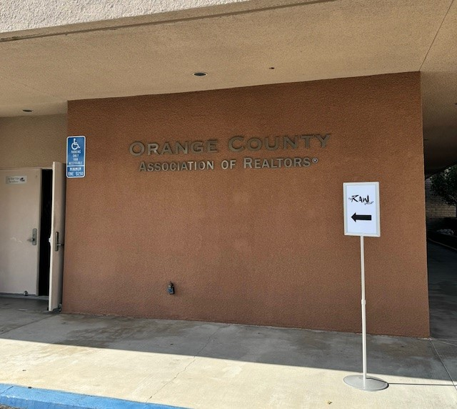
Meeting Space
We use directional signs to direct our attendees through private entrances to our meeting room to protect their confidentiality.

Slide 15
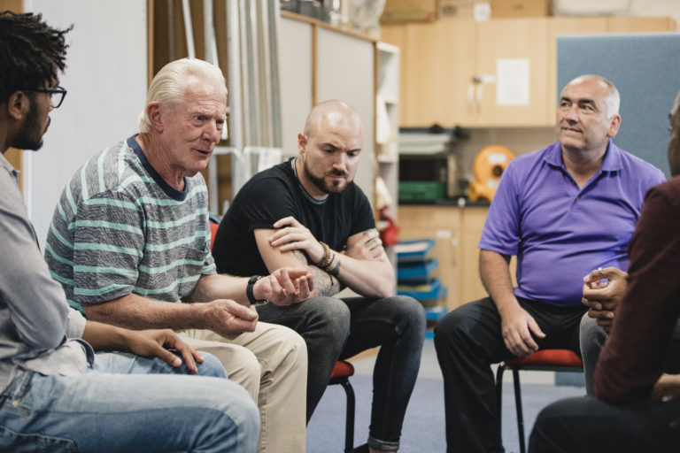
Meeting Outline
Agents and Affiliates have a chance to network
and then watch a 3-5 minute video.
11:45 - 12:00
2
Facilitator reads the Preamble Script
and goes over the meeting Ground Rules.
12:00 - 12:05
12:05 - 12:55
Open sharing begins. Facilitator goes first.
Facilitator gives a literature report, offering free literature to attendees, and concludes the meeting by asking for a volunteer to facilitate the next meeting.
12:55 - 1:00

Slide 16
Video Links Library
Here is a small sampling of videos we share. We have a full library ready for you.
I Am Broken: https://youtu.be/2ou_zUINQ9k
Me vs Anxiety: https://youtu.be/FdSIjZGWW7w
Be a Mr. Jensen: https://youtu.be/4p5286T_kn0
Funny Stress: https://youtu.be/ybnzd4zu8xs
Your Value: https://youtu.be/yBrRpb8aLwk

Slide 17
Free Resource Information
Here are some resources you can share during the Literature Report
Meeting directories to various 12 step programs
Hotline information to various crisis intervention programs
Various meditation and inspirational books
Resource pamphlets produced by outside support groups

Slide 18
More Associations Now Offering RAW
Orange County REALTORS®
https://www.ocrealtors.org/education/raw
Bridge Association of REALTORS®
https://www.bridgeaor.org/post/raw-support-group-for-members-join-us
Bay East Association of REALTORS®
https://bayeast.org/video/the-raw-group-realtor-and-affiliate-wellness/
More associations that have implemented RAW Groups are listed on the NAR Safety webpage at: nar.realtor/safety

