Slide 1
The Livability Index: Great Neighborhoods for All Ages
Rodney Harrell, PhD
@DrUrbanPolicy
Director, Livability Thought Leadership
AARP Public Policy Institute - @AARPpolicy
#LivIndex

Slide 2
Nonprofit, nonpartisan, social welfare organization
Membership of nearly 38 million
Fights for the issues that matter most to families
Public Policy Institute
Research, analysis, policy
Social security, long-term care, health, financial security
Strategies and solutions to improve the quality of life for older Americans
Livable Communities Team
Promote the development of safe, accessible, vibrant communities
Policy areas: land use, housing, transportation, broadband
Aging in communities
Notes:
http://www.aarp.org/about-aarp/
AARP is a nonprofit, nonpartisan, social welfare organization with a membership of nearly 38 million that helps people turn their goals and dreams into real possibilities, strengthens communities and fights for the issues that matter most to families — such as health care, employment and income security, and protection from financial abuse.
http://www.aarp.org/about-aarp/company/social-impact/
Research: Through forward-looking research and practical solutions, AARP fosters debate to make a positive difference. For example, the AARP Public Policy Institute publishes major reports on health and financial security trends affecting people over 50 and their families. Our Research group conducts surveys on consumer issues and trends.
Advocacy: AARP fights for age 50 and over individuals and their families at the local, state and national levels; Fostering communities with affordable and appropriate housing, as well as supportive community features and options for getting around
Foundation: AARP Foundation serves vulnerable people 50+ by creating and advancing effective solutions that help them secure the essentials.
Direct Assistance: Working with local groups, government and national organizations, and corporations, the Foundation creates and supports solutions that help older people meet life's essentials: food, housing, income and personal connection.
Raising Awareness: We work to increase awareness among individuals and thought leaders about the critical issues low-income older Americans face today, including research into causes and longtime solutions for these problems.

Slide 3
What is a Livable Community?
“A livable community is one that is safe and secure, has affordable and appropriate housing and transportation options, and offers supportive community features and services. Once in place, those resources enhance personal independence; allow residents to age in place; and foster residents’ engagement in the community’s civic, economic, and social life.”
—AARP Public Policy Institute
Notes:
This is AARP’s definition of a livable community.
In a livable community, people of all ages can….take a walk; safely cross the street; ride a bike; use public transportation; live comfortably; work or volunteer; enjoy public places; socialize; spend time outdoors; be entertained; go shopping; buy healthy food; easily get to quality medical care; find the services they need; and make their city, town, or neighborhood a lifelong home.
The Livability Index will help to show how well a community is prepared for an aging population; help to educate policy makers about how to improve the community; and help individuals answer the question: “Is this a good place to live?”
AARP’s definition describes communities that support the needs of all residents regardless of:
age, physical ability, income, cultural background, race, or other factors.
We encourage communities to reach an aspirational goal to become as “livable” as they can
Challenge:
To create livable communities where people already live
When planning and designing new communities.

Slide 4
The Livability Index
Why was the Livability Index created?
Research has shown that most people would like to age in their homes and communities.
Unfortunately, many of America’s communities do not adequately support residents across the age spectrum in realizing their fullest potential.
The Livability Index provides insight to catalyze community conversations that can lead to positive change.
Notes:
Why did AARP create the Livability Index?
With over 50 years of experience, research and analysis of the 50+ population, AARP has a solid understanding of the needs of older adults and their families. Over 80 percent of older adults tell us that they want to remain in their homes and communities as they age. They don’t want to be forced to move because their needs can be better met elsewhere. They don’t want to compromise their health and well-being just to stay in their community. They expect that as they age, their communities will offer the type of environment and services that they need to age in place. Unfortunately, many of America’s communities are not prepared to deliver on this expectation.
We want to help make communities more livable, which makes aging in place possible for people at all life stages.

Slide 5
The Livability Index
Why was the Livability Index created?
Vision: Communities support residents across the lifespan in realizing their fullest potential and ability to age in place
Goal: Provide residents and community leaders w/a an interactive, online tool that enables them to visualize their performance against key indicators of livability
Main Objectives
State and local changes in policy, planning, and investment
Inform key stakeholders
Help communities become more livable for residents of all ages
Community resident participation
Notes:
Why did AARP create the Livability Index?
The purpose of the Livability Index is to serve as an informative and educational tool that will encourage policy development, new initiatives, and community stakeholder participation with the primary goal of improving the quality of life for community residents.
Main Objectives:
Stimulate local changes in policy, planning, and investment that will increase the livability of communities
Educate local policy makers on key policies, investments, and other community elements that will make communities more livable for people of all ages
Stimulate state level policy, planning, and investment that can support the growth of local livability
Educate residents and stimulate their participation in generating community change that fosters livability for people of all ages
Educate the general public about their housing and transportation choices so that they are better prepared for aging

Slide 6
The Livability Index
Categories & Attributes
Housing Accessibility
Housing Options
Housing Affordability
Transportation
Commitment to Livability
Convenient Transportation Options
Transportation Costs
Safe Streets
Accessible System Design
Commitment to Livability
Housing
Neighborhood
Proximity to Destinations
Mixed-use Neighborhoods
Compact Neighborhoods
Personal Safety
Neighborhood Quality
Commitment to Livability
Environment
Engagement
Internet Access
Civic Engagement
Social Engagement
Opportunity
Equal Rights
Commitment to Livability
Equal Opportunity
Economic Opportunity
Education
Multi-generational Communities
Local Fiscal Health
Commitment to Livability
Healthy Behaviors
Access to Health Care
Quality of Health Care
Commitment to Livability
Water Quality
Air Quality
Resilience
Energy Efficiency
Commitment to Livability
Health
Notes:
The following slide lists the seven categories with their respective attributes.
Commitment to Livability appears under each of the 7 categories because of the cross-cutting nature of the work. Member communities of the AARP Network of Age Friendly Communities, or comparable program that AARP is able to track, receive a single policy point.

Slide 7
The Livability Index
Metrics & Policies
Metrics and policies are the indicators used to measure livability. They are drawn from over 50 sources of data.
Metrics
Policies
Policies are actions communities can take to improve livability over time.
Metrics indicate how livable communities are in the present by measuring community characteristics.
40 metrics are used in the Livability Index; 21 of those evaluate livability at the neighborhood scale.
Each category contains 4-9 metrics.
Metrics must be relevant and subject to direct/indirect influence by state and local policymakers.
20 state and local policies are evaluated in the Livability Index.
Source:propay.com
Notes:
Livability Index Indicators/Measurements
Indicators include both metrics, which measure what is on the ground today, and policies, which give us a view into the future. All of the metrics and policies within a category collectively provide the basis for evaluating livability for that category.
Metrics
Must measure community characteristics, not characteristics of individuals
Must measure characteristics that would make a community more livable for residents, if improved.
Must be relevant to state/local policymakers
Must be subject to direct or indirect influence by state and local policymakers (e.g. weather cannot be influenced, but weatherization or disaster response can.)
“Indirect influence” refers to characteristics that the private sector directly controls, but that can be influenced by policies or other actions of local government (e.g. number of grocery stores is a private business decision, but zoning and outreach to attract grocers can be done by local government)
Policies
Include policies and programs that impact livability
Must be at the state or local level and relate to an attribute of livability. It is much harder to find national databases of local policies, thus many of the policies are state level policies.
Must be measurable on a binary system – places with “good” or “model” policies receive credit for those policies, while places with poor, incomplete, or nonexistent policies receive no credit
Measures must have a meaningful amount of variation across different geographies (e.g. a metric that has similar values across all U.S. counties is not meaningful; federal policies are not included because they have the same effect across the entire U.S.)
We cannot review individual ordinances or programs for inclusion in the Index; we can only include policies that are tracked and rated by third-party organizations.

Slide 8
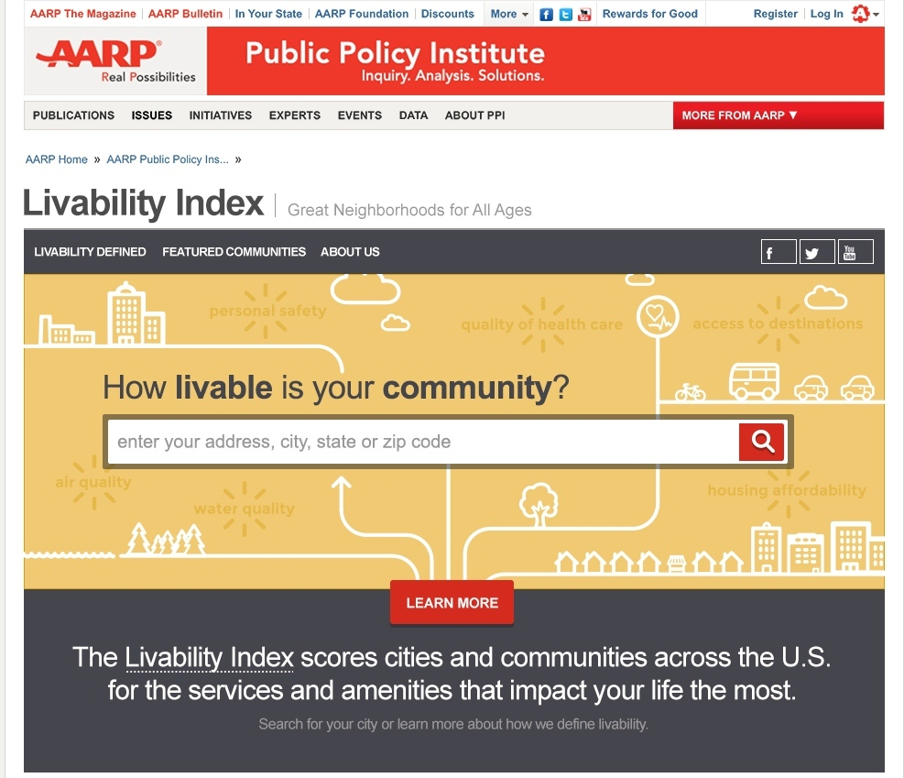
Navigating the Livability Index
Livability Index Homepage
Getting started is simple!
Users may enter their address, city, state, or zip code on the Livability Index’s homepage, found at:
www.aarp.org/livabilityindex.
Notes:
This slide is the homepage of the Livability Index.
The Index is sensitive to the level of geography entered. If the user inputs an address, a score for the neighborhood is returned. If s/he enters a city name, the score for the city is returned. City scores (and all higher levels of geography) are calculated for the average of all block groups within their boundaries.
At this point in time, the Index does not provide scores at the Metro scale, although three metrics pull data at this level (e.g., social involvement index, basic passage/housing accessibility and jobs per worker).

Slide 14
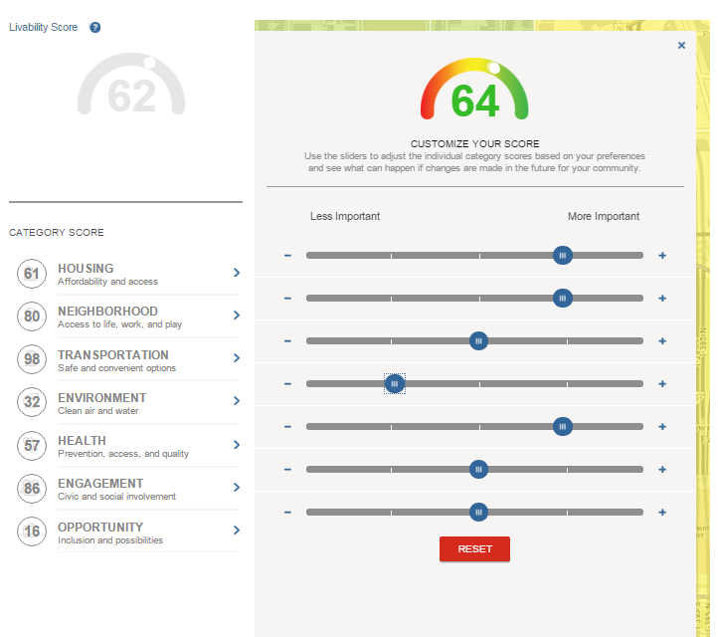
Navigating the Livability Index
Customizing Your Score
Original total score
New customized total score
Sliders to adjust scores based on importance of categories
Original category scores
Notes:
There is no one definition of livability. Everyone brings his or her own personal preferences to the selection of a home or neighborhood. Therefore, users can customize their scores according to which categories are more or less important to them. In other words, users can weight each category of livability according to their personal preference.
When a particular category score is close to the midpoint (50), new weights have less affect on the customized score.
The score adjusts automatically.
The reset button returns each category to the same weight.

Slide 15
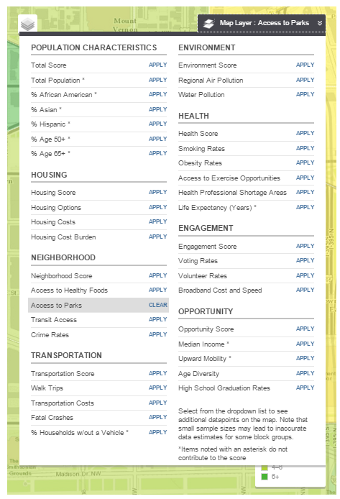
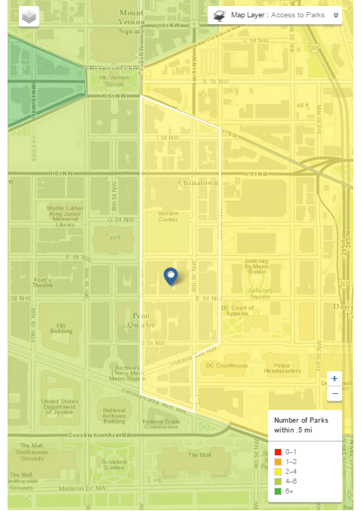
Navigating the Livability Index
Using Map Overlays
Users may select from a variety indicators for a geographic analysis of the livability score components.
Map showing residents’ accessibility to parks based on the number of parks within 0.5 mi.
Notes:
The results map has a link to map overlays that provide more geographic analysis of the searched location. Users can chose from more than 35 different map layers. Users will find demographic information such as race/ethnicity, age, and a visual display of the indicators that comprise the livability scores. Map layers tagged with an asterics (“*”) do not factor into the livability scores. They were included b/c they provide users with additional interesting information about their communities, states, and nation.
In the following example, “Access to Parks” is selected. This produces a color-coded map which shows residents’ proximity to parks based on the number of parks within a half-mile radius.
The map layers feature is particular powerful to observe geographic differences and inequities across communities, regions and states. For example, apply Upward Mobility or Life Expectancy zoom out until just before the level of geography moves from outlining counties to states and then pan from north to south. You will observe huge differences between the northern and southern regions of the country. Any of the metrics that present information at the neighborhood scale (such as walk trips) can show interesting differences across an individual community.

Slide 16
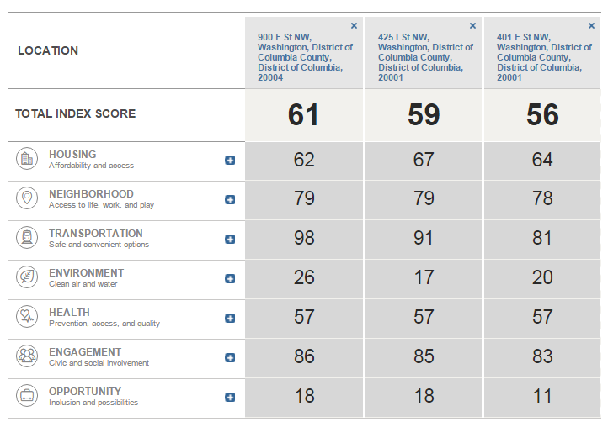
Navigating the Livability Index
Comparing Locations
Up to three locations can be compared.
Click the box for a detailed analysis of the metrics and policies of each location.
Notes:
Users can compare the livability score and category scores for up to three locations (any combination of address, town, city, county, or state).

Slide 17
Beyond the Livability Index
Applying the Data
A county executive and staff want to know how to meet the housing needs of the growing population of older adults.
A real estate agent wants to market his walkable community as a place to find great housing near many local businesses and other amenities.
A non-profit organization wants to show the need for transportation services in the community.
A community advocate wants to make the streets safer for those who cannot afford to drive and those who can no longer drive.
An AARP member is deciding between two locations and wants to live close to medical services because she is taking care of a family member.
What will the Livability Index do for your community?
Notes:
Possible uses for the Livability Index through user examples:
The livability index score will give the user a snapshot of the current conditions within a community and help local stakeholders make decisions about their needs.
A county executive and staff want to know how to meet the housing needs for the growing population of older adults.
The livability index could provide information about the types of housing currently available within the community and affordability of local housing options.
A community advocate wants to make the streets safer for those who cannot afford to drive and those who can no longer drive
The livability index could provide information about Complete Streets policies or older adult pedestrian fatalities.

Slide 18
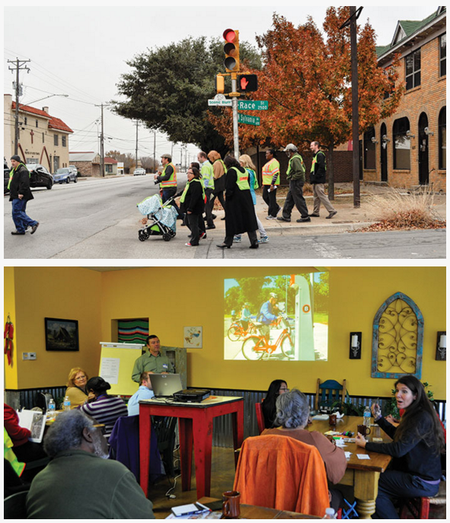
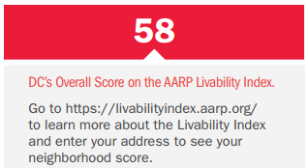
Livability Index Case Studies
Notes:
Washington DC 2015 Progress Report
http://agefriendly.dc.gov/sites/default/files/dc/sites/agefriendly/publication/attachments/AgeFriendly-2015ProgressReport-508-sm.pdf
APA Article: Livability for All
https://www.planning.org/planning/2015/dec/livabilityforall.htm

Slide 19
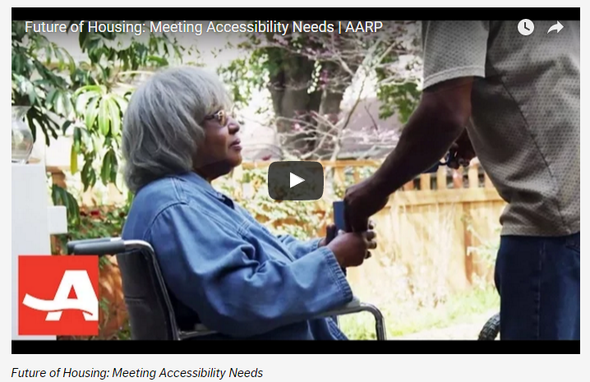
#FutureofHousing
www.aarp.org/futureofhousing
www.theatlantic.com/housingfortomorrow

Slide 20
For More Information
The Livability Index
www.aarp.org/livabilityindex
#LivIndex
Livable Communities Research and Policy Solutions
www.aarp.org/livablepolicy
@AARPpolicy
www.aarp.org/livable

