Slide 1


Slide 2


Slide 3


Slide 4
States That Allow Medical Marijuana Use
Alaska
Arizona
Arkansas
California
Colorado
Connecticut
Delaware
District of Columbia
Florida
Georgia
Hawaii
Illinois
Maine
Maryland
Massachusetts
Michigan
Minnesota
Montana
Nevada
New Hampshire
New Jersey
New Mexico
New York
North Dakota
Ohio
Oregon
Pennsylvania
Rhode Island
Tennessee
Vermont
Washington

Slide 5
States That Allow Recreational Marijuana Use
Alaska
California
Colorado
Maine
Massachusetts
Nevada
Oregon
Washington

Slide 6


Slide 7
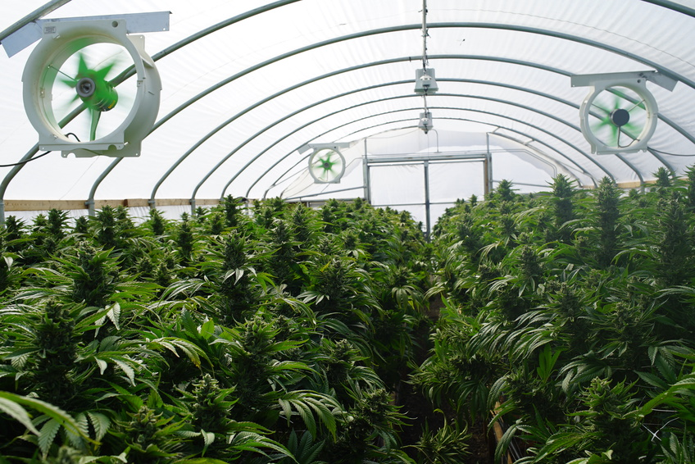

Slide 8


Slide 9


Slide 10
States Not Required to Accommodate Legal Marijuana
Alaska
Arizona
Arkansas
California
Colorado
Connecticut
District of Columbia
Florida
Georgia
Hawaii
Illinois
Maine
Massachusetts
Michigan
Minnesota
Montana
Nevada
New Hampshire
New Jersey
New Mexico
New York
Ohio
Oregon
Pennsylvania
Rhode Island
Vermont
Washington
Employers Barred from Discrimination Because of Card Status
Arizona
Arkansas
Connecticut
Delaware
Illinois
Maine
Minnesota
Rhode Island

Slide 11
Resources
Marijuana in Property Management
  https://www.irem.org/File%20Library/Public%20Policy/MarijuanaLegalizationLaws.pdf
Field Guide to the Impact of Legalized Marijuana
  https://www.nar.realtor/field-guides/field-guide-to-the-impact-of-legalized-marijuana
Marijuana Clauses Your Lease Should Include
  http://realtormag.realtor.org/commercial/feature/article/2016/04/marijuana-clauses-your-lease-should-include
What If Your Agent Smokes Pot?
  http://realtormag.realtor.org/for-brokers/network/article/2014/11/what-if-your-agent-smokes-pot

