Slide 1
Best Practices for Vetting Vendors

Slide 2

Review the Vendor’s Website
Check how long the vendor has been in business.
Review vendor’s areas of expertise.
Consider vendor’s business strategies.

Slide 3
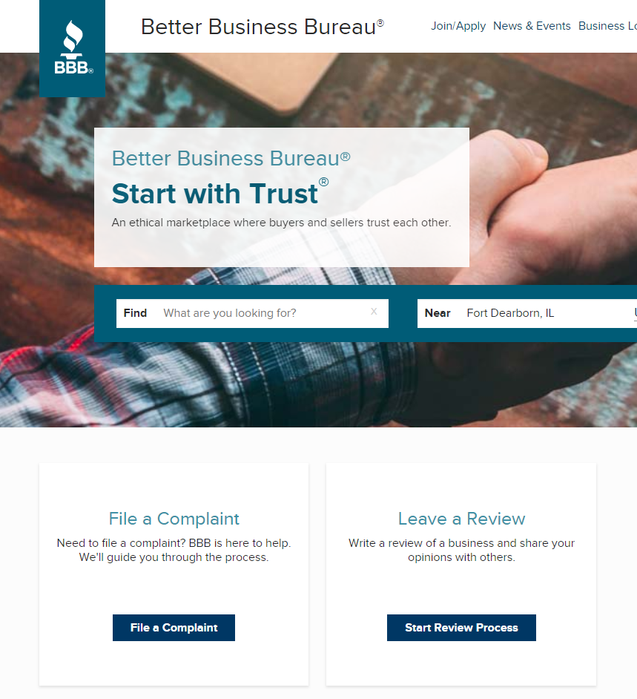




Check References and News
Request vendor provide references to learn previous customers’ experience.
Obtain information about vendor through third-party websites.
Conduct an online search of vendor.

Slide 4

Establish Expectations

Slide 5
Copyright
Address issues related to use of any intellectual property created under the agreement, including through a
work-made-for hire or licensing provision.

Slide 6
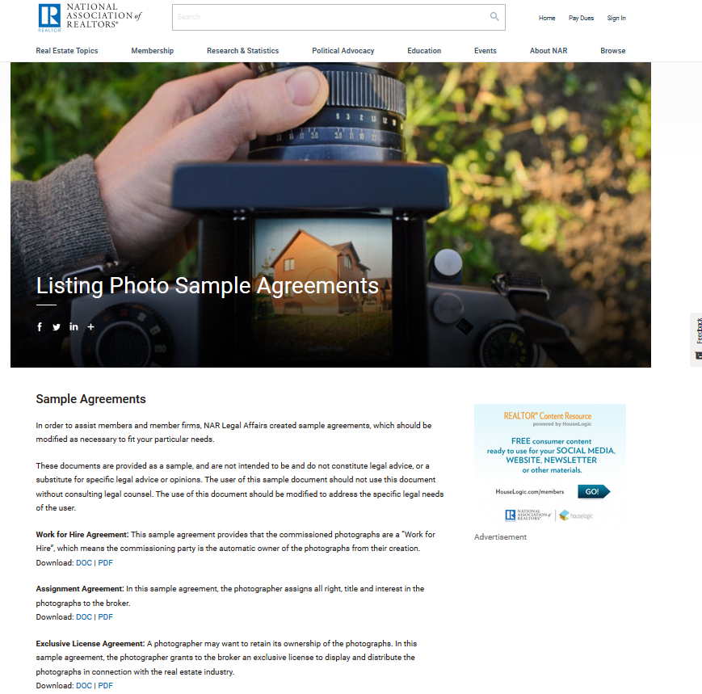
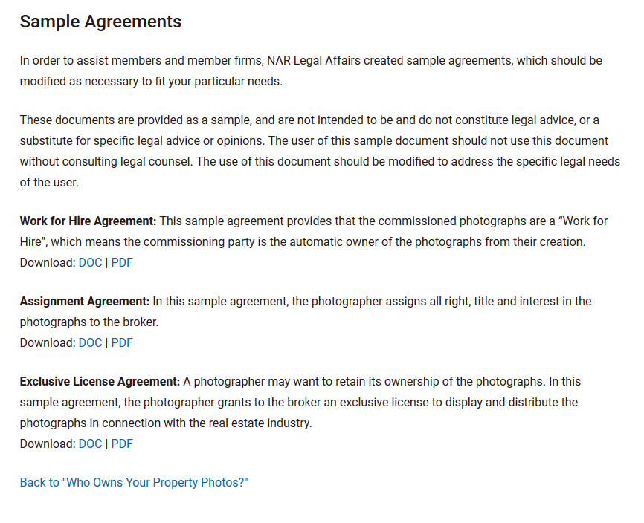
https://www.nar.realtor/legal/copyright-trademark/listing-photo-sample-agreements

Slide 7
Standards of Performance
Require vendor’s products and service follow industry standards.

Slide 8
Indemnification
Seek protection against third-party claims related to the vendor’s products or service.

Slide 9
Assignment
Require consent be obtained prior to vendor transferring any obligations to a third party.

Slide 10
Termination for Convenience
Seek the ability to terminate the contract for any reason.

Slide 11
Check out NAR’s
“Vetting the Vendor Checklist”:
http://nar.realtor/vetting-the-vendor-checklist

