Slide 1
Lets Get Started! FinancialWellness.realtor

Slide 2
FinancialWellness.realtor

Slide 3
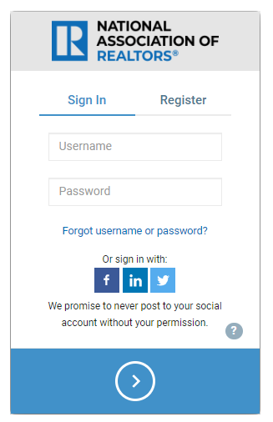
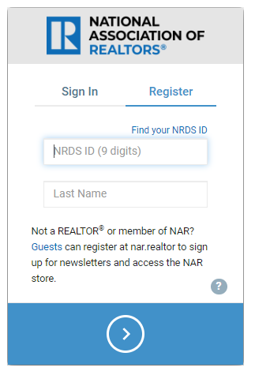
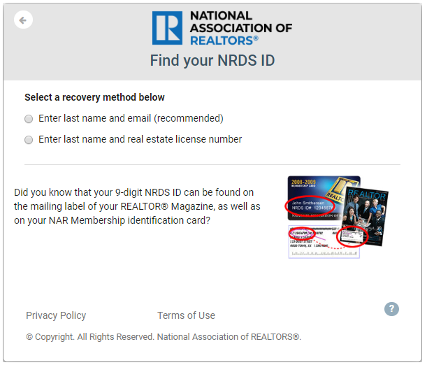
Options for Creating Your Account: 1 2
1-800-874-6500

Slide 4
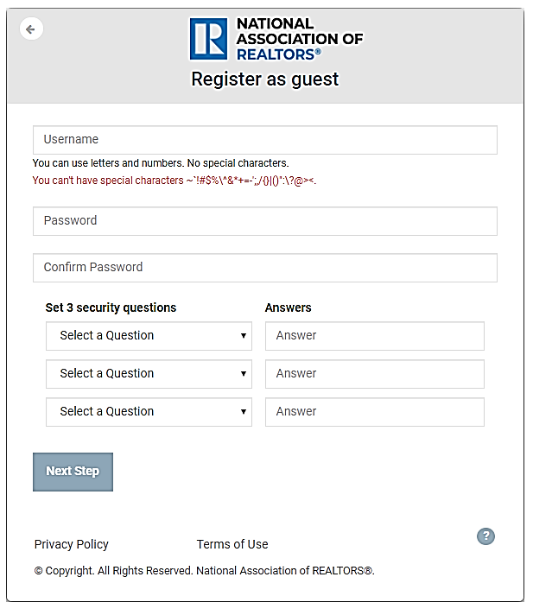
Options for Creating Your Account: 1 2 3

Slide 5
Homepage

Slide 6
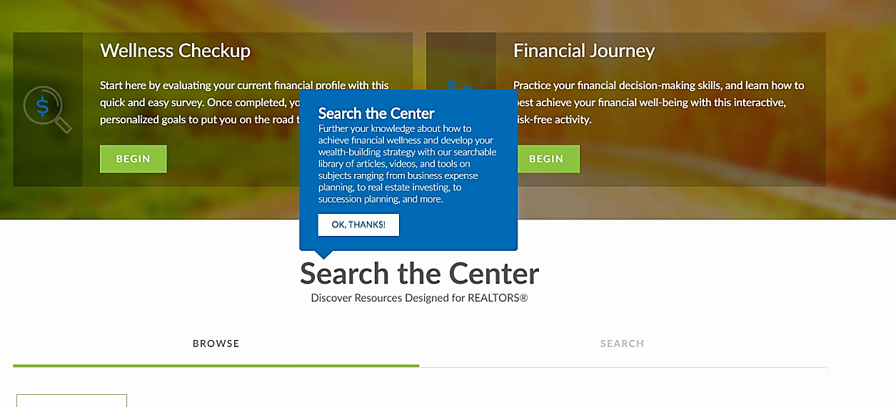

Slide 8
Take Your Assessment

Slide 9
Example 1

Slide 10
Example 1

Slide 11
Example 1

Slide 12
Example 1

Slide 13
Example 2

Slide 14
Example 2

Slide 15
Assessment Completed!

Slide 16
Your Personalized Goals

Slide 18
Add Additional Goals

Slide 19
Add Additional Goals

Slide 20
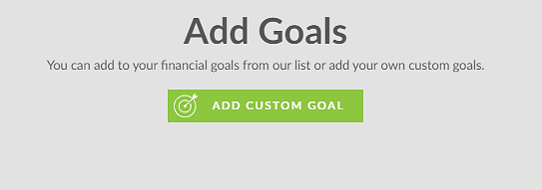
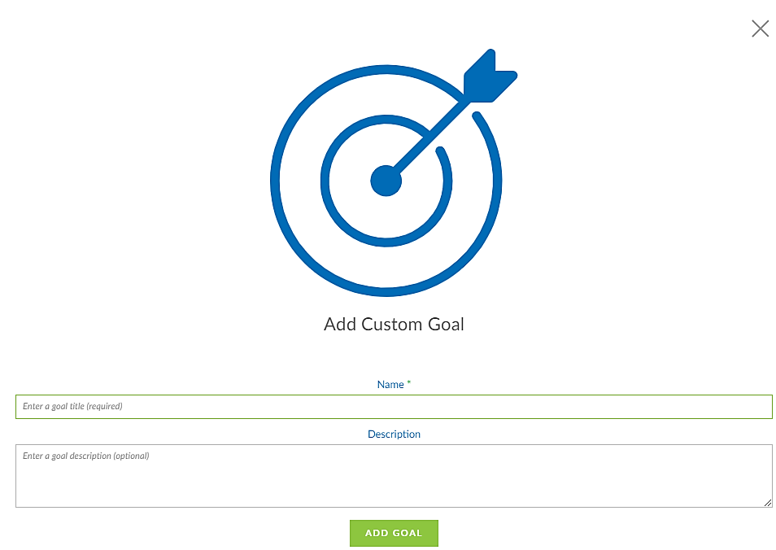

Slide 21
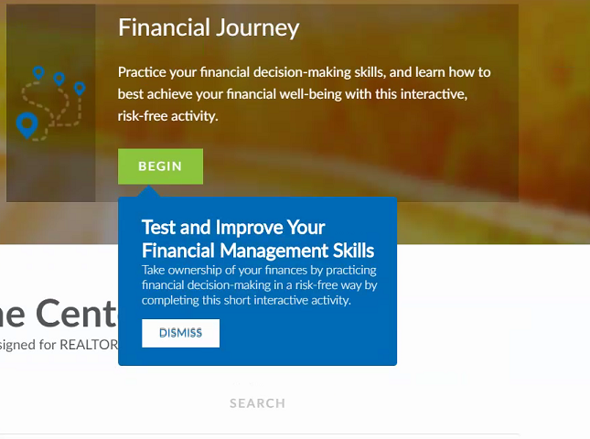

Slide 22
Let’s Get Started!

Slide 23
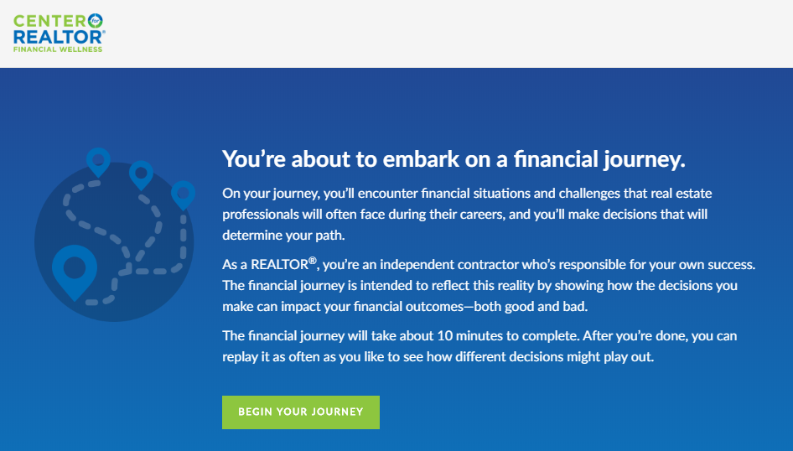

Slide 26
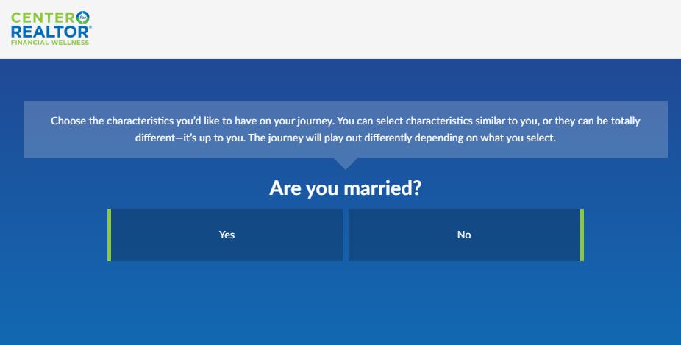

Slide 28
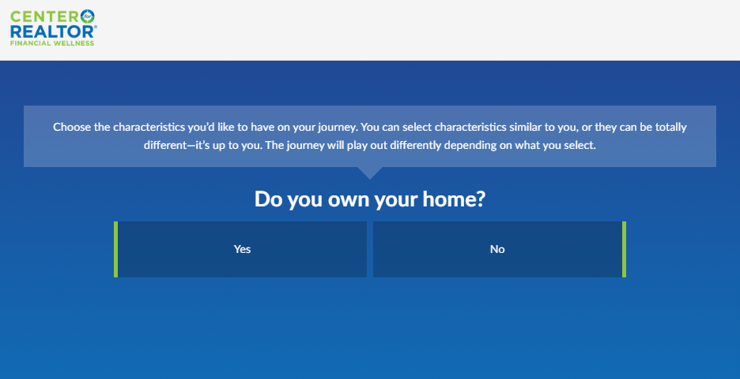

Slide 30
Actions Affect Outcomes

Slide 31
Current Finances

Slide 32
Current Finances Happiness

Slide 33
Current Finances Happiness Future Finances

Slide 34
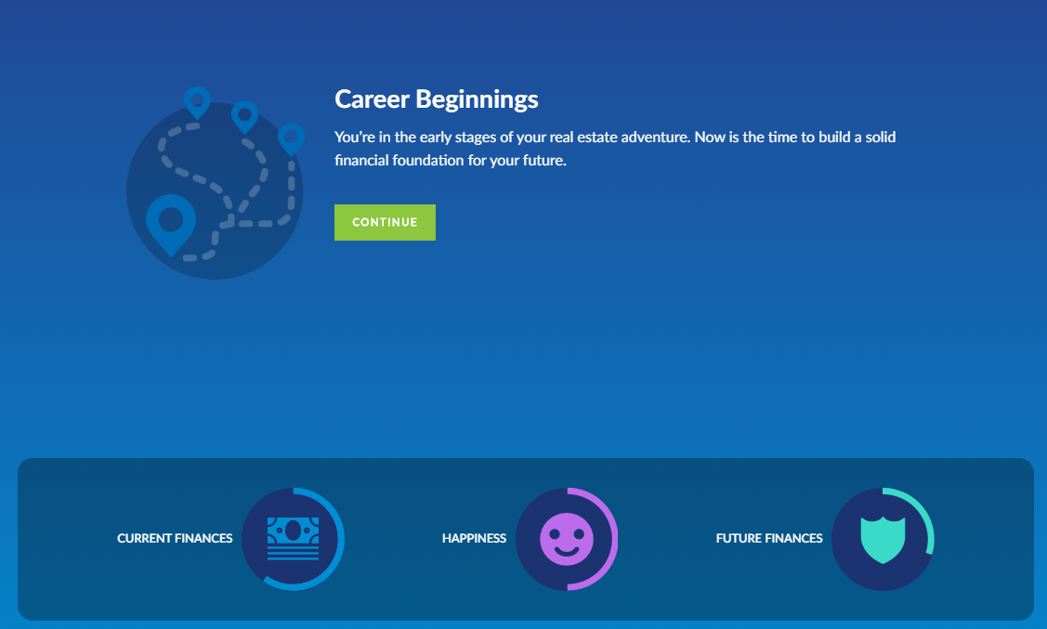

Slide 36
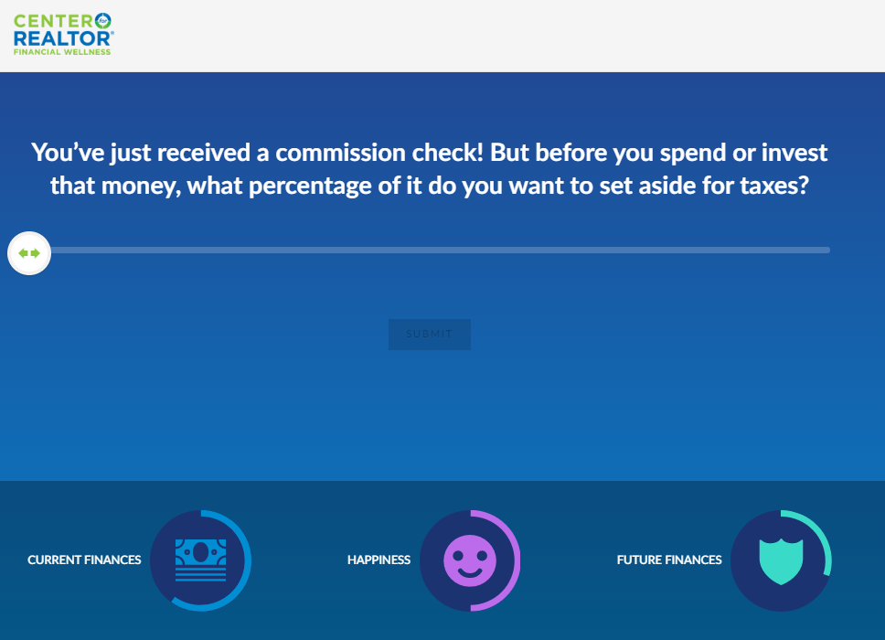

Slide 37
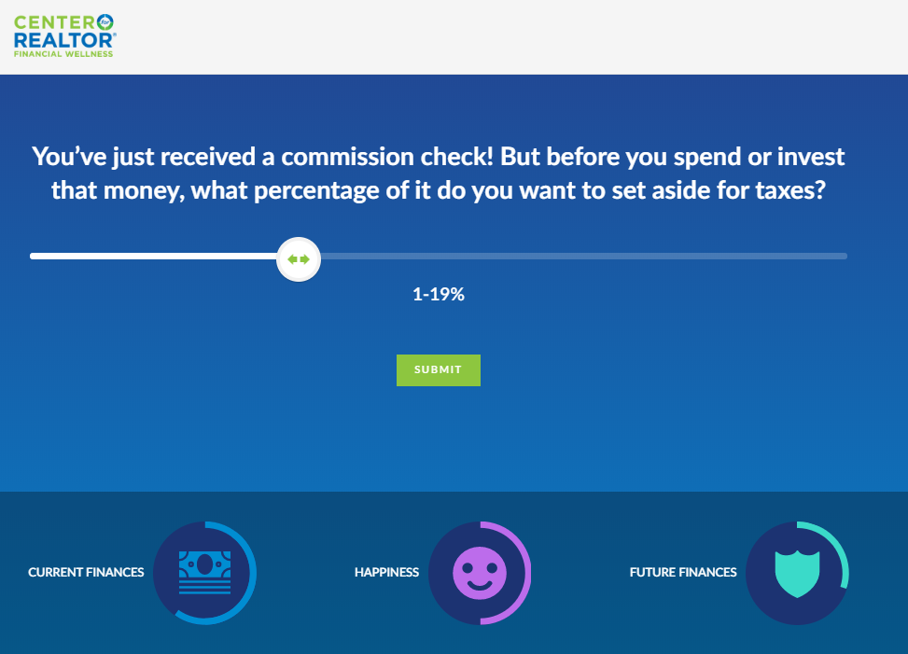

Slide 39
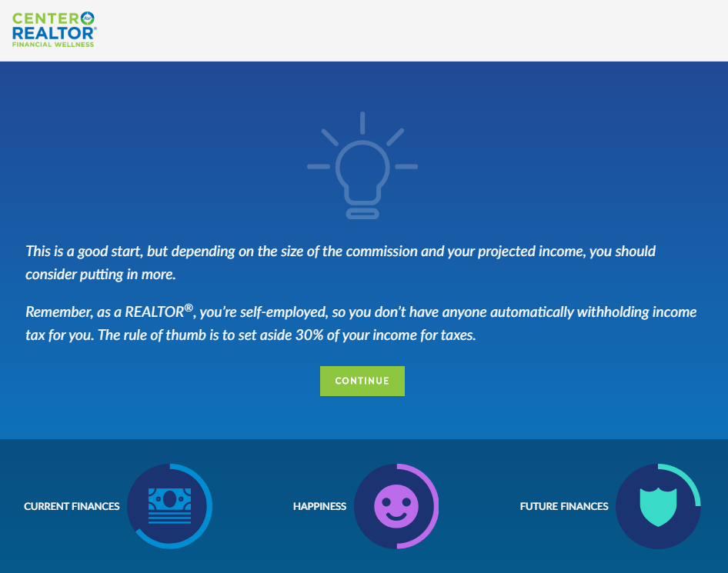

Slide 44
Results

Slide 45
Challenge!

Slide 48
Results Before After

Slide 49
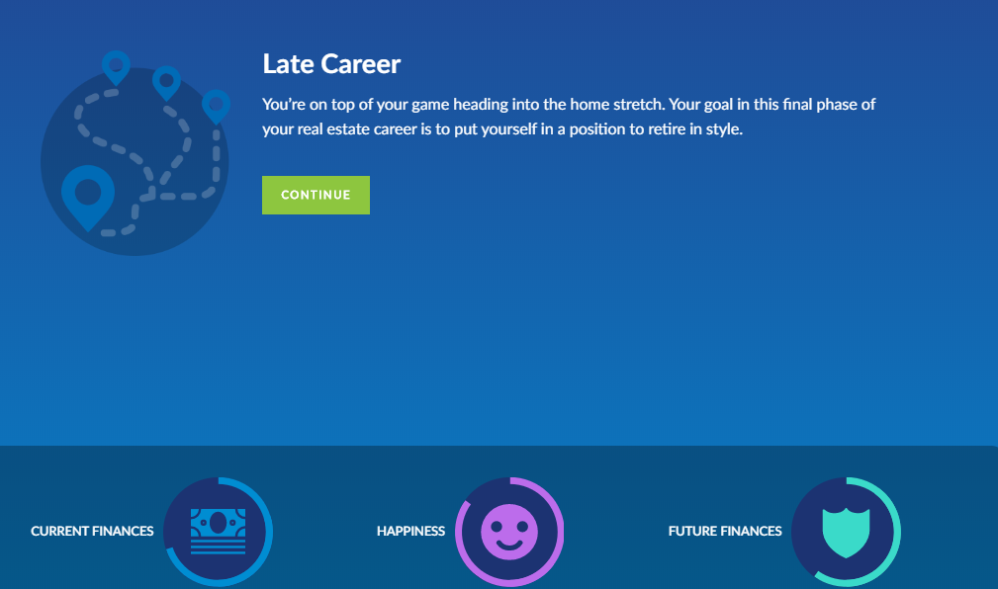

Slide 51
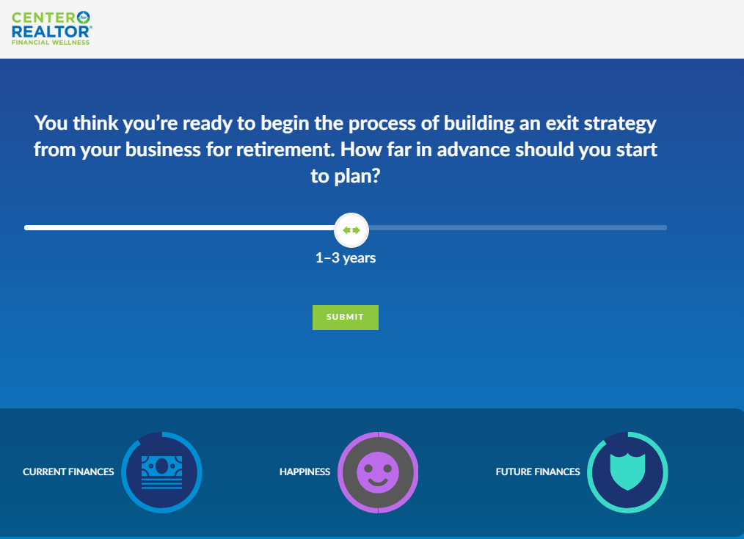

Slide 52
Results

Slide 54
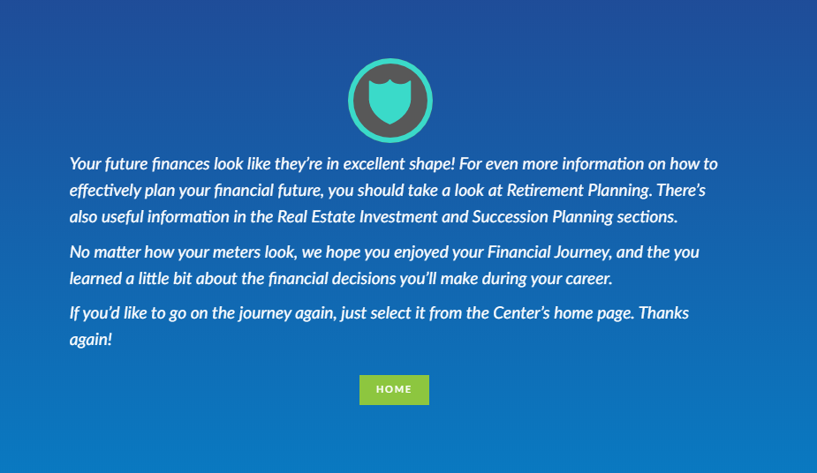

Slide 56
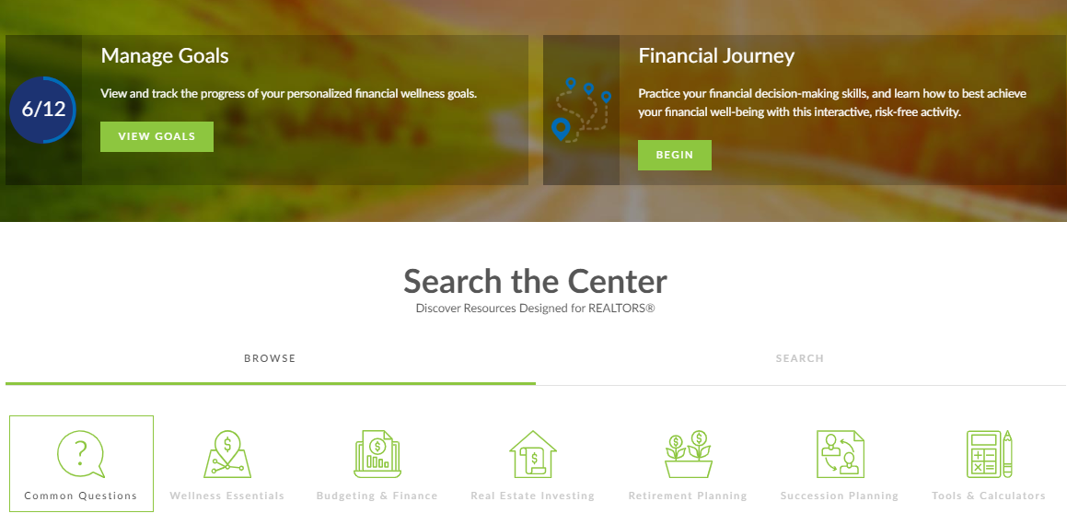
FinancialWellness.realtor

Slide 57
Resources

Slide 58
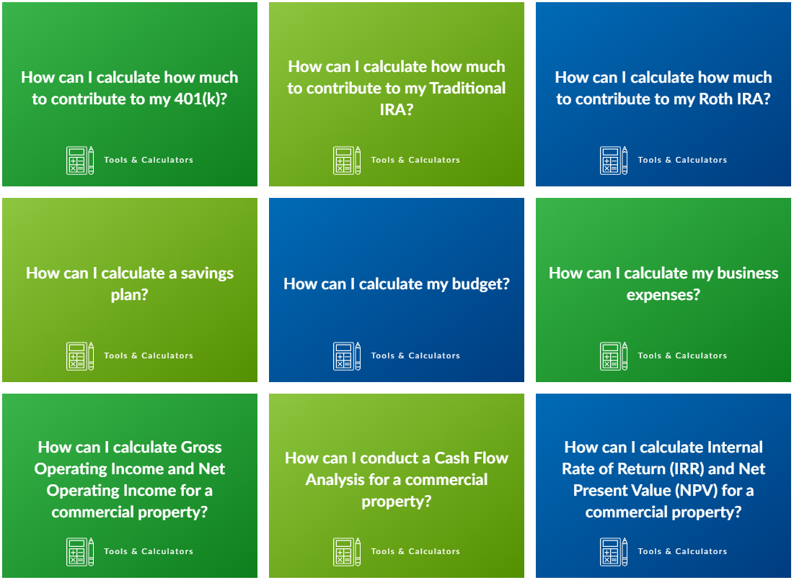

Slide 60
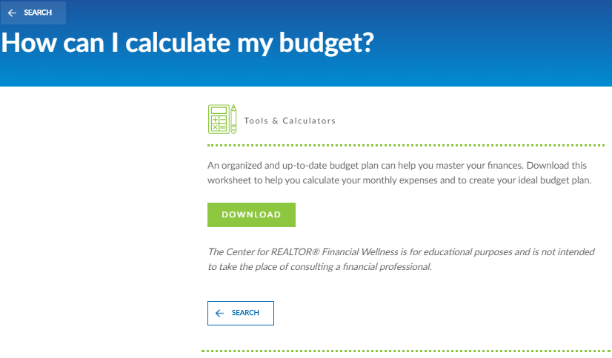

Slide 61
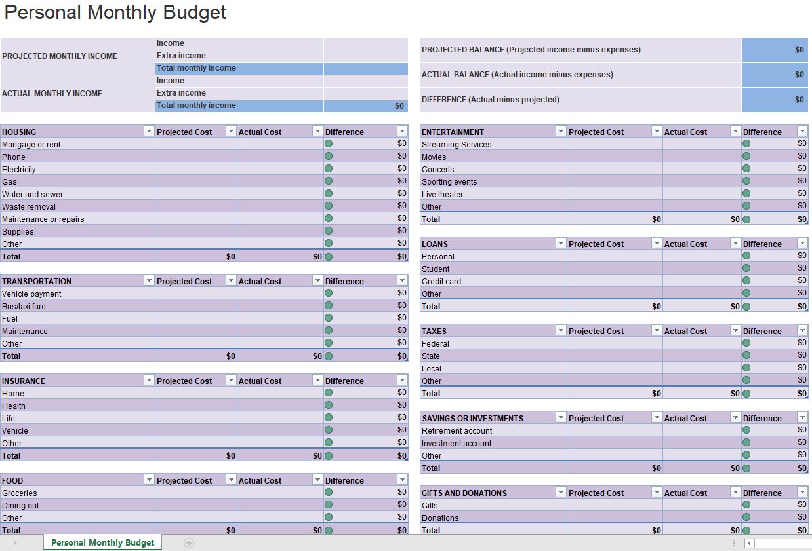

Slide 62
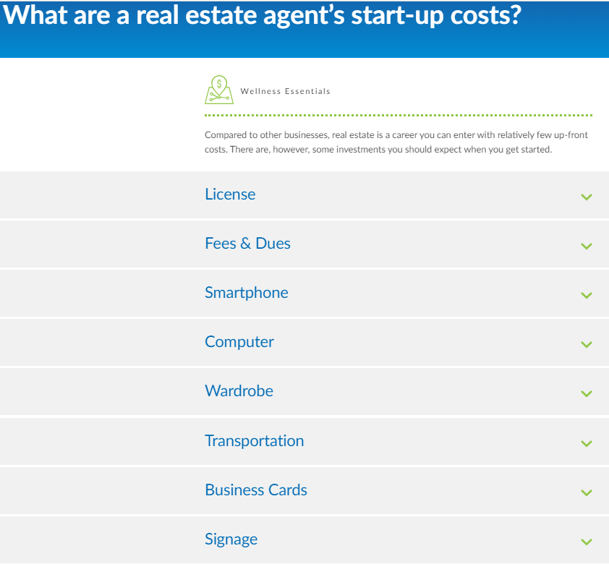

Slide 63
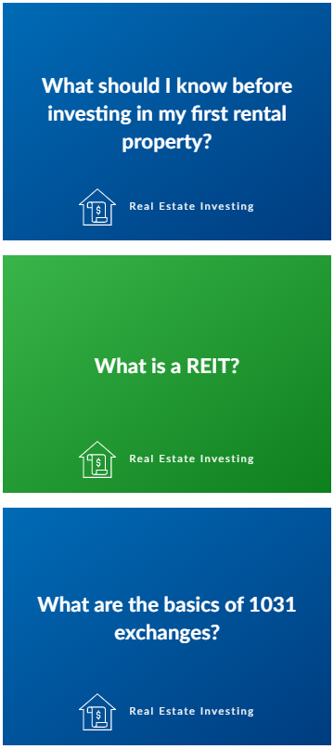
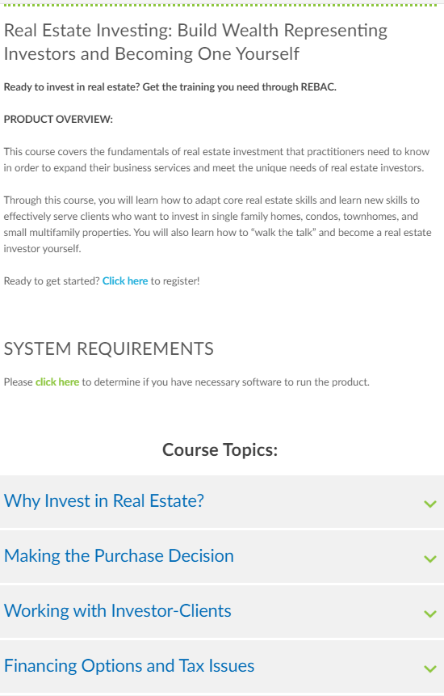

Slide 64
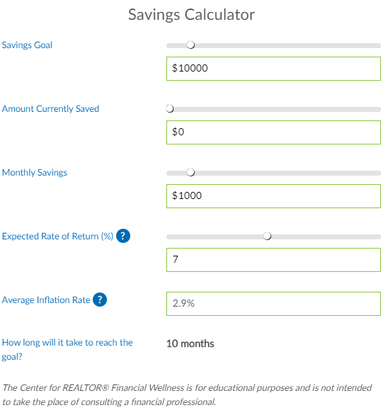

Slide 65
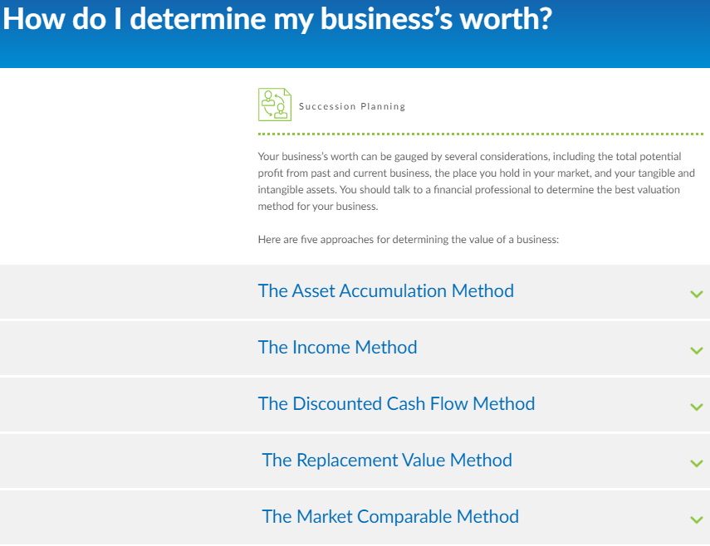

Slide 66
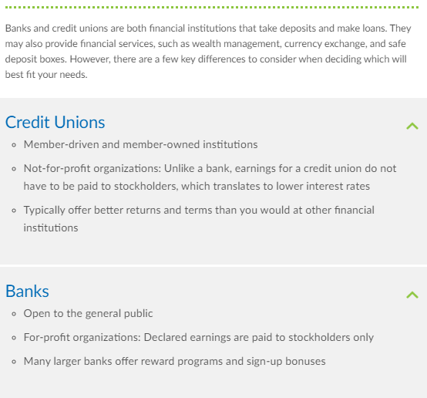

Slide 67
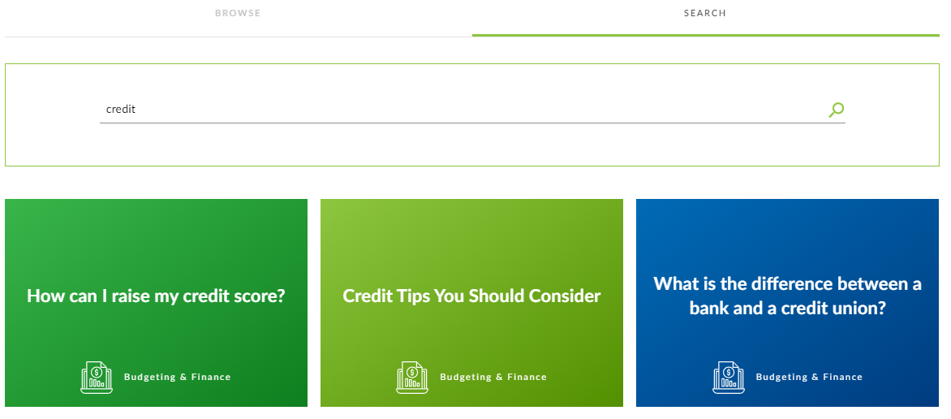
Additional Resources

Slide 68
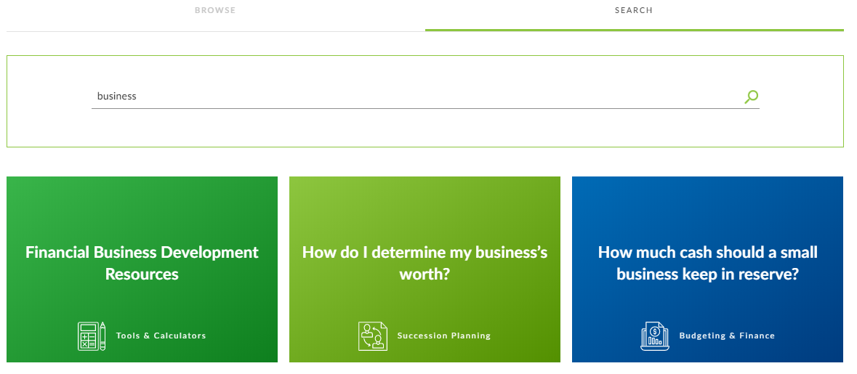
Additional Resources Continued

Slide 69
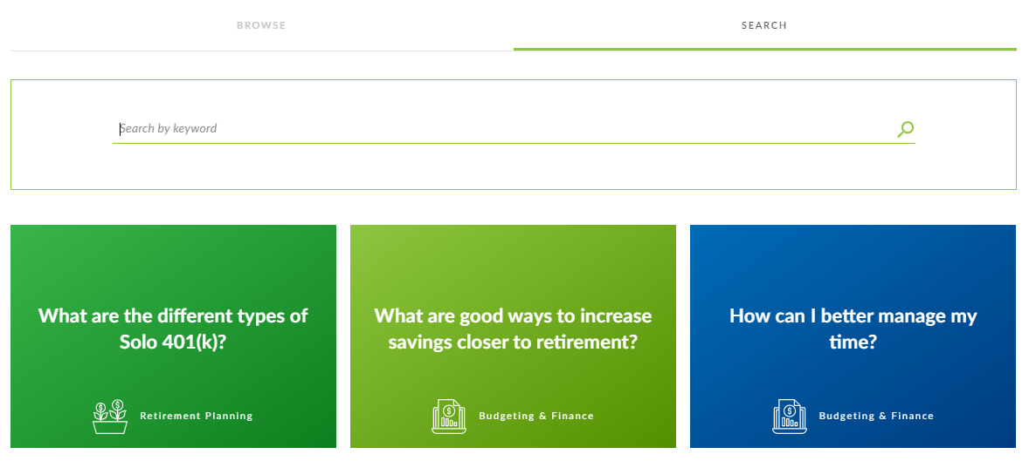
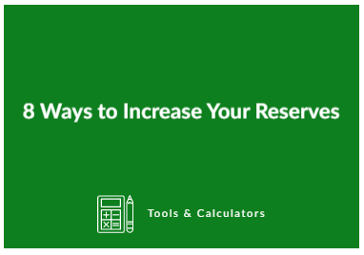
Additional Resources Continued

Slide 70
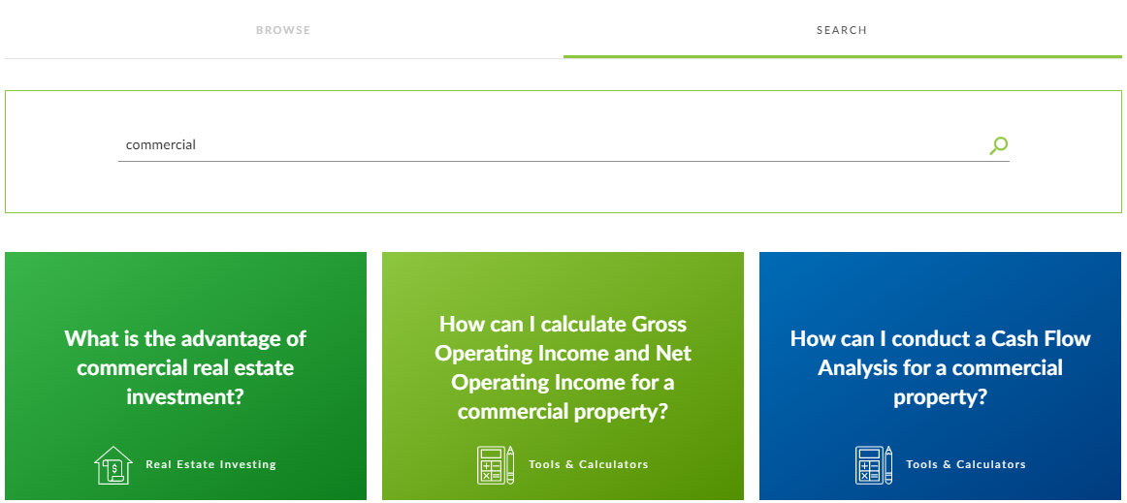
Additional Resources Continued

Slide 71
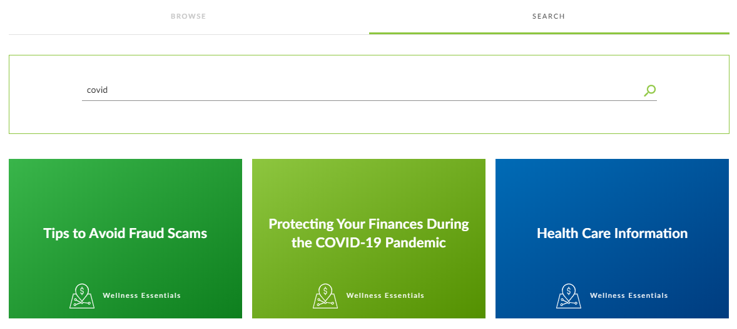
Additional Resources Continued

Slide 72
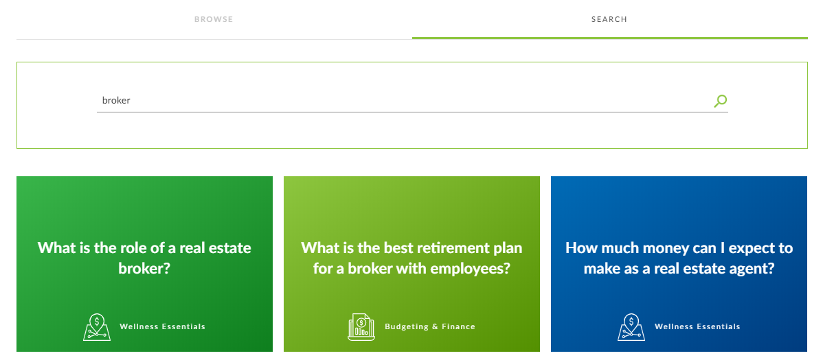
Additional Resources Continued

Slide 73
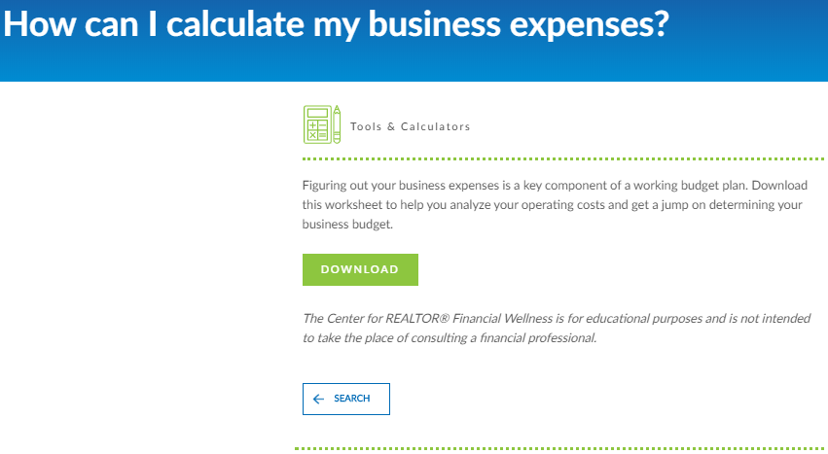
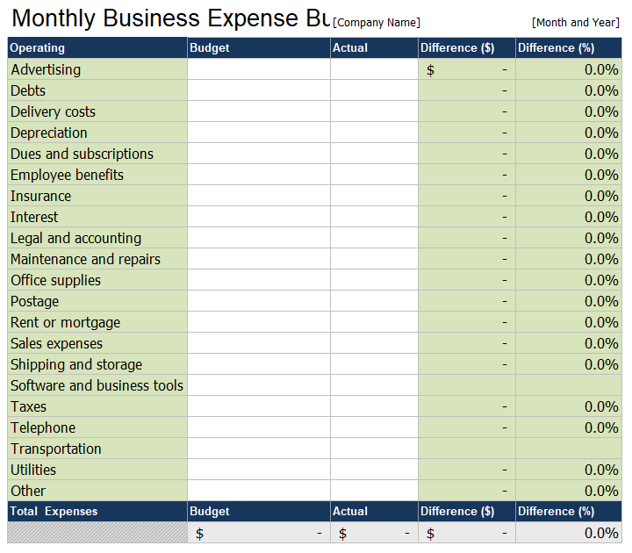
Broker Resources

Slide 74
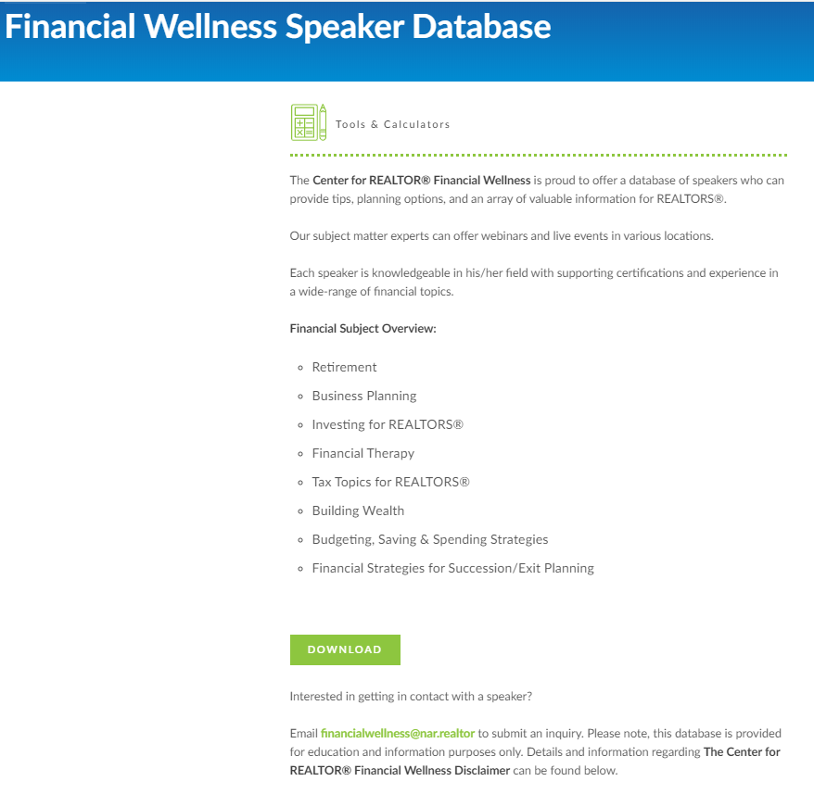
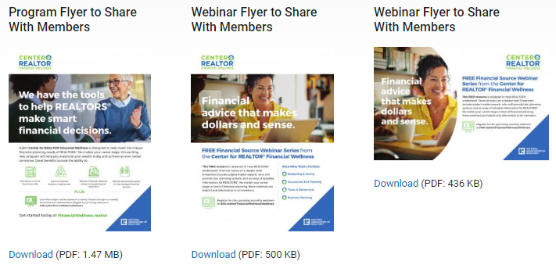
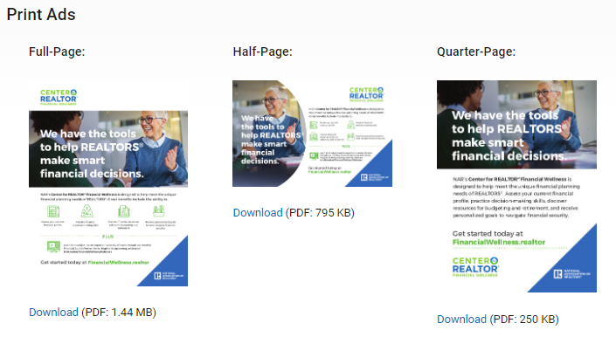
FREE Resources nar.realtor/financialwellness

Slide 75
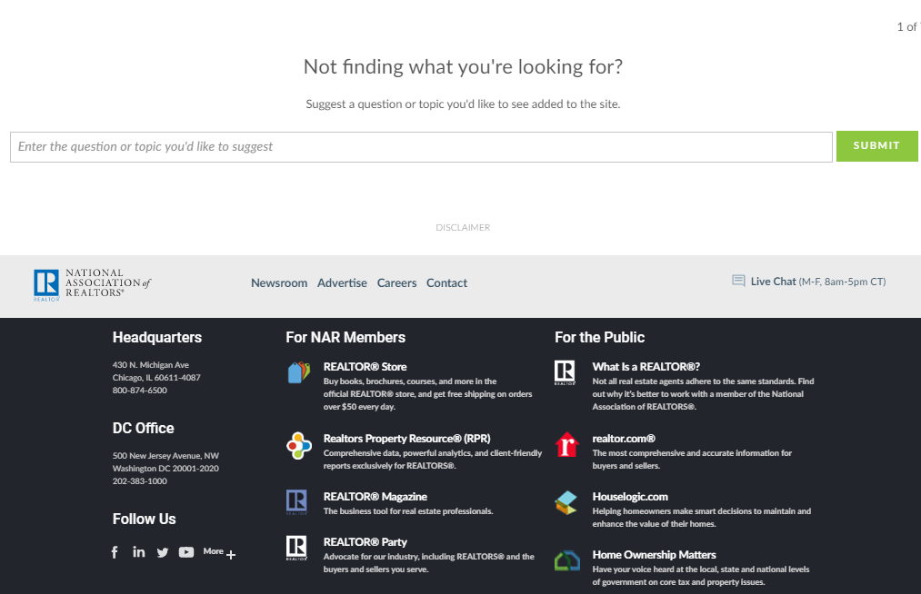

Slide 76
Platform site:
FinancialWellness.realtor

