Slide 1

FinancialWellness.realtor
Notes:
Welcome everyone and thank you for joining us today for our monthly Financial Source Webinar series, presented by The Center for REALTOR® Financial Wellness. I am Brittany Schanck, NAR’s Financial Wellness Manager.

Slide 2

Improving an Entrepreneurs’ Financial Health
Recording Available: Wednesday, May 27

Slide 3
CENTER FOR REALTOR® FINANCIAL WELLNESS
WEBINAR AND SEMINAR
DISCLAIMER
For Education and Information Purposes Only
Please note that the information and materials provided in Center for REALTOR® Financial Wellness webinars and seminars are not intended or provided to be used as a substitute for the advice of your tax, investment, legal and/or financial advisors or to be the basis of specific financial planning activities. The opinions and views expressed or shared in this presentation represent only those of the developers, speakers, presenters or instructors and have not been endorsed or approved by the National Association of REALTORS®. While substantial care is taken to try to provide accurate and current data and information, the National Association of REALTORS® does not warrant the accuracy, completeness or timeliness of any data and information provided in the webinars and seminars. Further, any principles and conclusions presented are subject to court decisions and to local, state and federal laws and regulations and any revisions of such laws and regulations. If you seek or need tax, investment, legal or financial advice, you must obtain such advice and services from the appropriate professionals.
Any links to third-party websites, tools, materials or resources are provided as a convenience and for your information. Any products, services or opinions of third-party entities or associated individuals are neither endorsed nor have they been vetted by the National Association of REALTORS®, and their inclusion in the webinar or seminar and any related materials do not constitute a recommendation by the National Association of REALTORS® and should not be inferred as suggesting a preference over other products, services or information available in the market. The National Association of REALTORS® bears no responsibility for the accuracy, completeness, legality or the content provided in the webinar or seminar and any related materials.
Notes:
Here I would like to provide a small disclaimer. Please note that the information and materials provided in Center for REALTOR® Financial Wellness webinars and seminars are not intended or provided to be used as a substitute for the advice of your tax, investment, legal and/or financial advisors or to be the basis of specific financial planning activities. The opinions and views expressed or shared in these presentations represent only those of the developers, speakers, presenters or instructors and have not been endorsed or approved by the National Association of REALTORS®. More information regarding our webinar disclaimer can be found here on slide 5.

Slide 4
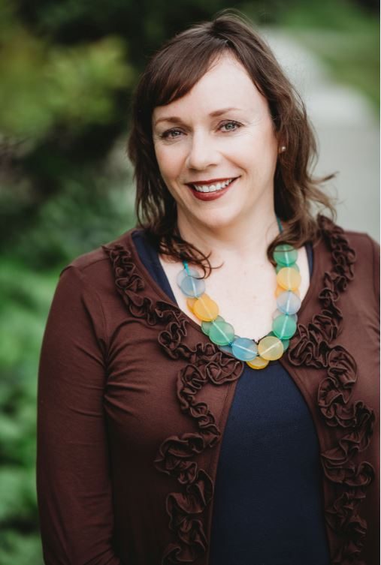

Presenter: Mariah Hudler
LCSW, MBA
CEO of KORU Financial Therapy

Slide 5
Improving an Entrepreneurs’ Financial Health
MARIAH HUDLER, LCSW,MBA
KORU FINANCIAL THERAPY
Notes:
Like it.

Slide 6
Objectives
The objectives for this Webinar are:

Slide 7
Objectives
The objectives for this Webinar are:
How to deal with financial stress and anxiety with a variable income

Slide 8
Objectives
The objectives for this Webinar are:
How to deal with financial stress and anxiety with a variable income
How to manage emotional decisions related to money

Slide 9
Objectives
The objectives for this Webinar are:
How to deal with financial stress and anxiety with a variable income
How to manage emotional decisions related to money
How to set goals as well as identify and overcome financial roadblocks

Slide 10
Objectives
The objectives for this Webinar are:
How to deal with financial stress and anxiety with a variable income
How to manage emotional decisions related to money
How to set goals as well as identify and overcome financial roadblocks
We will be approaching these objectives through an emotional lens and model. Ultimately, I want you to leave this webinar with not only practical tips but an increased awareness to this burning question:

Slide 11
Objectives
The objectives for this Webinar are:
How to deal with financial stress and anxiety with a variable income
How to manage emotional decisions related to money
How to set goals as well as identify and overcome financial roadblocks
We will be approaching these objectives through an emotional lens and model. Ultimately, I want you to leave this webinar with not only practical tips but an increased awareness to this burning question:
Why do I make certain decisions when it comes to my finances?

Slide 12

Financial Health for Entrepreneurs
Goal: Having a balanced, comfortable relationship with money.
What does that look like?
Notes:
This is a good lead in to the next slide.

Slide 13

Signs of Financial Health
1
Understanding the unconscious beliefs, or “money scripts,” one has learned about money, and being able to change those that are detrimental to one’s financial health.

Slide 14

Example Case Study:
Fina
Notes:
Fina is a 47 year old married real estate agent who loves her job and started her realty business to help others achieve their dream of homeownership as well as make a positive impact in the community. She has the passion, influence, work
ethic and drive to increase her network base and referrals to be successful. Fina wrangled with the normal negative thoughts of failure. She is well aware of the hills and valley aspect of her income. Thus, she and her partner saved and
invested their own personal money to get the business up and running.

Slide 15








Fina
Notes:
Financially, Fina is making sales and hitting goals but is unsure of where the money goes. Month to month there is something about the numbers that makes her flinch. There never seems to be enough. Fina is timid and reticent to really look at her monthly financials. In fact, thinking about money makes her heart start to race. Money is often the first thing Fina thinks about when she wakes up in the morning and she knows this is impacting him throughout her day. Money has also become a point of contention in her personal relationship. She tells herself the money will be there if she puts in the time. She sees it in so many of his colleagues - success - so it is only a matter of time. Things will be better when he makes more money.
https://medium.com/@ViivasWellbeing/to-regulate-your-emotions-differentiate-them-c618df28d4aa

Slide 16
Financial Anxiety
It’s real and it’s happening right now.

Slide 17
Financial Anxiety
It’s real and it’s happening right now.
It has physical, emotional and relational impacts
Notes:
In 2018, a survey by Northwestern mutual reported money is the dominant source of stress (44%), dramatically outpacing personal relationships (25%) and work (18%). The American Psychological Association, who does an annual survey on Stress in America, reports “Regardless of the economic climate, money and finances have remained the top stressor since our survey began in 2007”.
4 in 10 Americans likely to experience “high” or “moderate” levels of anxiety due to:
Rising cost of healthcare: 59%
Unplanned financial emergency: 55%
Unplanned health emergency: 53%
Income: 48%
Level of savings: 48%
Debt: 42%
Planning for retirement: 41% --- up from 37% in 2017
Fina grew up in a single household. Money was tight. Her mother worked a lot to support the family finances and was not around that often. Their household also never had enough, typically, living paycheck to paycheck. Fina often was told that her mother worked so hard and long so that she could be successful and have a good life. Fina, in early stages associated success and a good life with money.

Slide 18
Financial Anxiety
It’s real and it’s happening right now.
It has physical, emotional and relational impacts
It is steeped in our family history and our money scripts

Slide 19
Financial Anxiety
It’s real and it’s happening right now.
It has physical, emotional and relational impacts
It is steeped in our family history and our money scripts
It can dictate and/or drive financial behavior [financial comfort zone]

Slide 20

Money Scripts (Beliefs)
Formed in childhood, shaped from both direct and indirect messages we receive about money from our parents, other significant people in our lives, our circumstances, and society as a whole.

Slide 21

Help you gain insight into your own money belief system.

Slide 22

Are essential in being able to address and make changes to financial decision making.

Slide 23

Key to shifting money mindset from scarcity to abundance.

Slide 24
Fina’s Money Scripts
“Fina believes that in order to make money she has to spend money, especially when attracting clients. She finds she becomes agitated when her partner asks about her spending. She avoids her partner by working more although it is causing tension between them. She tells herself the money will be there if she puts in the time or when she gets a higher priced listing”.
Notes:
Suggestion: offer the assessment to learn more about their money beliefs/personality, but do not mention “price”.

Slide 25
Fina’s Money Scripts
“Fina believes that in order to make money she has to spend money, especially when attracting clients. She finds she becomes agitated when her partner asks about her spending. She avoids her partner by working more although it is causing tension between them. She tells herself the money will be there if she puts in the time or when she gets a higher priced listing”.
“I work hard and I deserve to spend money how I want.”

Slide 26
Fina’s Money Scripts
“Fina believes that in order to make money she has to spend money, especially when attracting clients. She finds she becomes agitated when her partner asks about her spending. She avoids her partner by working more although it is causing tension between them. She tells herself the money will be there if she puts in the time or when she gets a higher priced listing”.
“I work hard and I deserve to spend money how I want.”
“If I don’t work hard and make a lot of money, I am a failure”.

Slide 27
Fina’s Money Scripts
“Fina believes that in order to make money she has to spend money, especially when attracting clients. She finds she becomes agitated when her partner asks about her spending. She avoids her partner by working more although it is causing tension between them. She tells herself the money will be there if she puts in the time or when she gets a higher priced listing”.
“I work hard and I deserve to spend money how I want.”
“If I don’t work hard and make a lot of money, I am a failure”.
“I don’t have enough money”.

Slide 28

Money Scripts Can Be Re-scripted
Notes:
Depends on how deeply the script was formed and how much painful emotion is associated with it.
Money Script Log, Money Mantra’s, Money Scripts Brainstorming - always, should, never. There is a Money Script Inventory that I use with clients to identify their Money Scripts - Status, Worship, Avoidance, Vigilance.
Excellent!

Slide 29

Exploration and Awareness
This is New

Slide 30


Create alternative money scripts and behaviors

Slide 31

Practice and Consistent Application

Slide 32

New Financial Status (scarcity to abundance)

Slide 33

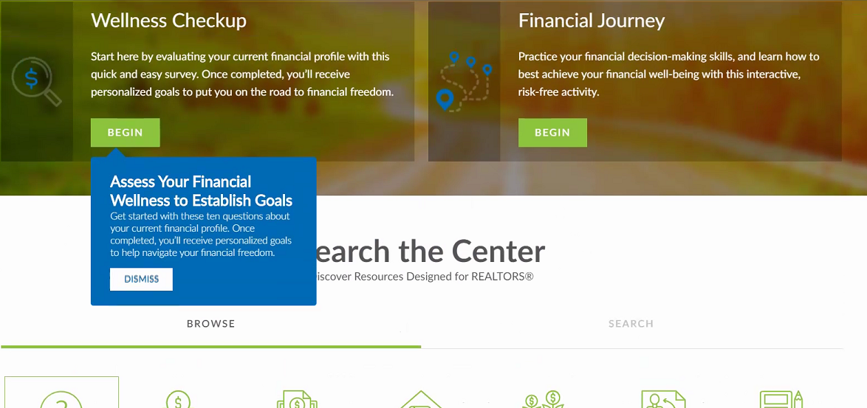

Visit: FinancialWellness.realtor
Notes:
Looking for a great starting point for a financial plan?
Take a quick 10-question, financial assessment from the Center for REALTOR® Financial Wellness.
After you take the assessment you will have personalized and trackable goals.
This Center is not only a great REALTOR® resource, this is a benefit included in your membership.
Note, this is an educational resource. It’s not intended to take the place of consulting a financial professional. The platform does not store, share, or sell any information.
For more information, visit FinancialWellness.realtor to get started or email your NAR team at FinancialWellness@nar.realtor.

Slide 34
Money Script Log
Behavior or Situation | Physical Sensation or Feeling | Money Script (Beliefs) | GOAL: Positive Alternative Money Script and /or Adaptive Behavior
I don’t know where my money goes. I avoid setting up a spending plan. | Heart racing, flinching, shame. | I work hard so I deserve to spend money on what I want. I don’t want to live in deprivation. | If I follow a saving and spending plan, I can allocate commissions to M&A as well as other categories so I don’t feel like I am chasing bills. Buy a book on spending plans and begin next month.
Notes:
Tool that allows you to examine your behaviors, feelings, and unconscious thinking patterns around money throughout your day. It is an adaptation of a cognitive-behavioral therapy technique designed to help clients identify their feelings, behaviors and automatic thoughts around money. It is helpful to do this over several days.
They are not necessarily bad or wrong
Updated the log to reflect the updated story.

Slide 35
Money Script Log
Behavior or Situation | Physical Sensation or Feeling | Money Script (Beliefs) | GOAL: Positive Alternative Money Script and /or Adaptive Behavior
I don’t know where my money goes. I avoid setting up a spending plan. | Heart racing, flinching, shame. | I work hard so I deserve to spend money on what I want. I don’t want to live in deprivation. | If I follow a saving and spending plan, I can allocate commissions to M&A as well as other categories so I don’t feel like I am chasing bills. Buy a book on spending plans and begin next month.
If I only got a higher priced listing, things would be better. | Racing thoughts, disrupted sleep, exhaustion. | I don’t have enough money. There will never be enough. | Leading a life of abundance, authenticity, and fulfillment is not about money. I have enough money to live a rich and fulfilled life.
Notes:
Tool that allows you to examine your behaviors, feelings, and unconscious thinking patterns around money throughout your day. It is an adaptation of a cognitive-behavioral therapy technique designed to help clients identify their feelings, behaviors and automatic thoughts around money. It is helpful to do this over several days.
They are not necessarily bad or wrong
Updated the log to reflect the updated story.

Slide 36
Money Script Log
Behavior or Situation | Physical Sensation or Feeling | Money Script (Beliefs) | GOAL: Positive Alternative Money Script and /or Adaptive Behavior
I don’t know where my money goes. I avoid setting up a spending plan. | Heart racing, flinching, shame. | I work hard so I deserve to spend money on what I want. I don’t want to live in deprivation. | If I follow a saving and spending plan, I can allocate commissions to M&A as well as other categories so I don’t feel like I am chasing bills. Buy a book on spending plans and begin next month.
If I only got a higher priced listing, things would be better. | Racing thoughts, disrupted sleep, exhaustion. | I don’t have enough money. There will never be enough. | Leading a life of abundance, authenticity, and fulfillment is not about money. I have enough money to live a rich and fulfilled life.
I work a lot and am away from home. I avoid sitting down with my partner to talk about money. | Agitation, shame and guilt. | If I don’t work hard and make a lot of money, I am a failure. | I feel confident talking about money. My partner and I are a team. Set up a monthly money date.
Notes:
Tool that allows you to examine your behaviors, feelings, and unconscious thinking patterns around money throughout your day. It is an adaptation of a cognitive-behavioral therapy technique designed to help clients identify their feelings, behaviors and automatic thoughts around money. It is helpful to do this over several days.
They are not necessarily bad or wrong
Updated the log to reflect the updated story.

Slide 37
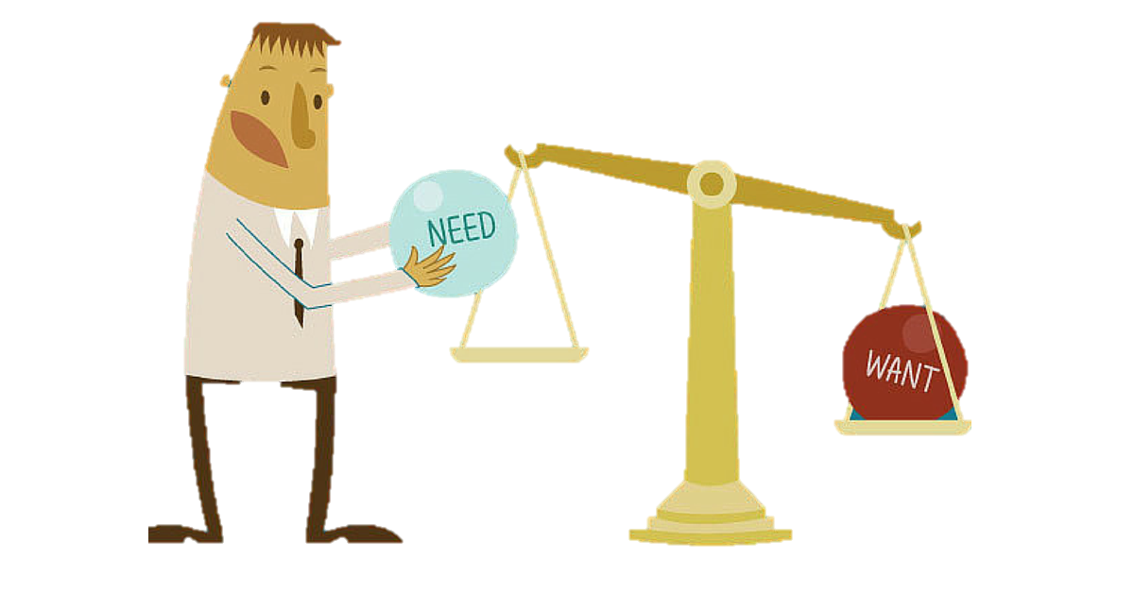
Money Scripts Re-scripted
Scarcity - thoughts and feelings that automatically orient the mind towards unfulfilled wants and needs.
Often leads to lapses in self-control
Drains cognitive resources needed to maximize opportunity and display judgment.
Live in stress and act out of despair
Notes:
The behavior related to the money script is rooted in emotion, not factual information; as long as the emotion is unchanged, the behavior will remain.

Slide 38

Money Scripts Re-scripted
Abundance - is the paradigm that there is plenty out there and enough to spare for everybody. It results in sharing of prestige, of recognition, of profits, of decision making. It opens possibilities, options, alternatives, and creativity.

Slide 39

Fina’s New Financial Comfort Zone
Re-scripted Money Scripts
Use of systems to reduce emotions/anxiety
Use of Nudges and Incentives
Notes:
Use of behavioral economics to make small yet meaningful changes over time -

Slide 40

Signs of Financial Health
2
Living within one’s business means and maintaining a positive cash flow.

Slide 41
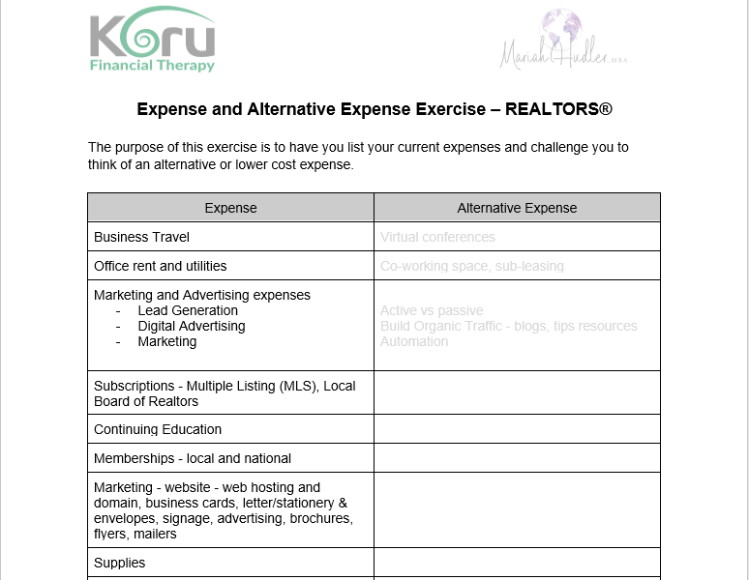
Free Exercise
Download At:
FinancialWellness.realtor

Slide 42
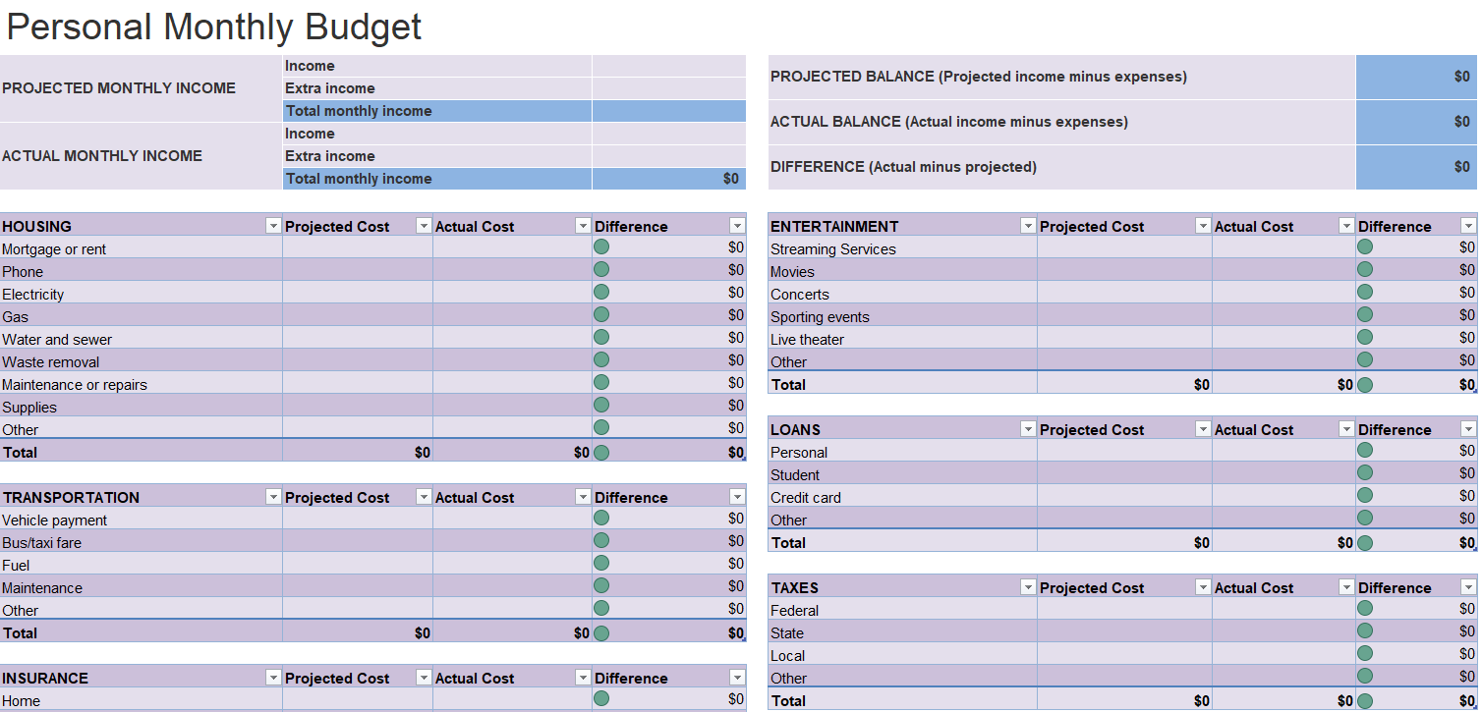
FinancialWellness.realtor
Notes:
Resources to help members track their personal monthly budget
Calculates monthly expenses like: entertainment, loans, personal taxes, transportation and so much more.
This is a FREE spreadsheet included in your membership through the Center for REALTOR® Financial Wellness
Website – FinancialWellness.realtor

Slide 43
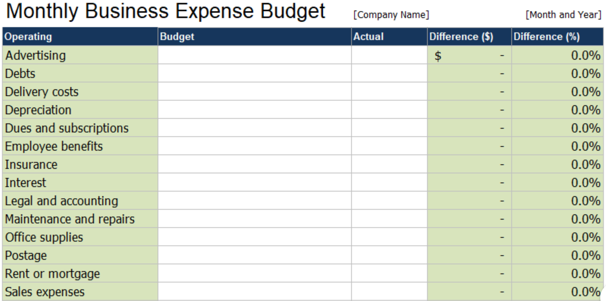
FinancialWellness.realtor
Notes:
Resources to help members track their business monthly budget
Calculates monthly expenses for your business: insurance, marketing, office supplies, and most importantly taxes and dues.
This is a FREE spreadsheet included in your membership through the Center for REALTOR® Financial Wellness
Website – FinancialWellness.realtor

Slide 44

Signs of Financial Health
3
Having clear financial goals and plans for meeting those goals.

Slide 45

TAXES
OPERATING EXPENSE
PROFIT
INCOME

Slide 46

Signs of Financial Health
PROFIT
OPERATING EXPENSE
INCOME
TAXES
4
Making financial choices and taking financial actions that are consistent with one’s values and purpose.

Slide 47

Signs of Financial Health
5
Having active savings and retirement plans.

Slide 48
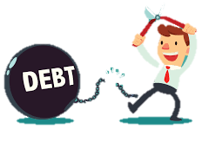
Signs of Financial Health
6
Maintaining reasonable and low debt.

Slide 49

Signs of Financial Health
7
Experiencing low levels of financial stress.
Notes:
Nudges and Incentives

Slide 50
Summary
How to deal with financial anxiety
Money Scripts, Money Scripts Log
How to manage emotions related to financial decision making
Use of systems to set goals, create space and reduce emotional decision making
How to set goals as well as identify and overcome financial roadblocks
Practice and Consistency. Nudges and Incentives

Slide 51
Looking for next steps?
Additional Services Through KORU Financial:
Koru Financial Therapy aims to improve the financial health of individuals, couples and entrepreneurs. Email Mariah Hudler to learn more about:
A 90 min Money History, Money Script and Values Exercise
60 min Strength Session
Coaching packages
Small business consulting
EMAIL: mariah@korufinancialtherapy.com
Notes:
Improve your financial health and set 1-2 new financial goals through exploring your money history by completing a money genogram, taking a test to learn about your core money beliefs and completing a values exercise.
This is a one off session for entrepreneurs that have a good grasp of their money and have solid money practices but have reached a plateau or are facing a significant financial crossroads that may be impeding or impacting their business financial health. This session provides a platform for interactively discussing one money matter.

Slide 52
Contact
Mariah Hudler, LCSW MBA
mariah@korufinancialtherapy.com
www.korufinancialtherapy.com
Instagram: @korufinancialtherapy
Facebook: Koru Financial Therapy
LinkedIn: Koru Financial Therapy
916-234-0414

Slide 53
Questions?
ASK IN THE CHAT
OR SEND AN EMAIL TO:
FINANCIALWELLNESS@NAR.REALTOR

Slide 54
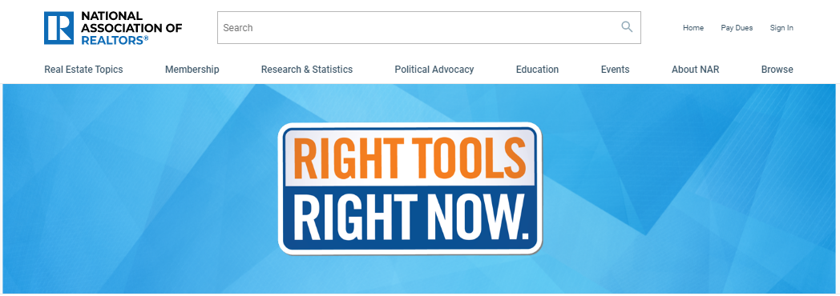
Additional Resources: nar.realtor/right-tools-right-now

Slide 55
Thank You For Your Time
Webinar Recording Available:
Wednesday, May 27
Visit – nar.realtor/cffw/webinars
FOR MORE INFORMATION or QUESTIONS
EMAIL: FinancialWellness@nar.realtor

Slide 56
1. Visit FinancialWellness.realtor
2. Leave us your feedback.
3. Register for the next webinar.
Thanks!

