Slide 1
Financialwellness.realtor

Slide 2
Win Your Future: Investing for REALTORS®

Slide 3
Upcoming Webinar

Slide 4
CENTER FOR REALTOR® FINANCIAL WELLNESS WEBINAR AND SEMINAR DISCLAIMER
For Education and Information Purposes Only
Please note that the information and materials provided in Center for REALTOR® Financial Wellness webinars and seminars are not intended or provided to be used as a substitute for the advice of your tax, investment, legal and/or financial advisors or to be the basis of specific financial planning activities. The opinions and views expressed or shared in this presentation represent only those of the developers, speakers, presenters or instructors and have not been endorsed or approved by the National Association of REALTORS®. While substantial care is taken to try to provide accurate and current data and information, the National Association of REALTORS® does not warrant the accuracy, completeness or timeliness of any data and information provided in the webinars and seminars. Further, any principles and conclusions presented are subject to court decisions and to local, state and federal laws and regulations and any revisions of such laws and regulations. If you seek or need tax, investment, legal or financial advice, you must obtain such advice and services from the appropriate professionals.
Any links to third-party websites, tools, materials or resources are provided as a convenience and for your information. Any products, services or opinions of third-party entities or associated individuals are neither endorsed nor have they been vetted by the National Association of REALTORS®, and their inclusion in the webinar or seminar and any related materials do not constitute a recommendation by the National Association of REALTORS® and should not be inferred as suggesting a preference over other products, services or information available in the market. The National Association of REALTORS® bears no responsibility for the accuracy, completeness, legality or the content provided in the webinar or seminar and any related materials.

Slide 5
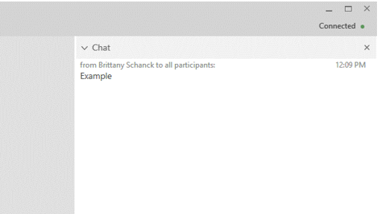
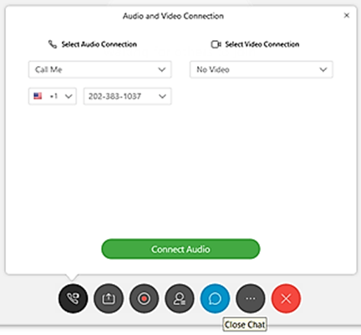
Presentation Format & Questions
OR Email us: financialwellness@nar.realtor

Slide 6
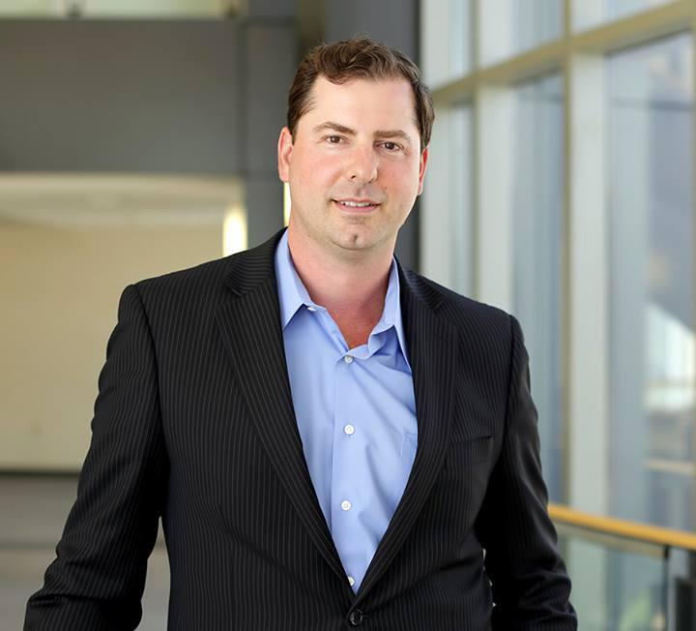
Presenter: Nick Krautter
CEO of City and State Real Estate

Slide 7
INVESTING FOR REALTORS®
INVESTING FOR REALTORS
NICK KRAUTTER, CCIM
CEO, CITY & STATE REAL ESTATE
AUTHOR, THE GOLDEN HANDOFF
NICK KRAUTTER, CCIM

Slide 8
INVESTING FOR REALTORS
WHY INVEST IN
REAL ESTATE?
NICK KRAUTTER, CCIM

Slide 9
The Benefits of Investing in Real Estate
LEVERAGE
INCOME
INSURANCE
TAX BENEFITS
DEPRECIATION
FINANCIAL INDEPENDENCE

Slide 10
Leverage: Other people’s money!
Cash-on-cash return
Residential
Owner occupied: up to 97-100%
Investment: 80%
Commercial
Owner occupied: up to 90%
Investment: 75-80%
Apartments
up to 80%

Slide 11
Income
RENT
BILLBOARD/CELL TOWER
PARKING
PETS
LAUNDRY
STORAGE

Slide 12
Insurance
REPAIR & REPLACE BUILDING
LOST RENT PAYMENTS

Slide 13
Tax Benefits
DEFERRAL
SELF-DIRECTED IRAs/401K
WRITE-OFFS
UNLIMITED DEPRECIATION

Slide 14
Depreciation
Residential
27.5 years
Commercial
39 years
Improvements NOT land
Accelerated depreciation with cost segregation study

Slide 15
Financial Independence
When your passive income
is greater than
your living expenses

Slide 16
The Pros of Investing for Realtors
In the know
Market experts
Understanding seller motivation
Use commission to get discount
Discount with vendors
Private financing
Buy deals your clients terminate
iBuyer

Slide 17
The Cons of Investing for Realtors
PROPERLY DISCLOSE
IMPLIED AGENCY
CASH FLOW ARRANGEMENT
DISTRACTION
LAND RICH/CASH POOR

Slide 18
INVESTING FOR REALTORS
CHOOSING YOUR
PROPERTY TYPE
NICK KRAUTTER, CCIM

Slide 19
INVESTING FOR REALTORS
HOME
MULTIFAMILY
AIRBNB
COMMERCIAL

Slide 20
INVESTING FOR REALTORS
POSITIVE
LEVERAGE
NICK KRAUTTER, CCIM

Slide 21
Example: $500k apartment

Slide 22
Scenario 1
Pay cash.
Cash-on-cash return is same as return on investment, 6%.
$500000 invested, $30000 annual income = 6%

Slide 23
Scenario 2
50% Down.
Cash-on-cash goes to 8%.
$250000 invested, $20000 annual income = 8%
In scenario 2 and 3, interest rate on 30-year loan is 4%

Slide 24
Scenario 3
25% Down.
Cash-on-cash goes to 12%.
$125000 invested, $15000 annual income = 12%
In scenario 2 and 3, interest rate on 30-year loan is 4%

Slide 25
INVESTING FOR REALTORS
BUILDING YOUR
REAL ESTATE
TEAM
NICK KRAUTTER, CCIM

Slide 26
Your Real Estate Team
REALTOR
LENDER
ATTORNEY
CPA
TITLE & ESCROW CO.
CONTRACTOR
ARCHITECT

Slide 27
INVESTING FOR REALTORS
BUILDING YOUR
PORTFOLIO
NICK KRAUTTER, CCIM

Slide 28
Building Your Portfolio
Owner-occupied plex
House to rentals
ADU - Airbnb
Plex
Apartments
Office
Retail
Industrial
Land

Slide 29
INVESTING FOR REALTORS
DISTRESSED
PROPERTIES
NICK KRAUTTER, CCIM

Slide 30
What are Distressed Properties?
REO (Bank Owned)
Short Sales

Slide 31
INVESTING FOR REALTORS
APOD
ANNUAL PROPERTY OPERATING DATA
NICK KRAUTTER, CCIM

Slide 32
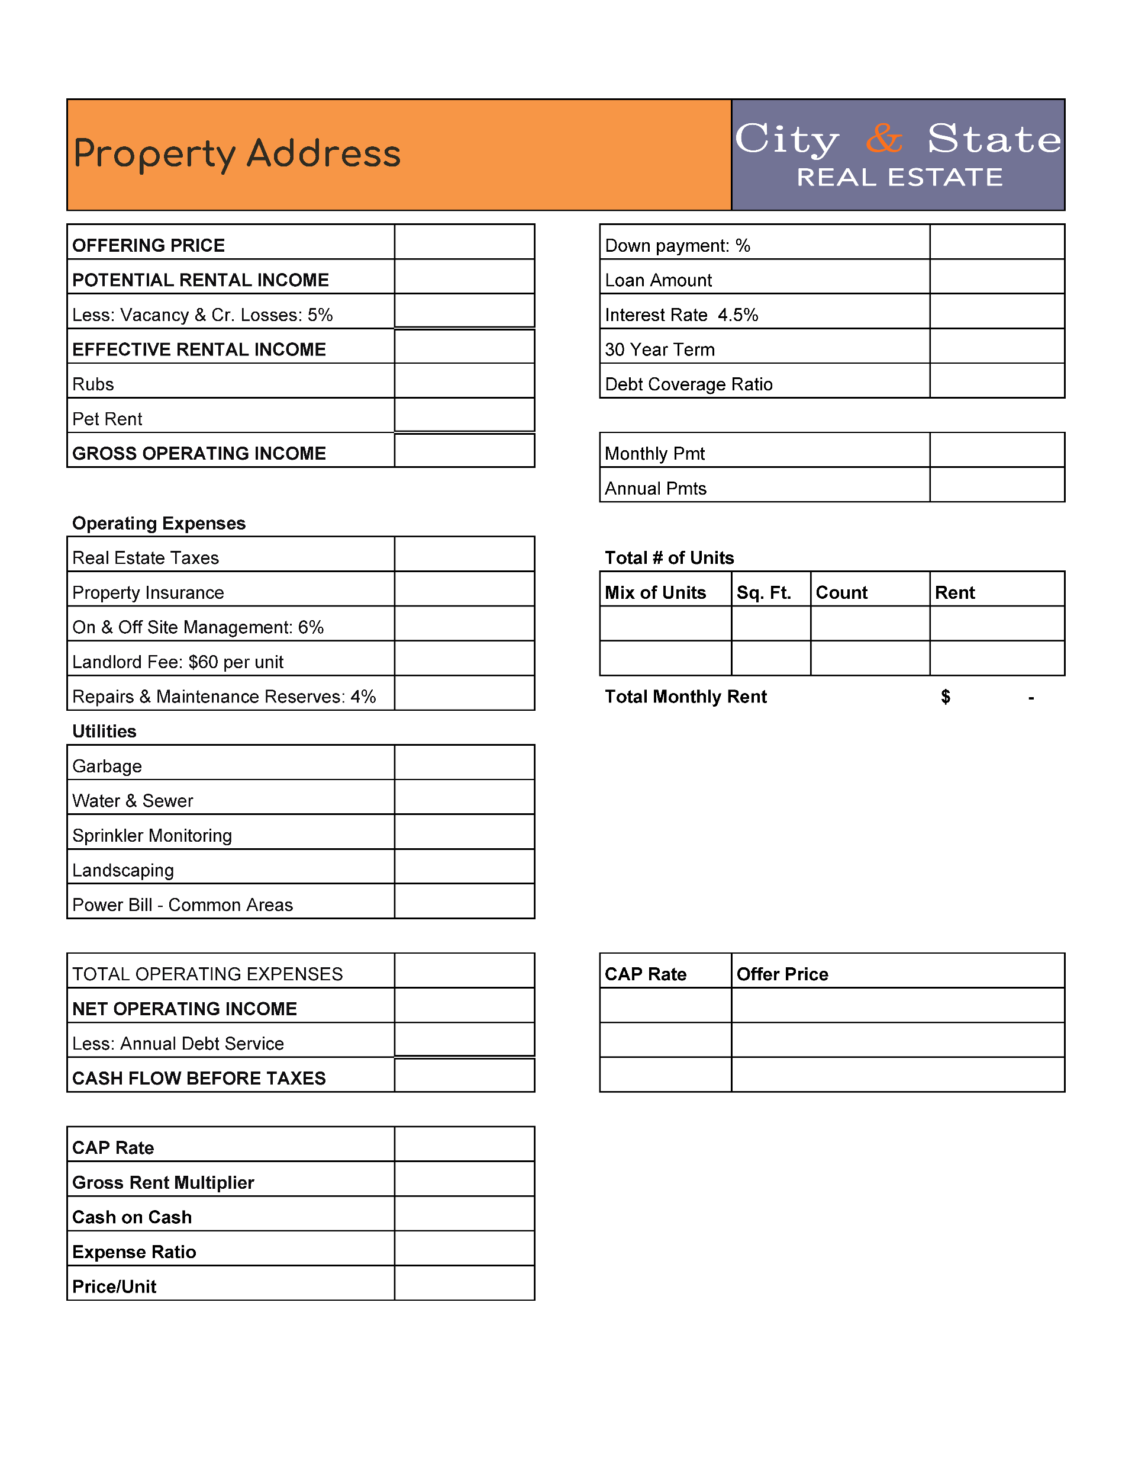
How to use an APOD
Soft vs. hard costs
Purchase price
Potential rental income
Vacancy
Gross operating income
Operating expenses

Slide 33
Metrics
Acquisition Price
Gross Rents
Gross Rent Multiplier =
Cash Flow Before Tax
Money Invested
Cash on Cash=
NOI
Acquisition Price
Capitalization (Cap) Rate =

Slide 34
Closing Statement
Nick Krautter, CCIM

Slide 35
Q&A
send an email to:
Financialwellness@nar.realtor

Slide 36
Additional Resources visit: financialwellness.realtor

Slide 37
Thank You For Your Time
Webinar Recording Available:
Friday, December 20th
Visit – nar.realtor/cffw/webinars
FOR MORE INFORMATION or QUESTIONS EMAIL:
financialwellness@nar.realtor
Notes:
Welcome…

Slide 38
1. Visit financialwellness.realtor 2. Leave us your feedback. 3. Register for the next webinar. Thanks!

