Slide 1
Financialwellness.realtor
Webinar site:
Nar.realtor/cffw/webinar

Slide 2
CENTER FOR REALTOR® FINANCIAL WELLNESS WEBINAR AND SEMINAR DISCLAIMER
For Education and Information Purposes Only
Please note that the information and materials provided in Center for REALTOR® Financial Wellness webinars and seminars are not intended or provided to be used as a substitute for the advice of your tax, investment, legal and/or financial advisors or to be the basis of specific financial planning activities. The opinions and views expressed or shared in this presentation represent only those of the developers, speakers, presenters or instructors and have not been endorsed or approved by the National Association of REALTORS®. While substantial care is taken to try to provide accurate and current data and information, the National Association of REALTORS® does not warrant the accuracy, completeness or timeliness of any data and information provided in the webinars and seminars. Further, any principles and conclusions presented are subject to court decisions and to local, state and federal laws and regulations and any revisions of such laws and regulations. If you seek or need tax, investment, legal or financial advice, you must obtain such advice and services from the appropriate professionals.
Any links to third-party websites, tools, materials or resources are provided as a convenience and for your information. Any products, services or opinions of third-party entities or associated individuals are neither endorsed nor have they been vetted by the National Association of REALTORS®, and their inclusion in the webinar or seminar and any related materials do not constitute a recommendation by the National Association of REALTORS® and should not be inferred as suggesting a preference over other products, services or information available in the market. The National Association of REALTORS® bears no responsibility for the accuracy, completeness, legality or the content provided in the webinar or seminar and any related materials.

Slide 3
Presenter: Tim Vohar
REALTOR®, Managing Broker - Norfolk
Director of Education & Training
Graduate Realtor® Institute

Slide 4
Funding Your Unexpected Expenses
Tim Vohar, Graduate Realtor Institute

Slide 5
Welcome Introduction
A little about
Tim Vohar
Business Plan & Budgeting
Living the life
you want
Notes:
3 Things you will take away from today, a little about me… A LOT about Budgets and UNEXPECTED preparation…hopefully learning how to budget for the life you want to live

Slide 6
If you answer NO to the following questions, please reassess immediately!
Do you have a Business Plan?
Do you have a personal AND business banking account(s)?
This Photo by Unknown Author is licensed under CC BY-SA
Notes:
Business Plans will help you focus on day to day, week to week, month to month activities
Personal Banking account plus a business banking account
Banking accounts should be separate so you can see how much you are spending

Slide 7
UGG! WHY START WITH TAXES
This Photo by Unknown Author is licensed under CC BY-ND
Notes:
BECAUSE this is the most UNEXPECTED item {reveal next slide}

Slide 8
The #1 Unexpected (EMERGENCY) is paying Taxes on April 15th!
Quarterly Payment Dates
April 15, 2020
June 15, 2020
September 15, 2020
January 15, 2021
2020 Tax Brackets
12-37%
Self-Employment Tax 2020 = 15.3%
State Taxes
Lets talk about the benefit of … OVER-budgeting
*Please Seek Advice from Your TAX ATTORNEY or ACCOUNTANT
Notes:
and yet it is the ONLY ITEM that is automatic for EVERYONE….. Figure out your tax bracket and budget for the next higher bracket…if you are 22%, budget for 24%, you have Social Security and State taxes as well

Slide 9
The IRS Tax Calculator
This Photo by Unknown Author is licensed under CC BY-ND
HTTPS://apps.irs.gov/app/tax-withholding-estimator
This calculator is for Standard withholding (W-2 not 1099)
BUT will be a helpful planning tool
Notes:
Brittany will have this link as well as other resource links available on the uploaded version of this recording available on Friday February 21st.

Slide 10
Avoid Tax Surprises
Select a CPA or another financial advocate who knows your business to help you with your taxes.
the rule of thumb is 30%
Keep clean, accurate records for expenses and deductions
Keep business and personal expenses separate
Take advantage of a tax-deferred IRA
Keep up with taxes by paying them quarterly throughout the year rather than in a large annual payment
Notes:
One good way would be to select a CPA or another financial advocate who knows your business to help you with your taxes. Allocate a monthly amount for taxes—the rule of thumb is 30 percent
This would be another expense to add to your list, but paying a tax advisor is a cost usually recouped via tax savings—not to mention peace of mind. There are also a number of actions you can take yourself in order to avoid tax surprises, such as:

Slide 11
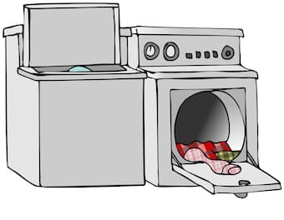
ADS, DUES & WASHER/DRYER??? what & why, of paying UNEXPECTED expenses
This Photo by Unknown Author is licensed under CC BY-NC
This Photo by Unknown Author is licensed under CC BY-NC-ND
This Photo by Unknown Author is licensed under CC BY-NC-ND
Notes:
Client insists on an ad in print or on-line….you forget that you are a member of a group or organization, IE ABR….something was misidentified in a listing

Slide 12
PAYCHECK BUDGET POLL
20%
30%
50%
DO YOU HAVE A written HOME/PERSONAL BUDGET?
DO YOU HAVE A written BUSINESS BUDGET?
Notes:
The exact percentage to hold from a commission check for savings or taxes varies depending on the person and situation. Some REALTORS® have found success by putting away about half of each commission check for taxes and savings, with 30 percent directed towards taxes and the remaining 20 percent for reserves.
Saving from every check puts you ahead of the curve. By setting aside reserve funds, you have a cushion for unexpected expenses or market downturns.

Slide 13
COST OF DOING BUSINESS
.
.
.
.
.
5%
5%
10%
30%
This Photo by Unknown Author is licensed under CC BY-NC-ND
50%
This Photo by Unknown Author is licensed under CC BY
This Photo by Unknown Author is licensed under CC BY-SA
This Photo by Unknown Author is licensed under CC BY
Notes:
This is reality of selling real estate!

Slide 14
ITEMS TO BUSINESS BUDGET (10%)
Dues & Fees (REALTOR ®, Franchise, Brokerage, Office, Team, other?)
Phone/Internet
Car (payment, gas, insurance, repairs)
Customer Relationship Manager (CRM)
Marketing Advertising
Software/Online Subscription services
Notes:
Advertising is part of Marketing. Marketing is the strategic plan for a product to include advertising. Advertising is the expenditure of money to place the product in front of a mass group audience

Slide 15
REAL ESTATE EDUCATION (5%)
Continuing education for license renewal*
NAR Designation & Certification classes
Books, Podcasts, Books on Tape ☺
Sales Seminar ~ Developing your inner salesperson
Leadership Development Training
Studying and Utilizing Marketing Trends
How to build an Advertising Plans
Social Media Utilization
Color/Style Trends ~ Staging
News Subscriptions for Real Estate Reading
Notes:
Just examples and NOT ALLL should be attempted in one year, with the exception of license renewal classes

Slide 16
And the hardest item to save for….
This Photo by Unknown Author is licensed under CC BY

Slide 17
THE UNEXPECTED (5%)
This Photo by Unknown Author is licensed under CC BY-NC-ND
This Photo by Unknown Author is licensed under CC BY-NC-ND
Notes:
A separate bank account for Personal, Business, Taxes, Unexpected….60% of Americans DO NOT have $1000 to cover emergency expenses 5% of $100,000 is $5,000….

Slide 18
MINDSET: I Just Want to Help People!!!
This Photo by Unknown Author is licensed under CC BY-NC-ND
Notes:
If You Don’t help yourself first you cant help other people

Slide 19
Be Prepared for the Unexpected:
This Photo by Unknown Author is licensed under CC BY-NC-ND
This Photo by Unknown Author is licensed under CC BY-SA
Notes:
…. A fireman puts his oxygen mask on for himself but what he is doing is for someone else!
You HAVE to budget for you first…be prepared for the UNEXPECTED….

Slide 20
Who Brushes Your Teeth?
This Photo by Unknown Author is licensed under CC BY-SA-NC
Notes:
You do Right? Its your choice to do it or not….its your choice if you want to be prepared for the unexpected or you want to let the unexpected freak you out and control YOU

Slide 21
Who Brushes Your Teeth?
You can only control YOU!
You NEED to control your expenses and costs
You may need to have hard conversations with your SUPPORT
Notes:
You do Right? Its your choice to do it or not….its your choice if you want to be prepared for the unexpected or you want to let the unexpected freak you out and control YOU

Slide 22
ACTION: How Do I Make this Happen!?!?!
#1 You Should Have WRITTEN/VISUAL Goals
Vision Boards
College Teddy Bear
Write Checks (even if you don’t have a checkbook) or Use CASH
Soap on the Mirror
4 Jars (or 5 or 6)
Life, Fun, Savings, Charity, (Education, Dreams)
Notes:
The unexpected wont be so unexpected if you plan for the unexpected.

Slide 23
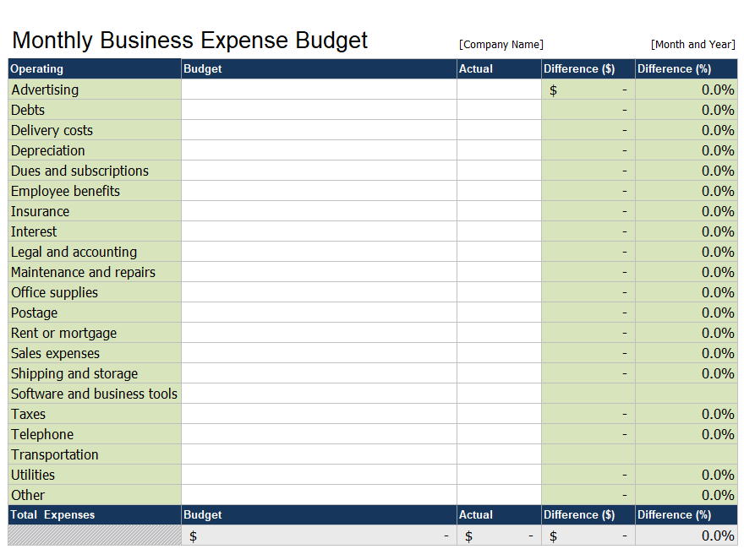
FREE Monthly Budget – financialwellness.realtor

Slide 24
“To expect the unexpected, shows a thoroughly modern intellect.”
~Oscar Wilde
Thank you for your Time and Energy Today. Tim

Slide 25
Questions?
Ask in the chat
Or send an email to:
Financialwellness@nar.realtor

Slide 26
Additional Resources visit: FinancialWellness.realtor

Slide 27
Thank You For Your Time
Webinar Recording Available:
Friday, February 21
Visit – nar.realtor/cffw/webinars
FOR MORE INFORMATION or QUESTIONS EMAIL:
financialwellness@nar.realtor
Notes:
Welcome…

Slide 28
1. Visit FinancialWellness.realtor 2. Leave us your feedback. 3. Register for the next webinar. Thanks!

Slide 29
SITED RESOURCES:
HTTPS://apps.irs.gov/app/tax-withholding-estimator
https://taxfoundation.org/2020-tax-brackets/​
https://www.getrichslowly.org/learning-to-budget-with-the-jars-system/​
https://en.wikipedia.org/wiki/Oscar_Wilde​
https://www.cnbc.com/2019/01/23/most-americans-dont-have-the-savings-to-cover-a-1000-emergency.html​
https://abcnews.go.com/US/10-americans-struggle-cover-400-emergency-expense-federal/story?id=63253846​

