Slide 1
Financialwellness.realtor
Webinar site:
Nar.realtor/cffw/webinar

Slide 2
CENTER FOR REALTOR® FINANCIAL WELLNESS WEBINAR AND SEMINAR DISCLAIMER
For Education and Information Purposes Only
Please note that the information and materials provided in Center for REALTOR® Financial Wellness webinars and seminars are not intended or provided to be used as a substitute for the advice of your tax, investment, legal and/or financial advisors or to be the basis of specific financial planning activities. The opinions and views expressed or shared in this presentation represent only those of the developers, speakers, presenters or instructors and have not been endorsed or approved by the National Association of REALTORS®. While substantial care is taken to try to provide accurate and current data and information, the National Association of REALTORS® does not warrant the accuracy, completeness or timeliness of any data and information provided in the webinars and seminars. Further, any principles and conclusions presented are subject to court decisions and to local, state and federal laws and regulations and any revisions of such laws and regulations. If you seek or need tax, investment, legal or financial advice, you must obtain such advice and services from the appropriate professionals.
Any links to third-party websites, tools, materials or resources are provided as a convenience and for your information. Any products, services or opinions of third-party entities or associated individuals are neither endorsed nor have they been vetted by the National Association of REALTORS®, and their inclusion in the webinar or seminar and any related materials do not constitute a recommendation by the National Association of REALTORS® and should not be inferred as suggesting a preference over other products, services or information available in the market. The National Association of REALTORS® bears no responsibility for the accuracy, completeness, legality or the content provided in the webinar or seminar and any related materials.

Slide 3
Presenter: Lynn Madison
REALTOR®, MRED Board of Managers, Secretary
ABR, GRE, PSA, RENE, SRS,

Slide 4
Financial Steps for Business Planning & Setting-Up Shop

Slide 8
How much money can I make?
Depends on you!
The more you list and sell – the more you make
Depends on your market!
The higher the price point – the more you make

Slide 9
Steps – Experienced Agent
What did you do last year?
What do you want for this year?
Where did your business come from?
Where can you generate more business?

Slide 10
Steps – New Agent
You do not have a ‘last year’
You need guidance from your broker
What is your offices’ median sales price?
What is your offices’ median compensation per sale?
What are the expenses to generate leads?

Slide 11
Revenue Last Year Remember – if you are new you are getting this from your broker
How much did you make?
$
How many listings did you have?
How many sold?
How many buyers did you have?
How many bought?
How many referrals did you make?
How much did you earn from referrals

Slide 12
Revenue Goals – This Year
How much money do you want to make?
What percentage increase is that over last year?
How many listings will you need to take?
How many buyers will you need?
How many referrals will you make?
How much will you earn from referrals?

Slide 13
No inference of commission being standard is implied by use of any numbers in this exercise.
We need something to work from and this is just an example.
New agents must discuss this with their managing broker to determine – for their office – what this number currently is.
Experienced agents can use the percentage from their transactions last year.

Slide 14
Income Goal Calculation
Income goal $100,000
Average sales price $280,000*
Gross compensation rate/side 2.5% **
Gross compensation per side $5,750
Agent compensation – 60% split *** $3,450
Transactions needed to meet goal 29
The national median existing single-family home price in the third quarter was $280,200
** See Previous slide!!!!
*** This is an example for educational purposes only. Your split with your brokerage may be more or less than this. Please adjust accordingly.

Slide 15
Prospects Needed to Meet Goal
Assumptions for our exercise:
29 transactions needed
50% will be listings sold = 14 listings sold
50% will be sales made = 15 sales made

Slide 16
Not all the listing consultations you go on will list
We will apply a 3 to 1 ratio
Not all your listings will sell
We will apply a 20% expiration factor
Not all the buyers you show homes to will buy
We will apply the 4 to 1 ratio

Slide 17
The Listing Side Analysis
Listings sold needed 14
Listings taken 17
Listings presentations needed (3:1) 51
Number of weeks worked/year 50
Listing presentations/week needed Just 1

Slide 18
The Buyer Side Analysis
Buyer side transactions – sales make 15
Buyer clients needed (4:1) 60
Number of weeks worked 50
Buyers needed per week 1+

Slide 19
Generating Leads
How many contacts do you need – to create the prospects you need – to create the clients you need?

Slide 20
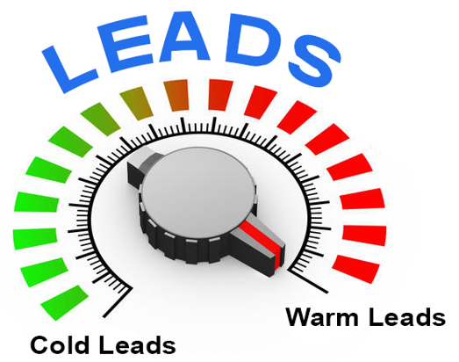
Warm Leads
people you know
people referred to you
someone you have some connection with
Need fewer of these to create a client.

Slide 21
Cold Leads
inquiries from website
on-line lead generation
cold calling (?)

Slide 23
Visible
Likeable
Memorable

Slide 24
Stay in Touch
Be in contact with your base 12 times a year
What can you do?
What will it cost you?
You have to budget
Time
Money

Slide 25
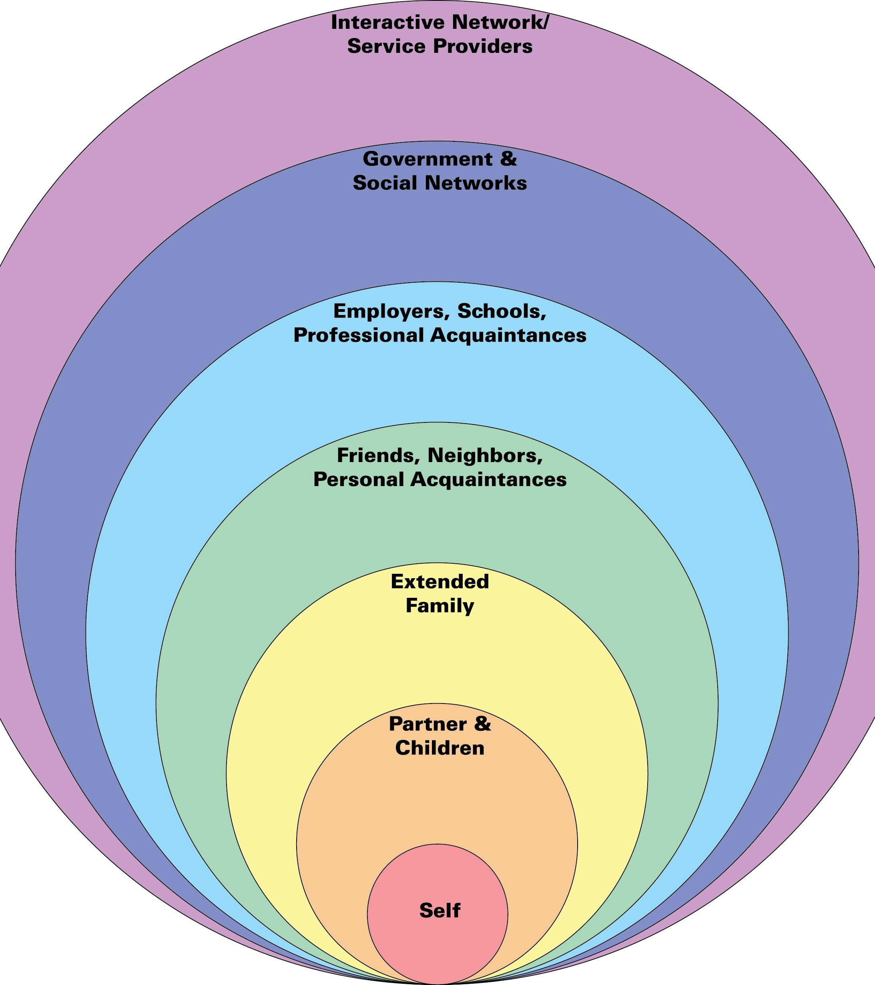
Who is your sphere?
Family
Business
Personal
School
Hobby
Service
Neighbors
Past Clients

Slide 26
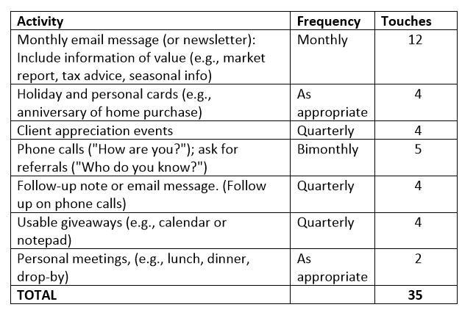
$
$
$
$
$

Slide 27
Other Sources of Business
Geographic Farming
FSBO’s
Expired Listings
Website/blog
Listings and profile on portals
Paid leads
Open houses
Yard signs
Direct mail (other than farm)
Business-to-business
Referrals – other Realtors
Referrals – business partners

Slide 28
Choose Your Targets
Target
Plan
% of business
$$ to accomplish

Slide 29
Track Your Success
Lead sources: Where are your leads coming from?
Conversion rate: How many leads are resulting in closed sales?
Communications: What methods of communication are the most effective?
Price per lead: How much are you paying for each lead?

Slide 30
Expenses
Business Expenses
Lead Generation Expenses
Marketing Listings

Slide 31
Business Expenses
Business cards
Office expenses
Phone
Technology
Education
Website
Brochures
CRM & database
MLS & Association
Insurance
Other

Slide 33
E-blasts
Direct mail
Social media
Syndication sites
Events
Advertising – print
Advertising – outdoor

Slide 34
Signage
Photos
Brochures
Emails
Open houses
Direct mail
Social media
Syndication sites
Print or digital ads
PR

Slide 35
General Expenses +
Lead Generation +
Marketing Listings +
Taxes & Retirement =
Total Expenses

Slide 36
GENERATE BUSINESS
Wake up early
Call people
Use social media
Handwritten notes
Develop a niche
Wear Realtor pin
Generate Realtor referrals

Slide 37
Geographic Farming
Specific community
Establish and brand yourself
Long-term investment
Takes time – and money
Once it takes off – it’s amazing!

Slide 38
Identifying a Farm Area
Research properties and potential buyers
Use MLS, RPR, other records for sales and demographic information
Ideally 200+ homes
Area you live in?
Area you like!

Slide 39
Things to look at . . .
Turnover rate – go for 8% or more
How long have owners lived there? 6 – 10 years ideal
Agents who have market share
Current trends
Renters vs. homeowners
Who lives there?
Demographics
Likely to sell?

Slide 40
Scripts
Geographic farm
Just listed
Just sold
Letter or postcard to farm
Looking for homes in area
Thank you after calling
Expired listings
For-sale-by-owners

Slide 44
Questions?
send an email to:
Financialwellness@nar.realtor

Slide 45
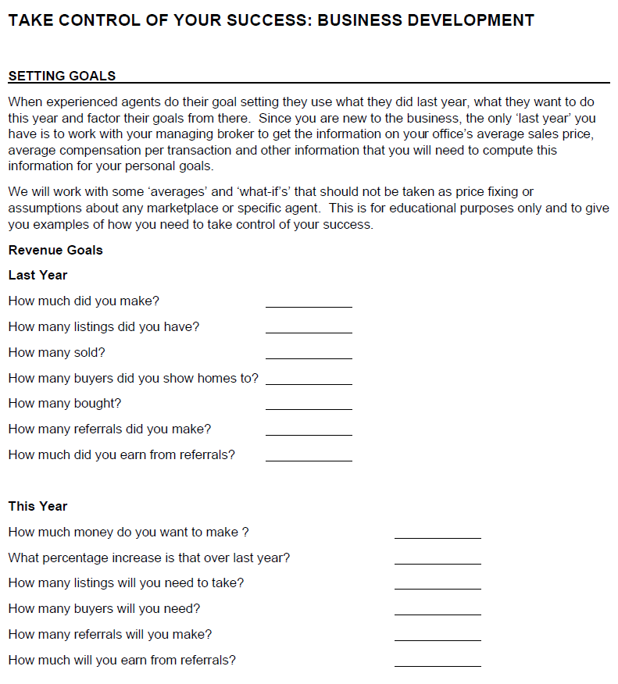
Additional Resources visit: financialwellness.realtor

Slide 46
Thank You For Your Time
FOR MORE INFORMATION CONTACT:
Lynn Madison
lynn@madisonseminars.COM
Notes:
Welcome…

