Slide 1
Crisis As Opportunity: Making Better Money Decisions Now and Later
Recording Available: Thursday, April 23

Slide 2
Webinar site:
nar.realtor/cffw/webinars
Notes:
If this is your first time joining our webinar series, we want extend a warm welcome to you! For returning members, thank you for your support and joining us again.
For our new guest, to give you a little bit of background about the program our Financial Source Webinar series has been created with YOU in mind. This resource is designed to help you understand financial topics on a deeper level. Each month, our subject matter experts will provide you with step by step solutions, tips, planning options, and an array of valuable information for your financial journey. No matter where you are in your career or stage of financial planning, we hope you’ll find these webinar sessions helpful and informative. For more details and information about registering for upcoming webinars and accessing our recorded webinars, please visit nar.realtor/cffw/webinars.

Slide 3
CENTER FOR REALTOR® FINANCIAL WELLNESS WEBINAR AND SEMINAR DISCLAIMER
For Education and Information Purposes Only
Please note that the information and materials provided in Center for REALTOR® Financial Wellness webinars and seminars are not intended or provided to be used as a substitute for the advice of your tax, investment, legal and/or financial advisors or to be the basis of specific financial planning activities. The opinions and views expressed or shared in this presentation represent only those of the developers, speakers, presenters or instructors and have not been endorsed or approved by the National Association of REALTORS®. While substantial care is taken to try to provide accurate and current data and information, the National Association of REALTORS® does not warrant the accuracy, completeness or timeliness of any data and information provided in the webinars and seminars. Further, any principles and conclusions presented are subject to court decisions and to local, state and federal laws and regulations and any revisions of such laws and regulations. If you seek or need tax, investment, legal or financial advice, you must obtain such advice and services from the appropriate professionals.
Any links to third-party websites, tools, materials or resources are provided as a convenience and for your information. Any products, services or opinions of third-party entities or associated individuals are neither endorsed nor have they been vetted by the National Association of REALTORS®, and their inclusion in the webinar or seminar and any related materials do not constitute a recommendation by the National Association of REALTORS® and should not be inferred as suggesting a preference over other products, services or information available in the market. The National Association of REALTORS® bears no responsibility for the accuracy, completeness, legality or the content provided in the webinar or seminar and any related materials.
Notes:
Here I would like to provide a small disclaimer. Please note that the information and materials provided in Center for REALTOR® Financial Wellness webinars and seminars are not intended or provided to be used as a substitute for the advice of your tax, investment, legal and/or financial advisors or to be the basis of specific financial planning activities. The opinions and views expressed or shared in these presentations represent only those of the developers, speakers, presenters or instructors and have not been endorsed or approved by the National Association of REALTORS®. More information regarding our webinar disclaimer can be found here on slide 5.

Slide 4
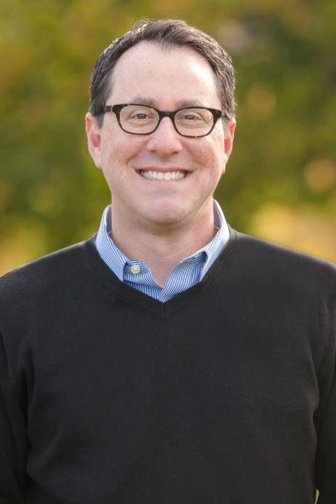
Presenter: Brian Portnoy
Ph. D., CFA
Founder of Shaping Wealth

Slide 5
Crisis As Opportunity:
Making Better Money Decisions Now and Later
Brian Portnoy, Ph.D., CFA
Shaping Wealth
April 21, 2020

Slide 6
The Flow of Today’s Talk
Brains & Money
Let’s Get Practical
The Big Picture

Slide 7
130,000

Slide 8
Your brain on money

Slide 9
Normal, not irrational.
The human brain has developed many short cuts for good (evolutionary) reasons, but they can diminish our money decision skills. In areas such as:
❶ How we process information
❷ How we manage risk

Slide 10
Normal, not irrational.
The human brain has developed many short cuts for good (evolutionary) reasons, but they can diminish our money decision skills. In areas such as:
❶ How we process information
❷ How we manage risk
“People aren’t dumb. The world is hard.”
— Richard Thaler, economist & Nobel Prize winner

Slide 11
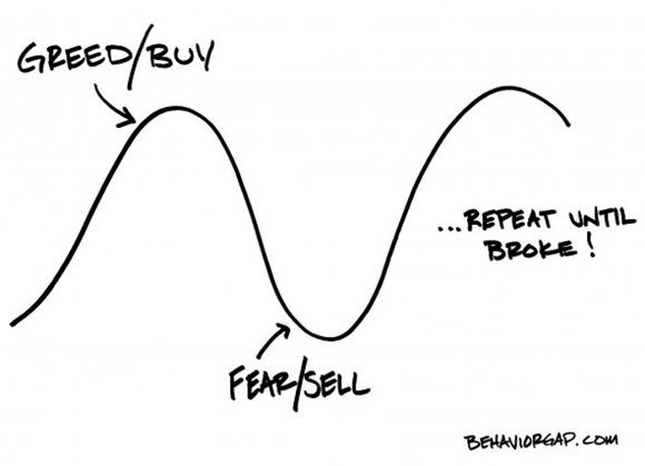
Risk’s endless cycle

Slide 12
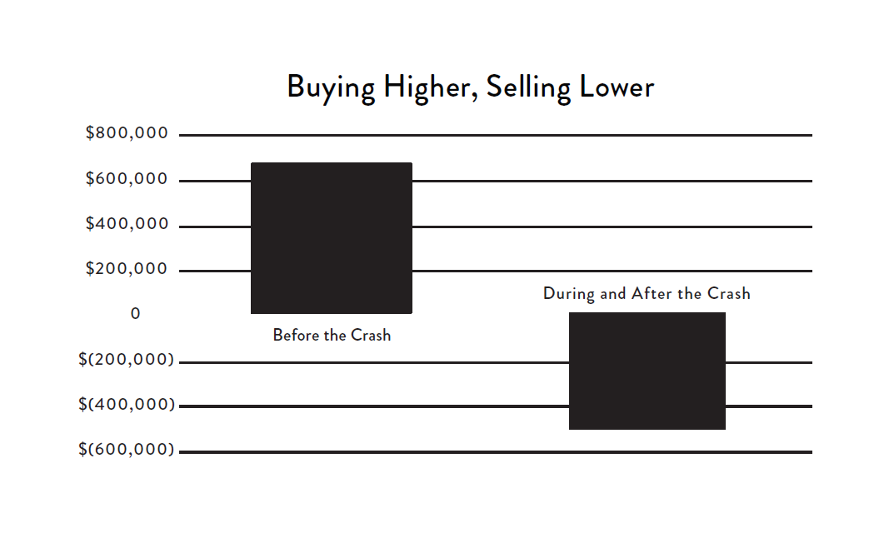
Buy high, sell low (2008)
In the 5 years leading up to the 2008 crash, money flooded into the market.
In the 5 years following the crash, money flooded out as the market surged higher.
$ Billions

Slide 13
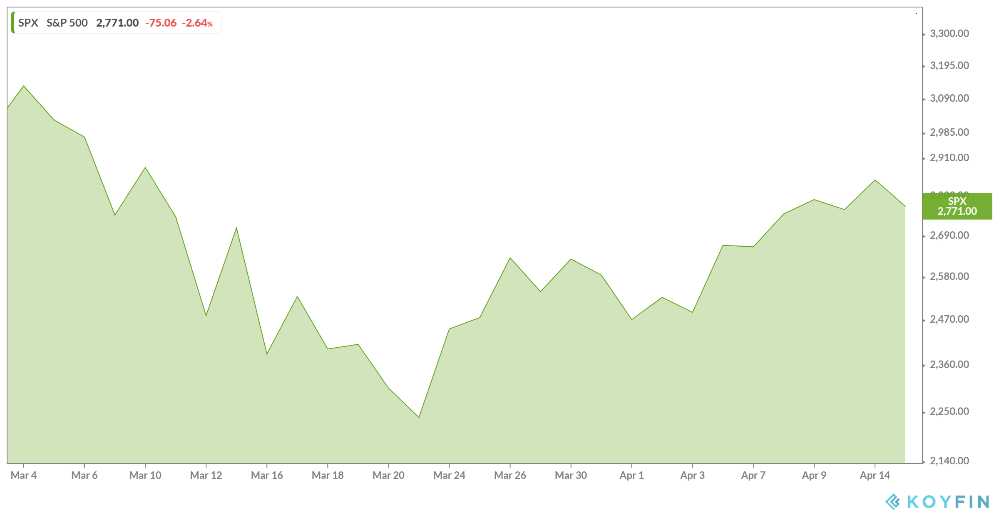
Here we go again (2020)
The U.S. stock market over previous weeks (March 4 – April 15, 2020)

Slide 14
Bad is stronger than good
GAIN
LOSS
“Loss aversion”

Slide 15
Loss aversion is normal
“A win doesn’t feel as good as a loss feels bad, and the good feeling doesn’t last long as the bad. Not even close.”
— Andre Agassi, Open

Slide 16
Recap
Your brain is wired to make lousy financial decisions. There’s no getting around that. But there are still many concrete things we can do now and later to fix problems and grab opportunity.

Slide 17
Getting things done

Slide 18
What is Financial Wellness?
 | Mode | Description
Defense | Getting By | Maintain control over day-to-day finances. Pay the bills on time. Not overwhelmed by debt. Make ends meet.
 | Feeling Safe | Able to deal with financial emergencies or unexpected pitfalls. Some savings, decent credit, insurance, and a network of friends and family that can help in times of need. Avoid financial fragility.
Offense | Achieving Goals | Have clear financial goals for your future and stay on track to meet them. Pay for college. Finance a new home. Save for a dignified retirement. Have some sense of direction and control.
 | Funding Contentment | Make your own choices to pursue a life worth living. Indulge your family and community, support your causes, afford travel, hobbies, and other indulgences. Find flow in your vocation and/or work less to enjoy life more. Underwrite a life that’s meaningful to you.

Slide 19
A framework for better money outcomes
Define
Purpose
Set
Priorities
Make
Decisions
Simple? Maybe.
Easy? No.

Slide 20
“Money Life” has many elements
Earn
Save
Spend
Invest
Borrow
Manage risk
Give

Slide 21
Things to do (1 of 3)
Give: What you can do to help others?
Emergency fund (1-3 months)
Where does my money go?
Review credit or debit card statements. Asses fixed versus variable costs. Where in your lifestyle can you find savings? (And not spending is ≠ saving!)
Set a budget (lockdown and “normal” versions?)
Budgeting tools: Quicken; Mint; YNAB
Shop for better savings rates, especially online
What do you owe?
Figuring out the number isn’t fun. Balance sheet?
Can you roll highest interest rates debt into lower?
Review your credit reports: annualcreditreport.com

Slide 22
Things to do (2 of 3)
Negotiate EVERYTHING. Negotiate every fixed cost in your budget. Go through every regular bill and call up those companies to ask for some form of relief. That includes:
Rent
Mortgage (many banks are working with consumers to suspend payments for up to 3 months)
Credit cards (ask for a lower monthly payment or interest charge)
Student loans (some are already suspended through September 30 so those savings should help)
Car insurance (many insurers are offering rebates or discounts on monthly payments)
Car payments (some automakers are offering payment delays)

Slide 23
Things to do (3 of 3)
Investing vs. Speculating: There’s a big difference. Making decisions within a plan vs. short-term opportunities. Stock market investments are for goals at least 5 years and probably longer.
Investments should be goals based (e.g., retirement, college, house)
Investments do 3 things: growth, income, or protection
Panic selling? Panic buying? If possible, don't sell long-term investments (for retirement, etc.). Don’t try to “buy the dip.”
Simple diversified portfolio: Stocks, bonds, cash. Real estate. Avoid complexity! Do not pick individual stocks. Stick with cheap index funds.
Diversification is not easy to stick with.
Higher yield means higher risk.
Your investments should be boring. Your life should be interesting.

Slide 24
Are you Alice?
Alice: Would you tell me, please, which way I ought to go from here?
The Cheshire Cat: That depends a good deal on where you want to get to.
Alice: I don't much care where.
The Cheshire Cat: Then it doesn't much matter which way you go.
Alice: ...So long as I get somewhere.
The Cheshire Cat: Oh, you're sure to do that, if only you walk long enough.

Slide 25
Are you Alice?
Alice: Would you tell me, please, which way I ought to go from here?
The Cheshire Cat: That depends a good deal on where you want to get to.
Alice: I don't much care where.
The Cheshire Cat: Then it doesn't much matter which way you go.
Alice: ...So long as I get somewhere.
The Cheshire Cat: Oh, you're sure to do that, if only you walk long enough.
A journey without a destination
or a map will not be successful.

Slide 26
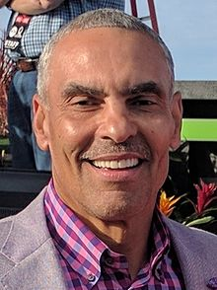
Goal ≠ Plan
“A goal without a plan is a wish.”
– Herm Edwards, NFL Head Coach

Slide 27
Goal ≠ Plan ≠ Planning
“A goal without a plan is a wish.”
– Herm Edwards, NFL Head Coach
“Everyone has a plan ‘till they get punched in the face.”
– Mike Tyson, boxing champ

Slide 28
Find a financial advisor and make a plan
Considerations:
Services
One-time, “check up,” ongoing
Are they looking to sell you or help you?
How are they compensated. Possibilities: asset-based commission; hourly; retainer
There are many resources available for
finding a qualified financial advisor:
GuideVine.com
WiserAdvisor.com
Napfa.org
PlannerSearch.org
GarrettPlanningNetwork.com
XYPlanningNetwork.com
BrokerCheck.Finra.org

Slide 29
Simple is not easy.

Slide 30
Recap
There is so much we can do to improve our money lives. We can:
Make short-term fixes
Fulfill long-term plans
Use this crisis is an opportunity to think about what really matters in our lives — not only what we want to do, but who we want to be
Notes:
I have no expertise in the CARES act or other government programs so I can’t help
Also can’t give specific financial advice

Slide 31
The big picture

Slide 32
What is your “benchmark”?
It is not the S&P 500. It is not the stock market.
For most of us, it is probably is “more.” But “more” invites a lot of problems.
Our ultimate goal is “funded contentment”—the ability to underwrite a life that’s meaningful to you. It’s both what you really want to do and who you really want to be.

Slide 33
Hedonic adaptation
“Happiness is what you get right before you want more happiness.”
— Don Draper, Mad Men

Slide 34
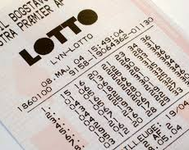
Hedonic adaptation
“My expectations were reduced to zero when I was twenty-one. Everything since then has been a bonus.”
– Stephen Hawking, Scientist

Slide 35
“Funded Contentment”
Rich
The accumulation of MORE
Wealthy
The ability to underwrite a life that is MEANINGFUL to you

Slide 36
“Wealth, truly defined, is only achievable in the context of a life where purpose and practice are thoughtfully calibrated.”
– The Geometry of Wealth, p. 2

Slide 37
The Foundations of a Meaningful Life
Connection
Control
Competence
Context

Slide 38
A framework
Define
Purpose
Set
Priorities
Make
Decisions
Simple? Maybe.
Doable? Yes.

Slide 39
In review
Your brain is wired to make lousy financial decisions. There’s no getting around that.
But there are many things you can do today and tomorrow to fix what’s broken and improve on what’s not. A crisis can be an opportunity.
We have been gifted an opportunity to think about what really matters in our lives—not only what we want to do, but who we want to be. Make money work for you in that endeavor.

Slide 40
Thank you!
Financial wellness for everyone.

Slide 41
Brian Portnoy, Ph.D., CFA
bp@shapingwealth.com
www.shapingwealth.com
@brianportnoy

Slide 42
Questions?
Ask in the chat
Or send an email to:
Financialwellness@nar.realtor

Slide 43
Visit: FinancialWellness.realtor
Notes:
Looking for a great starting point for a financial plan?
Take a quick 10-question, financial assessment from the Center for REALTOR® Financial Wellness.
After you take the assessment you will have personalized and trackable goals.
This Center is not only a great resource, this is a FREE member benefit for REALTORS®.
Note, this is an educational resource. It’s not intended to take the place of consulting a financial professional. The platform does not store, share, or sell any information.
For more information, visit FinancialWellness.realtor to get started or email your NAR team at FinancialWellness@nar.realtor.

Slide 44
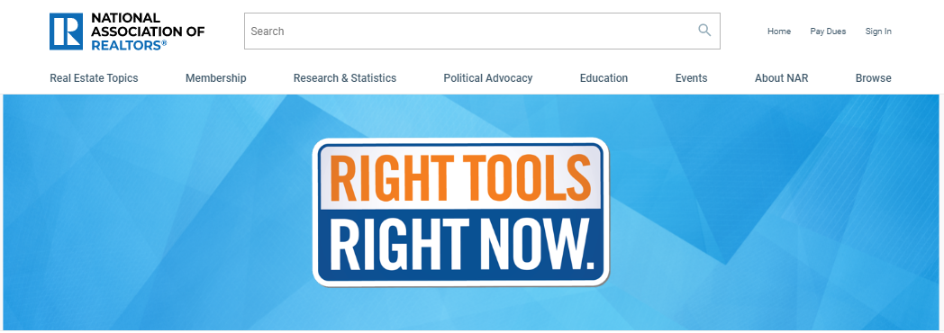
Additional Resources: nar.realtor/right-tools-right-now

Slide 45
1. Visit FinancialWellness.realtor 2. Leave us your feedback. 3. Register for the next webinar. Thanks!

