Slide 1
Financialwellness.realtor

Slide 2
5 Options for Dealing With Debt
Recording Available: Friday, July 17th
^{nar.realtor/cffw/webinars}

Slide 3
NAR.realtor/cffw/webinars

Slide 4
CENTER FOR REALTOR® FINANCIAL WELLNESS WEBINAR AND SEMINAR DISCLAIMER
For Education and Information Purposes Only
Please note that the information and materials provided in Center for REALTOR® Financial Wellness webinars and seminars are not intended or provided to be used as a substitute for the advice of your tax, investment, legal and/or financial advisors or to be the basis of specific financial planning activities. The opinions and views expressed or shared in this presentation represent only those of the developers, speakers, presenters or instructors and have not been endorsed or approved by the National Association of REALTORS®. While substantial care is taken to try to provide accurate and current data and information, the National Association of REALTORS® does not warrant the accuracy, completeness or timeliness of any data and information provided in the webinars and seminars. Further, any principles and conclusions presented are subject to court decisions and to local, state and federal laws and regulations and any revisions of such laws and regulations. If you seek or need tax, investment, legal or financial advice, you must obtain such advice and services from the appropriate professionals.
Any links to third-party websites, tools, materials or resources are provided as a convenience and for your information. Any products, services or opinions of third-party entities or associated individuals are neither endorsed nor have they been vetted by the National Association of REALTORS®, and their inclusion in the webinar or seminar and any related materials do not constitute a recommendation by the National Association of REALTORS® and should not be inferred as suggesting a preference over other products, services or information available in the market. The National Association of REALTORS® bears no responsibility for the accuracy, completeness, legality or the content provided in the webinar or seminar and any related materials.

Slide 5
About the Presenter
Lynnette Khalfani-Cox, The Money Coach® CEO and Co-Founder, AskTheMoneyCoach.com MoneyCoachUniversity.com New York Times Bestselling Author of Zero Debt: The Ultimate Guide to
Financial Freedom Twitter: @themoneycoach
Facebook, Instagram, LinkedIn: @LynnetteKhalfaniCox

Slide 6
5 OPTIONS
FOR DEALING
WITH DEBT
By: Lynnette Khalfani-Cox, The Money Coach®
Notes:
Verify the title

Slide 7
Workshop Objectives
To Evaluate Your 5 Debt Relief Options
To Learn the Financial, Tax and Credit Ramifications of How You Deal With Debts
To Understand Your Legal Rights to Get Rid of Debt

Slide 8
5 Options To Dealing With Debt
Ignore your debt
Borrow your way out of debt
Negotiate your way out of debt
Walk away from your debt
Pay your way out of debt
Notes:
Happy to add animation

Slide 9
1. Ignoring Your Debt

Slide 10
Ignoring Your Debt: Pros
The Pros/Advantages:
You don’t have to do anything different
No change is required on your part

Slide 11
Ignoring Your Debt: Cons
The Cons/Disadvantages:
Ignorance is NOT bliss
You can make your $$$ problems worse
You may have extra worry and stress

Slide 12
Ignoring Your Debt: Best Case
Best Case Scenario
You blow off creditors
You manage to live “Off the Grid” or without much financial & credit consequences

Slide 13
Ignoring Your Debt: Worst Case
Worst Case Scenario
Your debts land you in legal trouble
Notes:
Debtors prison was abolished in America in the 19th Century, but you can still get arrested and thrown in jail for:
missing court-ordered debt payments … or
being held in contempt of court (because you didn’t show up to court)
States with harsh laws where people have been put in jail for debt related legal issues: Arizona, Arkansas, Illinois, Indiana, Minnesota, Washington

Slide 14
Ignoring Your Debt: Best for Whom?
Ignoring Your Debt: Is it Best?
Non-traditionalists OK with “opting out”
People who’ve given up

Slide 15
2. Borrowing Your Way Out of Debt

Slide 16
Borrowing Your Way Out of Debt
Can you borrow your way out of debt?
Some people say “absolutely not!”
My view:
It’s doable, but often doesn’t work

Slide 17
Borrowing Alternatives
What are the borrowing alternatives?
Refinance your home
Do credit card balance transfer
Get a peer to peer loan
Do a debt consolidation loan
Get a family/personal loan

Slide 18
Refinancing a Home: Pros
The Pros/Advantages:
Lower interest rates
Better cash flow
One monthly payment
Interest deduction
Positive credit score impact

Slide 19
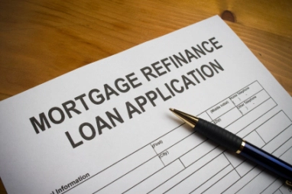
Refinancing a Home: Cons
The Cons/Disadvantages:
Putting your home at risk
Larger mortgage payment
Unsecured debt now secured debt
Risk of running up credit card debt again

Slide 20
Home Refinance: Best Case
Best Case Scenario
Everything works out great!

Slide 21
Home Refinance: Worst Case
Worst Case Scenario
Everything goes horribly wrong!

Slide 22
Balance Transfers: Pros
The Pros/Advantages:
Lower interest rate
More affordable monthly payments
Improved cash flow

Slide 23
Balance Transfers: Cons
The Cons/Disadvantages:
Balance transfer fees
Teaser rates expire
Temptation to charge more
Can hurt your credit rating

Slide 24
Balance Transfer: Best Case
Best Case Scenario
Debt payoff plan works perfectly!

Slide 25
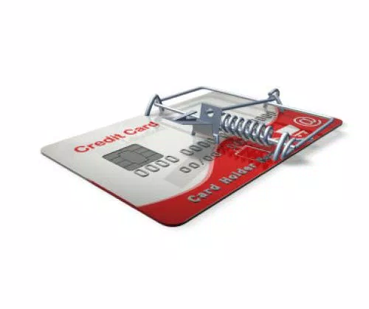
Balance Transfer: Worst Case
Worst Case Scenario
Debt payoff plan goes bust!

Slide 26
Peer to Peer Loan: Pros
The Pros/Advantages:
Rates typically lower than credit cards
Shorter payoff schedule
Potential positive impact on credit score
Eliminates credit card debt faster

Slide 27
Peer to Peer Loan: Cons
The Cons/Disadvantages:
Relatively high rejection rates
Must have good credit
Monthly payments can be higher
Potential short-term negative credit impact

Slide 28
Peer to Peer Loan: Best Case
Best Case Scenario
Out of debt in 1 or 3 years
Everything worked

Slide 29
Peer to Peer Loan: Worst Case
Worst Case Scenario
You fail to repay loan as agreed
Your credit and finances are even worse!

Slide 30
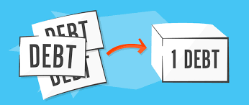
Debt Consolidation: Pros
The Pros/Advantages:
Lower monthly payments
Better cash flow
Ease of having one streamlined payment

Slide 31
Debt Consolidation: Cons
The Cons/Disadvantages:
Confusion about types of “Debt Consolidation”
Could be asset-based loan
May put property at risk
Potential short-term hit to credit score

Slide 32
Debt Consolidation: Best Case
Best Case Scenario
It all works out!

Slide 33
Debt Consolidation: Worst Case
Worse Case Scenario
Nothing goes according to plan!

Slide 34
Family/Personal Loans: Pros
The Pros/Advantages:
No credit check needed
Likely more flexible terms
May not require interest

Slide 35
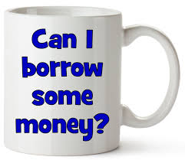
Family/Personal Loans: Cons
The Cons/Disadvantages:
May be awkward or embarrassing to ask
You might inadvertently burden the other party
Can change the dynamics of the relationship
Relationship fallouts can occur

Slide 36
Family/Personal Loans: Best Case
Best Case Scenario
Solidifies relationship
Everything goes perfectly

Slide 37
Family/Personal Loans: Worst Case
Worst Case Scenario
Damages or ends the relationship
Everything goes awry

Slide 38
Borrowing: Best for Whom?
Those hit by Dreaded D’s … and problem is fixed:
Downsizing
Divorce
Death In the family
Disability
Disease
Disaster of any kind

Slide 39
3. Negotiating Your Way Out of Debt

Slide 40
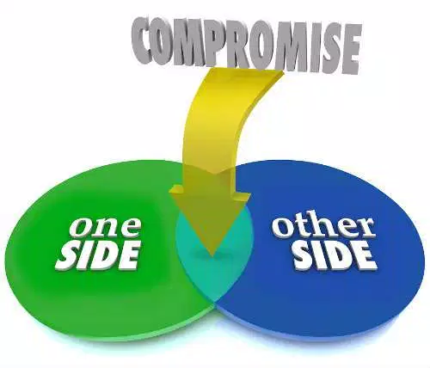
Negotiating Your Way Out of Debt
What are the negotiating alternatives?
You do it
A third party does it for you

Slide 41
You Negotiate: Pros
The Pros/Advantages of You Doing It:
It’s free
Can be empowering
A learning experience
Can give you financial relief

Slide 42
You Negotiate: Cons
The Cons/Disadvantages of You Doing It:
It’s time-consuming
Requires organization/ follow-up
Can be frustrating/stressful
May not yield the desired results

Slide 43
You Negotiate: Best Case
Best Case Scenario
You lower your bills
You get your finances back on track

Slide 44
You Negotiate: Worst Case
Worst Case Scenario
Your creditors don’t budge at all
You spent time on a process that didn’t work
You’re no worse off economically than before

Slide 45
You Negotiate: Best for Whom?
Those who’ve not yet tried
People willing to spend time, effort
Individuals with some financial flexibility

Slide 46
Third Party Negotiation
Should a Third Party Negotiate For You?
Debt Settlement Firms & Debt Management Firms:
Two totally different approaches to debt relief

Slide 47
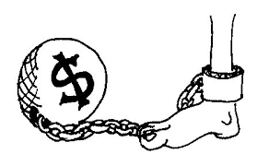
Third Party Negotiation: Pros
The Pros/Advantages of a Third Party Doing It:
Can sometimes be done free or at a low cost
Can drastically lower your interest rates
Can get late penalties/other charges removed
Professionals have more experience than you
Removes the stress/burden of negotiating

Slide 48
Third Party Negotiation: Cons
The Cons/Disadvantages of a Third Party Doing It:
Can be a medium or high cost service
Can impact your credit
Can have tax ramifications
You may have to give up your credit cards

Slide 49
Debt Settlement: How it Works
They charge you hefty fees
They tell you not to pay creditors
They offer your creditors a lump sum
They try to settle for pennies on the dollar

Slide 50
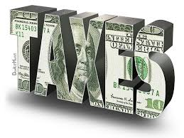
Debt Settlement: Best Case
Best Case Scenario
Your creditors take the deal
Your pay only a fraction of your debt(s)
You are legally rid of the debt
You get a tax bill the following year
Your credit is worse than before

Slide 51
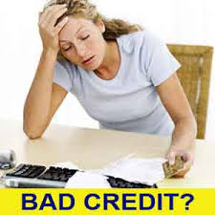
Debt Settlement: Worst Case
Worse Case Scenario
Your creditors don’t budge
You still legally owe your debts
You spent a lot of $$$ on a process that failed
Debt collectors are hounding you
Your credit is worse than before
You are totally stressed out

Slide 52
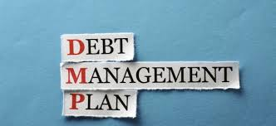
Debt Management: How it Works
They charge you moderate fees
They provide you with credit counseling
They enroll you in a Debt Management Plan
They have pre-established rate reductions
They require you to close your credit cards
They get late payments & penalty fees waived

Slide 53
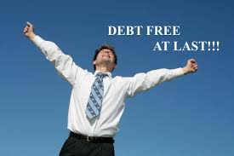
Debt Management: Best Case
Best Case Scenario
Your bills get lowered
You get your finances back on track
You maintain your credit rating
You pay off your debts, usually in 3 to 5 years

Slide 54
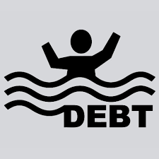
Debt Management: Worst Case
Worst Case Scenario
Your monthly payments only drop slightly
You repay as agreed and rebuild financially
You fail to repay & further damage Your Credit

Slide 55
They Negotiate: Best for Whom?
Those who’ve tried but not succeeded
People with unmanageable debt
Individuals that want a structured payoff plan

Slide 56
4. Walking Away From Your Debt

Slide 57
Walking Away From Your Debt
What Are The “Walking Away” Alternatives?
Chapter 7 Bankruptcy
Chapter 13 Bankruptcy

Slide 58
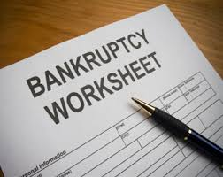
Walking Away: Chapter 7 Bankruptcy
How It Works:
Income test
Means test
Debts wiped away

Slide 59
Walking Away: Chapter 7 Bankruptcy
The Pros/Advantages
You eliminate many consumers debts
You get a “Fresh Start”
You get an automatic “Stay” on legal actions

Slide 60
Walking Away: Chapter 7 Bankruptcy
The Cons/Disadvantages
Not all debts go away (child support & student loans)
Bankruptcy stays on your credit report 10 years
May need to wait 2+ years for a home loan
Social/emotional stigma for some people

Slide 61
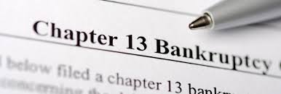
Walking Away: Chapter 13 Bankruptcy
How It Works:
Wage earner’s plan
Repay over 3 to 5 years
You repay some or all debts

Slide 62
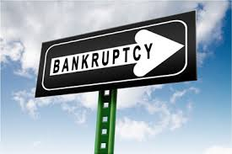
Walking Away: Chapter 13 Bankruptcy
The Pros/Advantages:
You get time to reorganize your finances
You get an automatic “Stay” on legal actions
Some get the satisfaction of paying their debts
You can be in Chapter 13 & get a mortgage

Slide 63
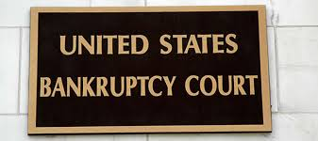
Walking Away: Chapter 13 Bankruptcy
The Cons/Disadvantages:
You still have to pay
Bankruptcy stays on your credit report 10 years
May need to wait 1+ years for a home loan
Social/emotional stigma for some people

Slide 64
Bankruptcy: Best Case
Best Case Scenario
Your eligible debts go away
You rebuild credit fairly quickly
You learn from the past & don’t repeat mistakes

Slide 65
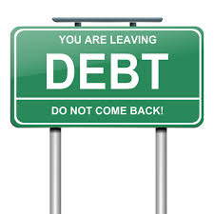
Bankruptcy: Worst Case
Worse Case Scenario
You can’t pay as agreed (Chap. 13)
Your credit is further damaged
Your finances worsen
You don’t learn from past mistakes & you wind up in bankruptcy court a 2nd or 3rd time

Slide 66
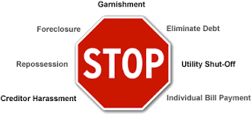
Bankruptcy: Best for Whom?
Those with massive medical bills
People who can’t repay debts in 5 to 7 years
Individuals under attack from creditors
Lengthy unemployment period

Slide 67
5. Paying Your Way Out of Debt

Slide 68
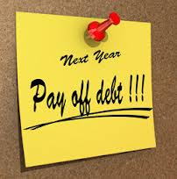
Paying Your Way Out of Debt
The Pros/Advantages:
You maintain or improve your credit rating
Emotional satisfaction of honoring obligations
You greatly improve your cash flow/finances

Slide 69
Paying Your Way Out of Debt
The Cons/Disadvantages:
Requires effort and sacrifice
May take longer than you anticipate
Can be hard to sustain over time

Slide 70
Paying Debt: Best Case
Best Case Scenario
You have a financial comeback
You become debt free
You get on the path to building wealth

Slide 71
Paying Debt: Worst Case
Worst Case Scenario
You struggle with debt for years
You start to accept debt as a way of life
You may/may not eventually become debt free

Slide 72
Paying Debt: Best for Whom?
Those willing and able to repay their bills
People capable of making minor/major changes
Employed workers with reasonably stable income

Slide 73
Which Option is Best for You?
Ignore your debt
Borrow your way out of debt
Negotiate your way out of debt
Walk away from your debt
Pay your way out of debt

Slide 74
Which Option is Best for You?
Consider your current circumstances

Slide 75
Which Option is Best for You?
Consider your future goals
- Retirement is especially important!

Slide 76
Which Option is Best for You?
Consider your risk and stress tolerance
Reduced debt = more real estate/investments

Slide 77
Which Option is Best for You?
Consider your financial capacity

Slide 78
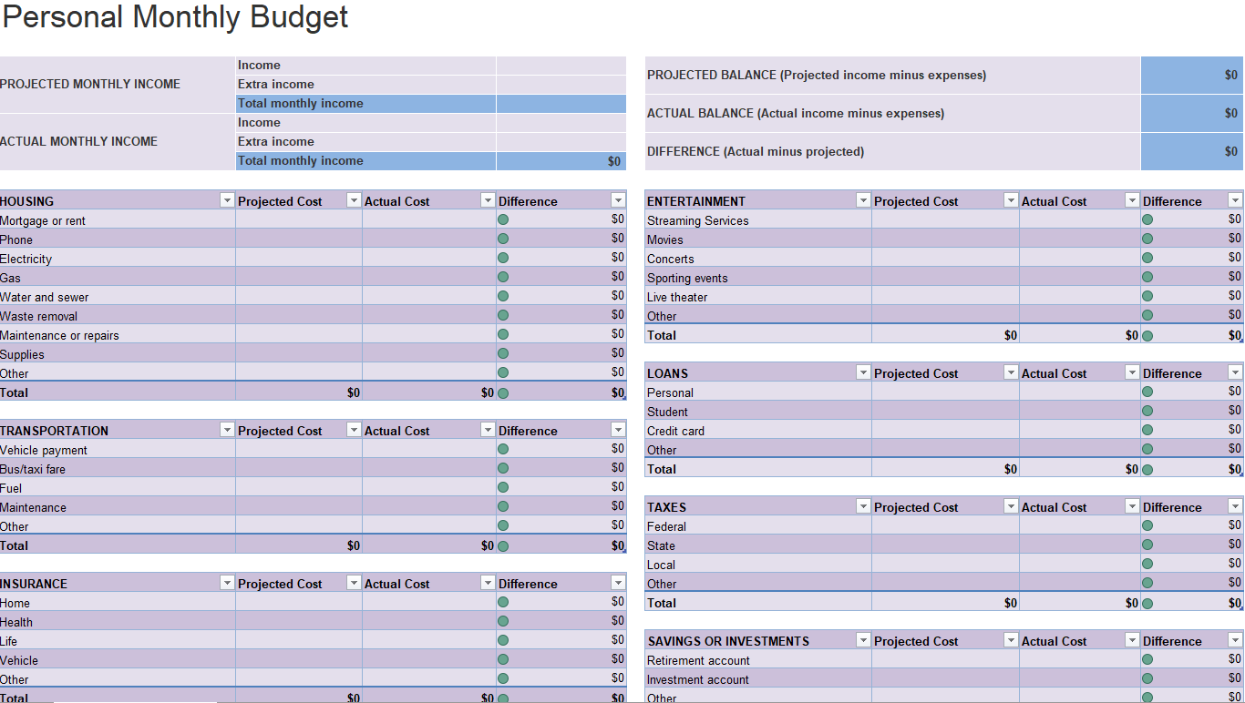
FREE Resource: FinancialWellness.realtor
Notes:
Mention that the Center for REALTOR® Financial Wellness has FREE budgeting tools that they can use to track/manage their finances
Resources to help members track their personal monthly budget
Calculates monthly expenses like: entertainment, loans, personal taxes, transportation and so much more.
This is a FREE spreadsheet included in your membership through the Center for REALTOR® Financial Wellness
Website – FinancialWellness.realtor

Slide 79
Debt Options: Your Challenge
Option 1
Ignore
Option 2
Borrow
Option 3
Negotiate
Option 4
Walk Away
Option 5
Pay
Instructions: Assign a number (1, 2, 3, 4 or 5) to each option
1 Definitely not. I’m 100% sure this isn’t for me
2 I don’t think this alternative is my best choice
3 Maybe this option could work for me
4 Very likely a good option for me
5 Absolutely yes. I’m 100% certain this is best

Slide 80
Debt Options: Your Challenge
Options
1 Ignore
2 Borrow
3 Negotiate
4 Walk Away
5 Pay
If you chose options 1 or 4, make sure you’ve tried options 2, 3 or 5 first
If you chose options 2, 3 or 5, each of those options can be accelerated to help you get debt free fast!

Slide 81
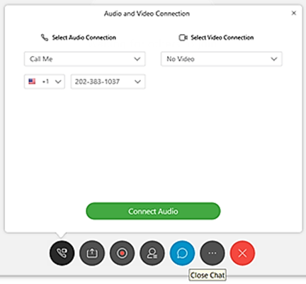
Q & A
Lynnette Khalfani-Cox, The Money Coach®
ASK IN THE CHAT
OR SEND AN EMAIL TO:
FINANCIALWELLNESS@NAR.REALTOR

Slide 82
Contact
Lynnette Khalfani-Cox, The Money Coach® CEO and Co-Founder, AskTheMoneyCoach.com MoneyCoachUniversity.com New York Times Bestselling Author of Zero Debt: The Ultimate Guide to
Financial Freedom Twitter: @themoneycoach
Facebook, Instagram, LinkedIn: @LynnetteKhalfaniCox

Slide 83
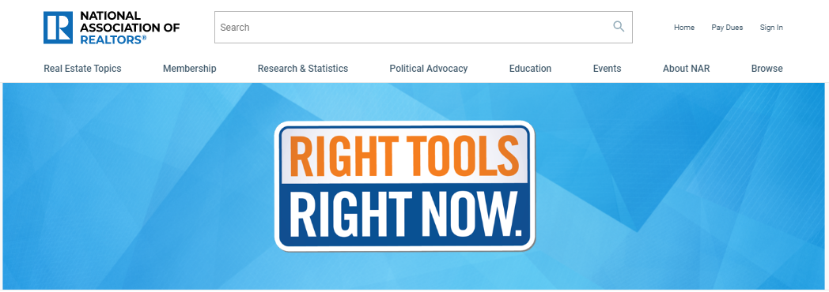
Additional Resources: nar.realtor/RTRN

Slide 84
1. Visit FinancialWellness.realtor 2. Leave us your feedback. 3. Register for the next webinar. Thanks!

